Slide 1
Classical Conditioning Wrap-Up
Do movies and tv classically condition us to fear minority groups?
Use US → UR
NS + US →UR
CS → CR
How can this conditioning be extinguished?

Slide 2
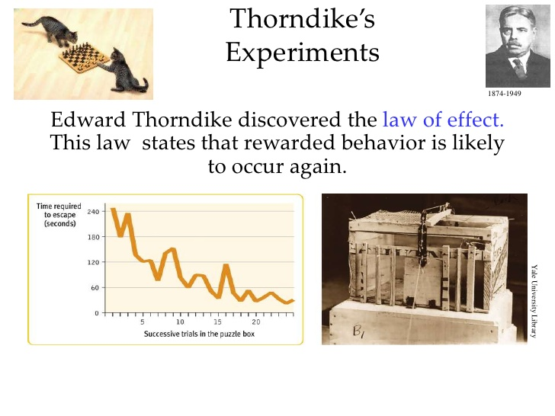

Slide 3
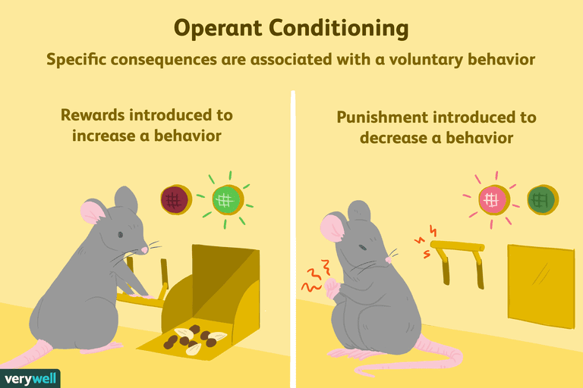
Operant Conditioning
(Behaviorism)
Works on voluntary behavior.
You learn to do things to earn rewards and to avoid punishment

Slide 4
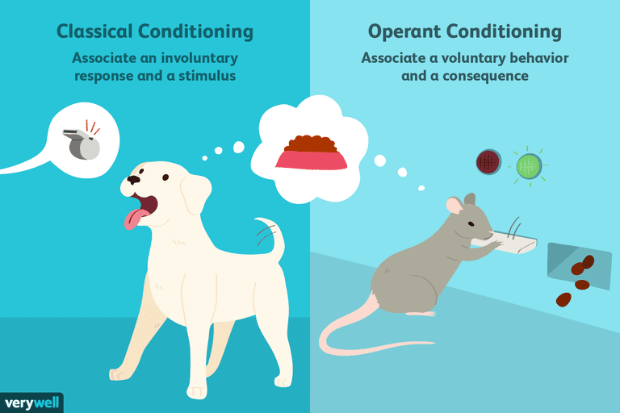

Slide 5
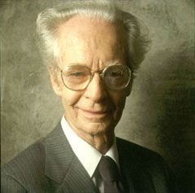
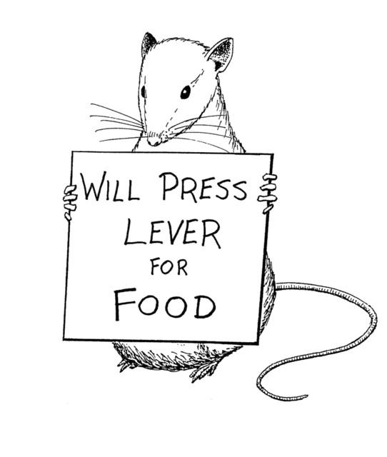
B.F. Skinner
The father of Operant Conditioning.
Created the Skinner Box for research.

Slide 6
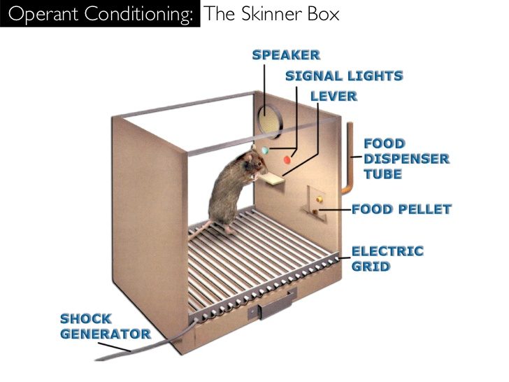

Slide 7

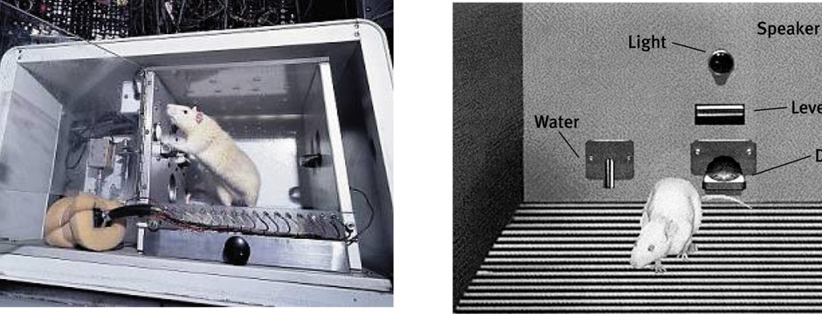
Operant Chamber
B.F. Skinner developed the Operant Chamber, or the Skinner Box, to study operant conditioning.

Slide 8
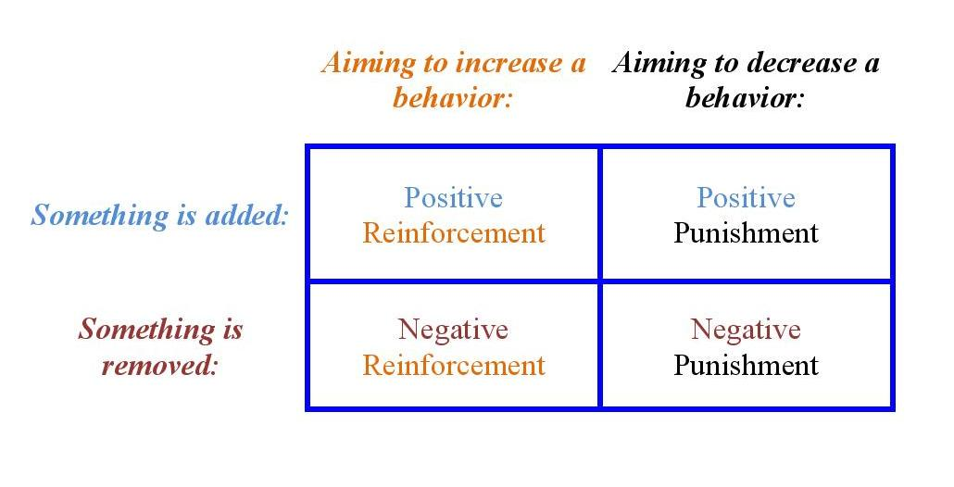
Key Terms
Reinforcement
Increases the behavior
Punishment
Decreases the behavior
2 types (positive and negative)
Positive = add something
Negative = remove something

Slide 9
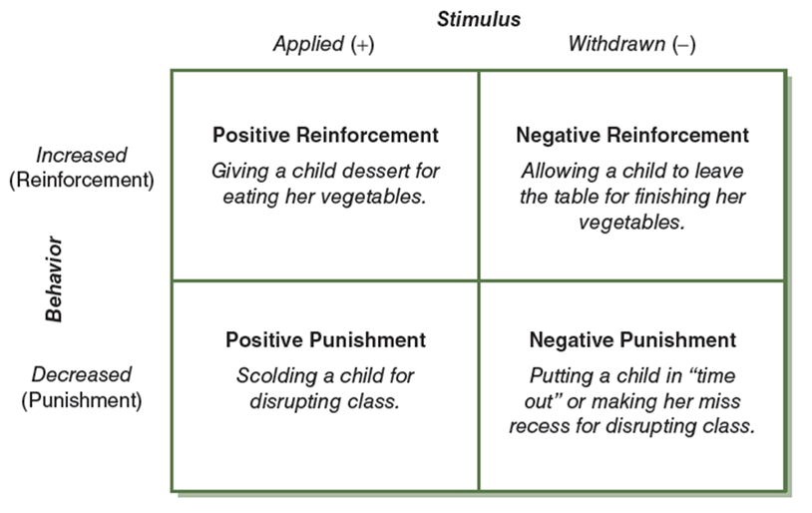

Slide 10
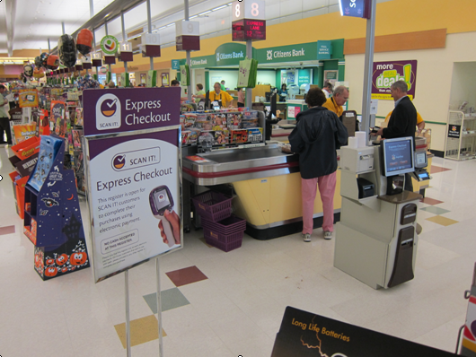
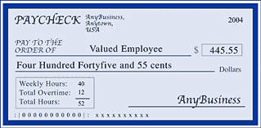
Which type is this?
Working
You go to work and get rewarded by a paycheck

Slide 11


Which type is this?
Curfew
You come home by curfew to avoid getting yelled at.

Slide 12

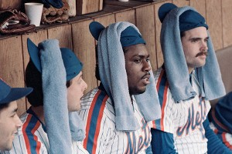
Which type is this?
Superstition
You do things you know have no real impact on reality because that one time you did it, the team won.

Slide 13



Operant Conditioning Examples
Go to school
You take challenging courses, do lots of work so that you can (i) go to a better school, (ii) please your parents, (iii) fear of embarrassment, and/or (iv) have more knowledge.

Slide 14
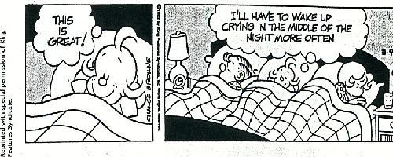

Slide 15
The Office
Classical conditioning is relatively easy to see in this video. But can you explain how it shows operant conditioning?
https://vimeo.com/35754924

Slide 16
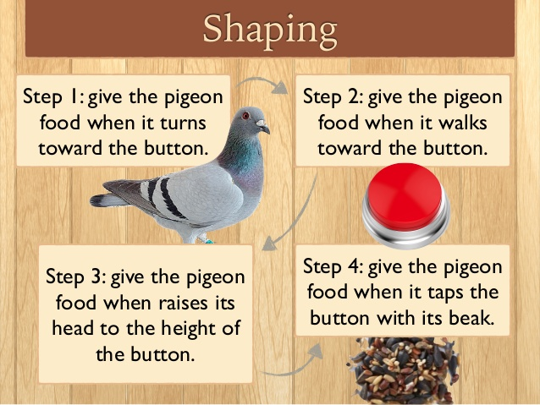
Shaping
Guide behavior towards the desired target behavior through successive approximations.
Notes:
OBJECTIVE 12| Describe the shaping procedure, and how it can increase our understanding of what animals and babies can discriminate.

Slide 17
Primary & Secondary Reinforcers
Primary Reinforcer:
An innately reinforcing stimulus like food and shelter.
1
Secondary Reinforcer:
A learned reinforcer that gets its power through association with the primary reinforcer.
2

Slide 18
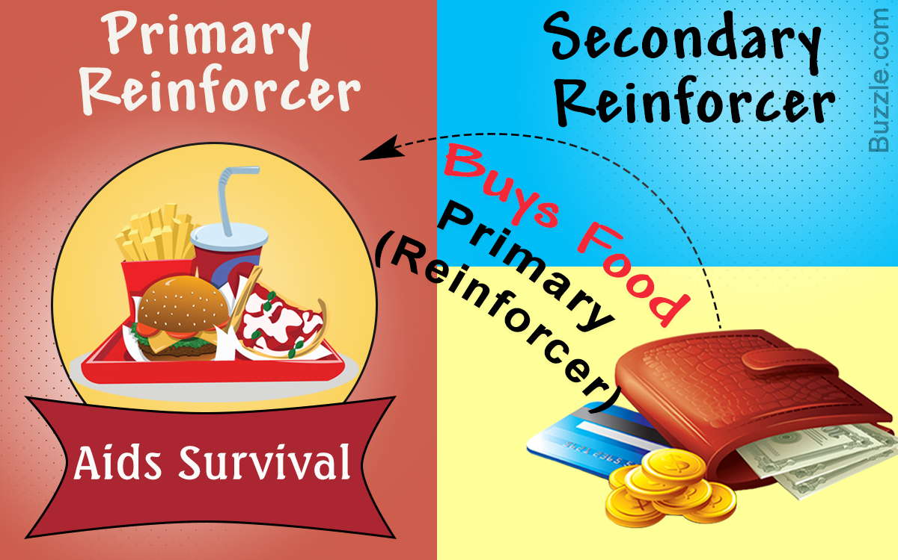

Slide 19
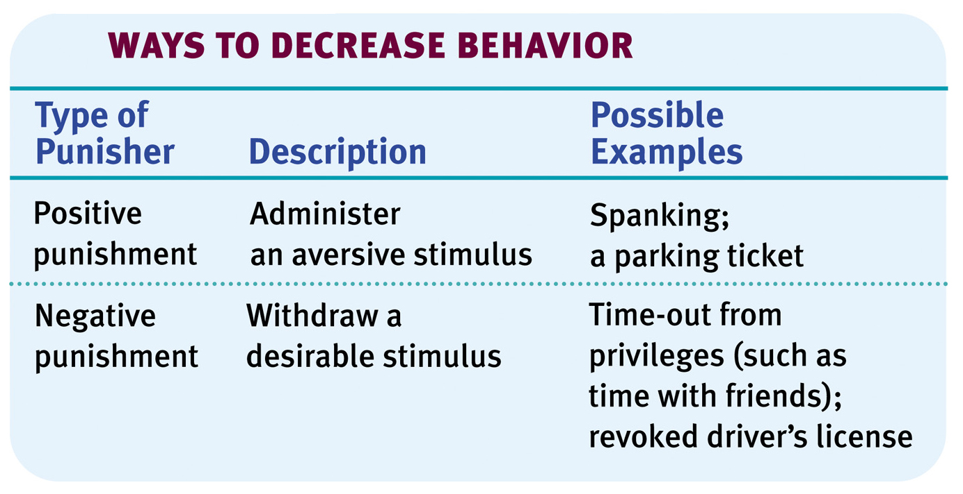
Punishment
An event that decreases the behavior it follows.
Notes:
OBJECTIVE 15| Discuss the ways negative punishment, positive punishment, and negative reinforcement differ, and list some drawbacks of punishment as a behavior-control technique.

Slide 20
Punishment
Effective punishment:
  Should occur as soon as possible after the behavior
  Should be sufficient, i.e., strong enough
  Should be certain, occurring every time the behavior does
  Should be consistent

Slide 21
Punishment
Results in unwanted fears.
May convey no information to the creature.
Justifies pain to others.
Causes unwanted behaviors to reappear in its absence.
Causes aggression towards the agent.
Although there may be some justification for occasional punishment (Larzelaere & Baumrind, 2002), it usually leads to negative effects.

Slide 22
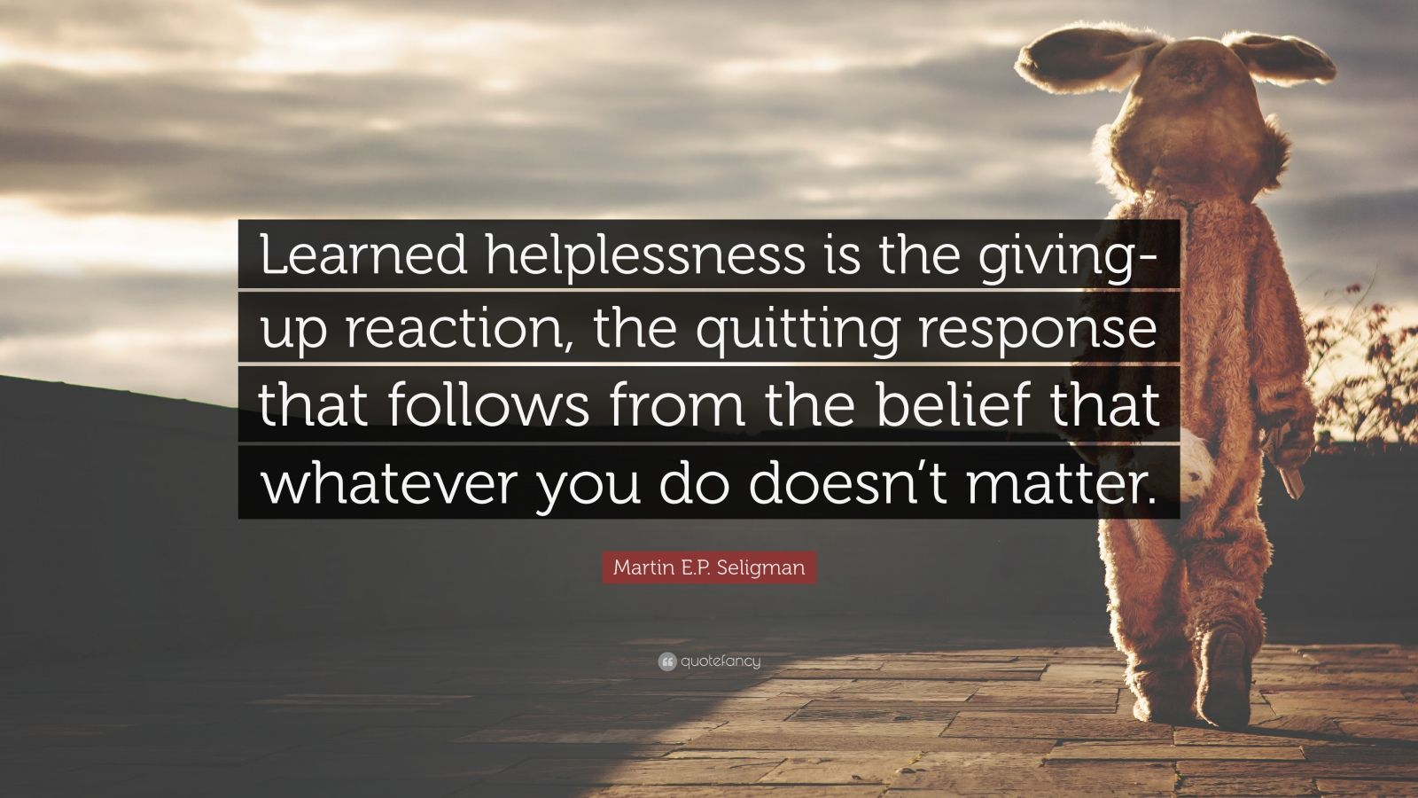
Learned Helplessness
No longer try to avoid an unpleasant stimulus because it appears unavoidable
Possible model for depression in humans

Slide 23
Behavioral Change Using Biofeedback
Biofeedback is an operant technique that teaches people to gain voluntary control over bodily processes like heart rate and blood pressure
When used to control brain activity it is called neurofeedback

