Slide 1
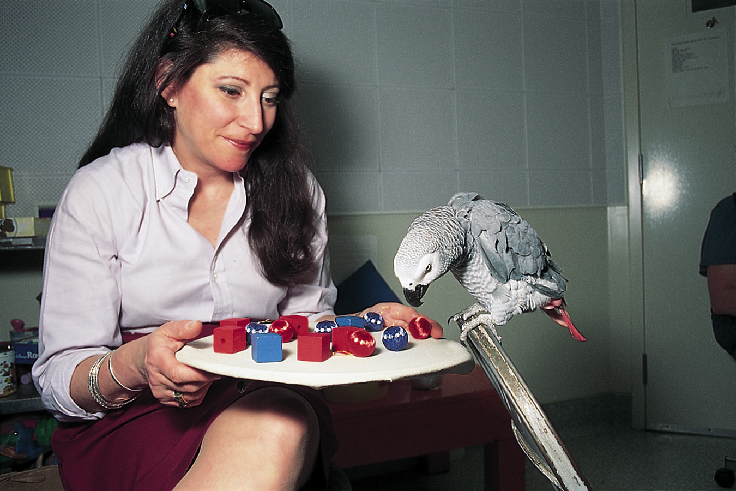
Do Animals Think?
Common cognitive skills in humans:
Concept formation.
Insight
Problem Solving
Culture
Sense of Self?
William Munoz
African grey parrot assorts red
blocks from green balls.
Notes:
OBJECTIVE 16| List five cognitive skills shared by the great apes and humans.

Slide 2

Concept Formation
Pigeons can sort objects according to their similarity.
Shown pictures of cars, cats, chairs, and flowers they learn the category
Shown a picture of a chair they reliably peck the key for ‘chairs’

Slide 3
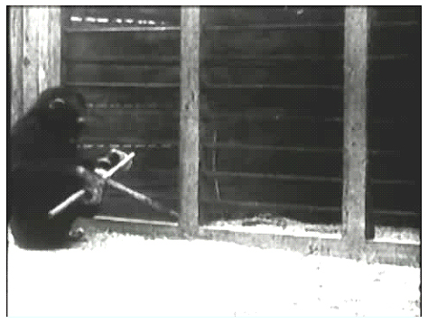
Insight
Chimpanzees show insightful behavior when solving problems. (Kohler)
Sultan uses sticks to get food.

Slide 4
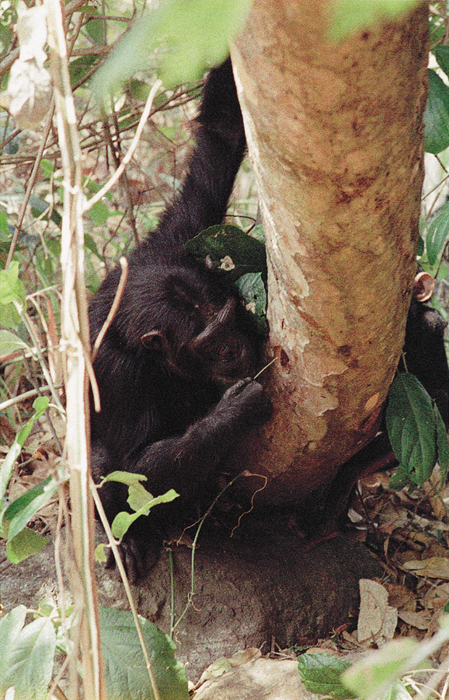
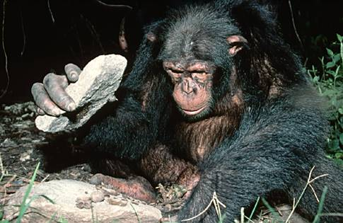
Problem Solving
Apes are famous, much like us, for solving problems.
Chimpanzee fishing for ants.

Slide 5
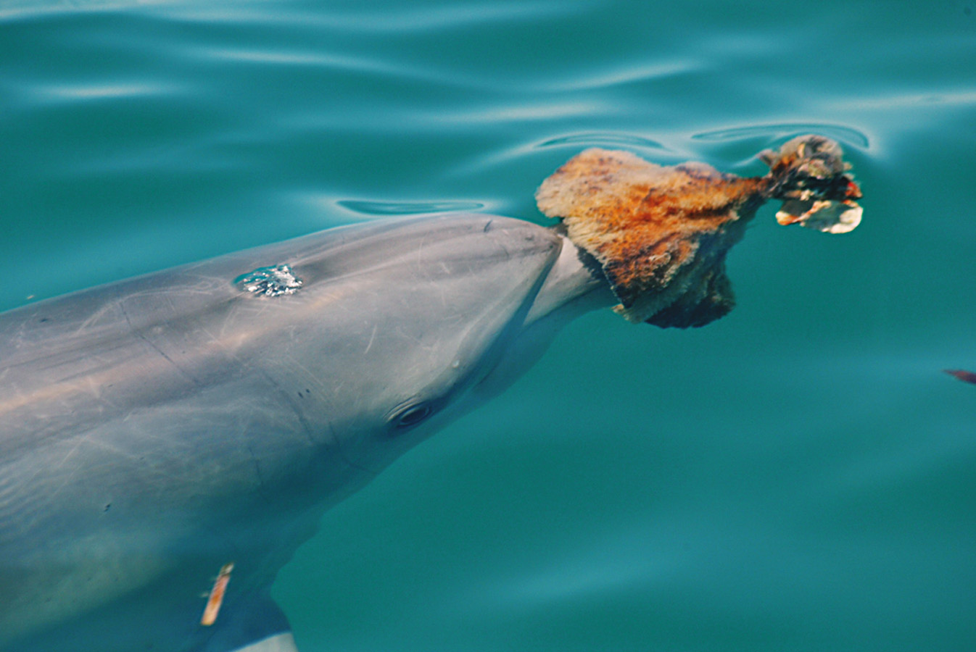
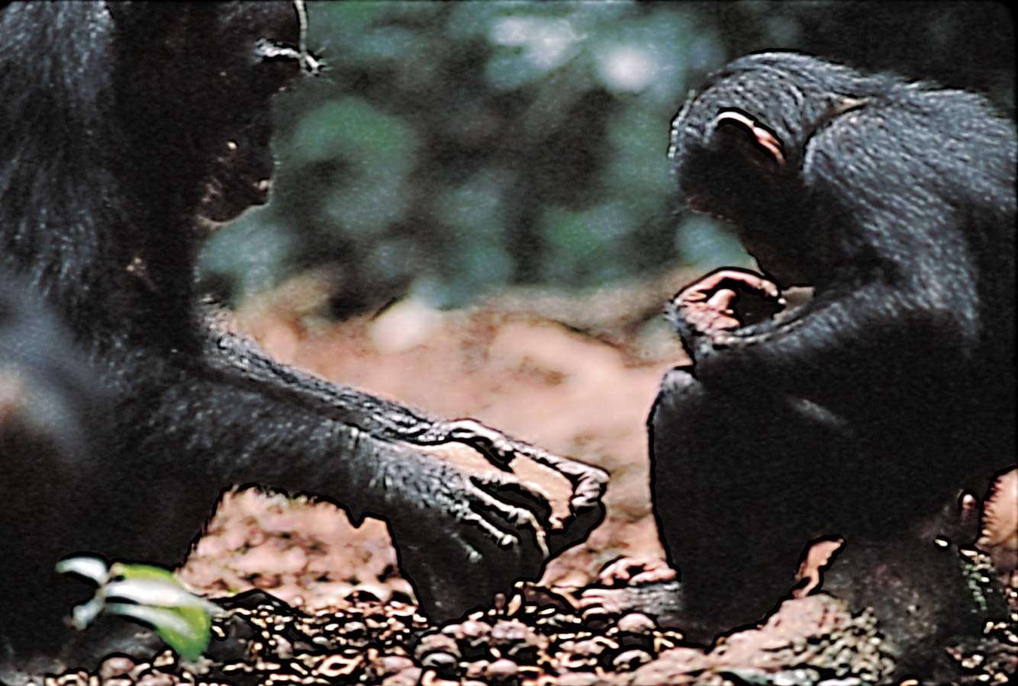
Animal Culture
Animals display customs and culture that are learned and transmitted over generations.
Michael Nichols/ National Geographic Society
Copyright Amanda K Coakes
Dolphins teach their young to use sponges as
forging tools.
Chimpanzee mother using and
teaching a young chimp how to use
a stone hammer.

Slide 6
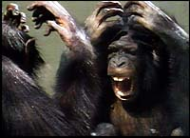
Mental States
Can animals infer mental states in themselves and others?
To some extent. Chimps and orangutans (and dolphins) used mirrors to inspect themselves when a researcher put paint spots on their faces or bodies.

Slide 7
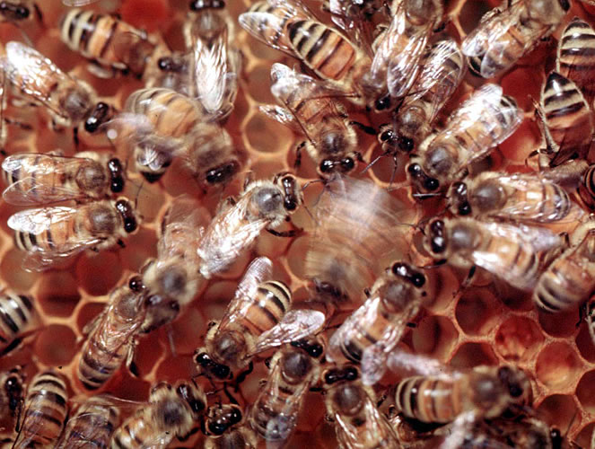
Do Animals Exhibit Language?
There is no doubt that animals communicate.
Vervet monkeys, whales and even honey bees communicate with members of their species and other species.
Notes:
OBJECTIVE 17| Outline the arguments for and against the idea that animals and humans share the capacity for language.

Slide 8
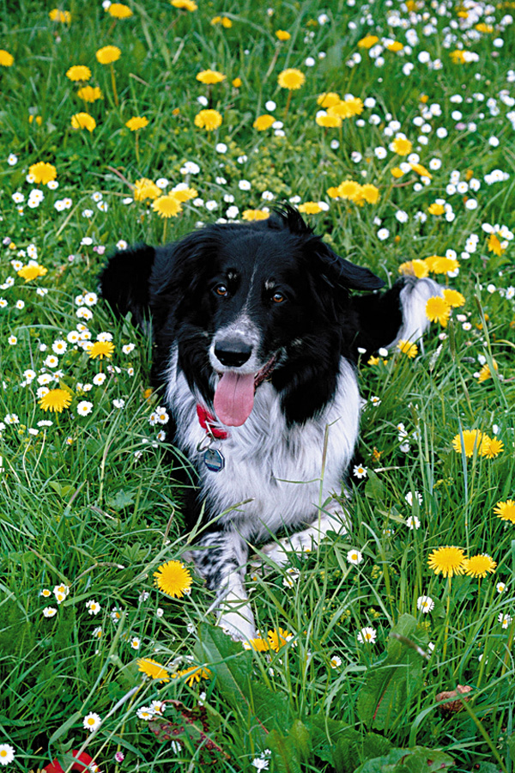
Rico Collie
Knows 200 items by name and can fetch any one of them from a group of 10 items
If asked to retrieve a toy he has never heard, Rico will pick out the novel toy
When hearing that novel word four weeks later will as often as not pick out that toy.
Notes:
OBJECTIVE 17| Outline the arguments for and against the idea that animals and humans share the capacity for language.

Slide 9
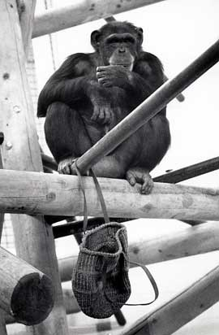
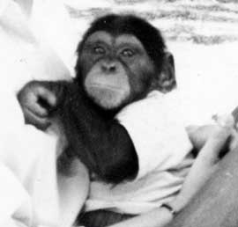
The Case of Apes
Chimps do not have a vocal apparatus for human-like speech (Hayes & Hayes,1951). Therefore, Gardner and Gardner (1969) used American Sign Language (ASL) to train Washoe, a chimp, who learned 182 signs by the age of 32.

Slide 10
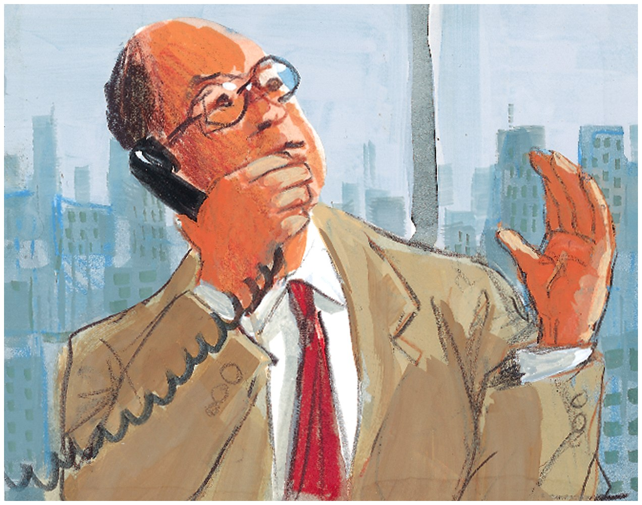
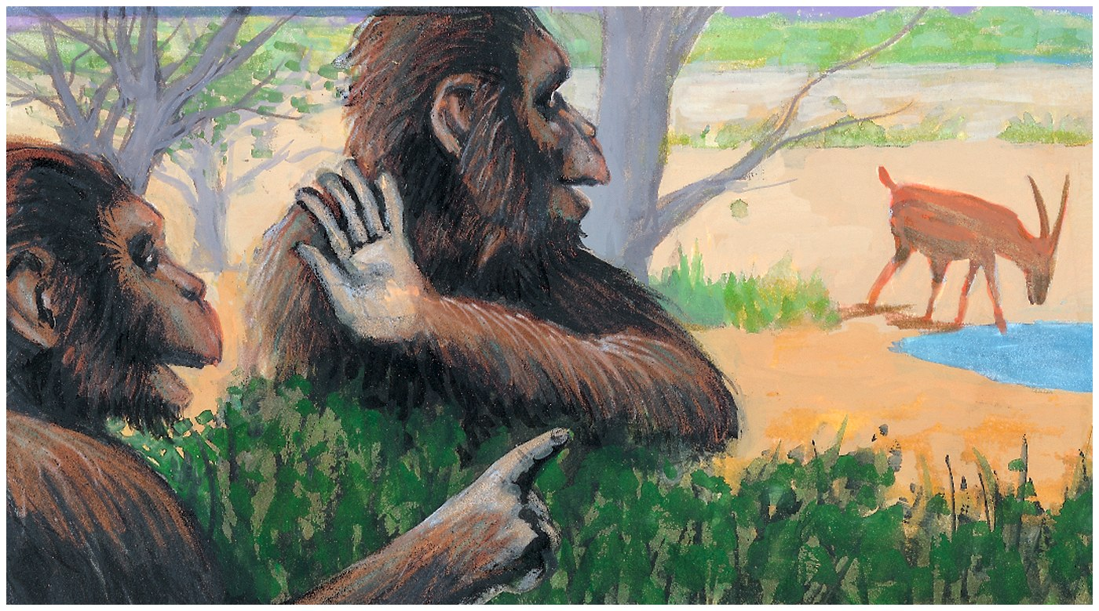
Gestured Communication
Animals, like humans, exhibit communication through gestures. It is possible that vocal speech developed from gestures during the course of evolution.

Slide 11
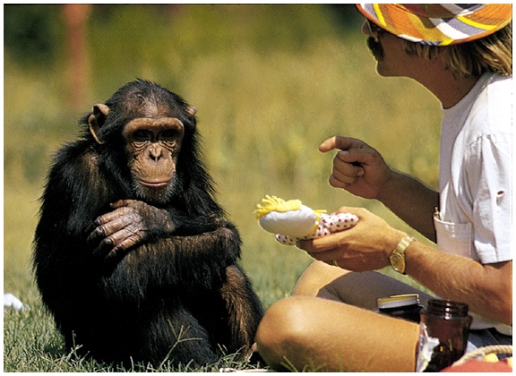
Sign Language
American Sign Language (ASL) is instrumental in teaching chimpanzees a form of communication.
When asked, this chimpanzee uses
a sign to say it is a baby.

Slide 12
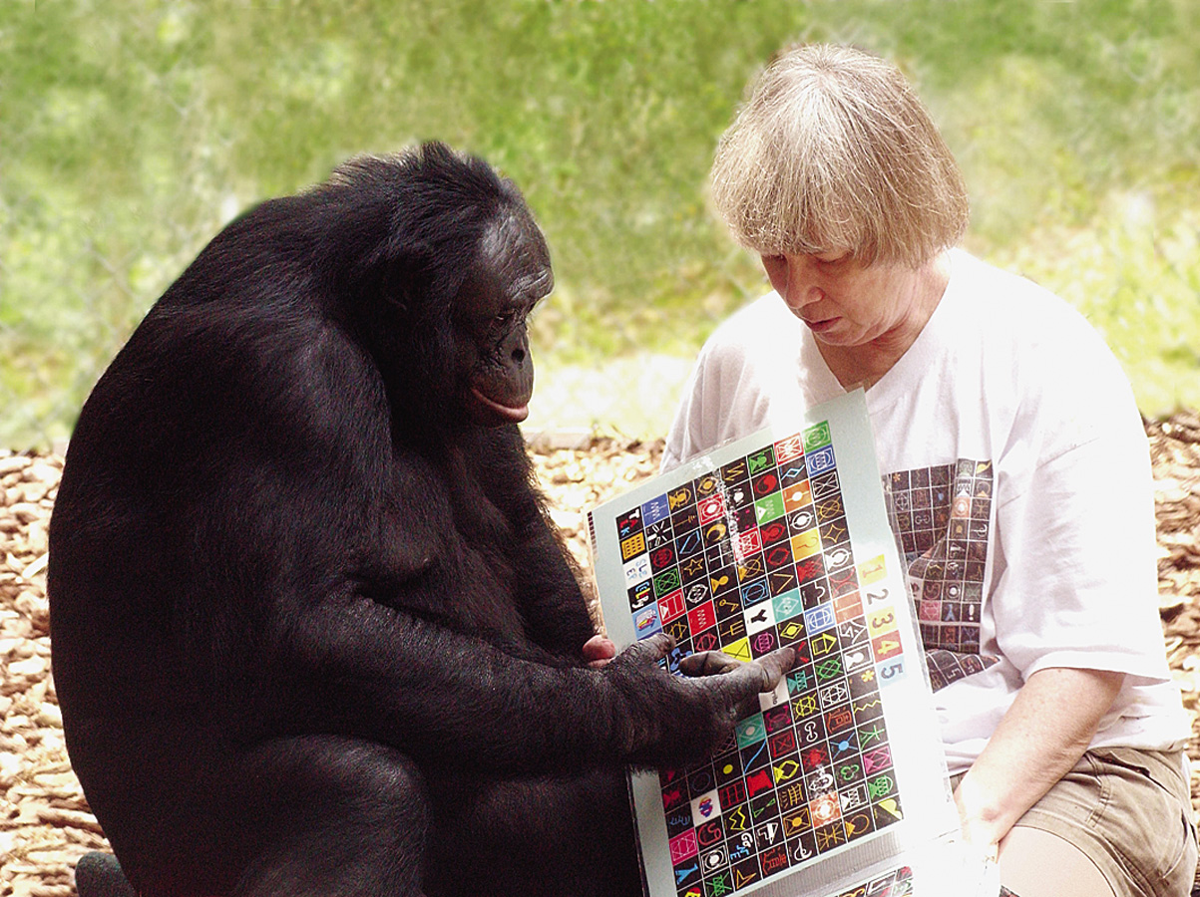
Computer Assisted Language
Others have shown that bonobo pygmy chimpanzees can develop even greater vocabularies and perhaps semantic nuances in learning a language (Savage-Rumbaugh, 1991). Kanzi and Panbanish developed vocabulary for hundreds of words and phrases.

Slide 13
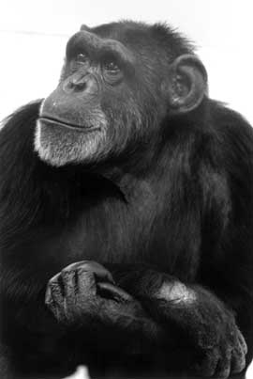
Anecdotal:
Washoe’s Phrase
“You me go out, please.”
Combined words creatively?
  Swan as “water bird”
  Pinocchio doll as “elephant baby”
Second Infant died
  Repeatedly asked “Baby”
  She is told “Baby dead, baby gone, baby finished.”
  When told about a foster baby Washoe signed “Baby, my baby.”

Slide 14
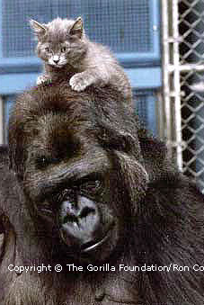
Koko
Signs spontaneously
Modestly bilingual in that she can translate English to ASL.

Slide 15
Criticism
Apes acquire their limited vocabularies with a great deal of difficulty, unlike children who develop vocabularies at amazing rates.
Chimpanzees can make signs to receive a reward, just as a pigeon who pecks at the key receives a reward. However, pigeons have not learned a language.
Chimpanzees use signs meaningfully but lack syntax.
Presented with ambiguous information, people tend to see what they want to see. (Washoe was just separately naming water and bird.)

Slide 16
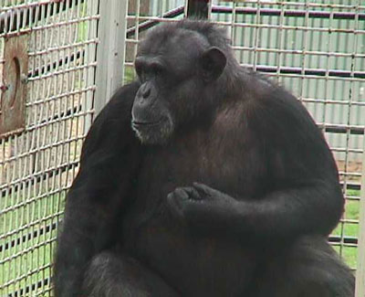
Nim Chimpski (Terrace)
Learned 125 signs in four years and signed 20,000 utterances with two or more signs
Stuck at Two-Word Stage
  Nim eat Nim eat
  Drink eat me Nim
  Me eat me eat
  You me banana me banana you

Slide 17
Conclusions
If by language we mean the ability to communicate through a meaningful sequence of symbols . . . than YES
If by language we mean verbal or signed expression of complex grammar . . . than NO

Slide 18
Conclusions
If we say that animals can use meaningful sequences of signs to communicate a capability for language, our understanding would be naive… Steven Pinker (1995) concludes, “chimps do not develop language.”

