Slide 1
Neutron Stars
Incredibly dense star left over after Type II supernova of star between 8-20x mass of sun.
Diameter 20km (the size of Manhattan), but mass 2x the Sun.
1 teaspoon of star would weigh 1 billion tons on Earth!

Slide 2
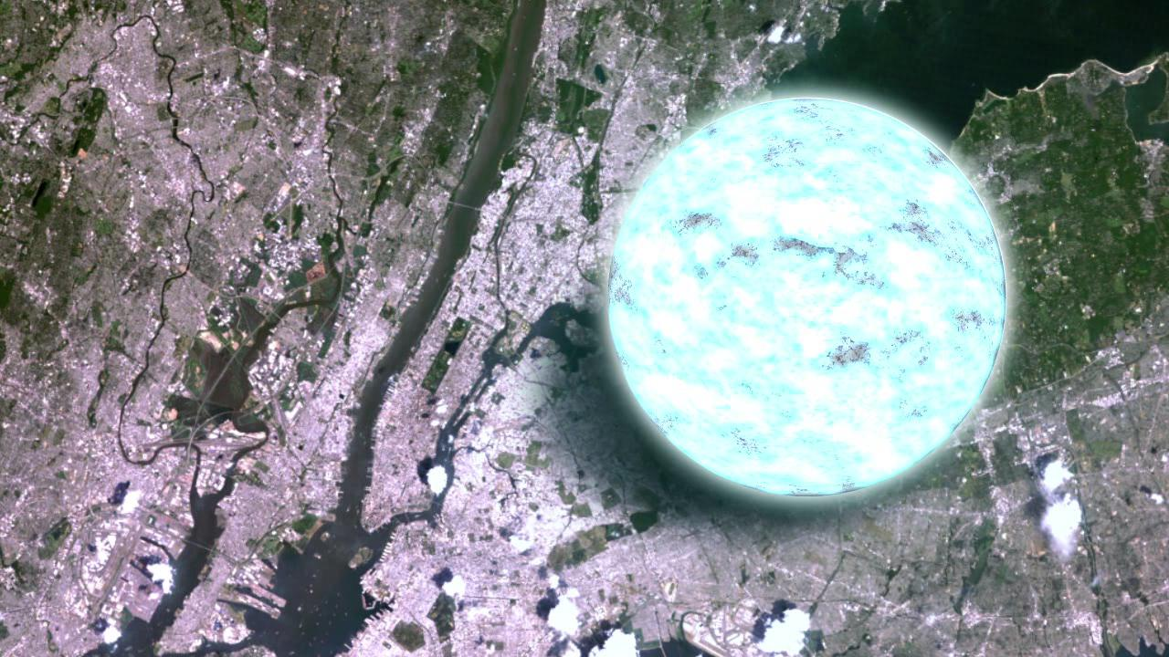

Slide 3
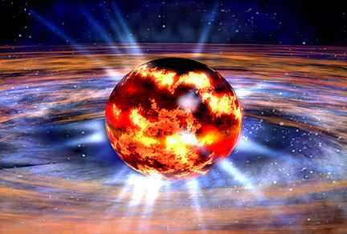

Slide 4
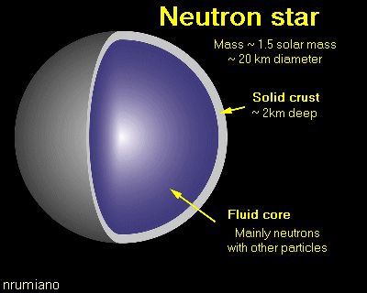
Neutron Stars
Rotates at speeds 1.4 ms to 30 seconds.
Roughly 2000 known neutron stars.

Slide 5
Pulsars
A neutron star that rotates, emitting pulses of radiation (“pulsating star”).
Don’t really pulse, but are likely continuous emission… rotation causes pulse (like lighthouse).
Rotation regularity precise as atomic clock… none rotate slower than 8.5 seconds.

Slide 6
Pulsars
Turns off after about 10-100 million years.
Of all pulsars in 13.8 by age of universe, 99% no longer pulsate.
Still not very well understood

Slide 7
Magnetars
Type of pulsar with extremely powerful magnetic field.
Have very strong bursts of x-rays and gamma rays.
Slower rotation than regular pulsar = only 1-10 seconds per rotation.
Only last about 10,000 years.

Slide 8
Starquakes
When a neutron star’s crust adjusts (similar to an earthquake).
Tremendous amount of energy released in form of gamma rays.
Caused by either the magnetic field or because the star is slowing its spin.

