Slide 1
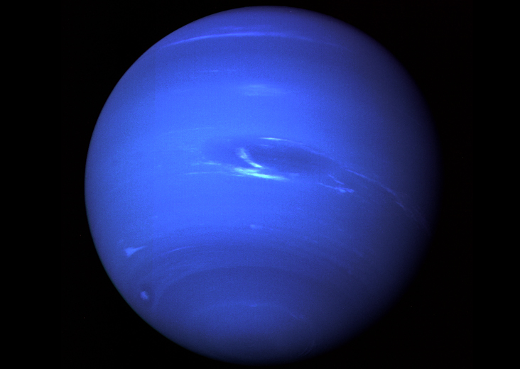

Slide 2
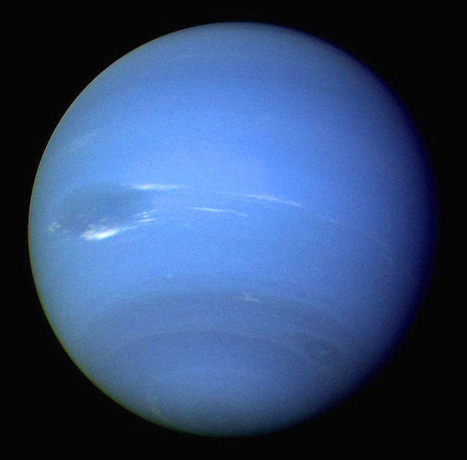

Slide 3
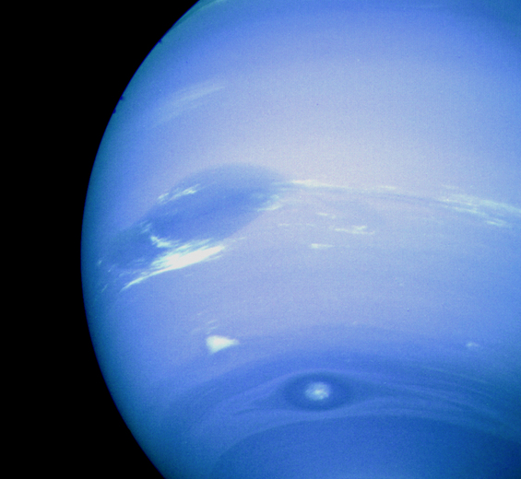

Slide 4
Neptune
4th largest planet with 13 moons.
Similar to Uranus in composition.
Neptune and Uranus are called “ice giants.”

Slide 5
Basics
Diameter = 4x size of Earth (63 Earths fit in Uranus)
Density = 1.64 g/cm³ (densest Jovian planet)
Rotation = 16 hours
Revolution = 165 years (for 20 years, Pluto is closer than Neptune… ended in 199)
Temperature = -214 ⁰C (-353 ⁰F)

Slide 6
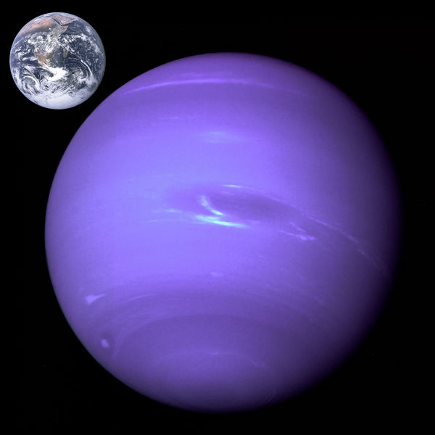

Slide 7
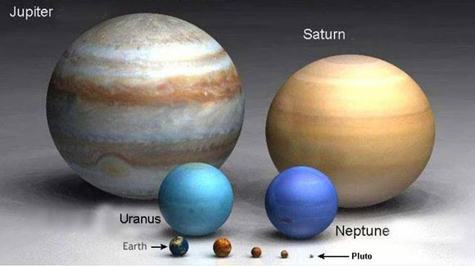

Slide 8
Atmosphere - Interior
Mostly hydrogen (85%) and helium (15%).
Bluer than Uranus… not sure why (methane is blue/green).
Contains “ices” like water, ammonia, methane, along with hydrocarbons.
Earth-size solid core.

Slide 9
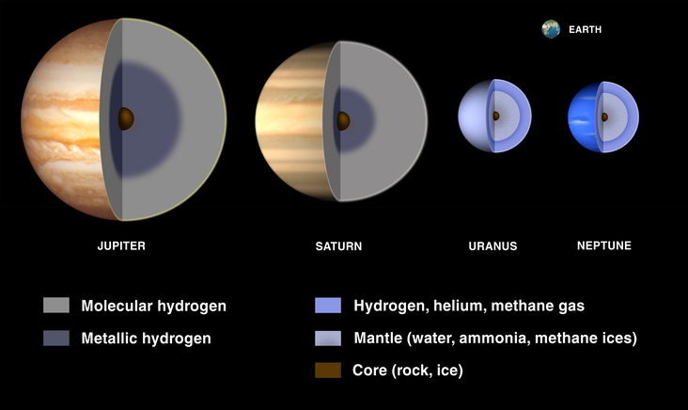
Core

Slide 10
Magnetic Field
Tilted 60 degrees from axis of rotation, similar to Uranus.
Might be generated by water-ammonia ocean.
About 27x as powerful as Earth.

Slide 11
Moons
Triton
Retrograde motion… opposite to Neptune’s rotation.
Probably a captured plutoid from Kuiper Belt.
Geologically active… nitrogen geysers

Slide 12
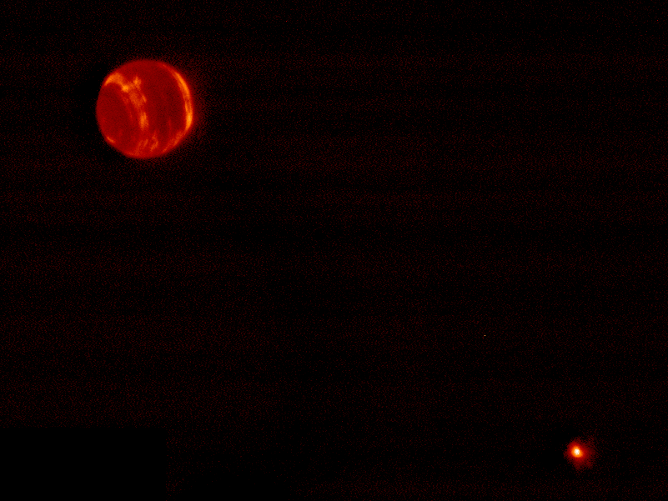

Slide 13
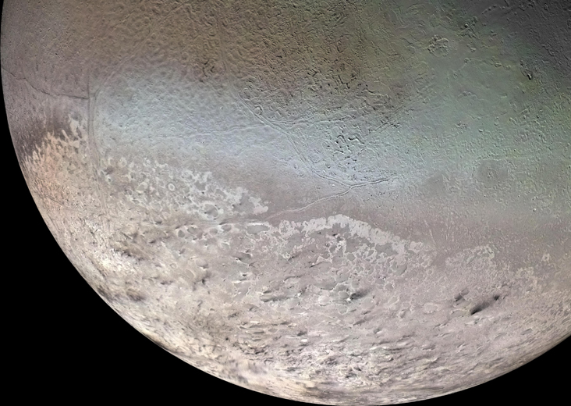

Slide 14
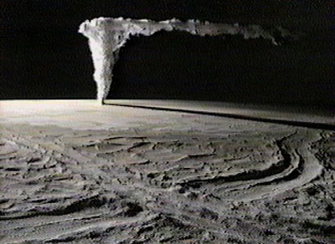

Slide 15
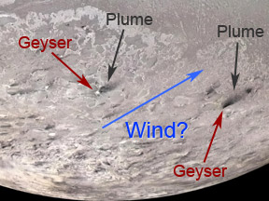

Slide 16
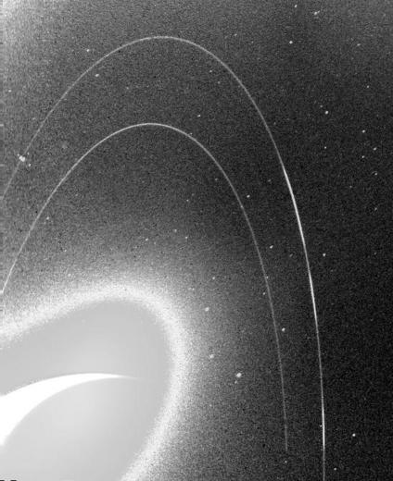

Slide 17
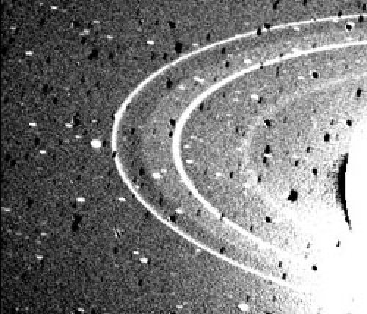

Slide 18
