Slide 1
Motives vs. Emotions
Motive
  Specific need or desire, such as hunger, thirst, or achievement, that prompts goal-directed behavior
Emotions
  Feeling, such as fear, joy, or surprise, that underlies behavior
Motive predicts behavior better than emotion.

Slide 2


Instincts and Evolutionary Psychology
Instincts are fixed behaviors that are not learned;
and are found throughout the species

Slide 3
Do humans have instincts?
Most important behaviors are learned
Human behavior is not fixed and found throughout the species
However, humans have reflexes (instincts?)
We may be predisposed to act certain ways due to evolutionary adaptations.

Slide 4
Theories of Motivation
Drive-Reduction Theory (behaviorism)
Incentive Theory (behaviorism)
Arousal Theory
Hierarchy of Motives
Notes:
OBJECTIVE 1| Define motivation as psychologists use the term today, and name four perspectives useful for studying motivated behaviors.

Slide 5
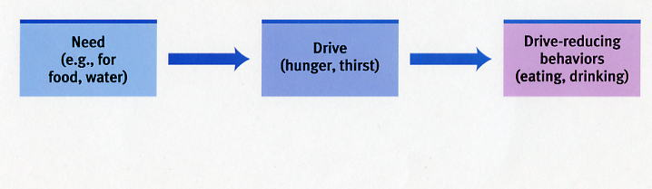
Drive-Reduction Theory
Drive Reduction replaced the instinct theory.
A bodily need creates a drive (unpleasant state) that motivates you to satisfy the need.
Notes:
OBJECTIVE 3| Explain how drive-reduction theory views human motivation.

Slide 6
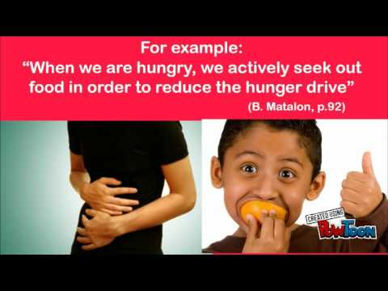
Drive Reduction
The goal of drive reduction is homeostasis
The maintenance of a steady internal state – balance.

Slide 7


Biological Drives (Primary Drives)
Created by Clark Hull (1951). Out of favor now.
Many primary drives start in the hypothalamus
  Hunger
  Thirst
  Sex
Evolutionary psychology talks about the four Fs (fighting, fleeing, feeding and reproducing).

Slide 8
Drive Reduction Theory
Strength
Explains most primary drives
Weakness
Doesn’t explain more complex behaviors/secondary drives (love, belonging, status, giving).

Slide 9
Incentive Theory
People are motivated by incentives (rewards)
Intrinsic – from the action itself or from within
Extrinsic – for something else (incentive)
Overjustification – giving a reward to someone intrinsically motivated may hurt motivation…better to do nothing.

Slide 10
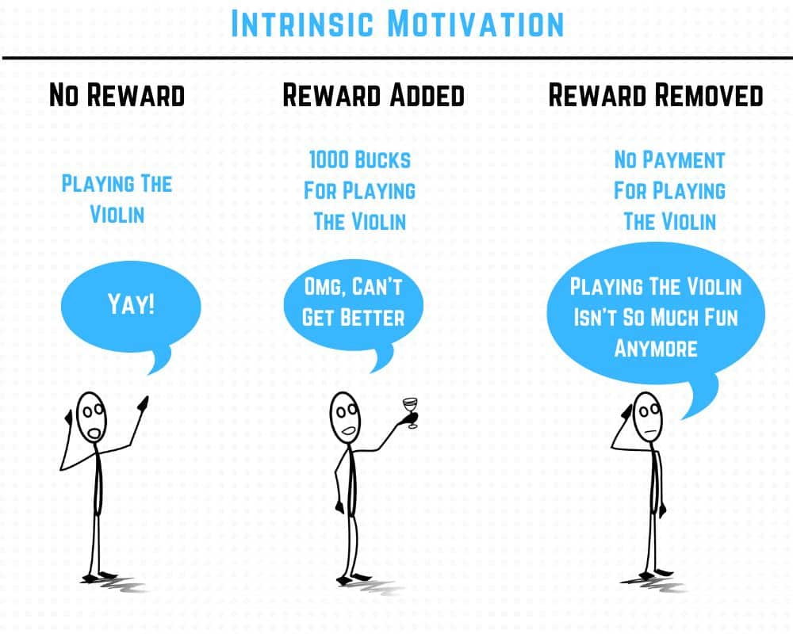
Overjustification

Slide 11
Arousal Theory
People do things in order to seek out an optimal level of excitement at any given moment.
high level of arousal – let’s do something epic tonight.
low level of arousal – let’s stay in tonight.
I am bored with my life I need a new job.
I am stressed at work, let’s take a vacation.

Slide 12
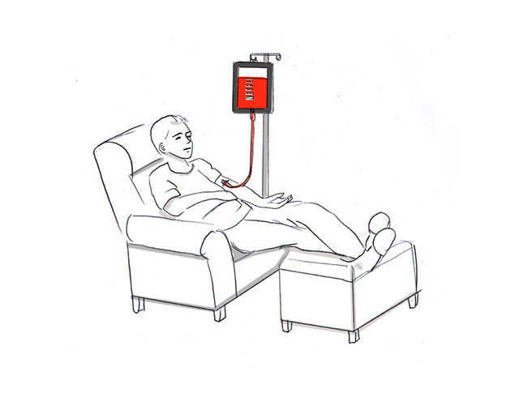

Optimum Arousal
Humans seek optimum levels of arousal.
Sometimes we want lots of arousal
Sometimes we want very low arousal
Some of us tend to want more and some of us tend to want less.
Notes:
OBJECTIVE 4| Discuss the contribution of arousal theory to the study of motivation.

Slide 13
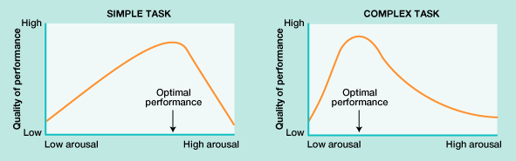
Yerkes-Dodson Law
  Difficult tasks are best with moderate arousal
  Simple tasks are best with higher arousal

Slide 14
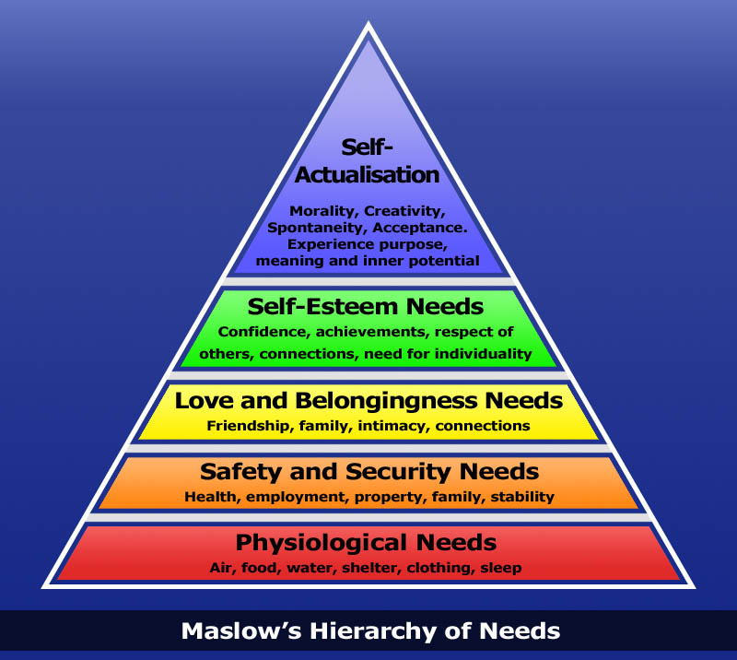
Hierarchy of Needs
Abraham Maslow
certain needs have priority over others.
Notes:
OBJECTIVE 5| Describe Maslow’s hierarchy of needs.

