Slide 1

Morality Development: Piaget
Responses to moral problems can be divided into two broad stages:
  Moral Realism (Morality of Constraint)
Rules are sacred, consequences determine all guilt (age 6)
  Moral Relativism (Morality of Cooperation)
Rules are flexible, intent is important in determining guilt (age 12)

Slide 2
Lawrence Kohlberg
Agreed with Piaget, but went further (3 stages)
Used 10 “dilemmas” and then asked questions. The sample comprised 72 Chicago boys aged 10–16 years.
Example of story:
In a country in Europe, a poor man named Valjean could find no work, nor could his sister and brother. Without money, he stole food and medicine that they needed. He was captured and sentenced to prison for six years. After a couple of years, he escaped from the prison and went to live in another part of the country under a new name. He saved money and slowly built up a big factory. He gave his workers the highest wages and used most of his profits to build a hospital for people who couldn’t afford good medical care. Twenty years had passed when a tailor recognized the factory owner as being Valjean, the escaped convict whom the police had been looking for back in his hometown.

Slide 3
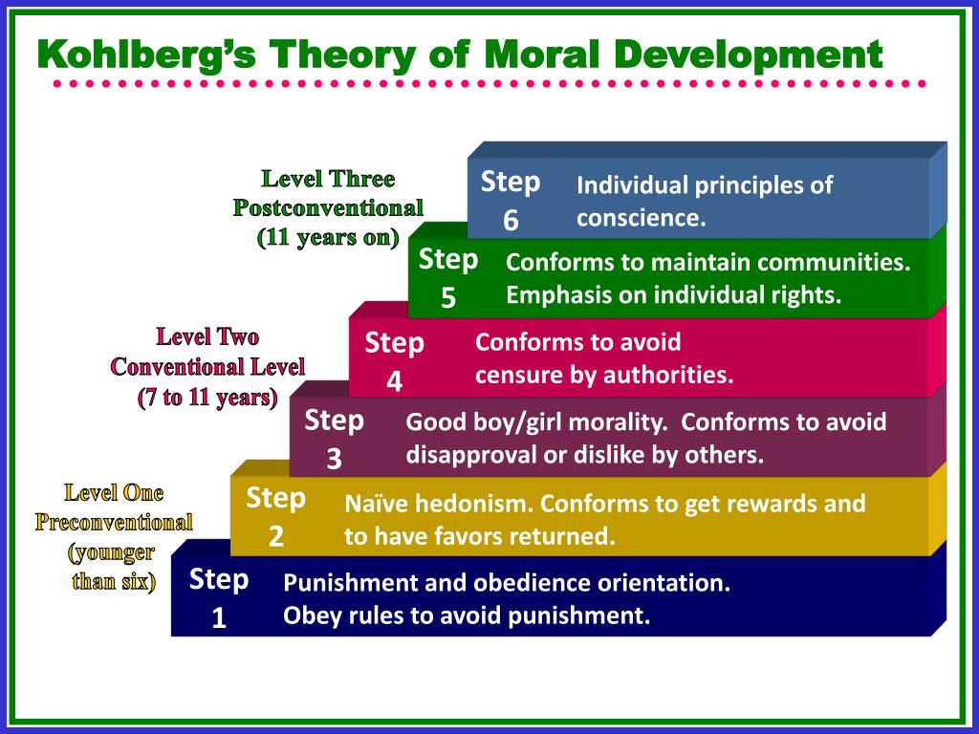

Slide 4
Level 1
Preconventional Morality
Stage 1. Obedience and Punishment Orientation.
The individual is good in order to avoid being punished. If a person is punished, they must have done wrong.
Stage 2. Individualism and Exchange.
The individual recognizes that there is not just one right view that is handed down by the authorities. Different individuals have different viewpoints.

Slide 5
Level 2
Conventional Morality
Stage 3. Good Interpersonal Relationships.
The individual wants to be seen as a good person by others. Looks for the approval of others.
Stage 4. Maintaining the Social Order.
The individual becomes aware of the wider rules of society, so judgments concern obeying the rules in order to uphold the law and to avoid guilt.

Slide 6
Level 3
Postconventional Morality
Stage 5. Social Contract and Individual Rights. Rules are good, but they may work against the interests of individuals.
Stage 6. Universal Principles.
Individual has developed their own set of moral guidelines which may or may not fit the law. The principles apply to everyone.
E.g., human rights, justice, and equality.

Slide 7
Possible Responses to Dilemma
Preconventional Morality:
Avoids punishment: “The tailor will be in trouble if he doesn’t tell the police.” (Stage 1)
Gains rewards: “The tailor may get a reward for turning in a criminal.” (Stage 2)
Conventional Morality:
Gains approval/avoids disapproval: “If you don’t report him, everyone will think you are just as much a criminal.” (Stage 3)
Does duty to society/avoids dishonor or guilt: “There has to be respect for the written law.” (Stage 4)
Postconventional Morality:
Affirms agreed-upon rights: “Although turning Valjean in may not be perfectly just, leaving such decisions up to each person’s judgment would result in greater injustice.” (Stage 5)

Slide 8
Problems with Kohlberg
Dilemmas are artificial and hypothetical. People may act differently in real situations.
Does moral judgement match moral behavior?
Sample was biased. Only boys
Gilligan shows that girls have different focus (more interpersonal)

Slide 9
Gender Differences
  Are there gender differences in morality? Do men and women approach moral dilemmas differently?
  Some suggest:
    Men: judgment on abstract concepts (justice, rules, individual rights)
    Women: Interpersonal connections and attention to human needs
  Ultimately, findings mixed

