Slide 1
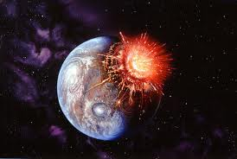
The Moon
Formation - Impact from Mars-size object ejects material into orbit… forms Moon.
- Best model to explain Moon’s composition.

Slide 2
Lunar Phases
Half of the Moon is always illuminated by the Sun.
But, we see moon phases? Why?
-- Because of moon’s revolution and angle.

Slide 3
Lunar Phases
Moon revolves (and rotates) around Earth in 27.3 days.
-- Because of this, we only see one side of moon.
(synchronous orbit).

Slide 4
But,
A full phase cycle = 29.5 days.
ie. Full moon to full moon.
Why the 2 day difference?
Because the Earth has moved in the meantime

Slide 5
Moon Phases
Terms:
Waxing = moon is in first half of cycle.
Waning = moon is in last half of cycle.
Gibbous = “hunchback” = moon close to full.

Slide 6
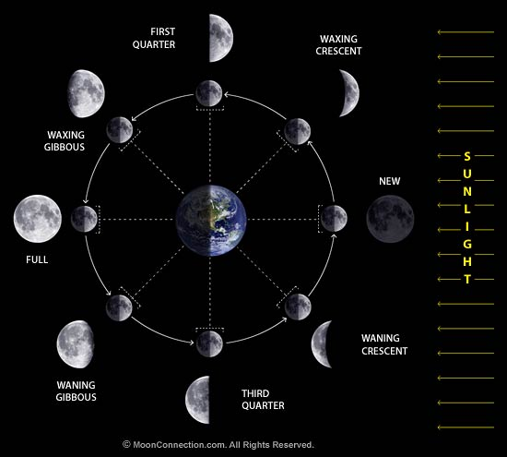

Slide 7
Eclipses
Lunar Eclipse = when Earth’s shadow covers the moon.
Only during full moon phase.
Umbra (shadow) covers moon completely. All persons on dark side of Earth can see the eclipse.
Usually 2 to 5x per year.

Slide 8
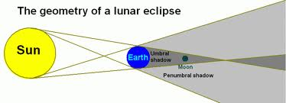

Slide 9
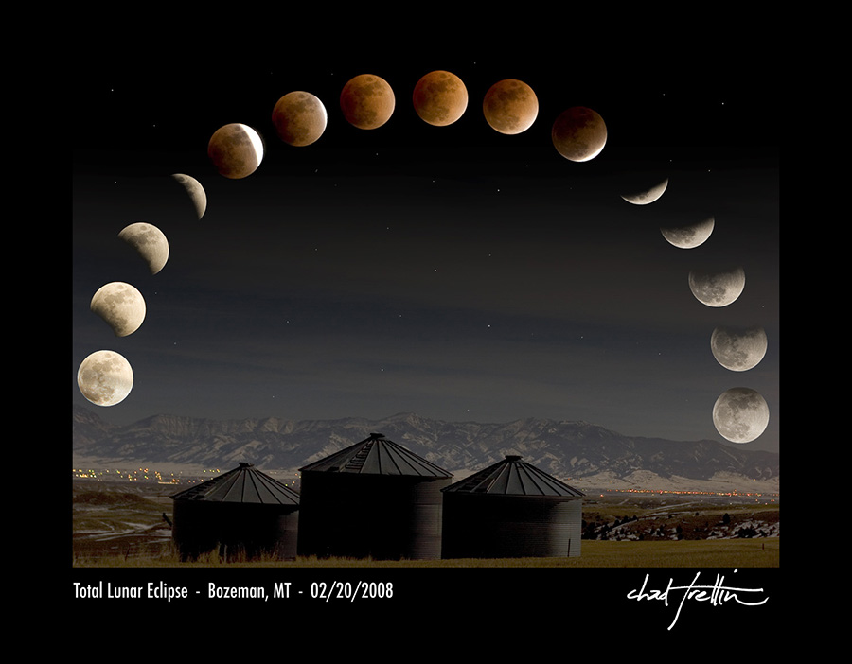

Slide 10
Solar Eclipse
Solar Eclipse = When the moon covers the sun.
Only during a New Moon.
Umbra (shadow) is small. Covers only a small portion of Earth.
Usually 2 to 5x per year.

Slide 11
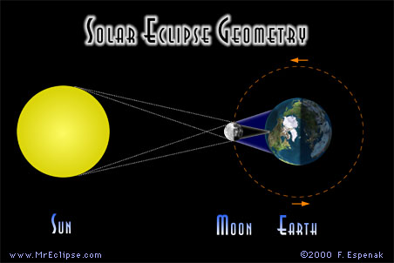

Slide 12
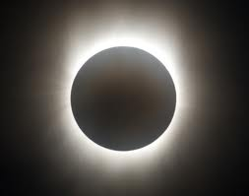

Slide 13
Moon’s Orbit
The Moon’s orbit is tilted 5º. Important!
Otherwise, there would be a solar and lunar eclipse every month.

Slide 14
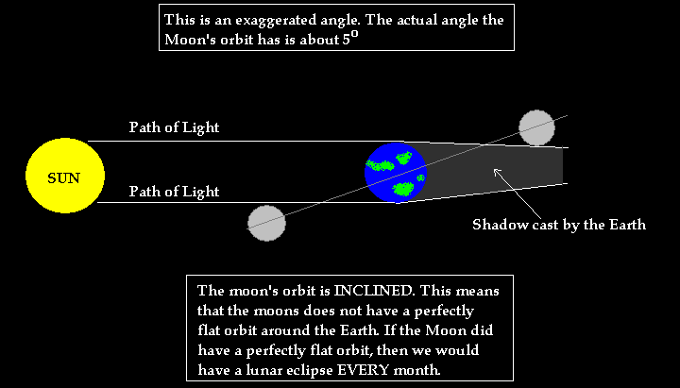

Slide 15
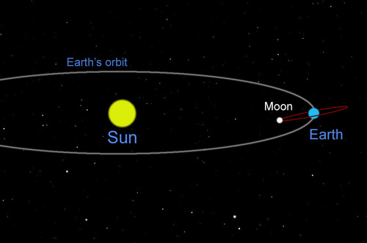
Moon’s Orbit

Slide 16
Tides
Tides = cyclic rise and fall of ocean levels.
Caused primarily by Moon’s gravity.. not sun’s.
Spring Tide = Moon and Sun align.
Neap Tide = Moon and Sun not aligned.

Slide 17
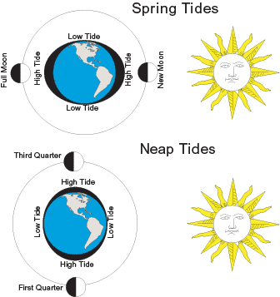

Slide 18
Neap vs. Spring Tides
Spring Tides:
- highest high tide and lowest low tide.
- Happens at full and new moon phases.

Slide 19
Neap vs. Spring Tides
Neap Tides:
- High tide not so high and low tide not so low.
- Happens at quarter moon phases.

