Slide 1
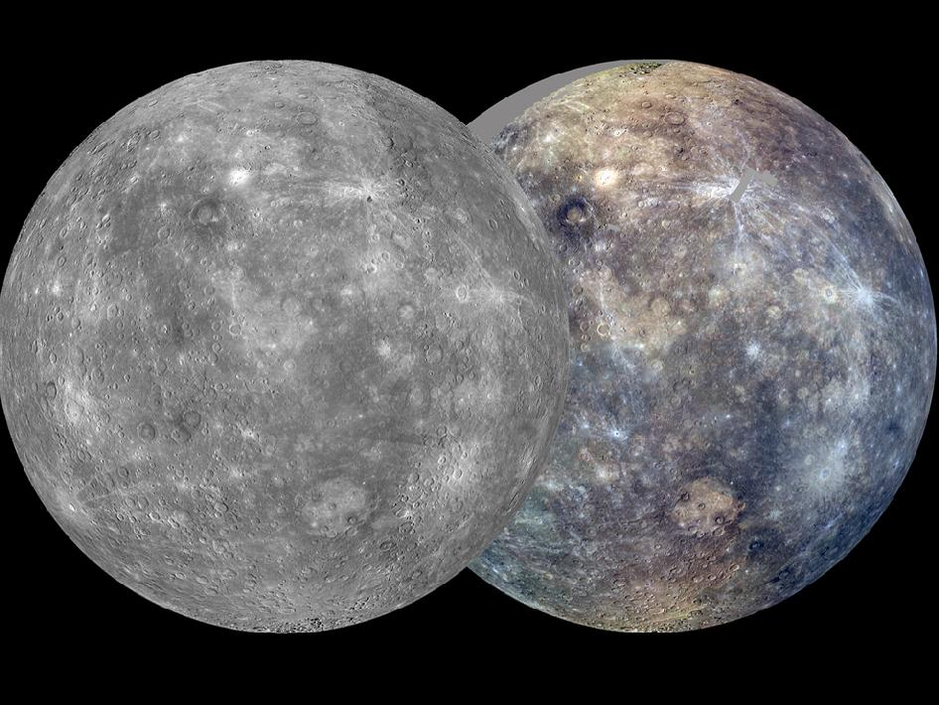

Slide 2
Mercury
No atmosphere
Differentiation = layered interior based on density.
Core is 40% of volume (Earth 17%)
60% of mass (Earth 30%)

Slide 3
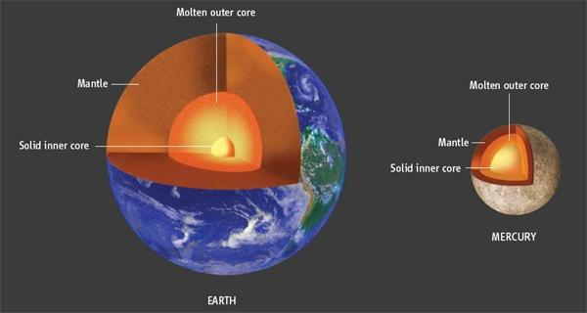
Core

Slide 4
Composition
Large core and thin crust… why?
Reasons??
1. close to Sun – solar wind vaporizes light materials.
2. materials knocked off by meteor collision(s).

Slide 5
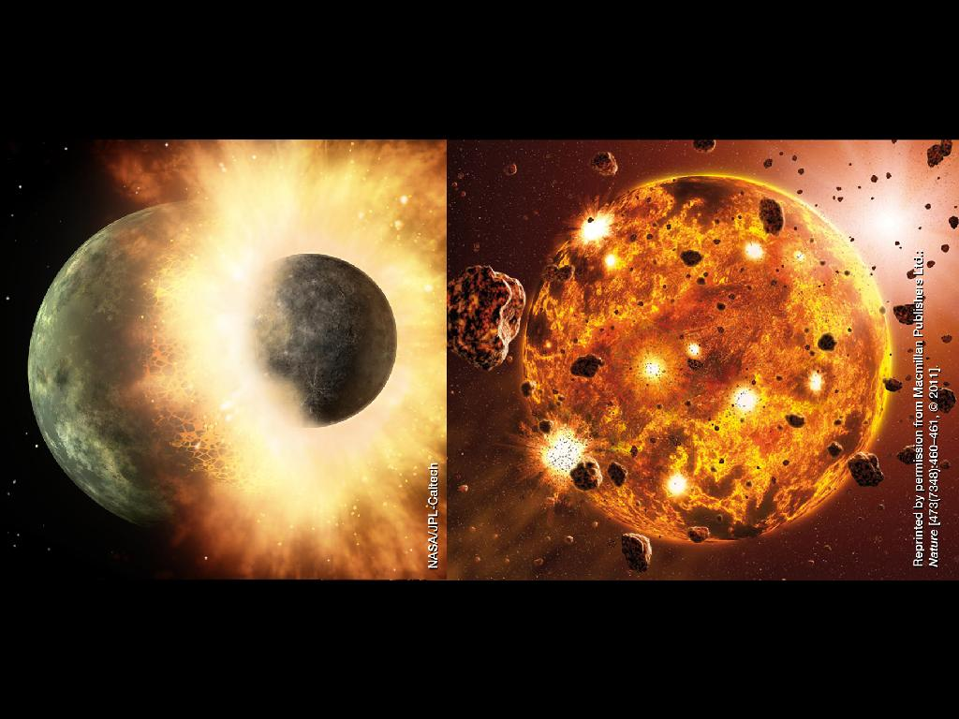

Slide 6
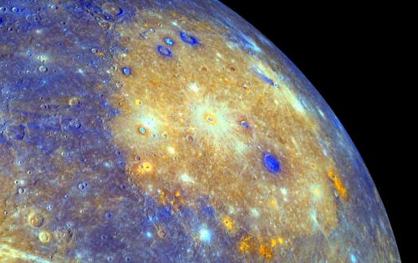
Caloris Basin (red volcanic vents)

Slide 7
Magnetic Field
Only terrestrial planet other than Earth with magnetic field.
Weak (1% of Earth’s), but strong for small planet.
Implies some liquid core, but not confirmed.

Slide 8
Observing Mercury
Messenger did three fly-bys in 2008/9. Then orbited Mercury until 2015.
From Earth, difficult to observe:
  Always near Sun
  Must view at sunrise or sunset; atmospheric blur
  During solar eclipse

Slide 9
News
Water ice and organics (carbon, nitrogen, etc.) confirmed on North Pole.
Located in perpetually dark craters.
Temps:
Daytime = 800 F
Night = -300 F

Slide 10
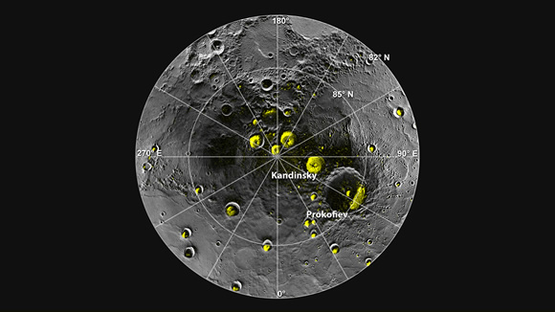

Slide 11
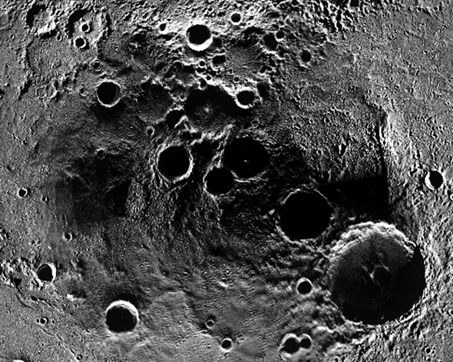

Slide 12
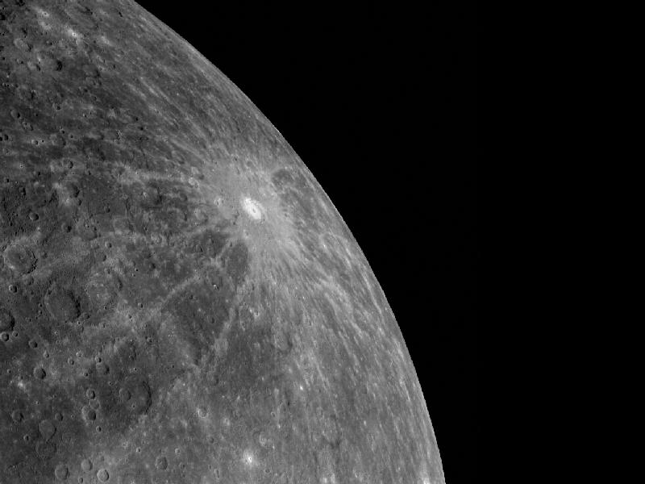
Messenger - Debussy

Slide 13
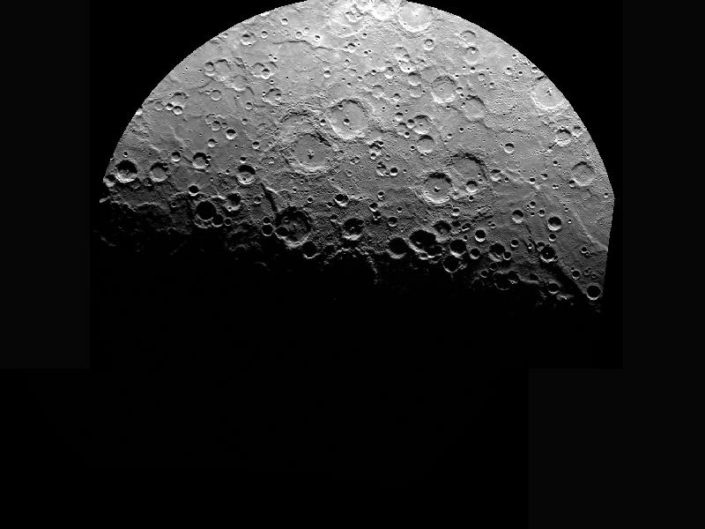
South Pole

