Slide 1
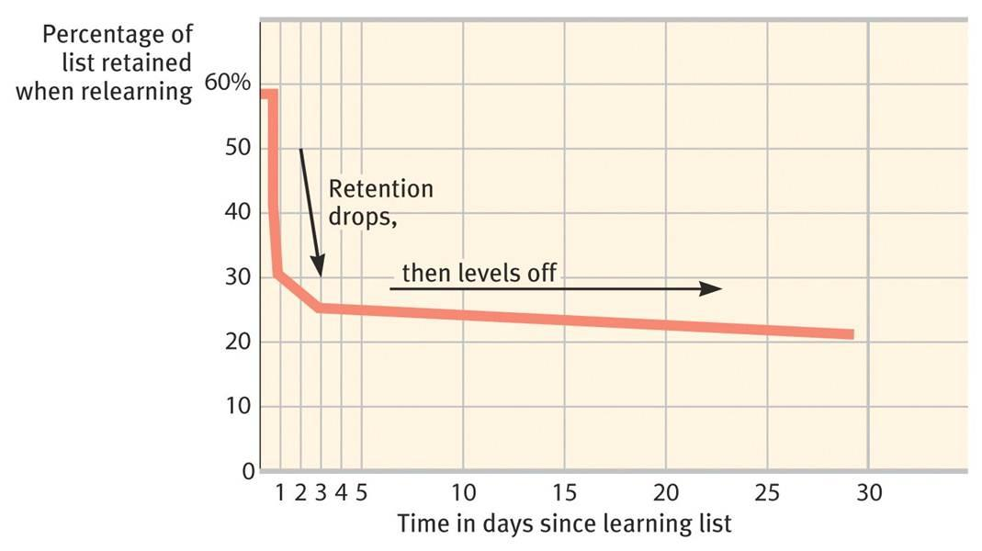
Memory Storage
Decay Theory – Ebbinghaus
The passage of time causes forgetting.
The longer information is not accessed, increases the chances of forgetting it.

Slide 2
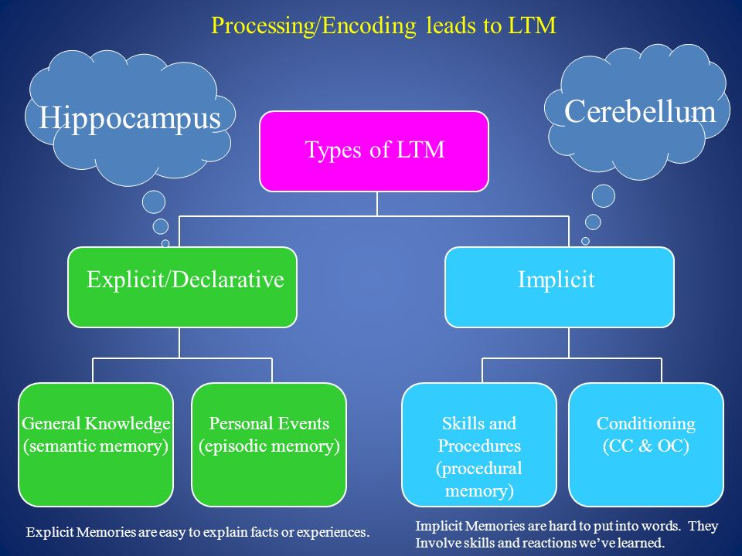
Memory Storage
Explicit memories are stored in the hippocampus – like a save button.
Implicit memories stored in the cerebellum and basal ganglia (procedural)

Slide 3
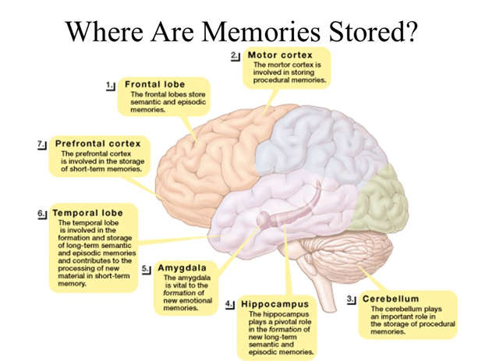

Slide 4
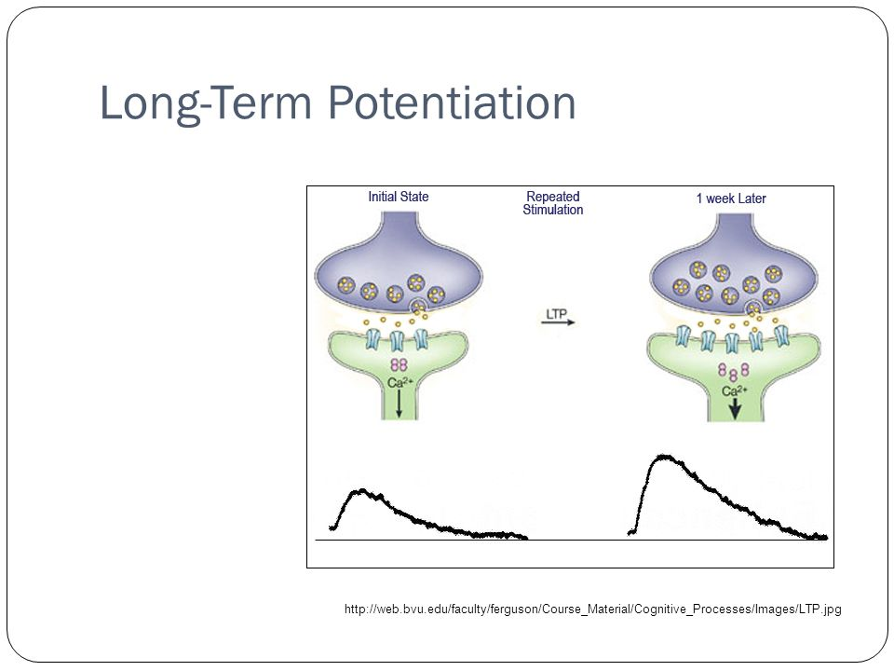
Long-Term Potentiation (LTP)
As you learn something, the firing of neurons in your brain increases in efficiency and speed.
When LTP is disrupted, learning fails.

Slide 5
Recognition vs. Recall
Recall – remembering without cues (fill-in the-blank test)
Recognition – remembering items shown to you (multiple choice test).
Which do you think is easier?

Slide 6
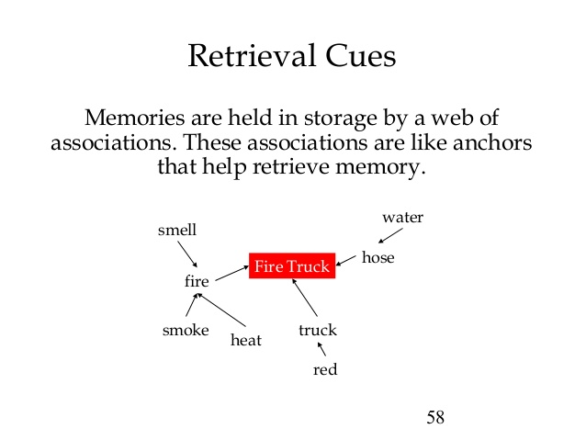

Slide 7
Retrieval Issues
State-Dependent Memory (mood dependent) – recall is easier if in same “state” or “mood” as when learned. If learn while drunk, may need to be drunk to remember.
Context-Dependent Memory – recall is easier if situation is similar to when learned. Ex. You go to another room to get something and when you get there you don’t remember why you went there. In order to remember, you should go back to the room where you started.
Serial Position Effect - recall is easier for the first items (primacy effect) and last items (recency effect) in a list
-- Primacy effect reflects long-term memory
-- Recency effect reflects short-term memory

Slide 8
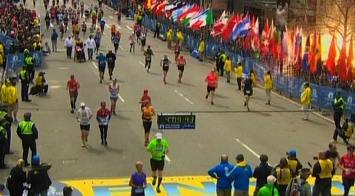
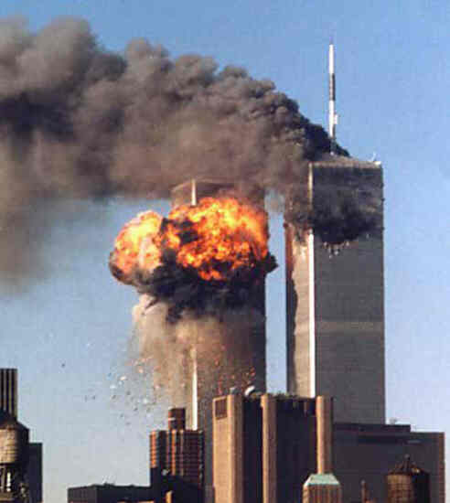
Emotions and Memory
Flashbulb Memories:
- Stress hormones provoke the Amygdala – fear center of the brain
- Creates a memory trace in the frontal lobe and basal ganglia
- Bakes in emotional memories.
- Extreme Stress hurts this process… why some people do not test well.

Slide 9
Question
Caitlin, a 5th grader, is asked to remember her second-grade teacher’s name. What measure of retention will Caitlin use to answer this question?
A. Storage
B. Recognition
C. Recall
D. Encoding

