Slide 1
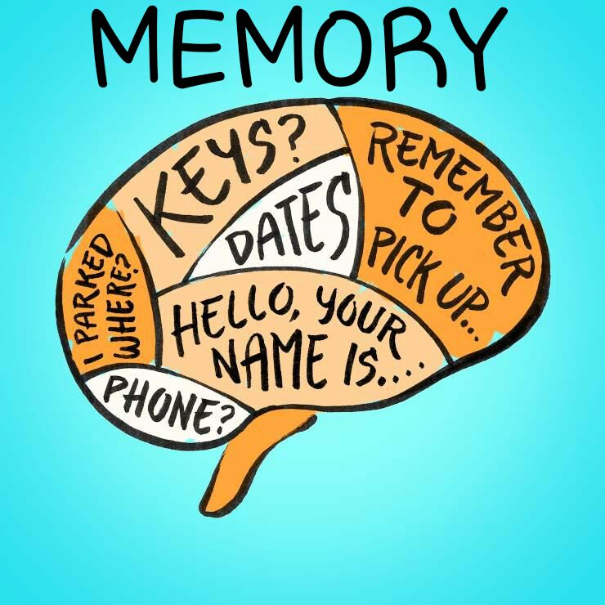
Memory
The ability to remember things we have experienced, imagined, or learned.
Information that has been acquired, stored and can be retrieved.

Slide 2
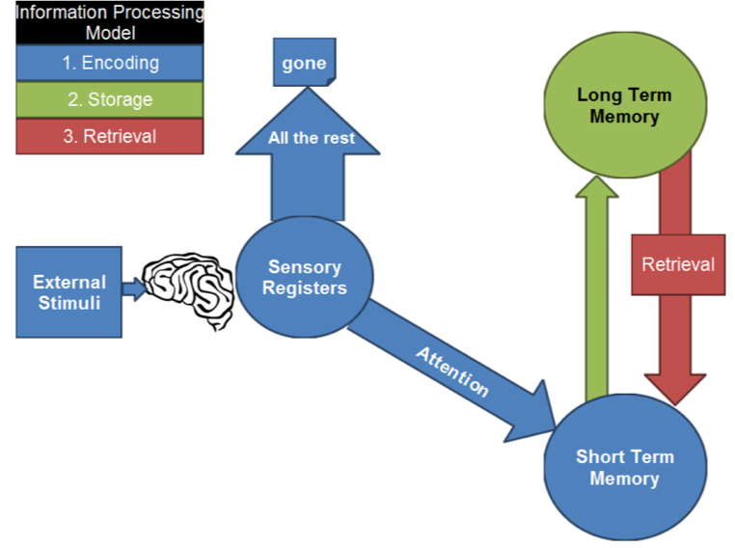
Memory Models
Information Processing Model
  Step 1: Encoding (Blue)
  Step 2: Storage (Green)
  Step 3: Retrieval (Red)
Developed by Atkinson and Shiffren

Slide 4

Atkinson-Shiffren
Stages:
Sensory Memory – here and gone.
Short-Term Memory – encoded through rehearsal (~7 bits of information for <30 seconds)
Long-Term Memory – unlimited

Slide 5


Improvements on IPM
Alan Baddeley replaced short-term memory with ”working memory”
Working Memory acts as a central executive, deciding to give attention, or not, to the stimulus.
Like short-term memory but is actively processing stimuli (deciding whether to pay attention or not)
Because its role is more active, psychologists prefer Working Memory.

Slide 6
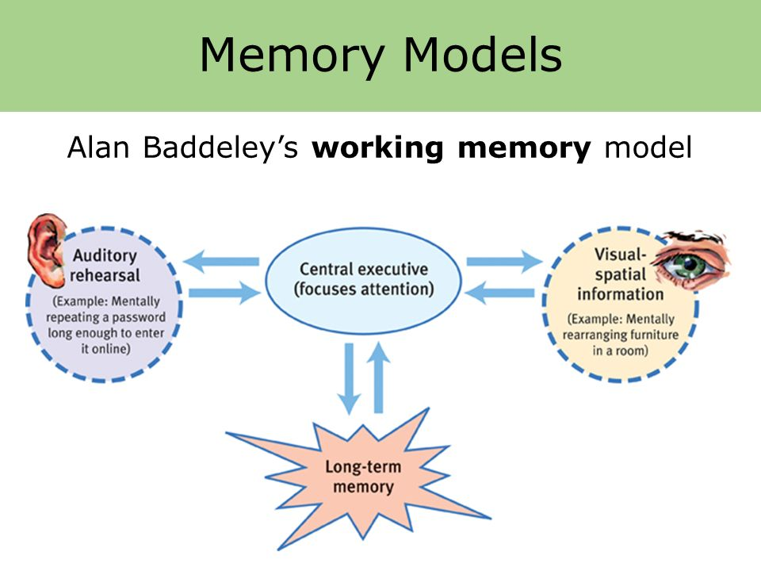

Slide 7
Sensory Memory
The sensory stays for only a very short time. Unless you attend to it, you lose it.
Visual (Iconic) vs Auditory (Echoic):
- Images last about ¼ of a second
- Sounds last several seconds.
Why do sounds last longer?
It only happens once? Slower processing time?

Slide 8
Test Visual Memory
I will flash the next picture for just ¼ of a second.
DON’T BLINK
After the image flashes we’ll return to a white screen and you can tell me everything you saw.

Slide 9
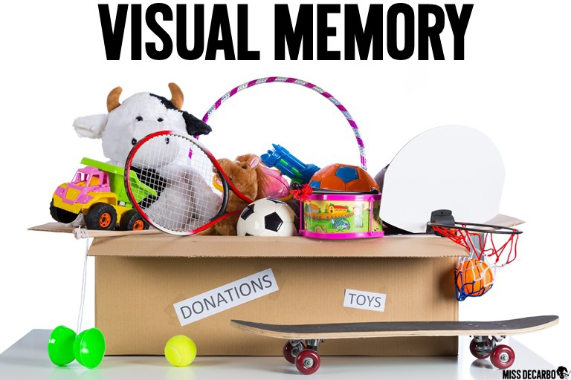

Slide 10
What did you see?

Slide 11
Selective Attention
We only pay attention to a small portion of our senses.
And only that information gets processed by STM/Working Memory.
The rest is lost!

