Slide 1
Forgetting
…bombarded every second by sensations, emotions, thoughts…nine-tenths of which we must simply ignore. The past is a roaring cataract of billions upon billions of such moments. Any one of them too complex to grasp in its entirety, and the aggregate beyond all imagination… At every tick of the clock, in every inhabited part of the world, an unimaginable richness and variety of ‘history’ falls off the world into total oblivion.
C.S. Lewis

Slide 2
Biological Forgetting
Damage to the Hippocampus
  Difficulty forming new memories (Patient H.M)
  Smaller in Alzheimer’s patients
Neurotransmitters play a role
  Acetylcholine
  Low levels in Alzheimer’s patients

Slide 3
Memory Loss
Types:
Anterograde Amnesia – can’t recall new things.
Retrograde Amnesia – can’t recall old things

Slide 4
Encoding Failure
What we fail to encode, we cannot remember!

Slide 5
Retrieval Failure
Decay Theory (Ebbinghaus)
Tip of the Tongue phenomena

Slide 6
Interference
Proactive Interference – when prior learning disrupts recall of new information.
Retroactive Interference – when new learning disrupts recall of old information.

Slide 7
Retroactive Interference
Try remembering the following:
  5614982

Slide 8
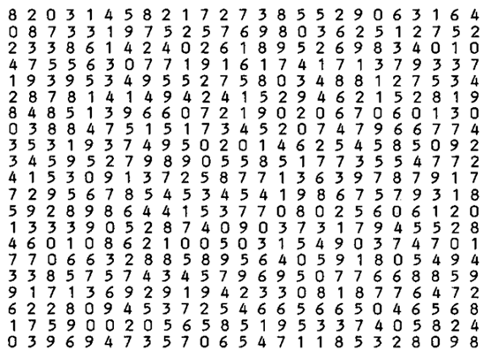
Now Read This…

Slide 9
Retroactive Interference
Here, we tested the OLD (retro) information.
The trial was hard because it overloaded your modality.
What type of music should you listen to when you write an essay?

Slide 10
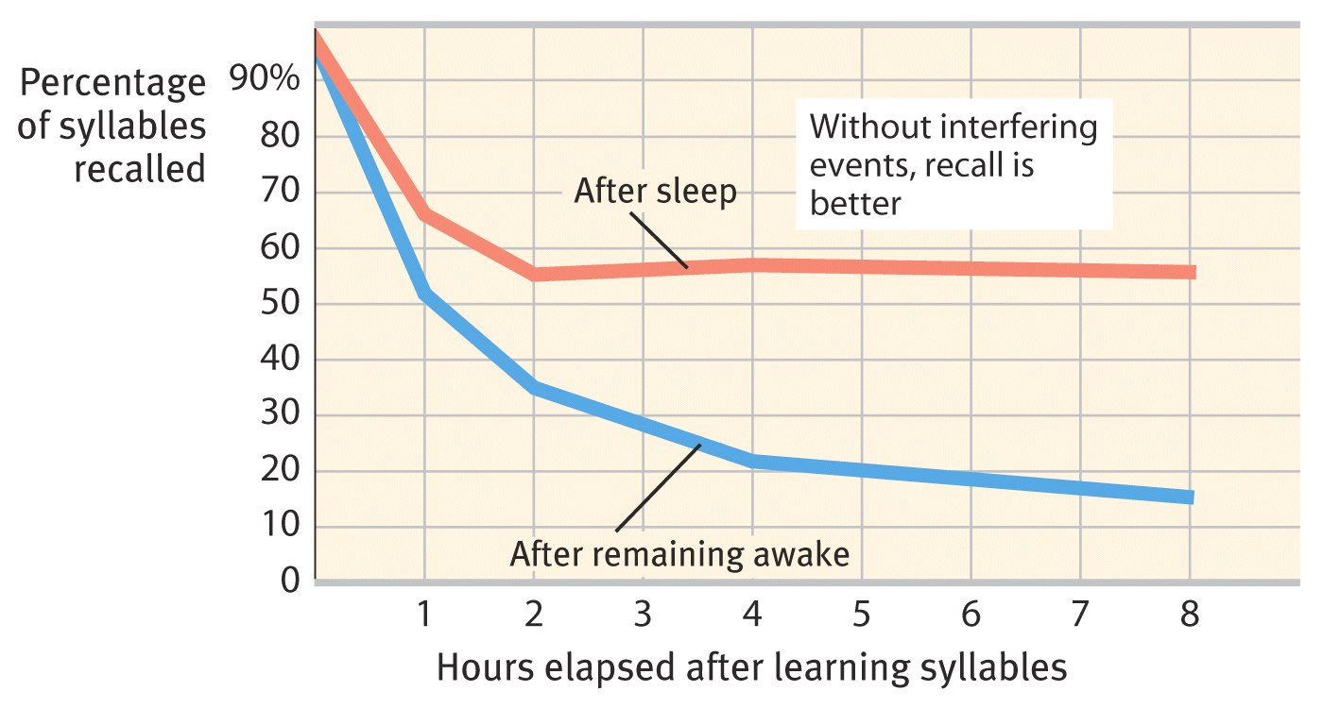
Retroactive Interference study by Jenkins and Dallenbach
People learned nonsense syllables, then asked to recall them 8 hours later.
Sleep helps… no time for new information

Slide 11
Which is which?
You are trying to type in your new password, but instead you accidently type in the old password.
You are writing an essay about WWI on your final exam but all you can remember is new information about WWII.

Slide 12
Childhood Amnesia
Generally poor memory for events prior to age 2-3
-maybe b/c hippocampus not fully formed until age 2
-maybe due to a lack of a clear sense-of-self in young children
-maybe absence of language

Slide 13
Memory is a Construct!
“When we remember something, we're taking bits and pieces of experience - sometimes from different times and places - and bringing it all together to construct what might feel like a recollection but is actually a construction. The process of calling it into conscious awareness can change it, and now you're storing something that's different. We all do this, for example, by inadvertently adopting a story we've heard.” Elizabeth Loftus

Slide 14
Misinformation Effect
Exposed to misleading information, we tend to misremember.
Ex. observers of a filmed car accident were asked how fast the vehicles were going when they “smashed” into each other. When “smashed” was used, observers portrayed the event as more serious than it was.

Slide 15
Source Amnesia
Forgetting where the information came from. Usually, the hardest thing to remember.
Ex. Songwriter writes song that they think is their own creation but is not.
Ex. I know you but don’t know where I’ve seen you before.

Slide 16
déjà vu
déjà vu (“already seen”) – the feeling that you’ve already done something or been somewhere.
Decreases with age
Explanations?
Some neurologists have suggested that déjà vu may result when the brain’s two hemispheres temporarily jump out of sync. Disease or fatigue can make one side of the brain perceive an event a fraction of a second after the other side. A distorted time sense leads the mind to interpret its second “experience” of the event as a repeat of something that happened long ago. Actually, you have been there before but only microseconds earlier.

Slide 17
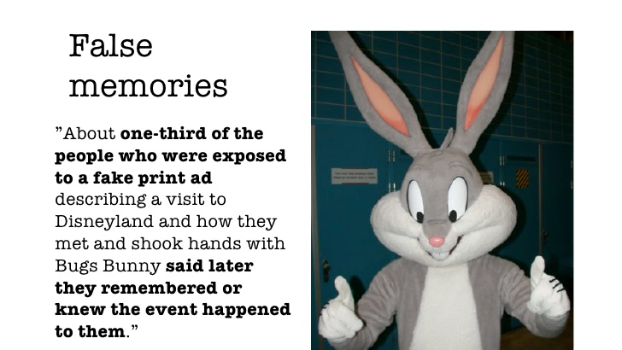

Slide 18
Elizabeth Loftus (cont’d)
1956 Air Show Disaster in England 1-10 Fighter Jet Broke apart in Mid-Air killing 12. Witnessed by 100,000 avid fans watching the event. They had the wreckage and photos and asked the people to write in. Got a few 1000 people to respond. Fewer than 6 gave info that was consistent with the evidence they had.
We can plant false memories (Elizabeth Loftus) Did an experiment with one of her graduate student’s 14 yr-old younger brother. Said here are four stories from your past (only three actually happened – one of them, being lost in the mall – was planted) Over the next two weeks whenever you remember something about one of these, write it down. Chris rated each of the four stories for clarity, he gave the false memory an 8 of 11. He picked a real memory as being fake.

Slide 19
Eyewitness Testimony
Generally unreliable
Memories are not stored like snapshots, but are instead like sketches that are altered and added to every time they are called up
Misinformation Effect: Elizabeth Loftus has shown subjects who are given false information about an event or scene tend to incorporate it into their memories, and "recall" the false information as a part of their original memory even two weeks later.

Slide 20
Eyewitness Testimony
No correlation between the feeling of certainty one has about a memory, and the memory’s accuracy

Slide 21
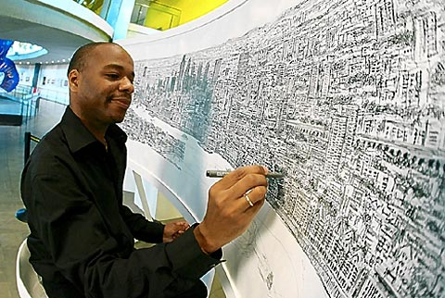
Eidetic Memory
Pop culture calls this a photographic memory
Not true “photographic” memory. Usually due to well developed memory techniques.

