Slide 1
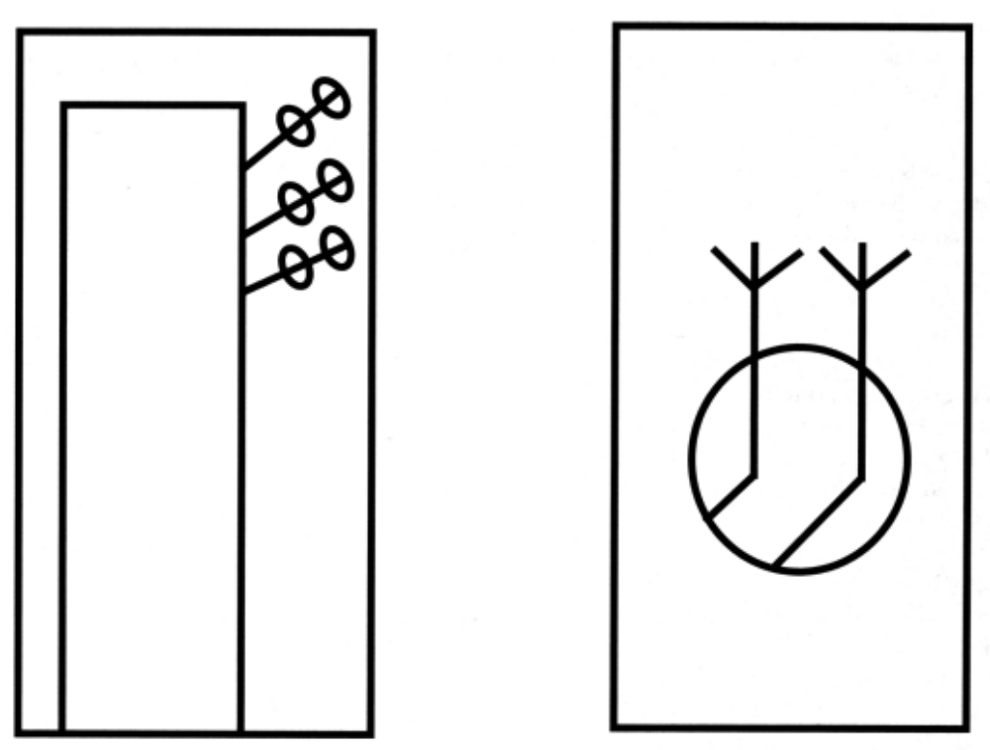
A
B
Notes:
Description: Show this page very briefly…study the two figures. Describe “A” or “B,” but not both. For “A” state, “This is a boy playing bagpipes in a telephone booth.” For “B” state, “This is an early bird who caught a very strong worm.” Immediately have students put the handout away and proceed with the class. At the end of the session, ask students to reproduce the two figures without looking at them. Then have them compare their reproductions with the actual figures.

Slide 2
Memory: Encoding
Definition – bringing sensory information from the outside world into brain.
Effortful Processing – how we encode explicit memories (facts and experiences).
Automatic Processing – how we encode implicit memories (without awareness)
ex. riding a bike.
Visual information encodes easier than audio

Slide 3
Short-Term or Working Memory
Information can be held in STM by rehearsing the information.
Involves repeating information over and over…not very effective in creating long term memories

Slide 4
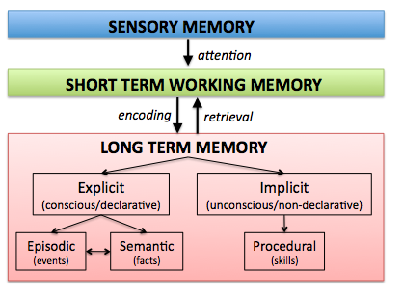

Slide 5


Long-Term Memory
Everything that is learned is stored in long-term memory
Capacity of LTM:
Vast amounts of information may be stored for many years.
Encoded through meaning.

Slide 6
Explicit Memories
Facts (semantic) and Experiences (episodic)
Encoded through “effortful” processing.
Strategies for encoding explicit memories:
1. Chunking – organizing into smaller units.
2. Mnemonics – using words or images in place of abstract meanings.
3. Hierarchies – broad concepts divided into narrow concepts and facts.
4. Spacing Effect – cramming all at once not as good as over time.
5. Testing Effect – practice exams rather than re-reading material.

Slide 7
Chunking
M-S-N-N-A-S-A-C-I-A-C-O-M or MSN NASA CIA COM
Try to Remember these numbers
7184950
5433789
7384890
3658392
5168493

Slide 8
Chunking Helps
718-4950
543-3789
738-4890
365-8392
516-8493

Slide 9
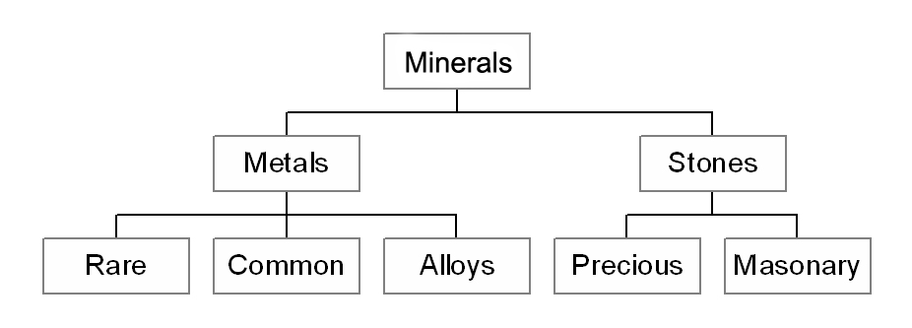
Hierarchy

Slide 10
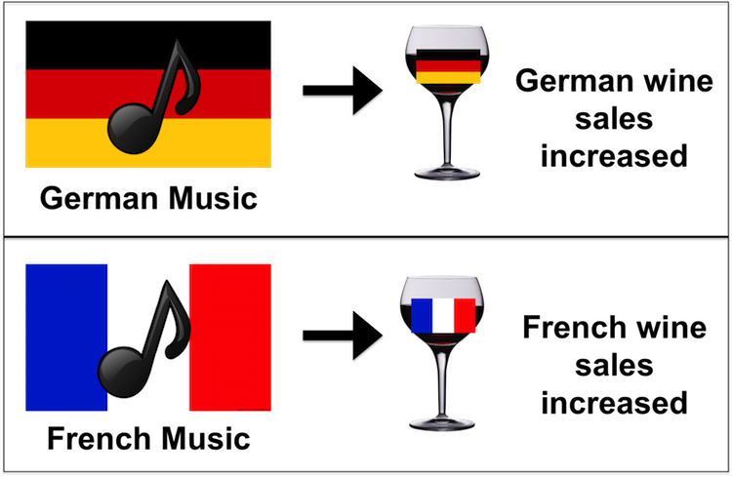
Implicit Memories
Procedural Memory: motor skills, habits… ride a bike, turn a car key.
Priming: when exposure to a stimulus influences response to a later stimulus.
Priming

Slide 11
Question
Working memory is most active during which portion of the information-processing model?
A. Short-term memory
B. Sensory memory
C. Encoding
D. Long-term memory

Slide 12
Question
Your memory of which of the following is an example of implicit memory?
A. What you had for breakfast yesterday
B. The need to spend some time reviewing tomorrow for a quiz.
C. Which way to turn the car key to start an engine.
D. How exciting it was to get the best birthday present ever.

Slide 13
Question
Which of the following is the most accurate description of the capacity of short-term memory and working memory?
A. Lasts for about 2 days in most circumstances.
B. Is thought to be unlimited. There is always room for more info.
C. Can handle about a half dozen items for each of the tasks you are working on at any time.
D. Can handle about a half dozen items total.

Slide 14
Question
Which of the following is most likely to lead to semantic encoding of a list of words?
A. Thinking about how the words relate to your own life.
B. Practicing the words for a single extended period.
C. Breaking up the practice into several relatively short sessions.
D. Noticing where in a sentence the words appear.

