Slide 1
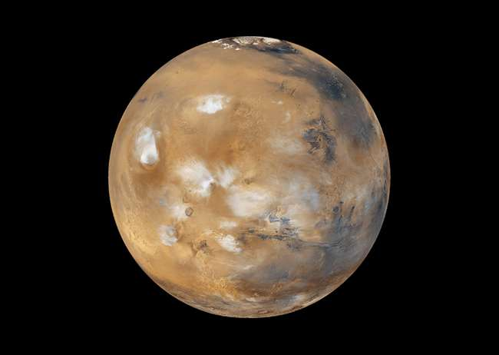

Slide 2
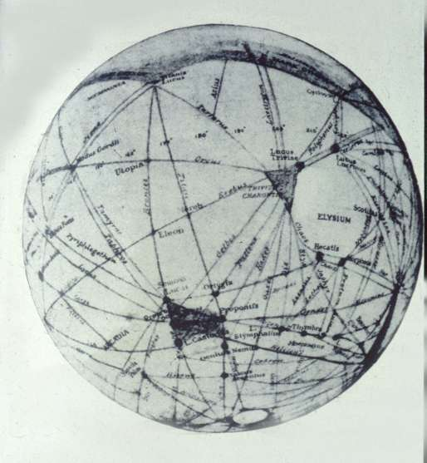
Percival Lowell

Slide 3
Basics
Size = half the size of Earth
Reddish in color; iron oxide (rust)
Average Temp. = -83⁰ F

Slide 4
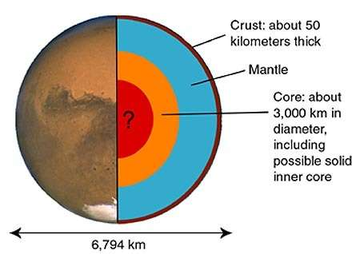
Core

Slide 5
Basics
Rotation = 24 hrs 40 min.
Revolution = 687 days
Has seasons:
Summer at equator = 70⁰ F
Winter at poles = -225⁰
Largest dust storms in solar system.

Slide 6
Moons
Two small moons:
Phobos - close to planet (9,000 km); will crash into Mars in a million years or so.
Deimos - 23,000 km away
Both Moons:
-- not round
-- different composition than Mars
-- captured asteroids or impact ejecta (?)

Slide 7
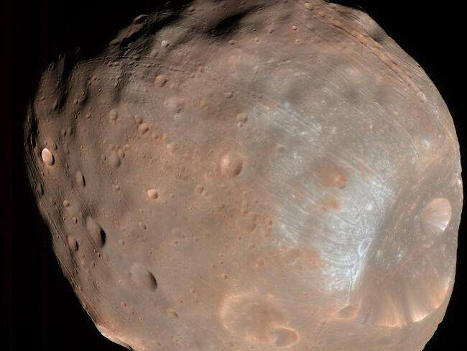
Phobos (doomed)

Slide 8
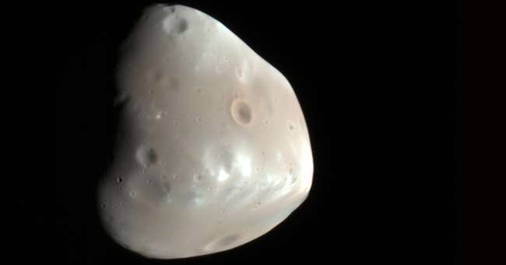
Deimos

Slide 9
Atmosphere
-- Very thin…. 95% carbon dioxide
-- Some water vapor and methane (?)
-- Methane is constantly being replaced; this implies either geologic or biologic activity.

Slide 10
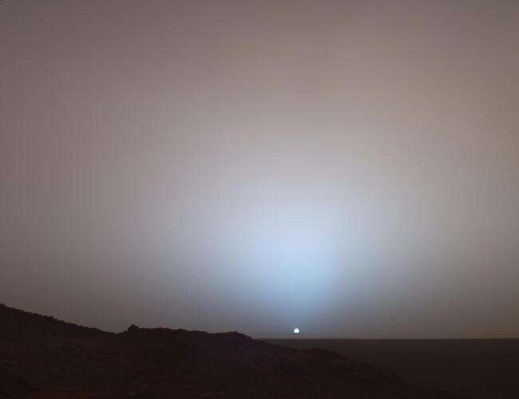

Slide 11
Water
-- Ice at poles.
-- Ice at shallow depths across most of Mars.
-- New evidence of underground lake of liquid water under South Pole.

Slide 12
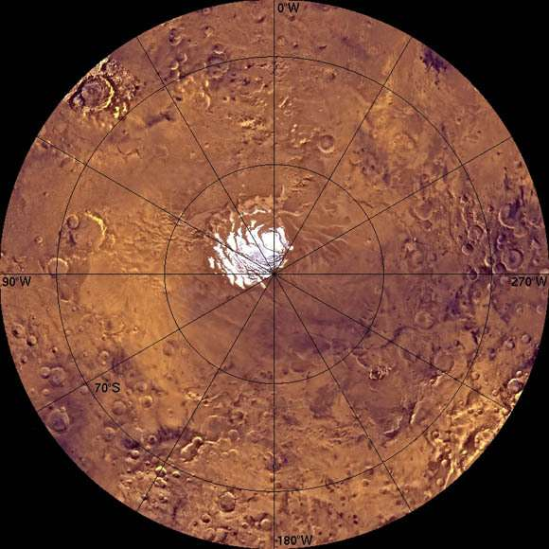
South Pole

Slide 13
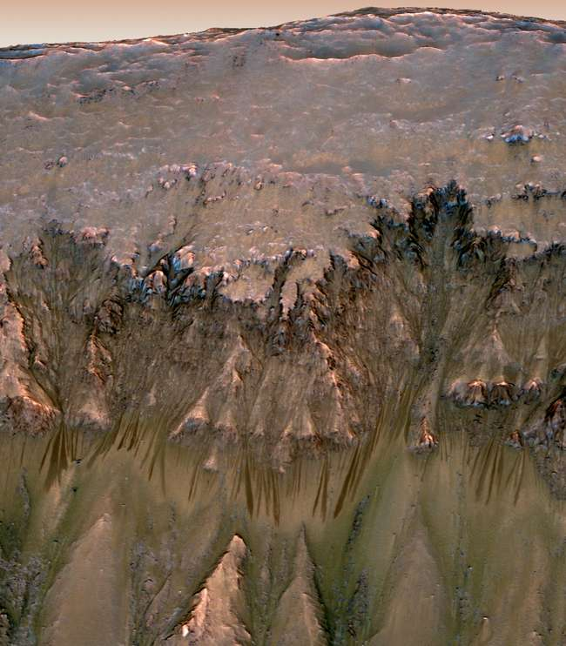
Gullies …Water? …Sand?

Slide 14
Magnetic Field
No global magnetic field,
But areas of magnetism

Slide 15
Surface
Northern Hemisphere:
-- Flat volcanic plains
-- Fewer craters mean younger surface (3by old)
-- covered by ocean in the past
Southern Hemisphere:
-- Many mountains
-- Heavily cratered (4by)

Slide 16
Surface
Sharp boundary between North and South
Tharsis Bulge:
  Giant bulge on equator… large volcanoes
  Few craters - younger (2-3by old)

Slide 17
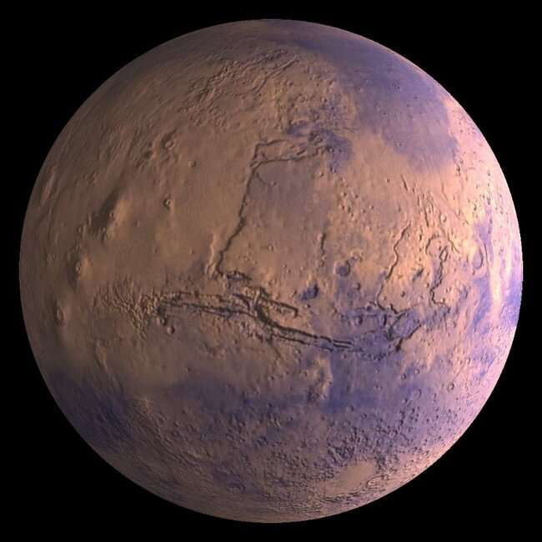

Slide 18
Valles Marineris
-- Giant rift valley - land split apart
-- Likely formed during uplift of Tharsis Bulge region.

Slide 19
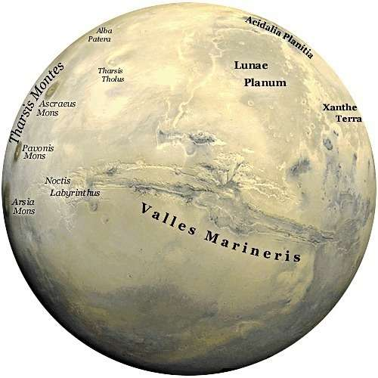

Slide 20
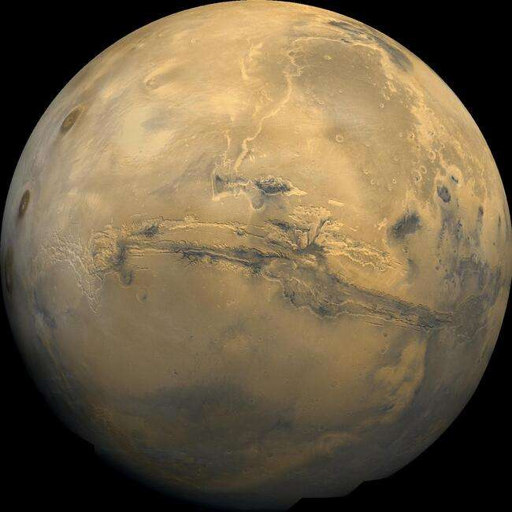

Slide 21
Volcanoes
Olympus Mons - largest planetary mountain. 16 miles high (3x Everest)
-- Are there still active volcanoes? None seen, but possible recent (2my) lava flows found.

Slide 22
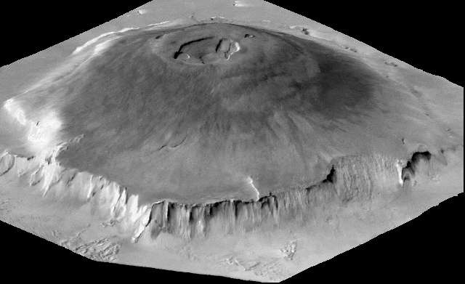

Slide 23
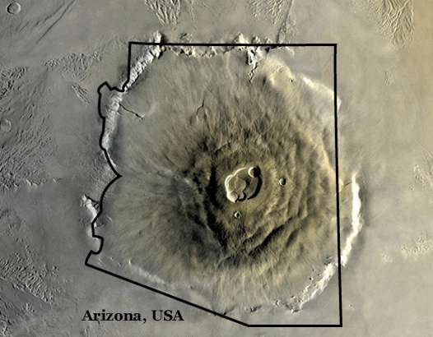

Slide 24
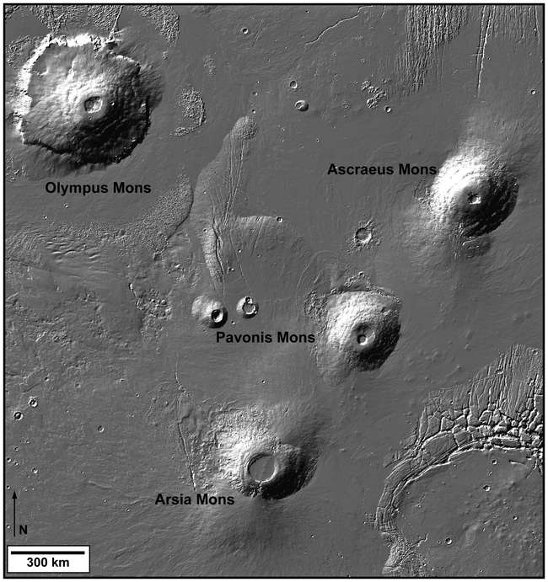
Other Volcanoes

Slide 25
Spirit and Opportunity
-- Land rovers with geologic instruments.
-- Landed in 2004. Supposed to last 90 days and travel ¾ mile.
-- Spirit stuck in soft soil in 2009. Lost contact in 2010. Traveled 4.8 miles.
-- Opportunity lost contact in June 2018. Had traveled 28 miles.

Slide 26

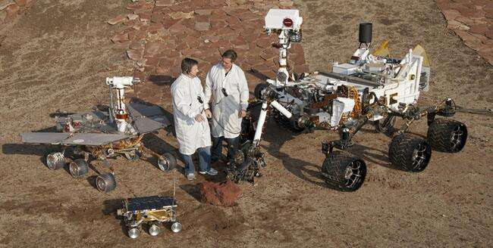
Curiosity
Landed in 2012
SUV-size vehicle
Still going strong

Slide 27
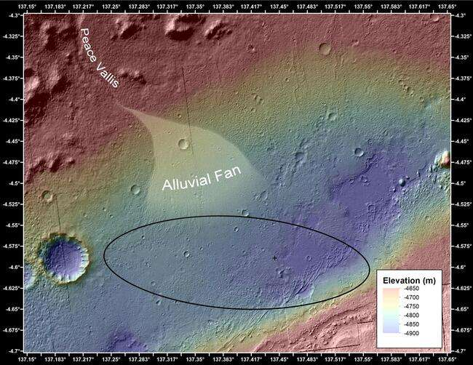

Slide 28
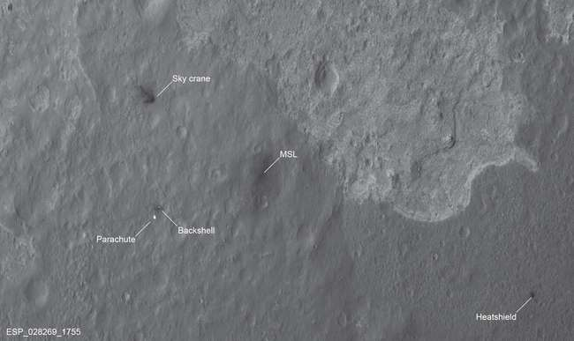

Slide 29
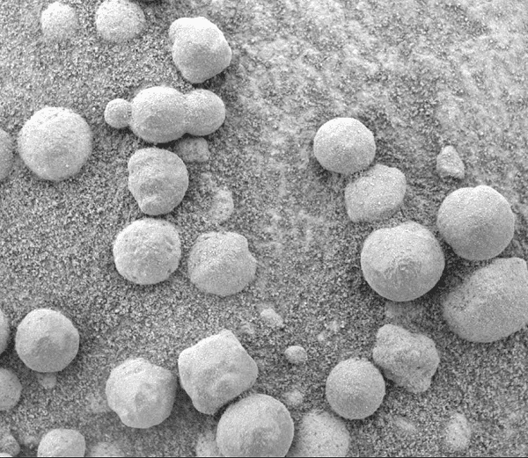
Hematite “Blueberries”

Slide 30
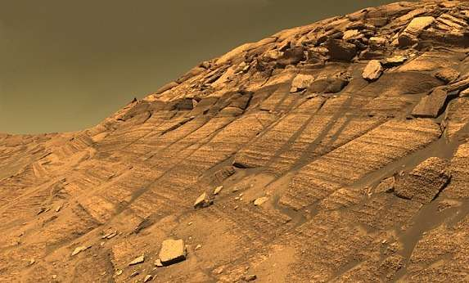
Burns Cliff

Slide 31
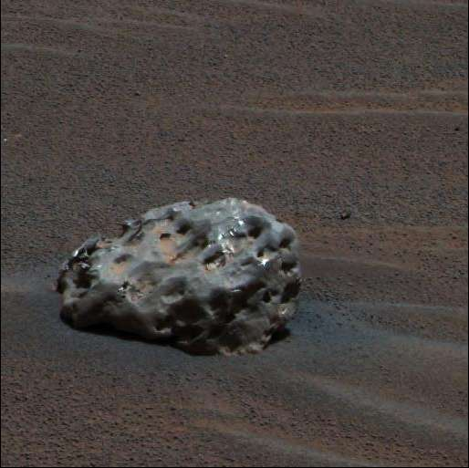
Meteorite
(first ever seen on another planet)

Slide 32
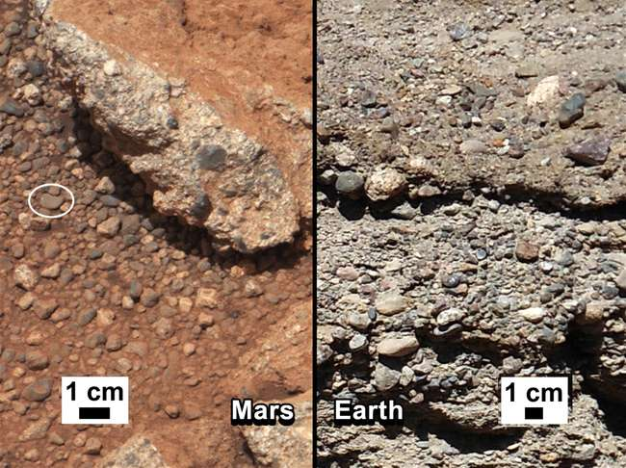

Slide 33
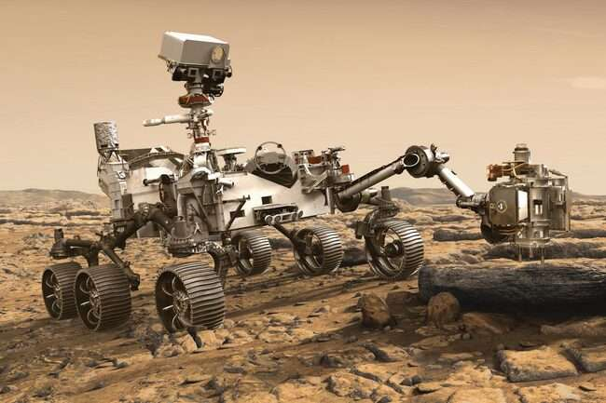
Perserverance

Slide 34
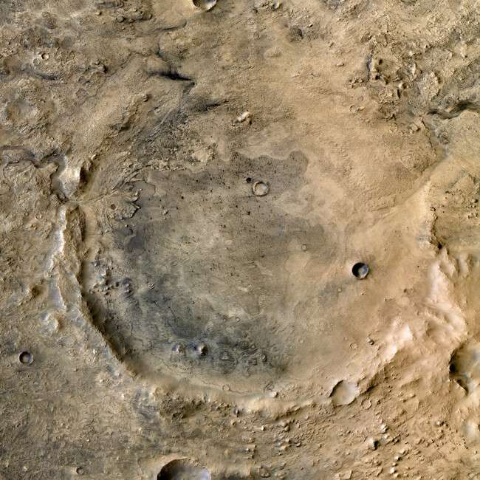
Jezero Crater

Slide 35
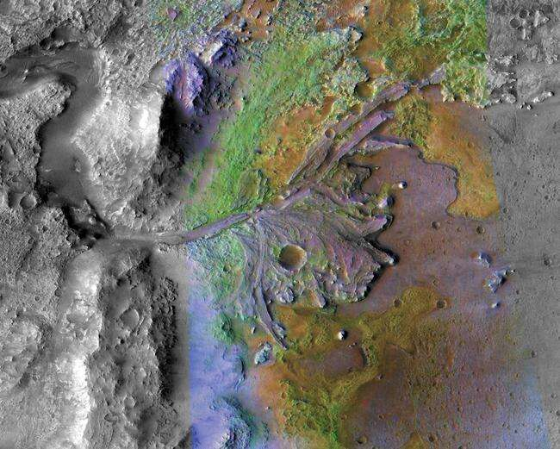

Slide 36
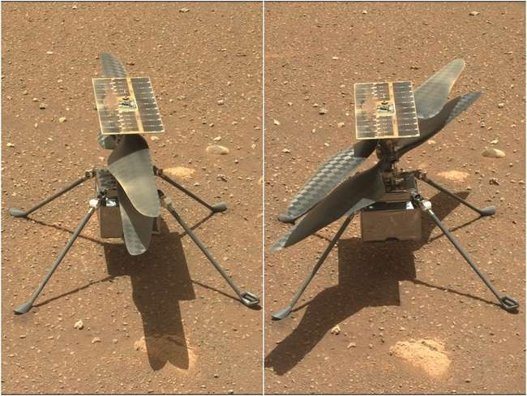
Ingenuity (Helicopter)

Slide 37
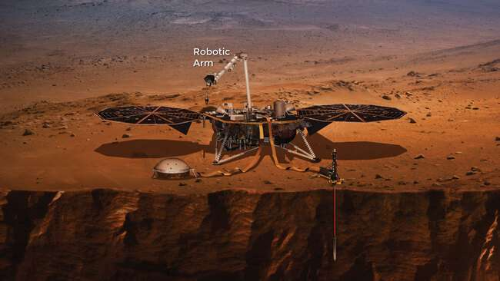
Insight
(Seismic Activity)

