Slide 1
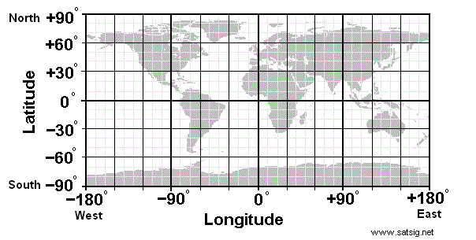
Aim: How are latitude and longitude used to locate places on the Earth?
Do Now: In what quadrant (corner) of the world is the USA located? How do you know from the map?
Use North, South, East and West in the appropriate combination.

Slide 2
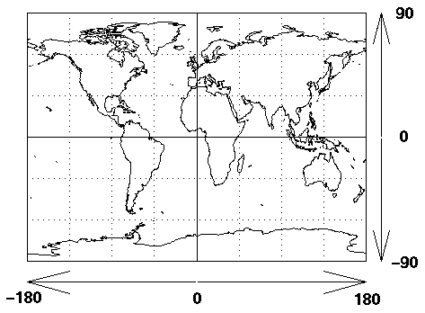
Places on Earth have an address.
NW
NE
SW
SE

Slide 3
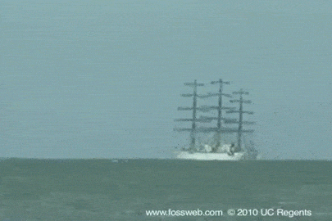
What does this image tell us about the shape of the Earth? Explain.

Slide 4
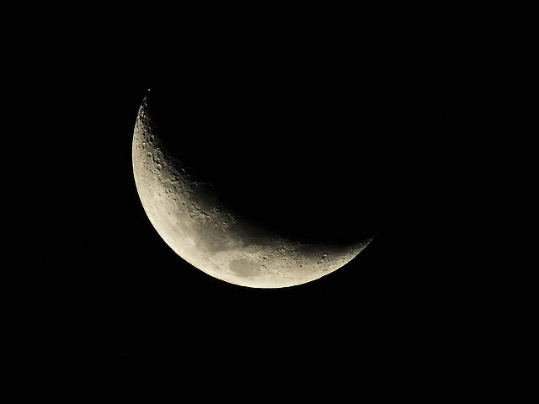
Shape of Earth
How do we know Earth is round?
Ships appear to sink on horizon.
Curved shadow of Earth on Moon during lunar eclipse.
Pictures from space (best evidence)

Slide 5
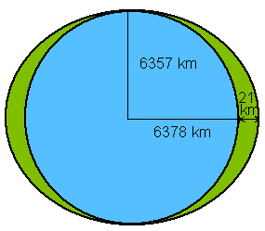
How Round?
Earth is an oblate spheroid. Almost perfectly round.

Slide 6
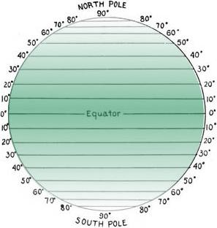
Latitude
Flat lines N or S of the Equator.
(0⁰ to 90⁰ N or S)
Equator = 0⁰ latitude

Slide 7
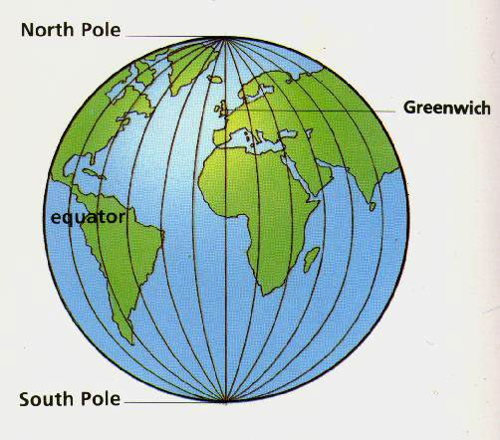
Longitude
Vertical lines E or W from the Prime Meridian
(0⁰ to 180⁰ East or West).
Prime Meridian
0⁰ Longitude

Slide 8
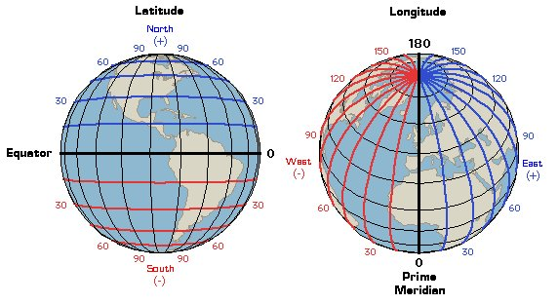
Latitude - Longitude

Slide 9
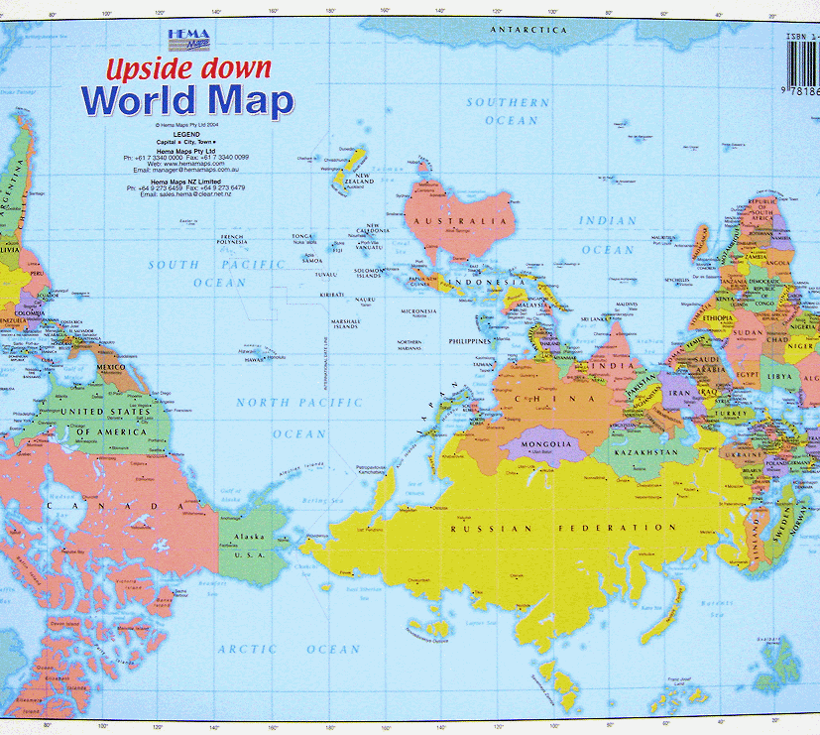
There is nothing wrong with this map!

Slide 10
Keep in Mind
Latitude lines are parallel.
Longitude lines meet at the poles.
Latitude always comes first:
42⁰ N 73⁰ W

Slide 11
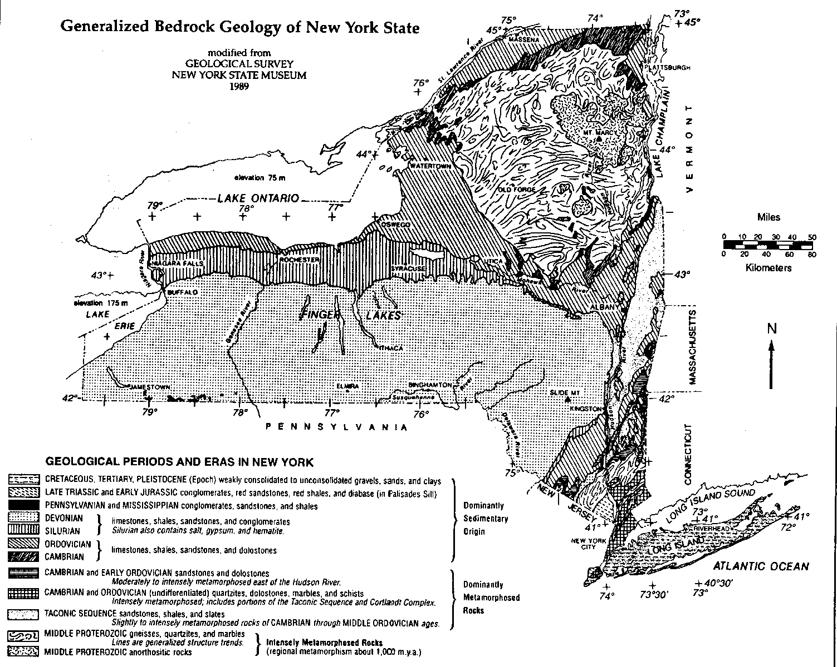

Slide 12
45°N
44°N
43°N
42°N
41°N
79°W
78°W
77°W
76°W
75°W
74°W
73°W

Slide 13
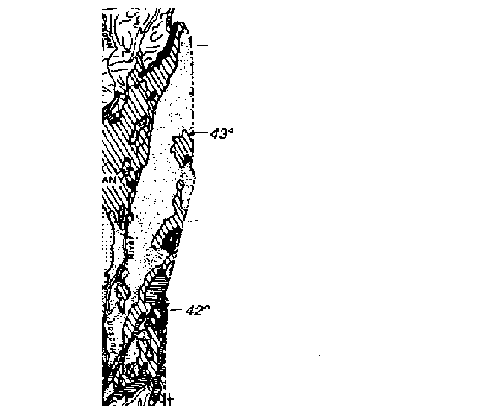
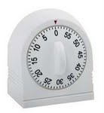
This mark that separates the one degree spread in half is 30 minutes!
42º 30’
You would say:
“forty two degrees, thirty minutes”
Think of 1 hour
as 1 degree.
degrees minutes
30 minutes would
be half way!

Slide 14
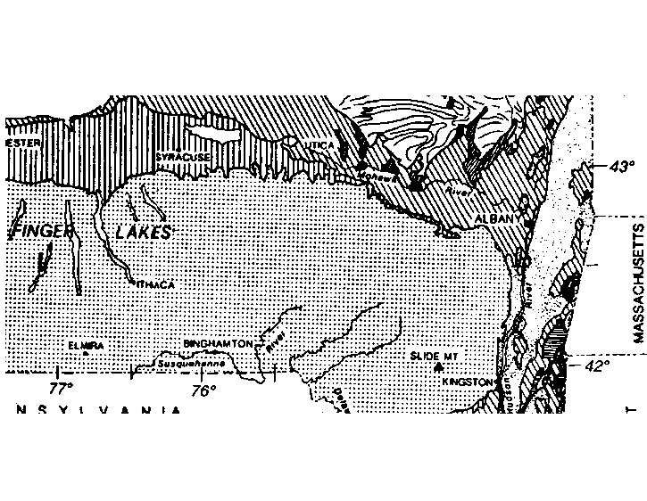
?
?
Record your answer on scrap paper.

Slide 15
Is your answer...
42º 20’ N 76º 30’ W
?

Slide 16

Earth’s
Rotation
Earth rotates counter-clockwise.
Sun rises in the East and sets in the West.

Slide 17
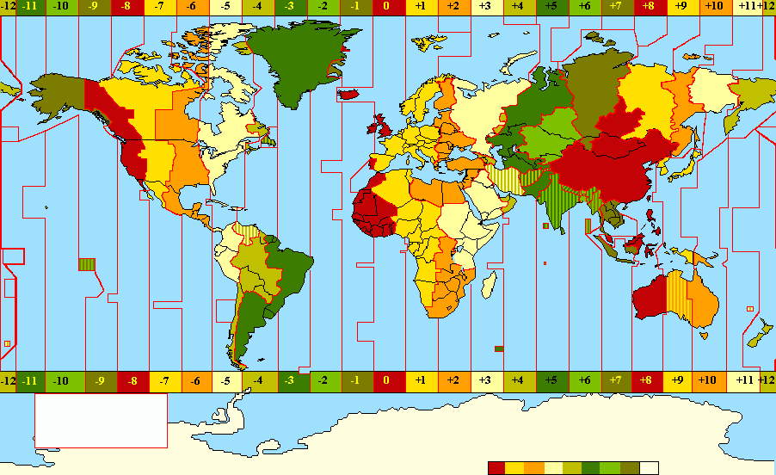
Longitude / Time Zones
Earth rotates 360⁰ in 24 hrs
So, 360⁰ ÷ 24 = 15⁰ / hr
24 time zones (1 hr each) 15⁰ apart

Slide 18
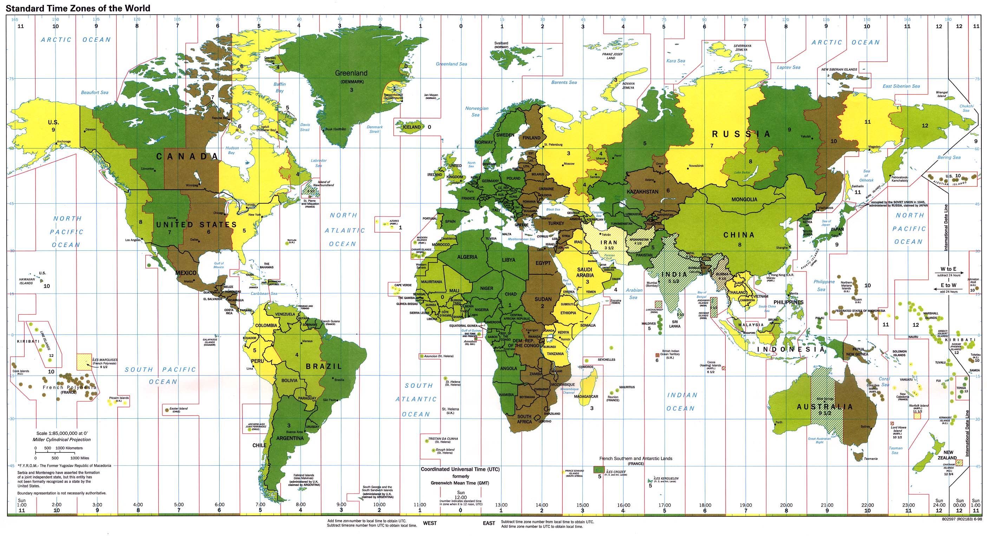

Slide 19
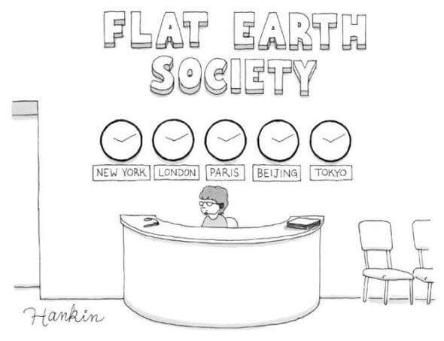

Slide 20
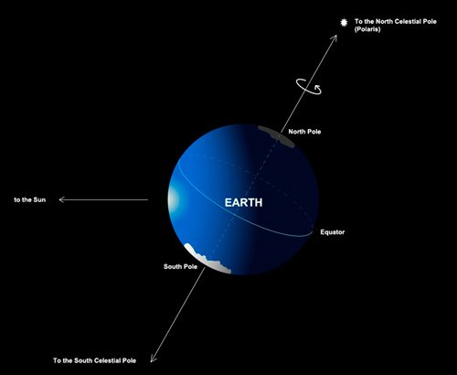
Polaris and Latitude
Polaris (North Star) is directly over the North Pole.

Slide 21
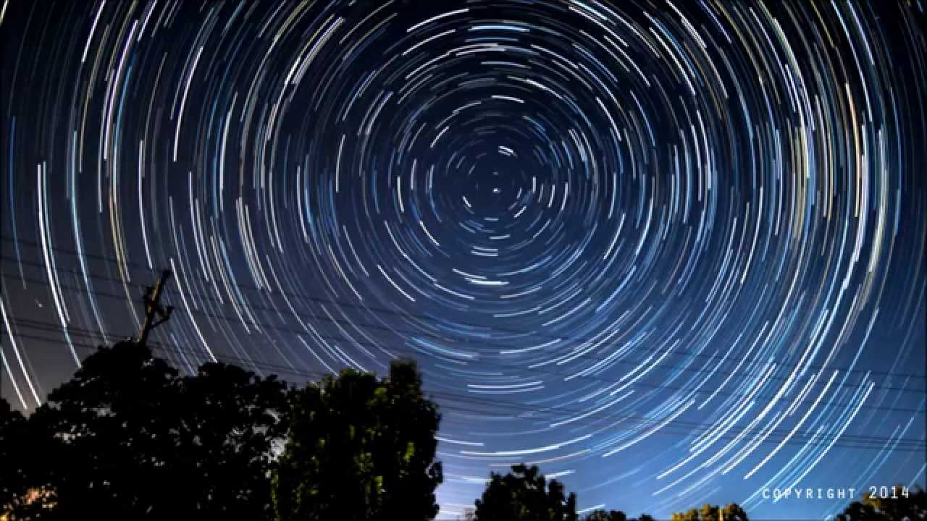
Polaris doesn’t move during night

Slide 22
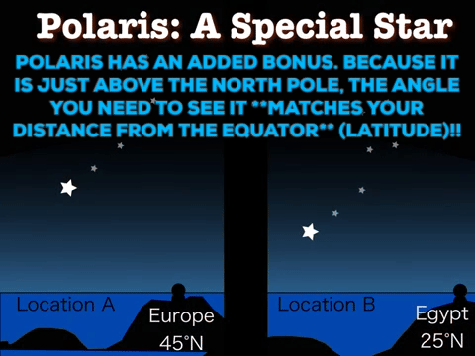

Slide 23
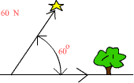
Angle to Polaris = Latitude

Slide 24
