Slide 1
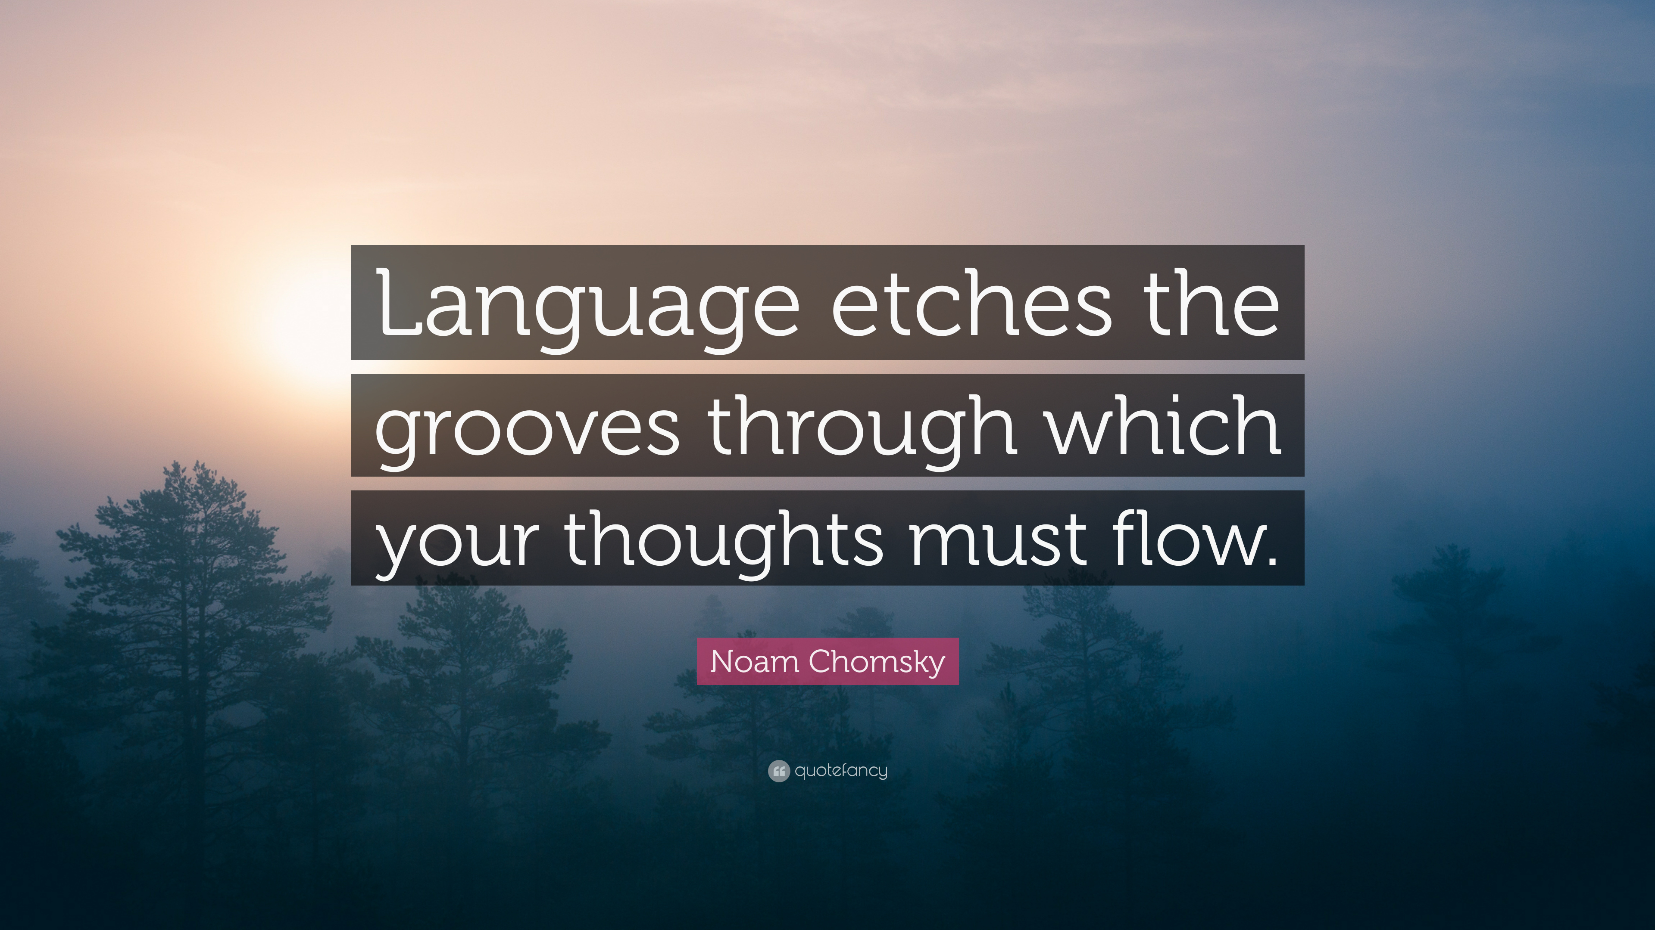

Slide 2

Building Blocks of Thought
Images
  Nonverbal mental representations of sensory experiences
Language
  A flexible system of symbols that enables us to communicate our ideas, thoughts, and feelings
  Nonhumans communicate primarily through signs

Slide 3
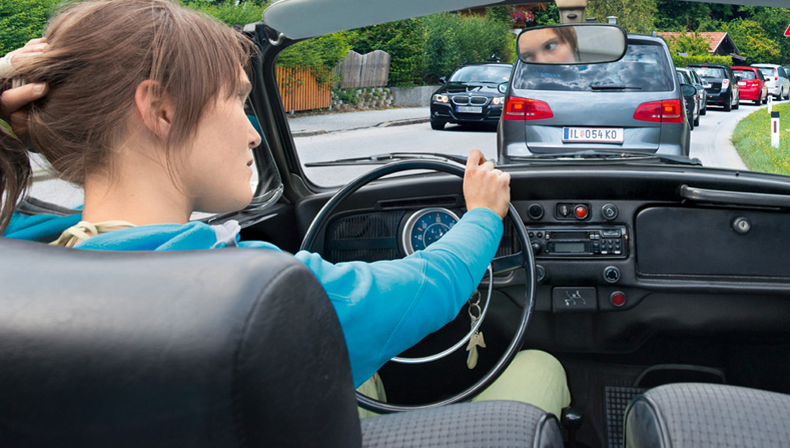
Thinking in Images
Cognition is largely language-based.
When alone, we may talk to ourselves.
However, we also think in images.
Notes:
OBJECTIVE 15| Discuss the value of thinking in images.

Slide 4
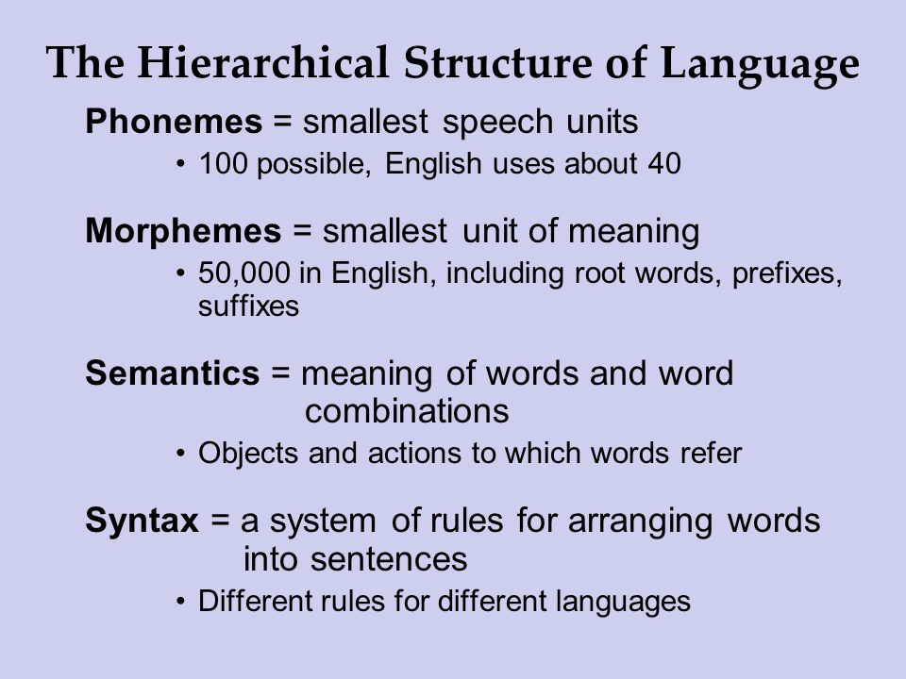

Slide 5
Phonemes
The smallest distinct sound unit.
Ex: bat, has three phonemes b · a · t
chat, has three phonemes ch · a · t
How many meanings can you make by varying the vowel phoneme between B and T?
Bait, bat, beat/beet, bet bit, bite, boat, boot, bought, bout, and but.
Notes:
OBJECTIVE 11| Describe the basic structural units of language.

Slide 6
Phonemes
Consonant phonemes carry more meaning.
Ex. The treth ef thes stetement shed be evedent frem thes bref demenstretien.

Slide 7
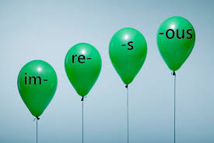
Morphemes
The smallest unit that carries a meaning.
It may be a word or part of a word.
Milk = milk
Pumpkin = pump . kin
Unforgettable = un · for · get · table

Slide 8
Grammar
System of rules that enable us to
communicate with and understand others.
Grammar
Semantics
Syntax

Slide 9
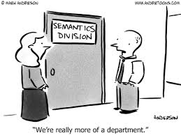
Semantics
The meaning of morphemes, words, and sentences.
Ex:
adding –ed to the word laugh means that it happened in the past.

Slide 10
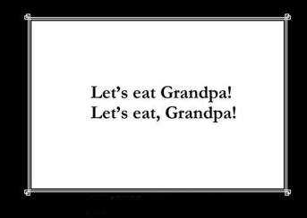
Syntax
Rules for making sentences.
In English, adjectives come before nouns; white house.
In Spanish, it is reversed; casa blanca.

Slide 11
Structure of Language
Surface structure:
  How we order the sentence
  English “She ate an apple”
  Japanese “She an apple ate”
Deep structure:
  Underlying meaning of a sentence

Slide 12
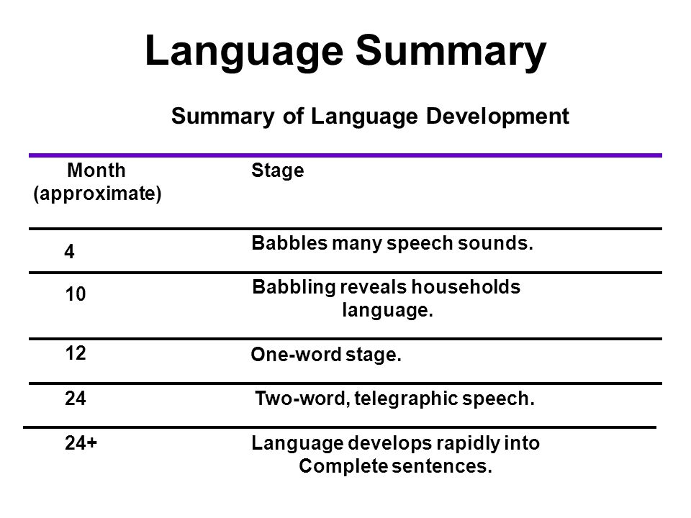
Language Development
Children learn language before learning to add 2+2.
After 1, we learn about 3,500 words a year, amassing 60,000 words by the time we graduate from high school.
Time Life Pictures/ Getty Images

Slide 13
Critical Period
Language Machines - A one-year old’s brain is statistically analyzing which syllables
most often go together to discern word breaks
Can we keep it up?
No, childhood seems to represent a critical period for mastering certain aspects of
language. (proven through deaf children getting cochlear implants at 2 and at 4).
Language learning capacity never fully develops when a young brain does not learn
ANY language. Ex. “Genie”

Slide 14
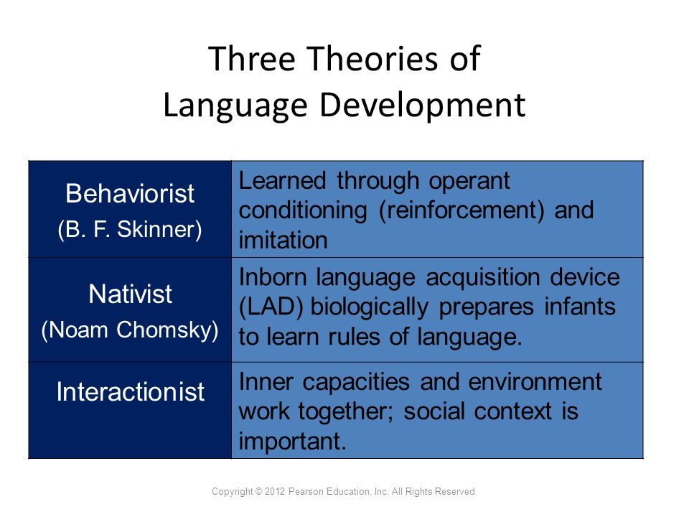

Slide 15
Imitation?
“Don’t they just listen to what is said around them and then repeat it?”
But, sentences produced by children are very different from adult sentences
  Cat stand up table
  A my pencil
  What the boy hit?
  Other one pants
And children who can’t speak for physiological reasons learn the language spoken to them and when they overcome their speech impairment they immediately use the language for speaking.

Slide 16
Operant Learning (Rewards-Punishment)
Association of the sight of things with sounds of words
Reinforcement by the caregiver
But, this assumes that children are being constantly reinforced for using good grammar and corrected when they use bad grammar. (Seldom occurs)
Cute mistakes?

Slide 17
Inborn Universal Grammar
Noam Chomsky argues we are hard-wired (genetics) to learn language.
Newly evolved…only humans.
Language will occur naturally under normal conditions.
Children acquire untaught words and grammar at a rate too high to be explained through learning.
Universal Grammar

Slide 18
Universal Grammar
All human languages have the same grammatical building blocks, such as nouns and verbs, subjects and objects, negations and questions.
We all start speaking mostly in nouns
We all follow language development stages

Slide 19
Linguistic Determinism
Benjamin Lee Whorf (controversial, but important)
Language determines how we think. This is most evident in bilingual speakers (2 or more languages).
ex. someone who speaks English and Chinese will feel differently depending on which language they are using. English has many words describing personal emotions and Chinese has many words describing inter-personal emotions.
ex. He thought that the Hopi Indians did not have a way of expressing the past, because they had no past tense… this was wrong.

Slide 20
How about language and color?
Jules Davidoff, a psychologist from Goldsmiths University of London, who worked with the Himba tribe from Namibia.
In their language, there is no word for blue and no real distinction between green and blue.

Slide 21
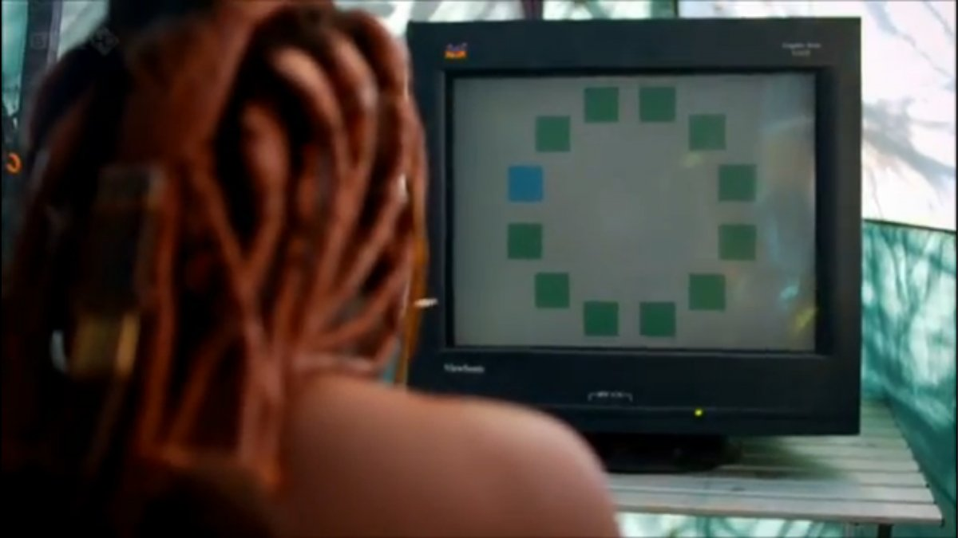
Himba struggle to complete this task – takes a while to pick out the blue square

Slide 22
THINKING AND LANGUAGE
Studies of the effects of the generic pronoun “he” show that subtle
prejudices can be conveyed by the words we choose to express our
everyday thoughts
Some evidence indicates that vocabulary enrichment, particularly bilingual education, can enhance thinking
  Children of signing deaf parents become fluent in sign language and outperform other students on measures of academic and intelligence achievement

