Slide 1
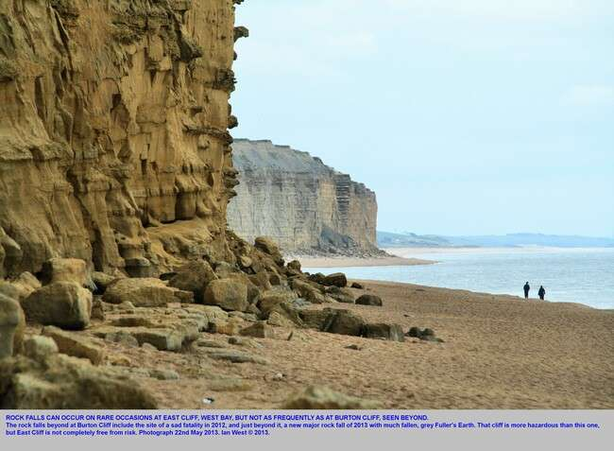
Types
Rockfall
Rocks fall down cliff.

Slide 2
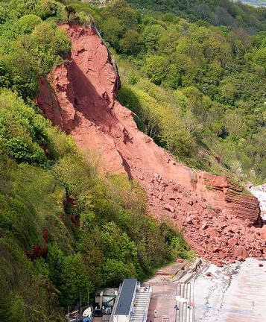
Types
2. Rockslide
less steep
heavy rains

Slide 3
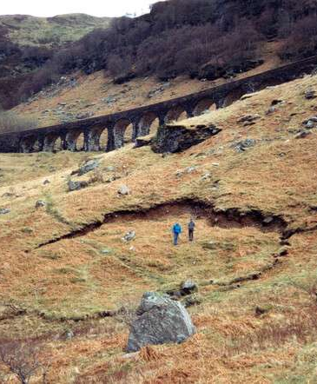
Types
Slump
huge mass moves in place.

Slide 4

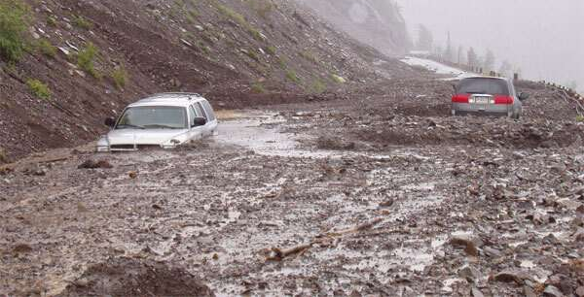
Types
4. Mudflow
fluid of rock, soil and water.

Slide 5
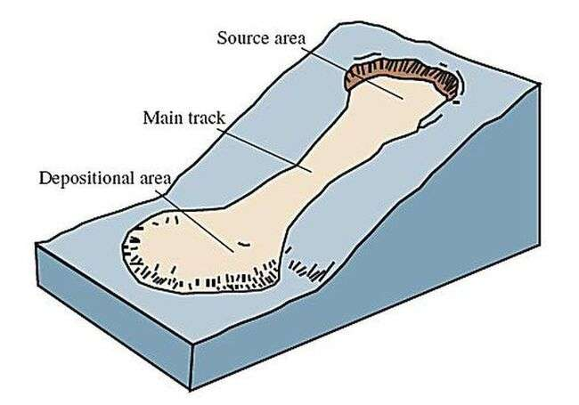
Types
5. Earthflow
may take hours

Slide 6
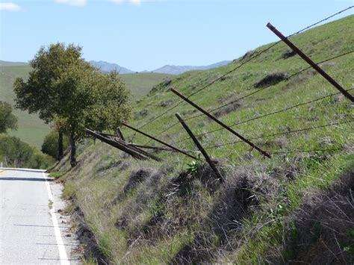
Types
6. Soil Creep
Tilted poles and fences provide evidence.

Slide 7
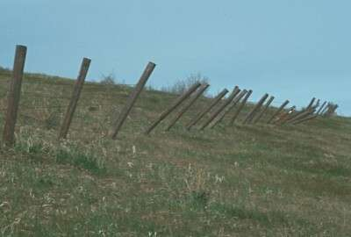
Soil Creep

Slide 8
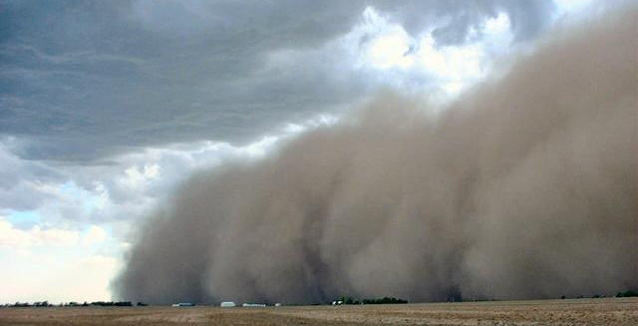
Wind
Wind carries (entrains) loose sediment.
Dry climate - hot or cold
Particles are fine… sand is largest.

Slide 9
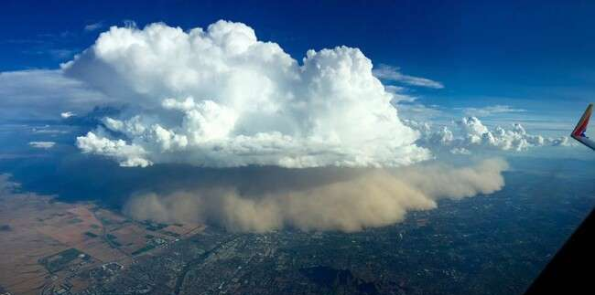
Haboob
Caused by thunderstorms
Downward forcing air in front of the thunderstorm carries loose sediment.
Seen in desert regions.

Slide 10
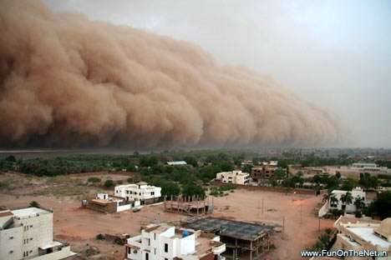

Slide 11
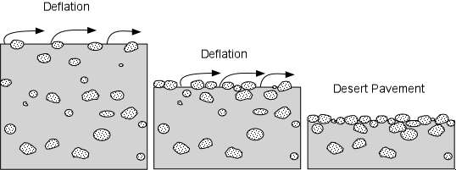
Erosion
Deflation = smaller particles are blown away, leaving only coarse particles.

Slide 12
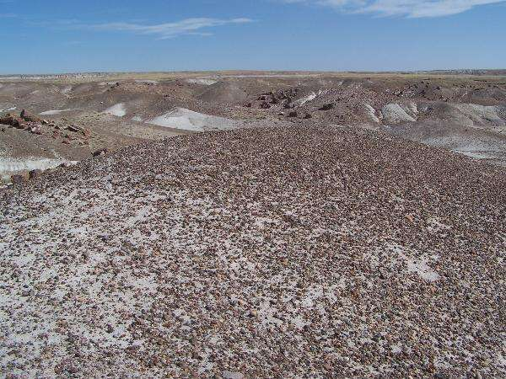

Slide 13
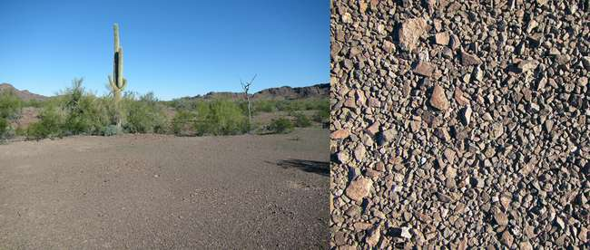

Slide 14
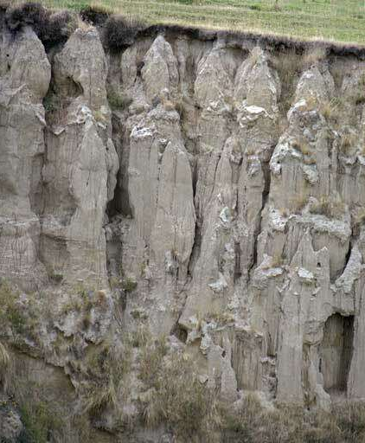
Deposition
Loess
wind-blown fine sediment.
makes excellent topsoil.

Slide 15
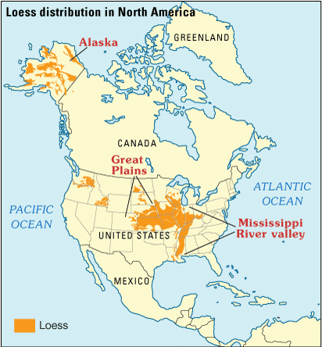

Slide 16
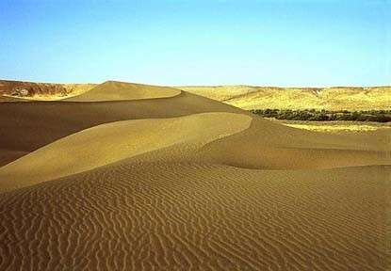
Dune
Mound of sand deposited by wind.

Slide 17
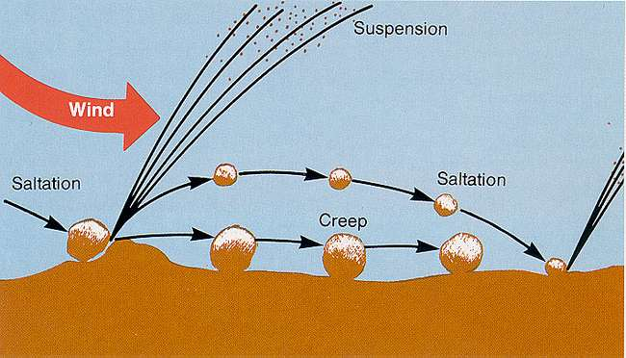
Saltation = how sand moves

Slide 18
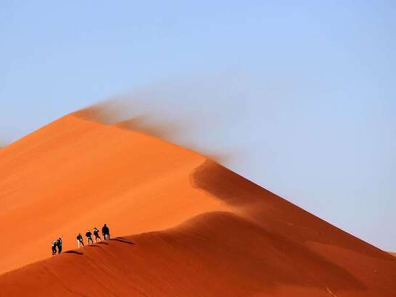

Slide 19
