Slide 1
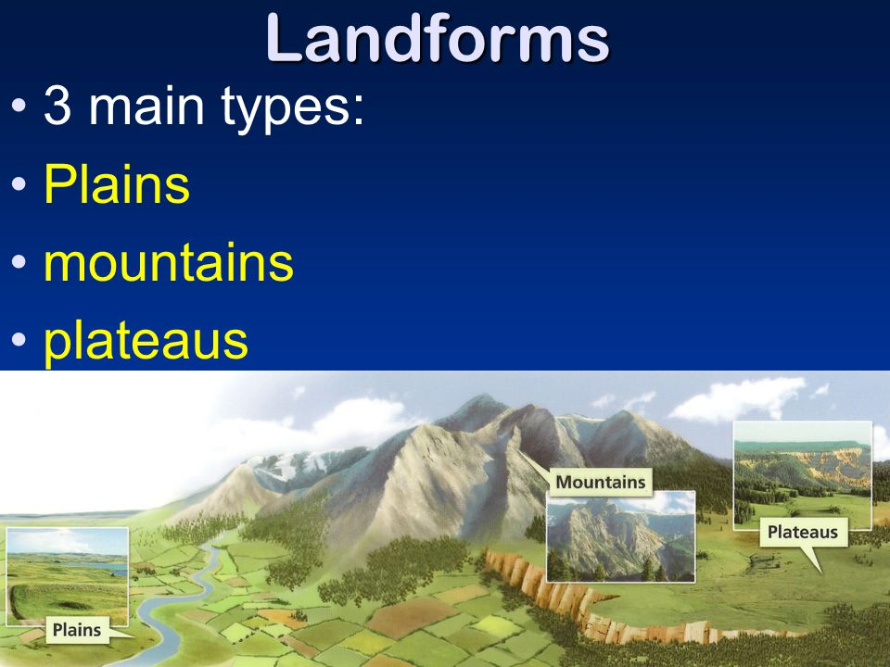
Landscapes
region with related physical features.

Slide 2
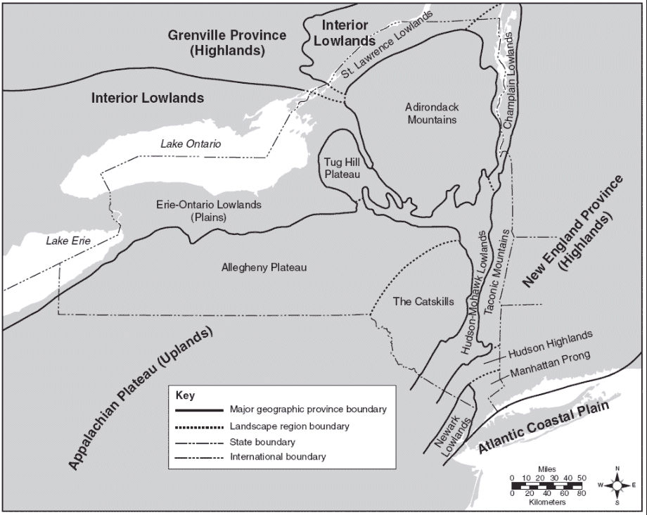
ESRT Page 2

Slide 3
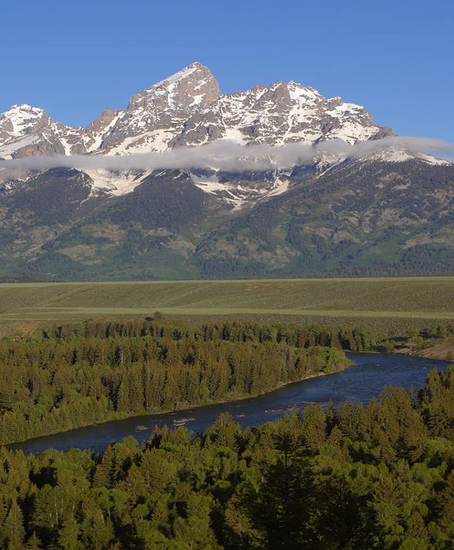
Mountains
Characteristics:
Steep slopes
Folding, faulting, volcanic

Slide 4
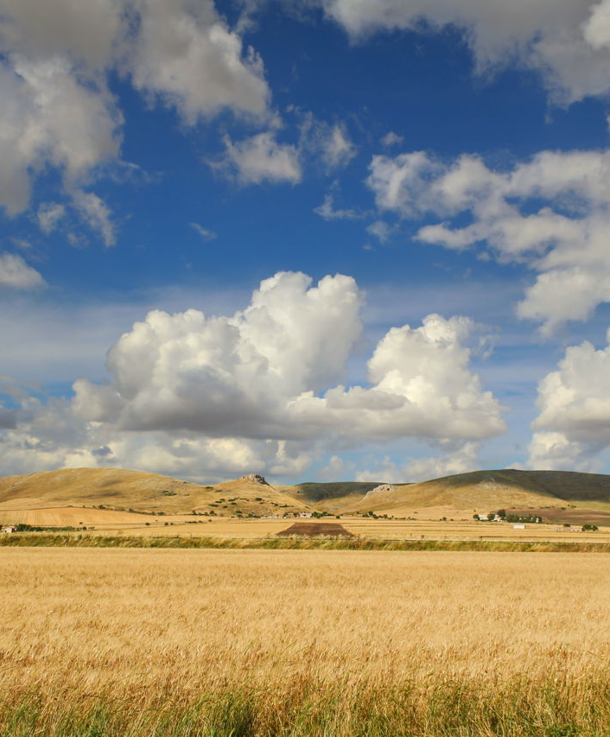
Plains
Characteristics:
Flat land - low elevation
Horizontal layers

Slide 5
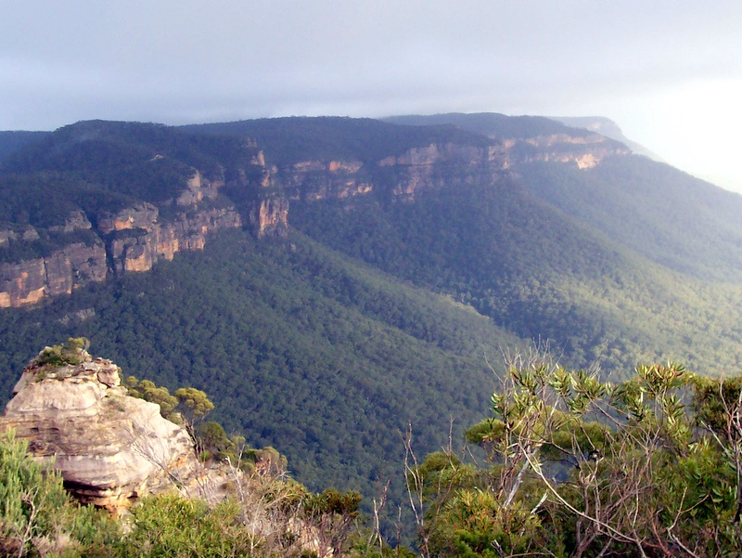
Plateau
Characteristics:
Flat land – high elevations
Horizontal layers

Slide 6
Climate Factors
Arid (Dry) Regions:
Less erosion/weathering
Less vegetation – no soil protection
Sharp, angular hills and valleys

Slide 7
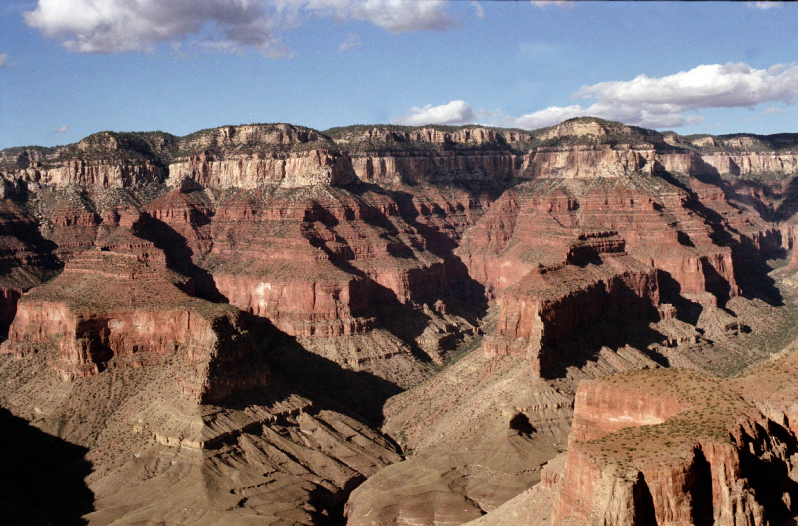

Slide 8
Climate Factors
Humid (Wet) Regions:
More erosion/weathering
More vegetation – protects soil.
Smooth, rounded hills and valleys

Slide 9
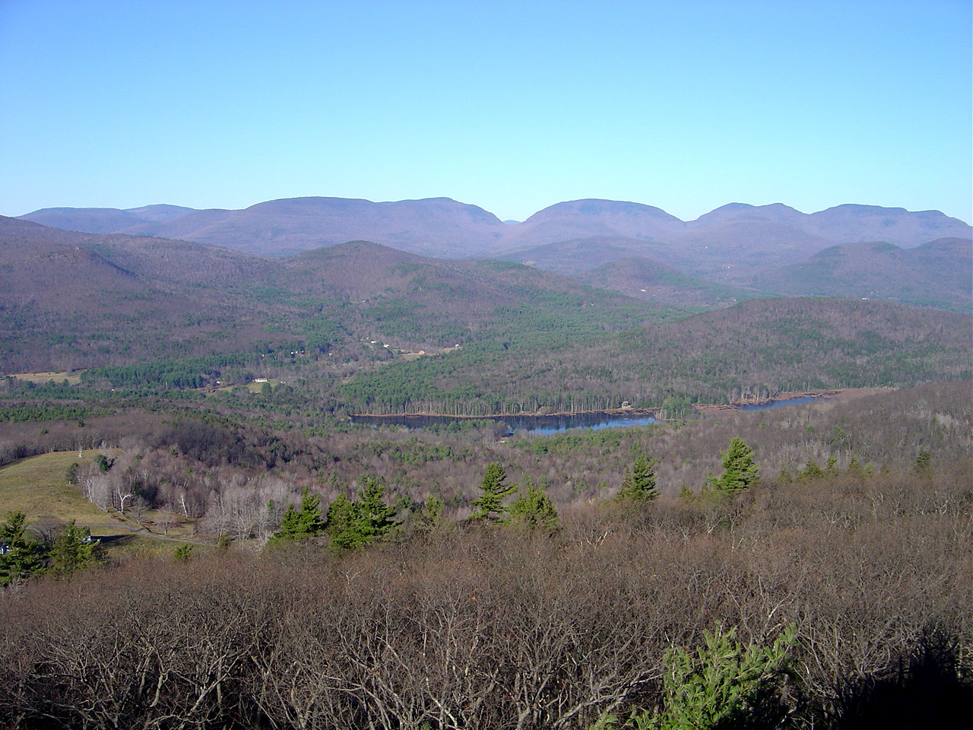

Slide 10
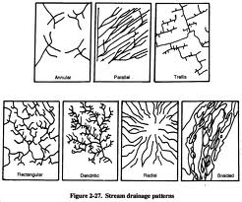
Stream Patterns

Slide 11
Boundaries
Well-defined boundaries between landscapes:
Sharp change in bedrock and elevation.
Includes:
Mountain edges
Fault zones
Ridges and cliffs
Slope changes

Slide 12
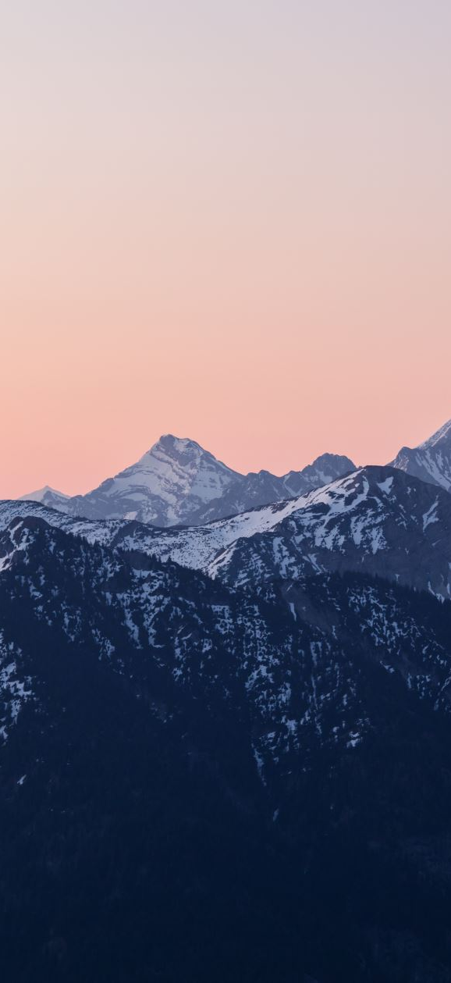
Mountain Cycle
Young = uplifting forces dominate (orogeny).
Mature = uplift and erosion equal.
Old = mountains eroded away to plains

Slide 13
Uplifting Forces
Tectonic plate collisions
Subduction
Underground magma expansion

Slide 14
Leveling Forces
Faults
Erosion / weathering
Subsidence, rifting

