Slide 1
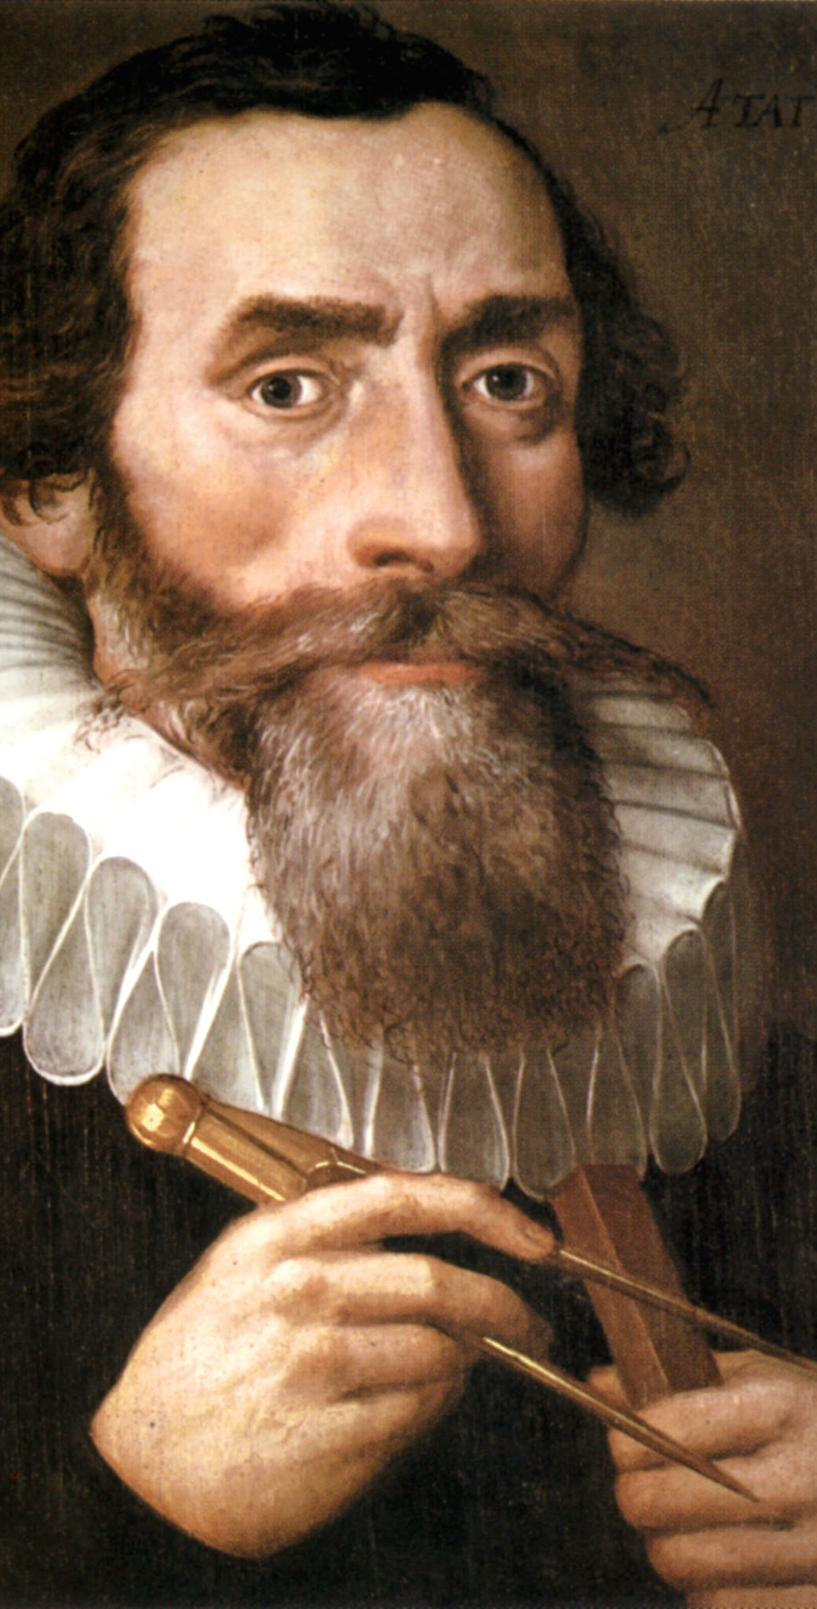
Early Astronomers
Johannes Kepler (1571 – 1630)
-- mathematician who believed heliocentric model.
-- answered Mars retrograde problem.
-- Kepler’s three laws of planetary motion.

Slide 2
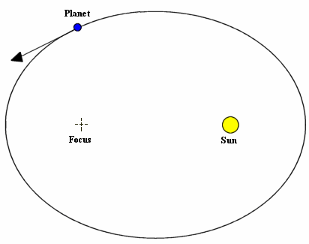
Kepler’s Laws
All planets travel in elliptical orbits with the sun at one focus.
This fixed problems with Copernicus’ system. Copernicus used circular orbits.
1. Elliptical Orbits

Slide 3
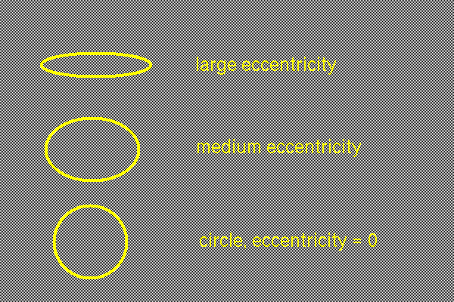
Eccentricity

Slide 4
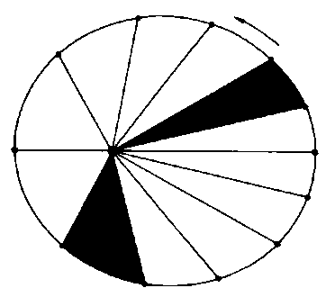
Kepler’s Laws
2. Law of Equal Areas
-- a line joining a planet and the sun sweeps equal areas at equal times.
-- shows that a planet moves slower when farther away from the sun.

Slide 5
Each triangle has the same area and the time it takes the planet to go from one position to the next is equal (one month).

Slide 6
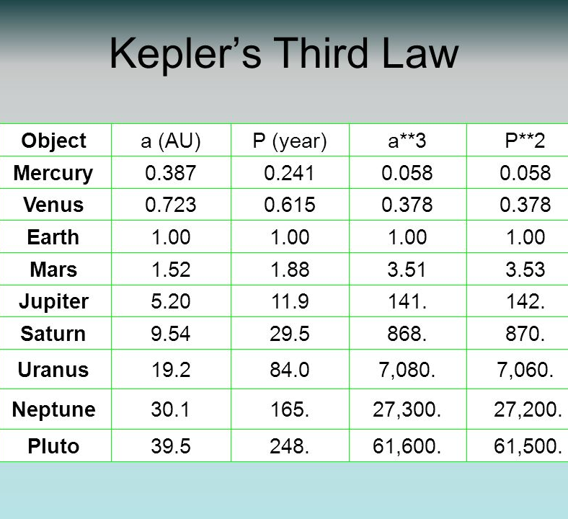
Kepler’s Laws
3. Law of Harmonic Motion
P² = D³
P = period (time to revolve around the Sun).
D = distance to the Sun.
Planet takes longer to revolve around Sun the farther away it is.

Slide 7
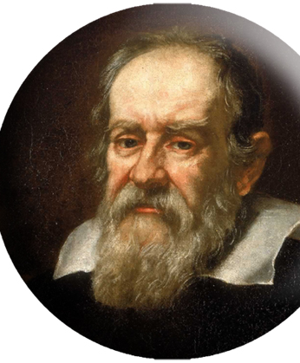
Galileo
Galileo Galilei (1564 – 1642)
-- finally disproved the geocentric theory.
-- the first to turn the telescope to the sky (he did not invent the telescope).
-- first scientist…tested ideas with experiments.

Slide 8
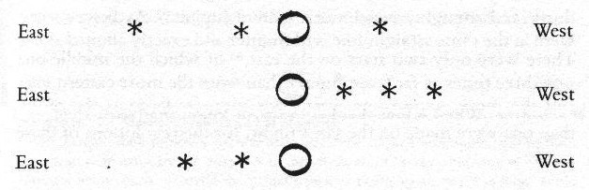
Jupiter’s Moons
Notes:
What do you think this represents? Can you tell these are moons?

Slide 9
Galileo Firsts
First to see 4 moons of Jupiter.
This ended the geocentric theory… not all objects orbit Earth.

Slide 10
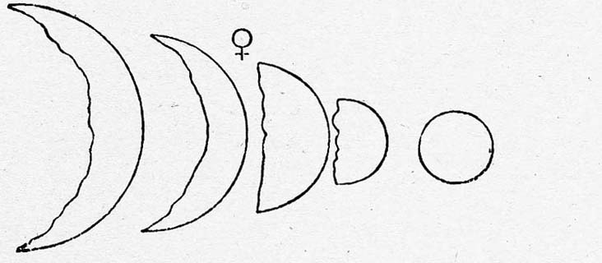
Galileo
First to see Venus’ phases; explained its brightness.

Slide 11
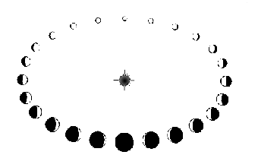

Slide 12
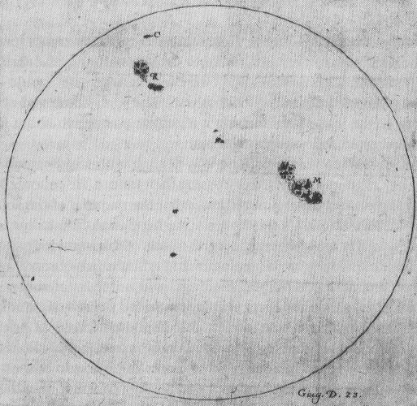
Sunspots
First to see sunspots and moon craters
universe not perfect

