Slide 1

Is Intelligence One General Ability or Several Specific Abilities?

Slide 2
One General Ability
Spearman - General Intelligence (g)
  can be measured and compared
  those that do well in one skill, do well in others
  like athleticism (underlying athletic ability)
g

Slide 3
Multiple Intelligences
Thurstone (1930s) - multiple intelligences
7 primary types: verbal, spatial, number, perceptual speed, etc.
Still, if excel at one type, usually excel at the others…like “g”
He also standardized the most common intelligence test used today (Stanford-Binet)

Slide 4
Multiple Intelligences
Cattel (1940s)
1. Crystallized intelligence – acquired knowledge and ability to recall it. Stays steady with age.
2. Fluid intelligence – problem solving, thinking “outside the box”. Declines with age.

Slide 5
Multiple Intelligences
Gardner (1980s) – 7-9 intelligences (independent of each other)
linguistic, logical-mathematical, musical, spatial, bodily-kinesthetic, intrapersonal, interpersonal, naturalist, existential
Are these intelligences or talents/abilities?
If you excel in one, you are better in others, implying a general intelligence (g?)
No science to back it up

Slide 6
Multiple Intelligences
Sternberg (2004) - 3 intelligences
Analytical (academic problem-solving intelligence)
Creative (artistic)
Practical (“street smarts”)
Focused on skills that lead to real world success.

Slide 7


Slide 8
Emotional Intelligence

Slide 9
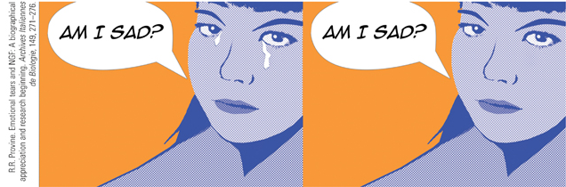
Emotional Intelligence
Emotional intelligence
  Perceive emotions
  Understand emotions
  Manage emotions
  Use emotions for adaptive or creative thinking

Slide 10
Creativity
Creativity – ability to generate, create, or discover new ideas, solutions, and possibilities.
In-depth knowledge
Seek novel solutions (divergent thinking)
Take risks
Divergent thinking – unique, multiple solutions (outside the box)
Convergent thinking – one solution

Slide 11
Origins of Intelligence Testing
Francis Galton’s intelligence testing
  Reaction time
  Sensory acuity
  Muscular power
  Body proportions

Slide 12
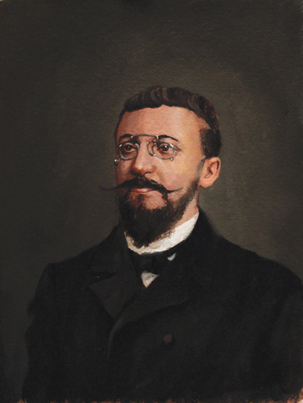
Alfred Binet
Identifying French school children in need of assistance.
IQ = (mental age/chronological age) X 100
100 is considered average

Slide 13
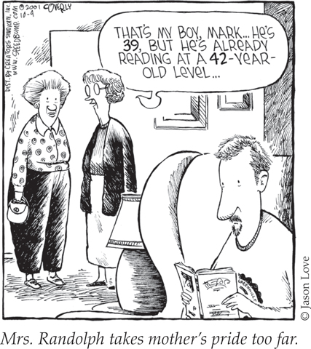
Lewis Terman
Stanford-Binet Test
  standardized test
  updated age norms

Slide 14
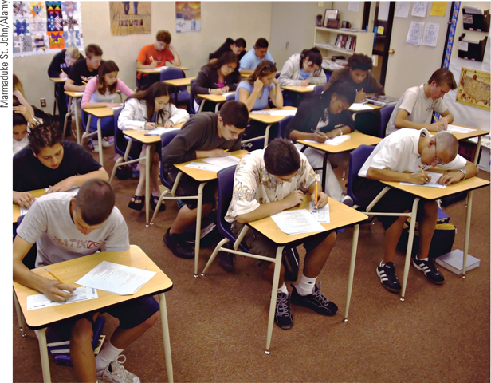
Modern Tests of Mental Abilities

Slide 15
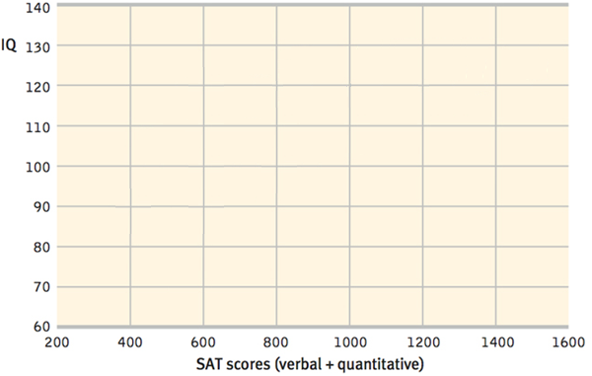
Modern Tests of Mental Abilities
Achievement tests
Aptitude tests

Slide 16
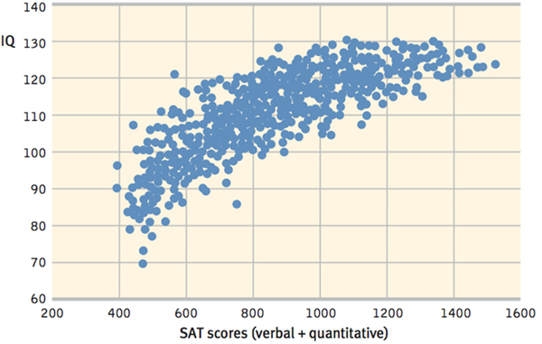
Modern Tests of Mental Abilities
Achievement tests
Aptitude tests

Slide 17
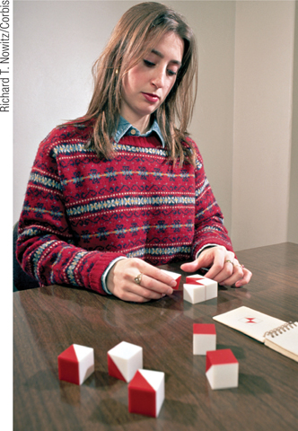
Modern Tests of Mental Abilities
Wechsler Adult Intelligence Scale (WAIS)
Wechsler Intelligence Scale
for Children (WISC)

Slide 18
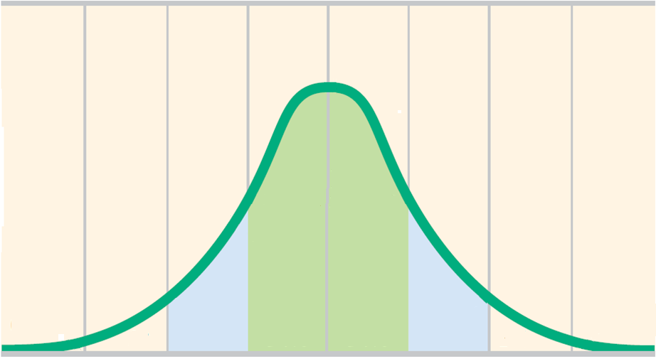
Principles of Test Construction
Standardization
Standardization
  Normal curve (bell curve)

Slide 19
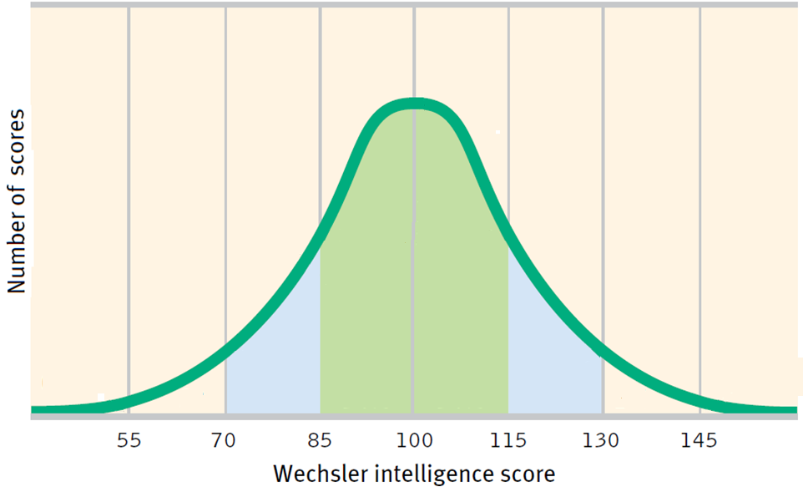
Principles of Test Construction
Standardization
Normal curve (bell curve)

Slide 20
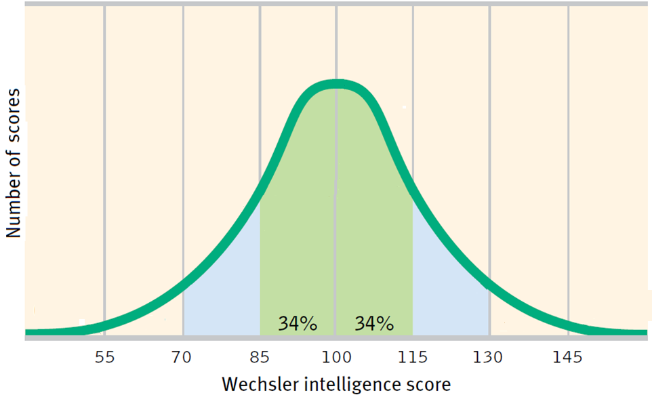
Principles of Test Construction
Standardization
Normal curve (bell curve)

Slide 21
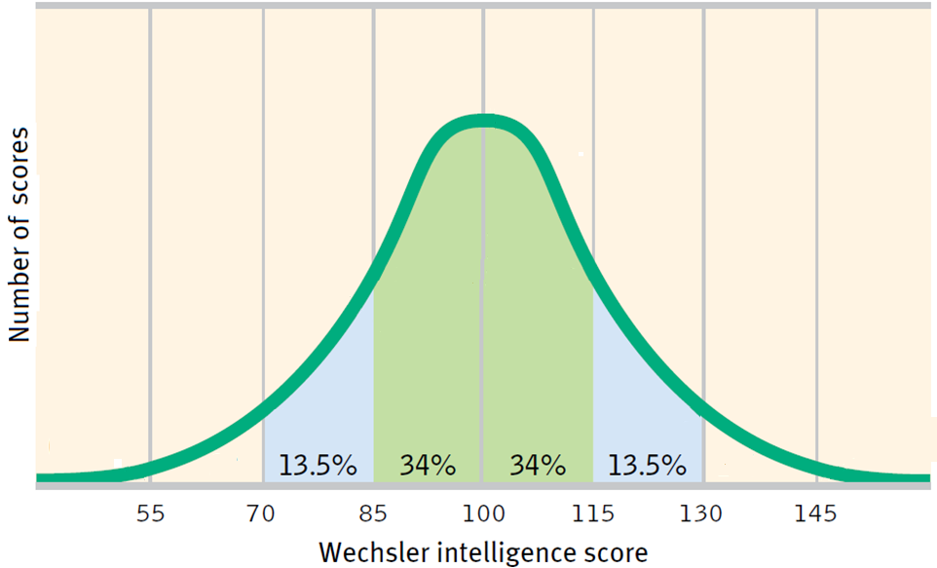
Principles of Test Construction
Standardization
Normal curve (bell curve)

Slide 22

Principles of Test Construction
Standardization
Normal curve (bell curve)

Slide 23
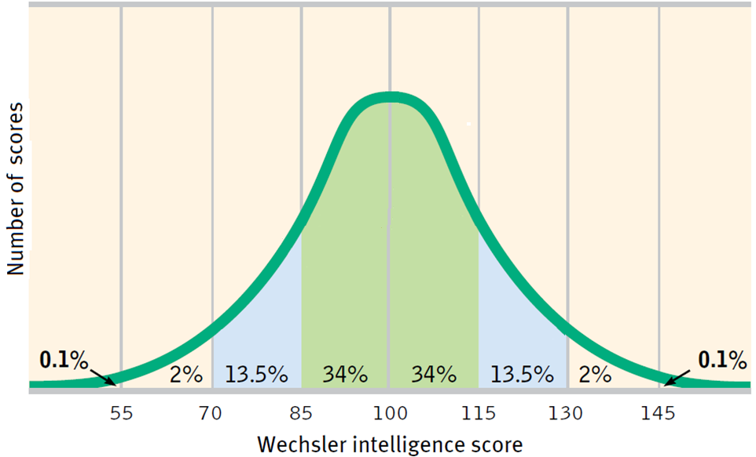
Principles of Test Construction
Standardization
Normal curve (bell curve)

Slide 24
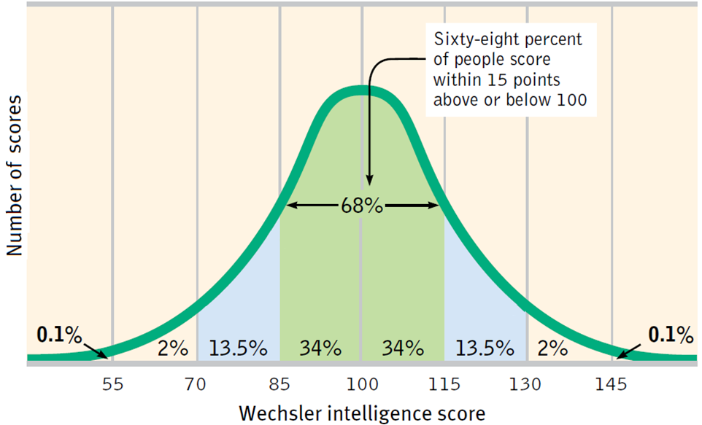
Principles of Test Construction
Standardization
Normal curve (bell curve)

Slide 25
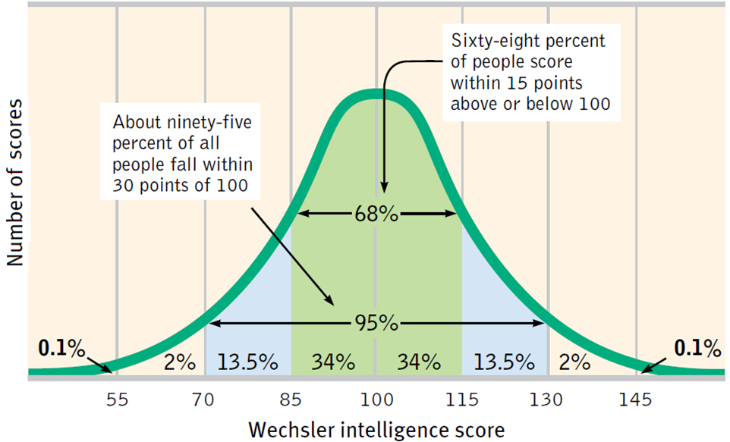
Principles of Test Construction
Standardization
Normal curve (bell curve)

Slide 26
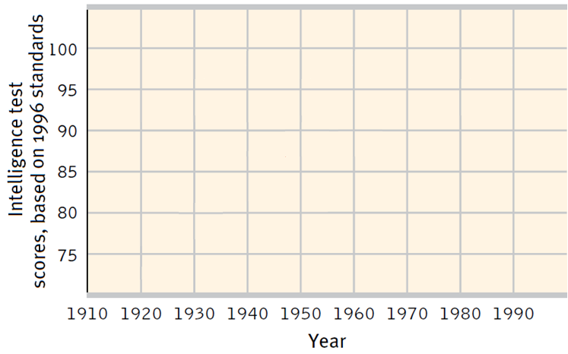
Principles of Test Construction
Standardization
Flynn Effect

Slide 27
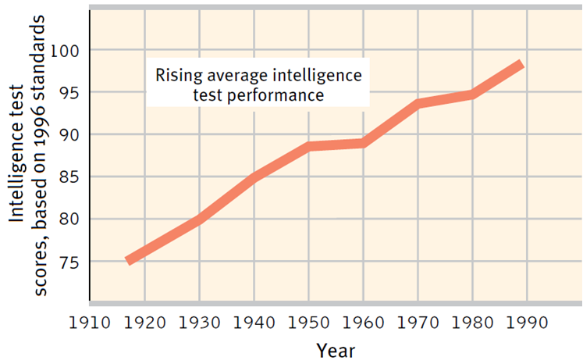
Principles of Test Construction
Standardization
Flynn Effect

Slide 28
Principles of Test Construction
Reliability and Validity
Reliability – are results consistent?
Validity – does the test measure what it proposes to measure

