Slide 1
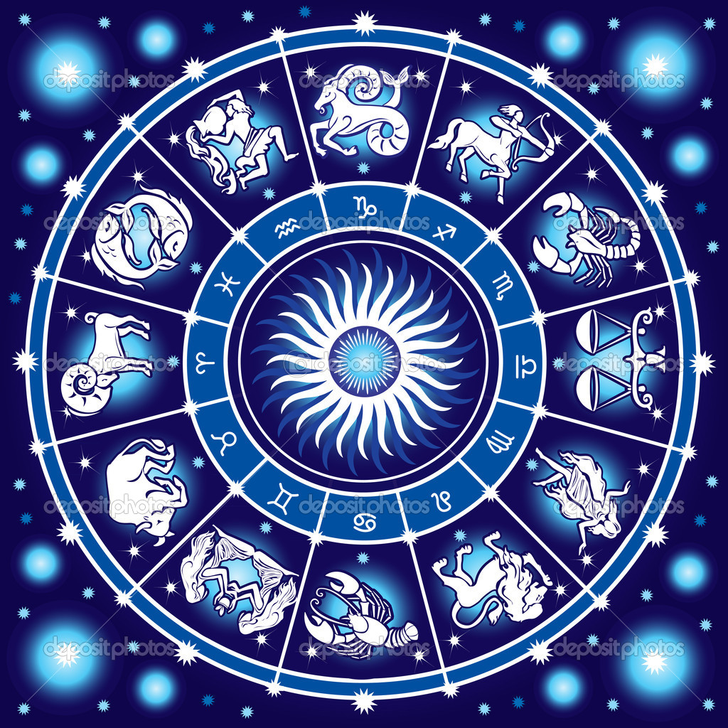
Introduction - History
Aim: What was the study of astronomy like long ago?
First there was astrology.
Astrology – Using stars to tell us about our daily affairs
Notes:
What is a constellation?

Slide 2
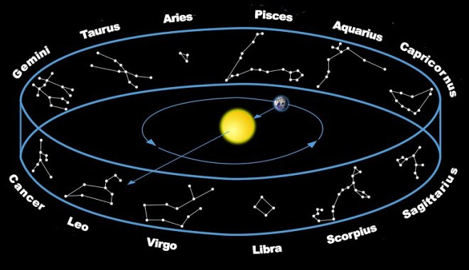
Constellations
(grouping of stars that humans see as a picture)

Slide 3
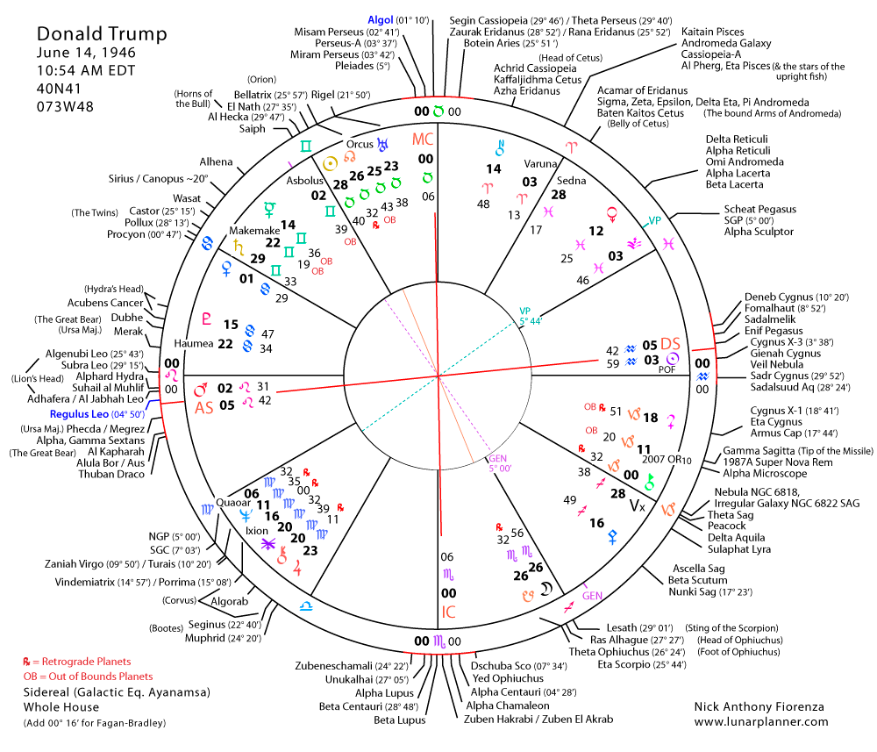

Slide 4
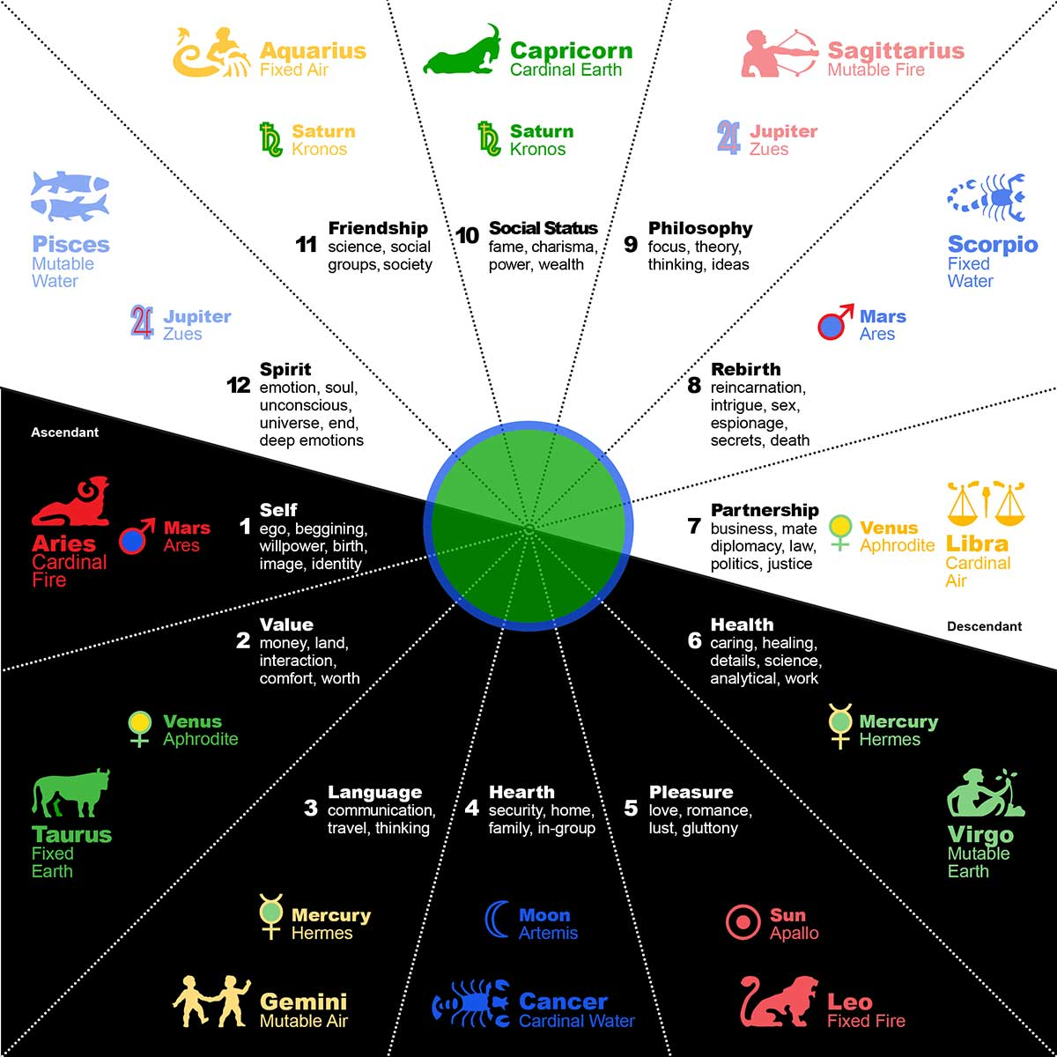

Slide 5
Why Astronomy
Why did humans first study Astronomy?
Galileo and scientific method starts astronomy
Mark time and cycles
Predict season change for planting crops
Navigation
Curiosity…desire to explain phenomena

Slide 6
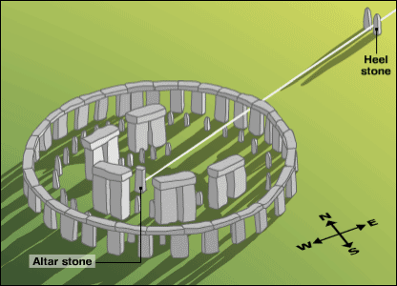
Early Astronomy
- Earliest known records show astronomical interest.
- Many ancient cultures built sites and kept records on
astronomical data.
- 3,000 BC - Stonehenge built (aligned with solstice and lunar eclipses).

Slide 7
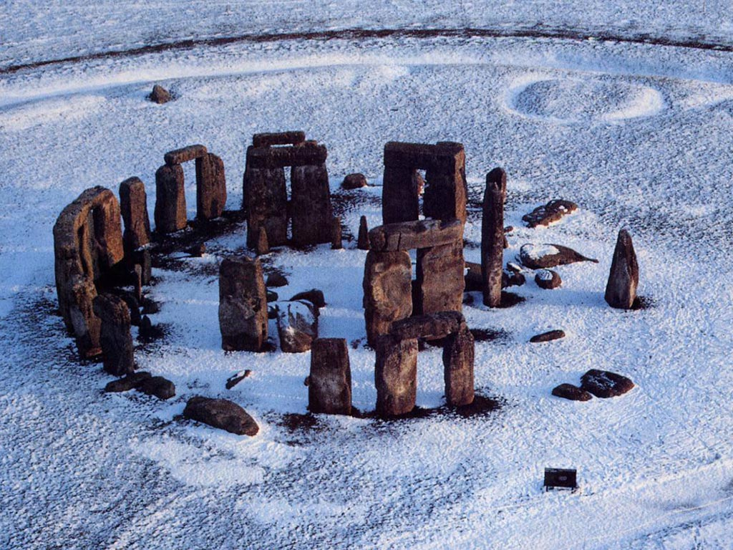

Slide 8
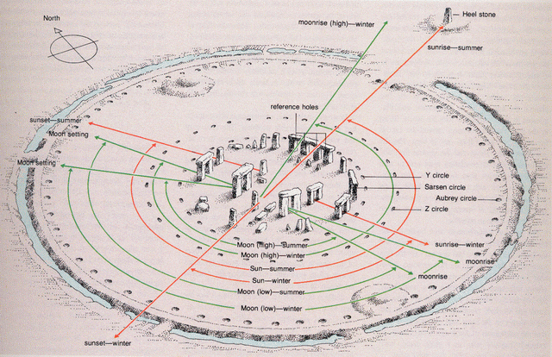
Stonehenge

Slide 9
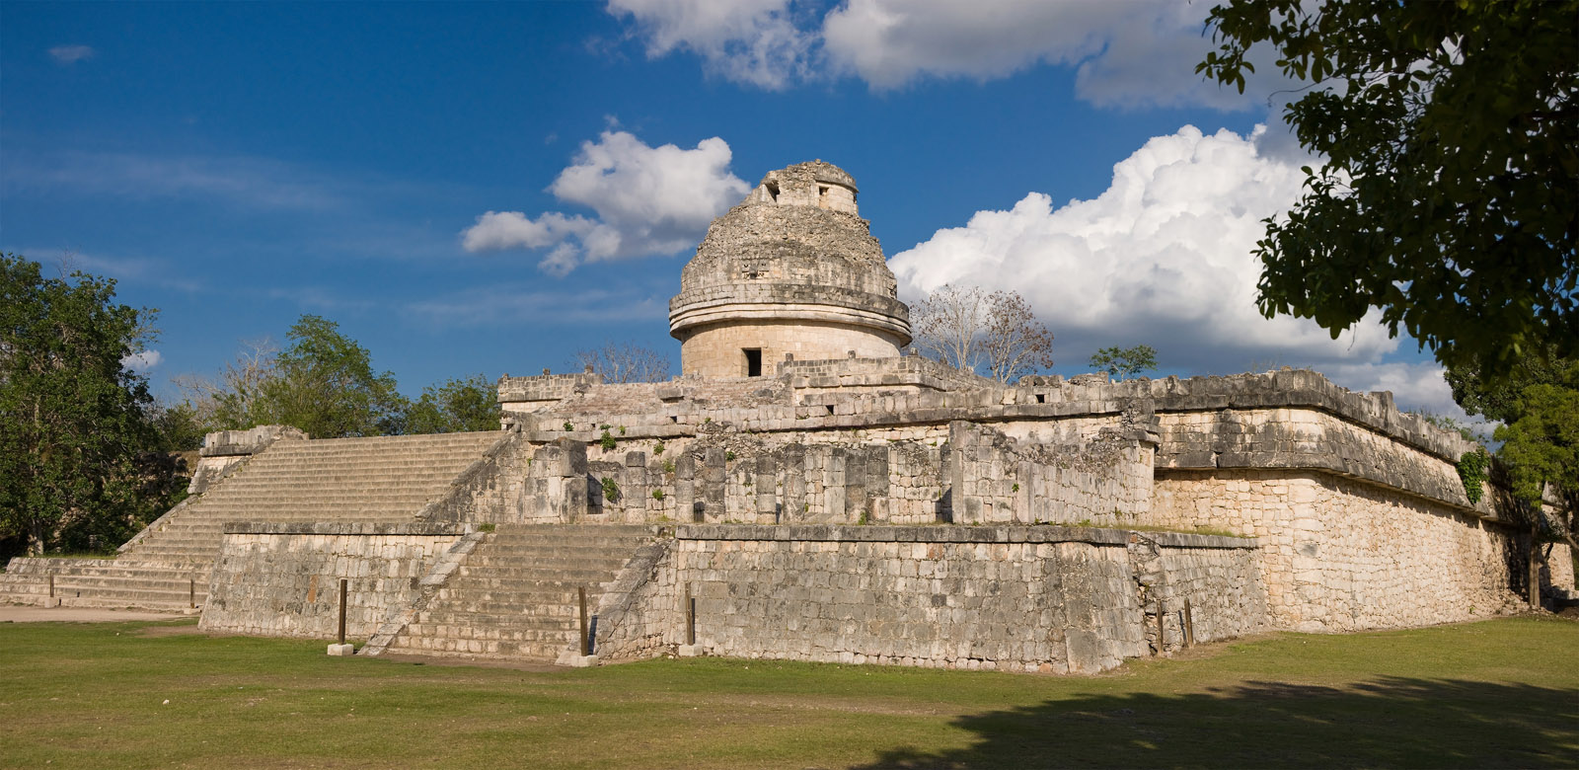
Caracol Observatory - Mayans
Notes:
El Caracol - Mayans

Slide 10
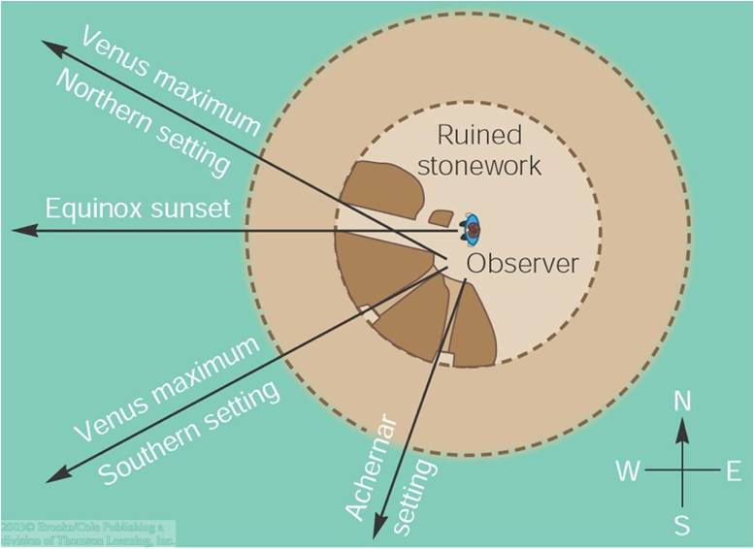

Slide 11
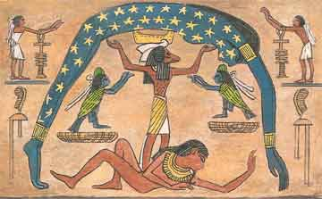
Egypt

Slide 12
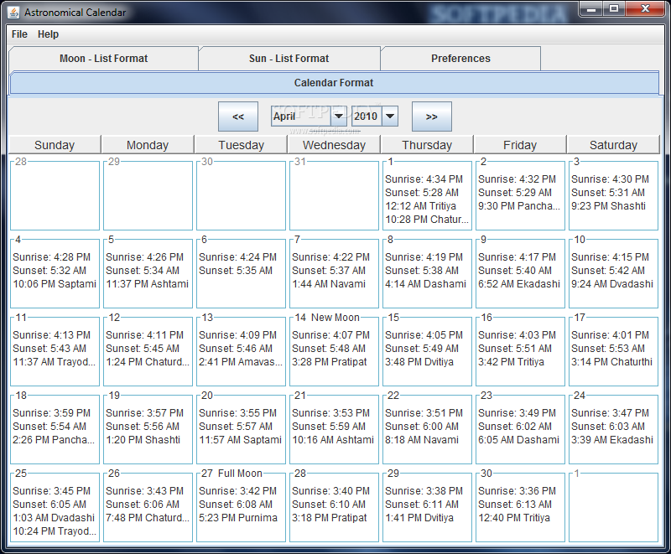
Calendars
Our calendar mark
astronomical events.
Year - one Earth revolution
around Sun.
Month - one Moon revolution around Earth
Day - one Earth rotation

Slide 13
Astronomy
Astronomy = study of celestial objects and phenomena outside Earth’s atmosphere
Includes galaxies, stars, planets, moons, cosmic radiation, etc.
Celestial object = Every object outside of Earth’s atmosphere

Slide 14
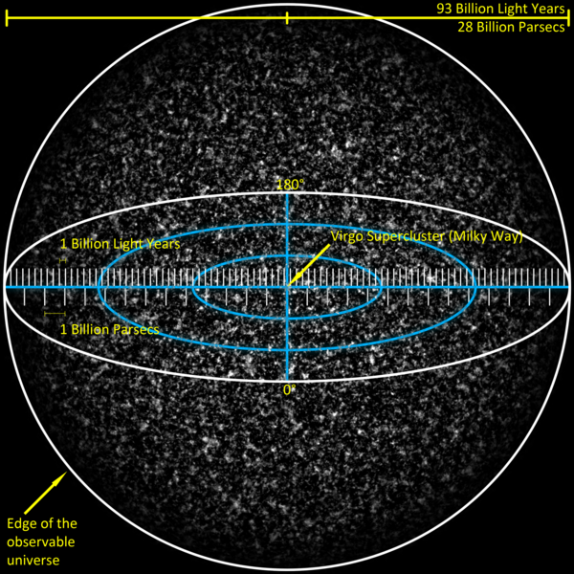
The Universe
Includes everything in existence.
~13.8 billion years old.

Slide 15
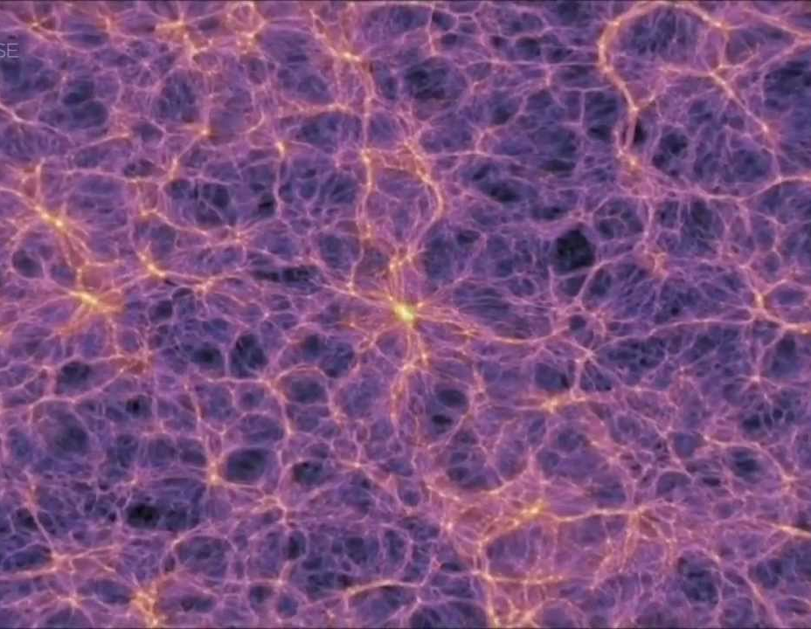
Galaxies
Collections of billions of stars.
Our galaxy is the Milky Way.
A group of galaxies is called a cluster.
A group of clusters is a supercluster.

Slide 16
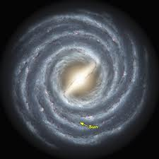
Milky Way

Slide 17
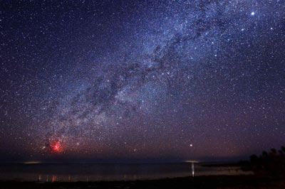
Milky Way

Slide 18
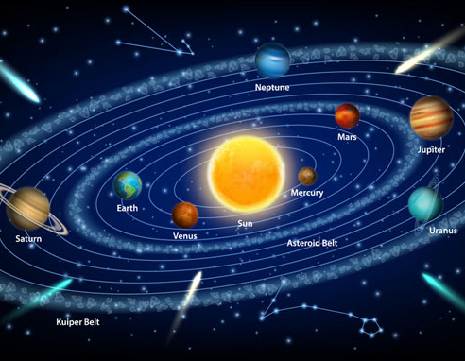
Solar System
Stars and whatever revolves around them
Includes planets, dwarf planets, comets, and asteroids.

Slide 19
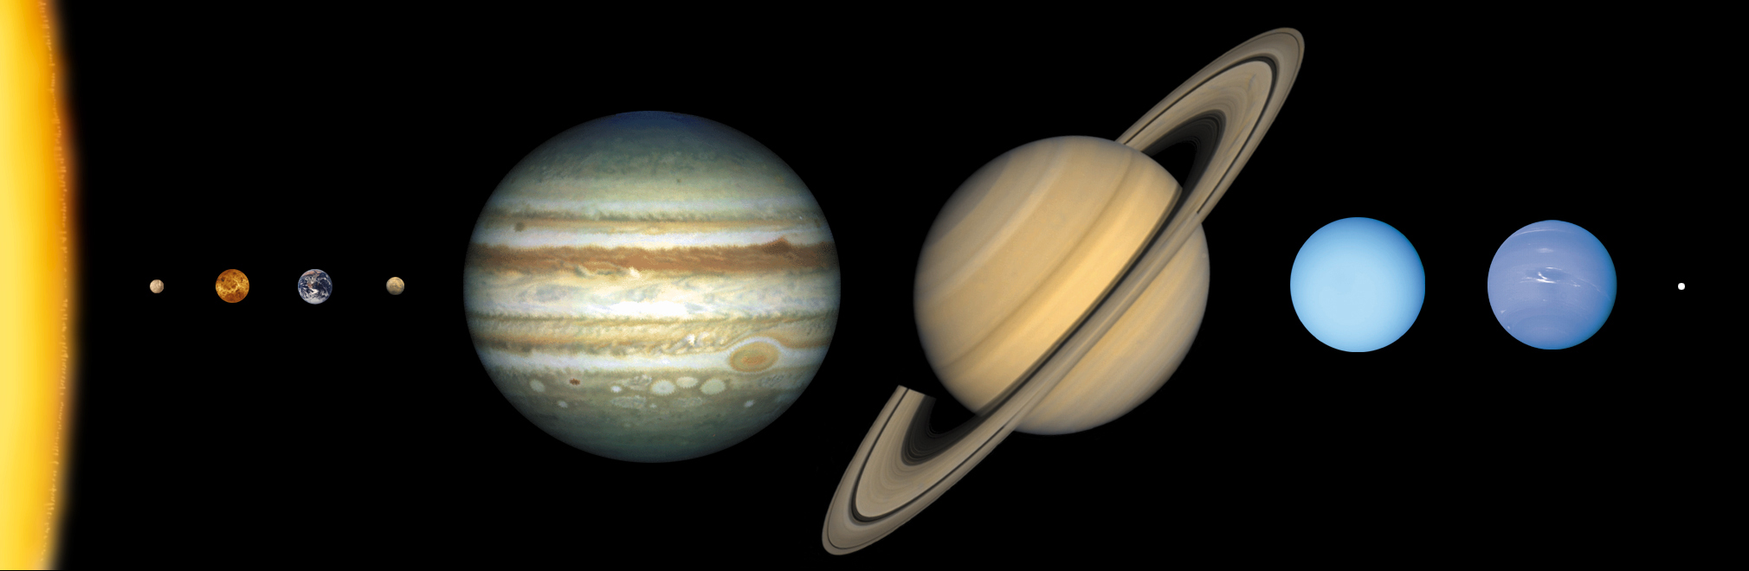
Solar System

Slide 20
Describe and explain your current beliefs and ideas about astrology and astronomy. At least 2 paragraphs.
  Which are you most familiar with?
  What are your beliefs and thoughts for each one?
  Which one, or both, do you think will be helpful in your life?

