Slide 1
Revolution
Earth revolves around Sun 1º / day.
365 days to complete a revolution
Counterclockwise.
Evidence:
Seasons.
Constellations change during year.

Slide 2
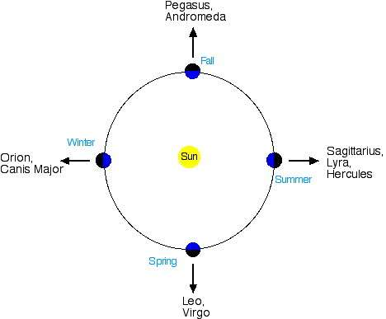

Slide 3
Rotation
Earth rotates counterclockwise at 15º / hr.
How do we know that the Earth is rotating?
Evidence:
1. Foucault’s Pendulum
2. Coriolis Effect – all winds move rightward in the northern hemisphere (video)

Slide 4
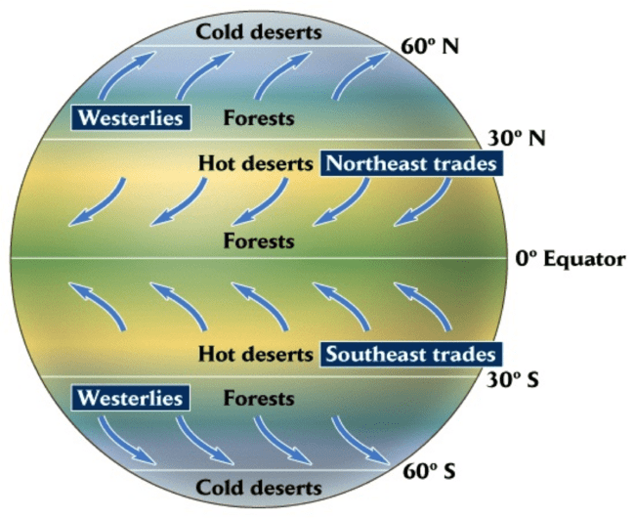
Coriolis Effect
Because of rotation,
All winds moves to the right in northern hemisphere

Slide 5
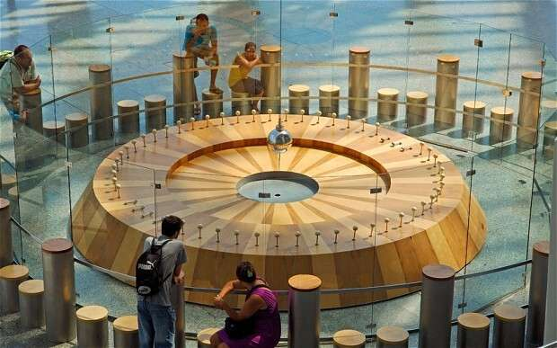

Slide 6
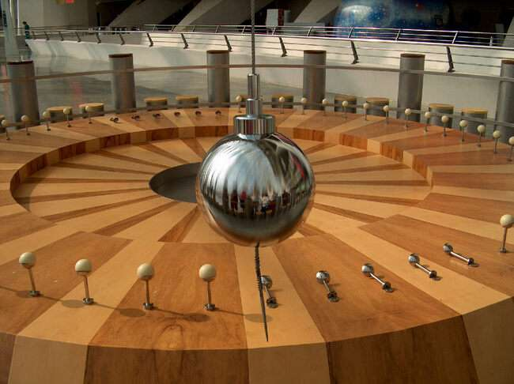

Slide 7
Length of Day
How long is a day?
Is it 24 hours or 23 hrs. 56 minutes?
Solar Day = Noon to Noon = Time it takes to rotate 361⁰ (24h).
Sidereal Day = actual time it takes to rotate 360⁰ (23h 56m).
Earth revolves around sun 1⁰ in a day. So, it takes an additional 4 minutes to complete turn.

Slide 8
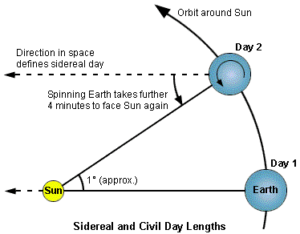

Slide 9
Aim: Why do we have seasons?
Do Now:
Why do we have seasons?

Slide 10

What do we call Sunlight?
Insolation =
Incoming Solar Radiation
(Sunlight)
More sunlight means warmer temperatures.

Slide 11
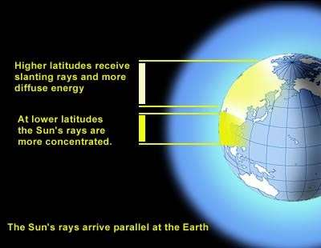
What Effects Sunlight
1. Latitude
Angle of Insolation:
High latitudes get indirect (low angle) sunlight…colder.
Low latitudes get direct (high angle) sunlight…warmer.

Slide 12
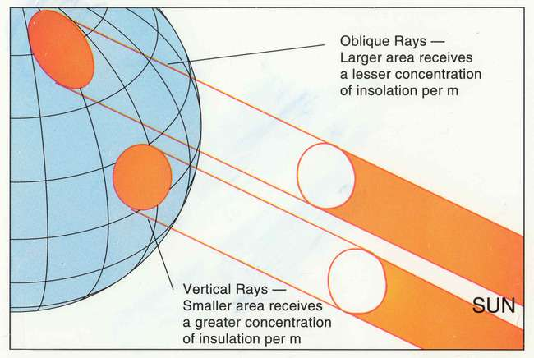

Slide 13
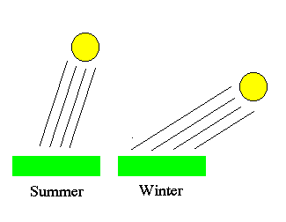
Angle of Insolation

Slide 14
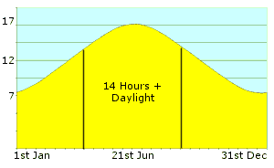
What Changes Amount of Sunlight?
2. Length of Daylight
Amount of sunlight effects temperature.

