Slide 1

Individual Behavior in the Presence of Others
Social Facilitation:
Improved performance in the presence of others.
Triplett (1898) noticed cyclists’ race times were faster when they competed against others than when they just raced against the clock.
Michelle Agnis/ NYT Pictures
Notes:
OBJECTIVE 10| Describe conditions in which the presence of others is likely to result in social facilitation, social loafing, or deindividuation.

Slide 2
The Norms for Helping
Social Exchange Theory: Our social behavior is an exchange process. The aim is to maximize benefits and minimize costs.
  Reciprocity Norm: The expectation that we should return help and not harm those who have helped us.
  Social–Responsibility Norm: Largely learned, it is a norm that tells us to help others when they need us even though they may not repay us.
Notes:
OBJECTIVE 27| Explain altruistic behavior from the perspective of social exchange theory and social norms.

Slide 3
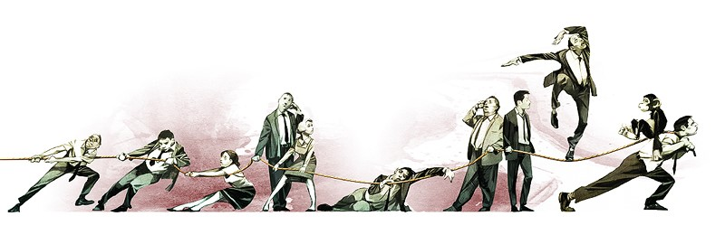
Social Loafing
The tendency of an individual in a group to exert less effort toward attaining a common goal than when tested individually (Latané, 1981).

Slide 4
Conflict
Conflict is perceived as an incompatibility of actions, goals, or ideas.
A Social Trap is a situation in which the conflicting parties, by each rationally pursuing their self-interest, become caught in mutually destructive behavior.
Ex. Tragedy of the Commons, short-term gain, long-term problem (nuclear power).
Notes:
OBJECTIVE 22| Explain how social traps and mirror-image perceptions fuel social conflict.

Slide 5

Peacemaking
Superordinate Goals are shared goals that override differences among people and require their cooperation.
Communication and understanding developed through talking to one another. Sometimes it is mediated by a third party.
Notes:
OBJECTIVE 28| Discuss effective ways of encouraging peaceful cooperation and reducing social conflict.

Slide 6
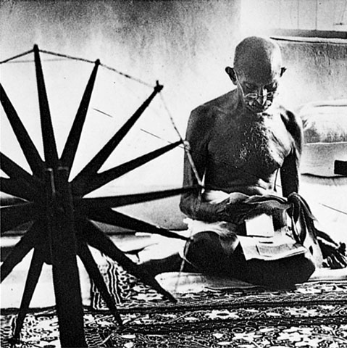
Power of Individuals
The power of social influence is enormous, but so is the power of the individual.
Non-violent fasts and appeals by Gandhi led to the independence of India from the British.
Margaret Bourke-White/ Life Magazine. © 1946 Time Warner, Inc.
Gandhi
Notes:
OBJECTIVE 12| Identify the characteristic common to minority positions that sway majorities.

Slide 7
