Slide 1
History - Approaches
Psychology is the scientific study of behavior and mental processes
Scientific?
  Not just common sense or guesses…but based on observations
  Scientific Method: careful observations and experimental testing
Behavior – what people do on the outside
Mental Processes – Thinking - we call this cognition.
Psychology includes the study of both humans and animals

Slide 2
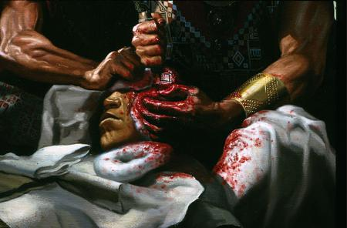
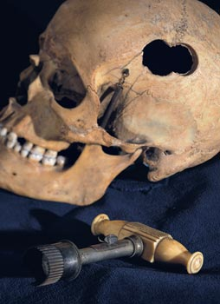
History of Psychology
Although the science of psychology started in the late 1800’s, the concept has been around a lot longer.
There was evidence of trephination (cutting holes into a skull to let evil spirits out) back in the stone age.

Slide 3
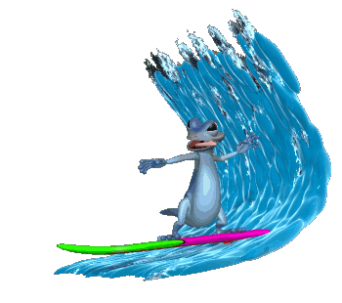
Waves of Psychology
The science of psychology has gone through about 5 different waves since it started.
Waves are different ways of thinking over time.

Slide 4
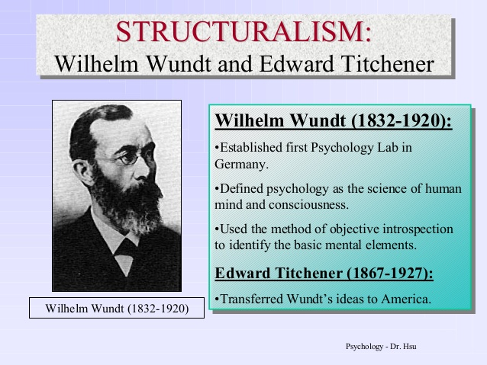

Slide 5
Structuralism
Titchner (Wundt student) – introduces structuralism
Structuralism - the basic units of experience (physical sensation, feelings, and memories) and the combinations in which they occur.
Introspection… asking people to report experiences like looking at a rose.
What are some problems with this?

Slide 6
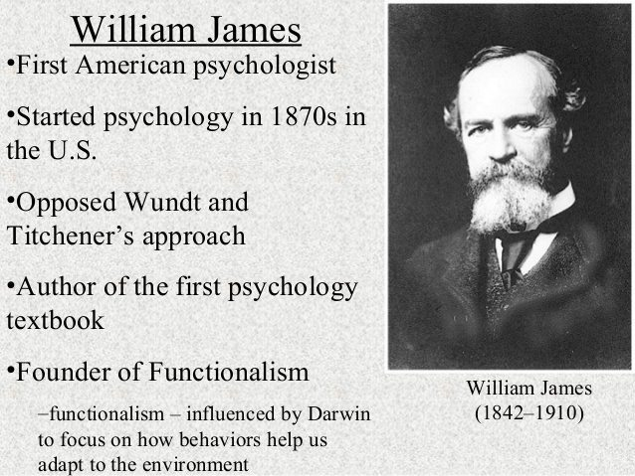

Slide 7

Structuralism vs. Functionalism
How would each study this situation?
Notes:
Structuralism: what does each product contain. Functionalism: what is the function of each product.

Slide 8
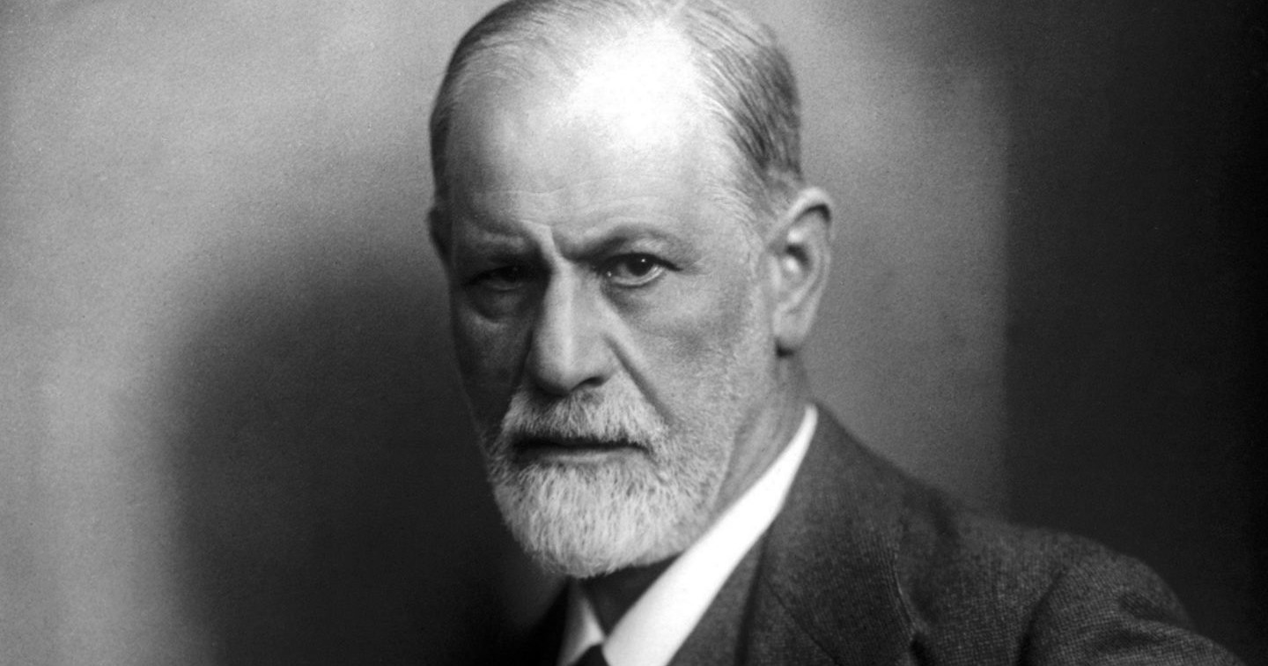
Psychodynamic
Psychology
Sigmund Freud
Behavior results from forces at an unconscious level. Often formed during childhood.
Since the person can’t access their own unconscious, it is hard to prove or disprove this theory scientifically

Slide 9
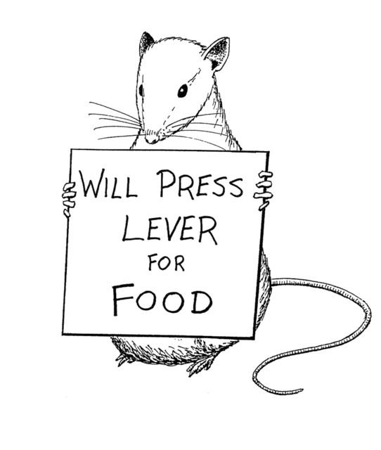
Behaviorism
Up until the 1920s, all psychology was how the mind effects behavior.
Behaviorism – scientific study of observable behavior. Learn through experience
Behavior is all we can observe… we cannot observe thinking
Ivan Pavlov, John Watson and B.F. Skinner

Slide 10
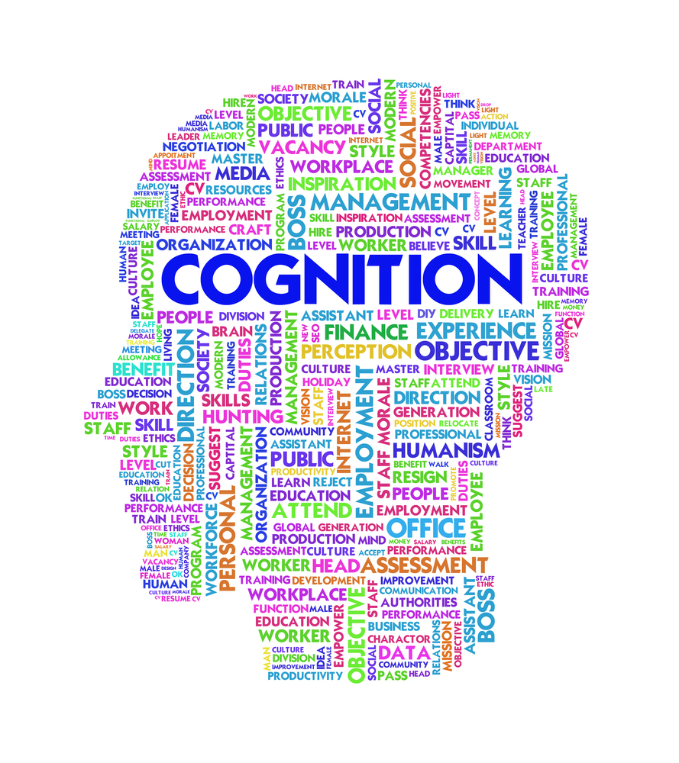
Cognitive Revolution
Study of mental processes.
We tend to lock into a way of thinking that may be detrimental and untrue.
If we can find a new better way of thinking about something, we will be better off.
Thinking
Learning
Feeling
Remembering
Decision-making

Slide 11
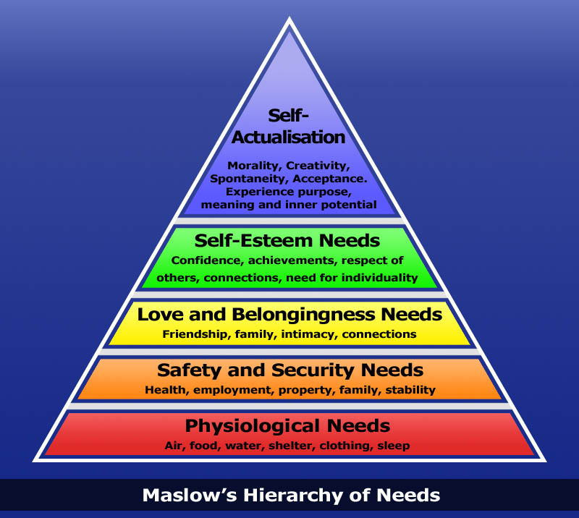
Humanism
Freudian and Behaviorism too harsh.
Humans are inherently good
Emphasizes realization of full potential
Abraham Maslow, Carl Rogers

Slide 12

Social-Cultural Psychology
Study of how people and culture influence our behavior
Topics include:
  First impressions
  Interpersonal attraction
  Attitude formation
  Prejudice
  Behavior in a group
  Obedience to Authority
  Cultural Norms

Slide 13
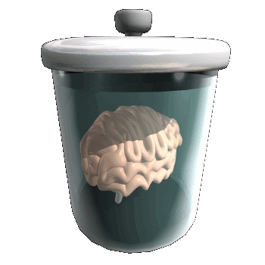
Biological Psychology (Neuroscience)
All of your feelings and behaviors have an biological root.
In other words, they come from your brain, body chemistry, neurotransmitters, etc…
Let us imagine for a second that your dog died (sad but it will happen). You become depressed. You stop eating and sleeping. What would a psychologist from this school say is going on and how might they help you?

Slide 14

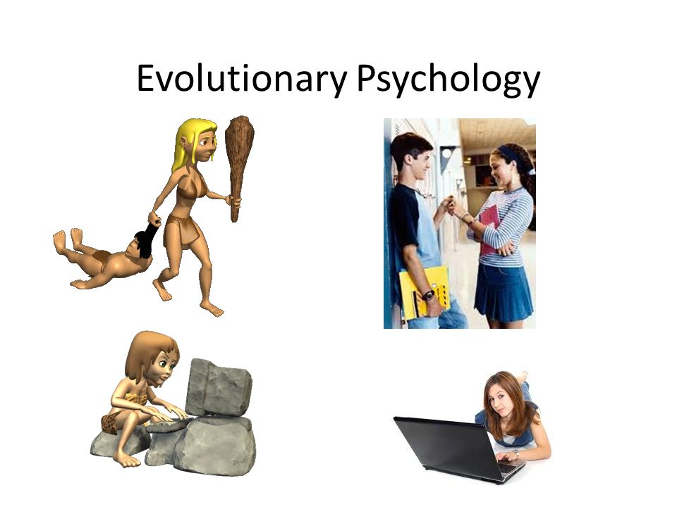
New Directions in Psychology
Evolutionary Psychology
– studies the adaptive value of behaviors and mental processes
Positive Psychology
– study of subjective well-being; focus on positive attitude

Slide 15
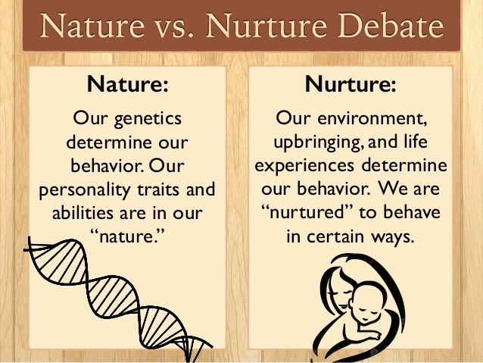
Nature vs. Nurture
Nature – what we’re born with
Nurture – what the environment does to us

Slide 16


