Slide 1
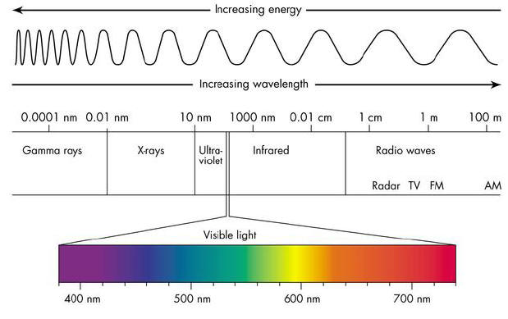
Electromagnetic Spectrum

Slide 2
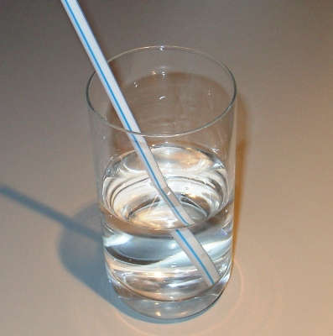
How Light Behaves
1. Refraction
Light bends from density differences.

Slide 3
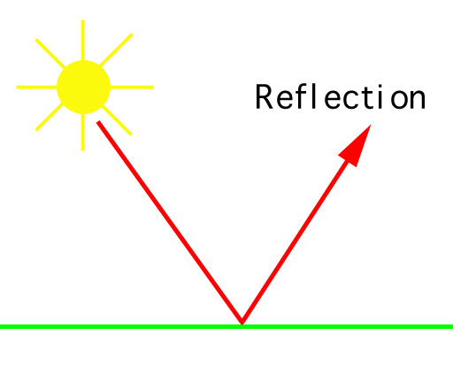
Reflection
Light bounces off material

Slide 4
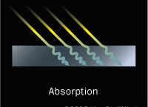
Absorption -
Light taken into material

Slide 5
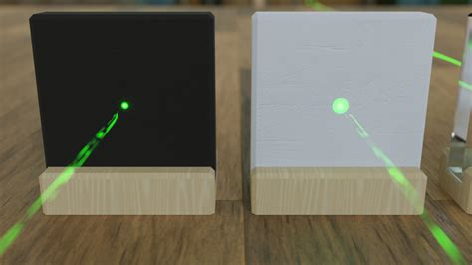

Slide 6
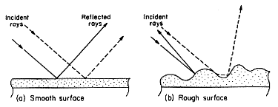
Smooth surfaces reflect more.
Rough surfaces absorb more.

Slide 7
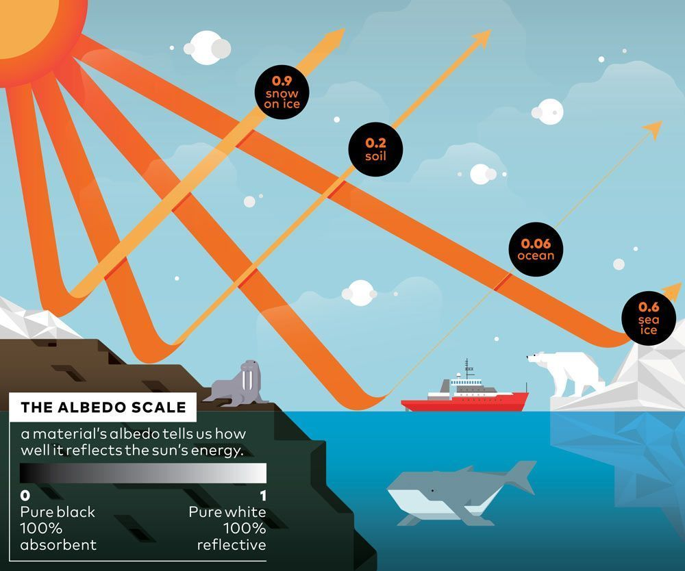
Absorb v. Reflect
Absorb
Dark, rough surfaces absorb light
ex. dark colors, dirt, ocean, forests
Reflect
Light, smooth surfaces reflect light
ex. light colors, snow

Slide 8
Earth’s Heat
Earth has 3 main sources of heat:
Sun
Radioactivity
Original heat from Earth’s formation.

Slide 9
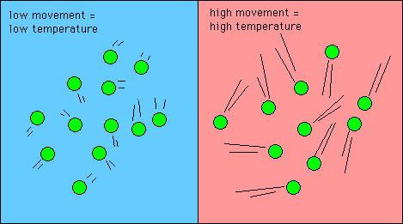
What is Temperature?
Temperature =
measurement (in degrees) of
atoms moving.
Fast atoms are hot
Slow atoms are cold
Energy always moves from high to low:
So, heat flows from hot to cold

Slide 10
Temperature
Temperature Scales
Kelvin = “absolute zero” is 0 Kelvin
Celsius
Fahrenheit
Absolute Zero (0 Kelvin)
when atoms stop moving (-273⁰ C)

Slide 11
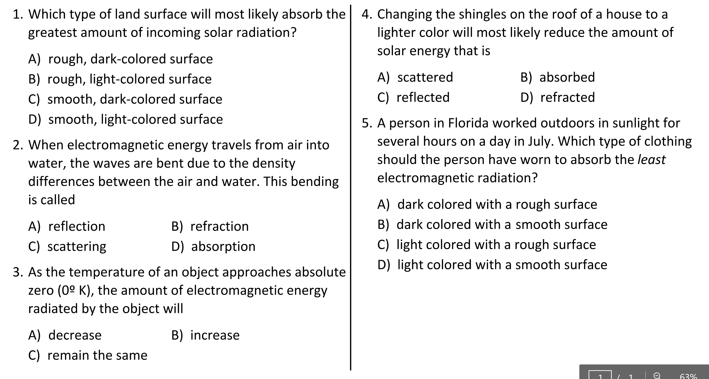

Slide 12
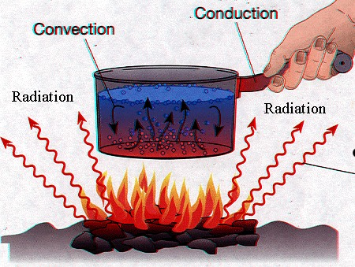
Heat Transfer
Heat is a form of energy and is measured in Joules (J).
Heat can move (transfer) in 3 different ways:
1. Conduction - contact
2. Radiation - waves
3. Convection - density

Slide 13
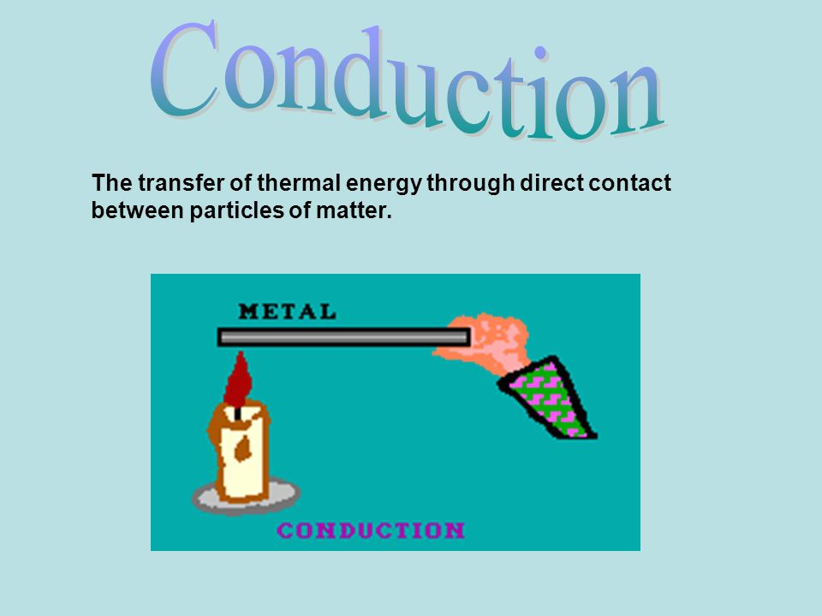
Heat Transfer
1. Conduction
when molecules touch other molecules.

Slide 14
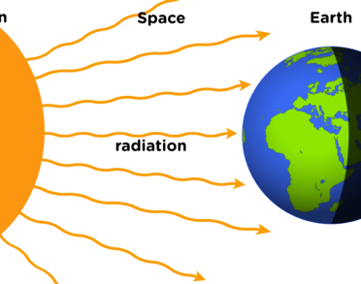
Radiation
electromagnetic waves

Slide 15
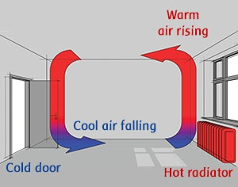
3. Convection
different densities cause movement.

Slide 16
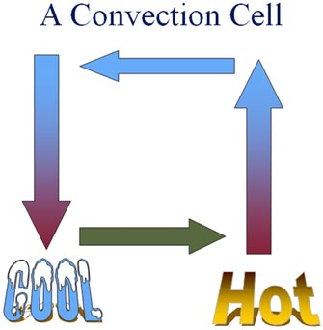
Convection = Hot Air Rises, Cold Air Sinks
Hot air expands = less dense.
Cold air compresses = more dense.

Slide 17
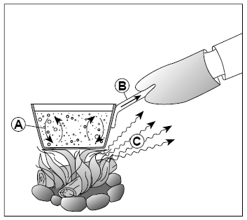
How does energy transfer from one area to another?
Do Now: Which list correctly identifies the energy transfer processes A, B, and C? Explain your choice.
A–conduction; B–convection; C–radiation
A–convection; B–conduction; C–radiation
A–convection; B–radiation; C–conduction
A–conduction; B–radiation; C–convection

Slide 18
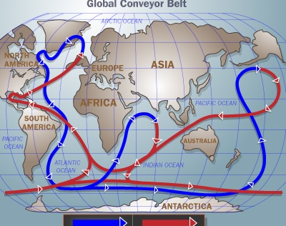
Global Convection Currents
1. Ocean Currents
Cold, dense water sinks at poles and circulates around the world.

Slide 19
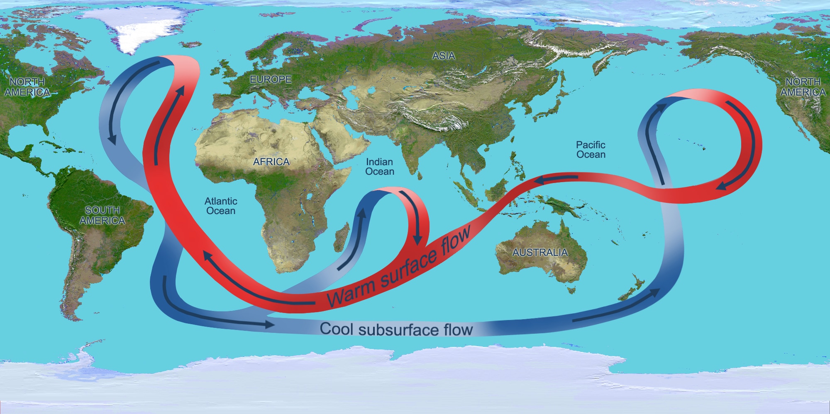
Global Conveyor Belt

Slide 20
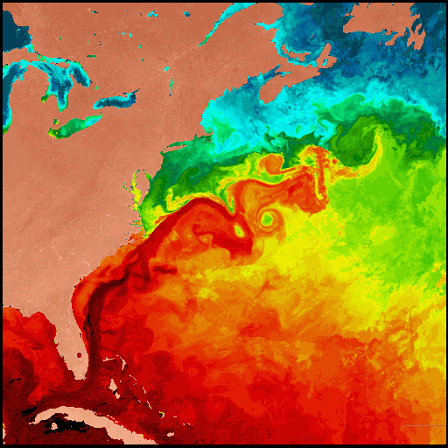
Gulf Stream

Slide 21
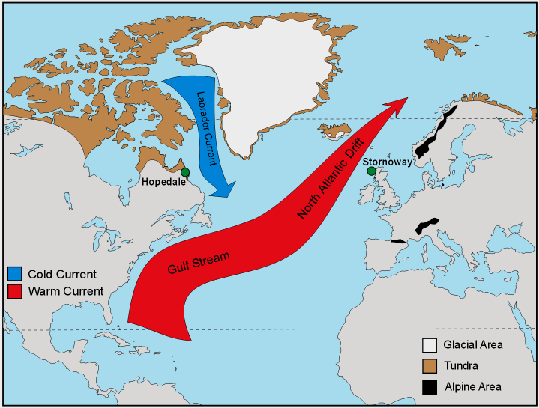

Slide 22
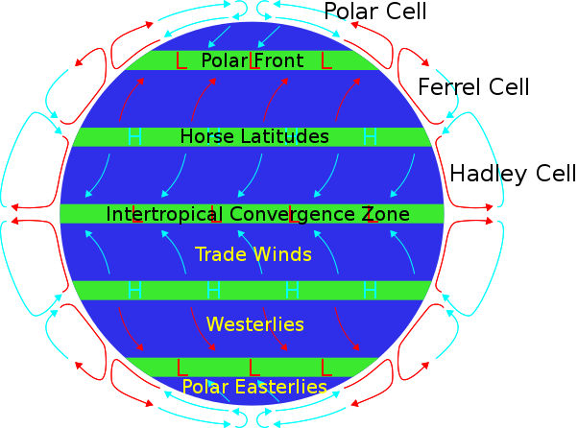
Global Convection Currents
2. Air/Wind Currents
Global wind currents transfer warm air from equator to poles.

Slide 23
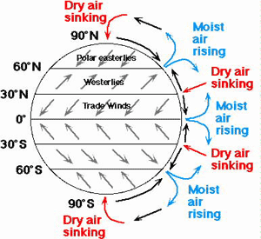
Global Wind Currents

Slide 24
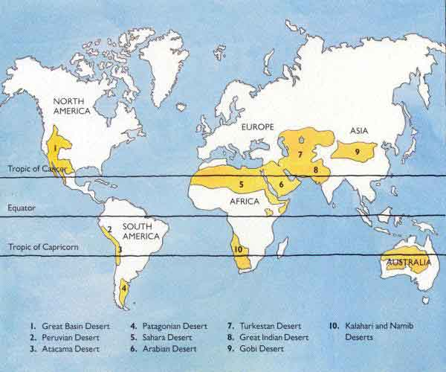
World Deserts

