Slide 1

Gravity
Aristotle = heavy objects fall faster than light objects…
NOT!
Kepler = laws of planetary motion (didn’t know cause).
Galileo = first to test “how objects fall” (didn’t know cause).

Slide 2
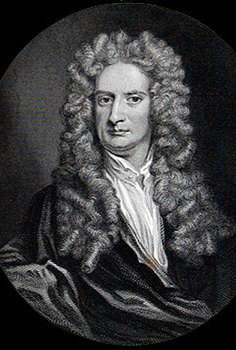
Sir Isaac Newton (1642 – 1727)
-- Gravity
-- 3 Laws of Motion
-- How light and rainbows work
-- How tides work
-- Built the first reflecting telescope
-- invented calculus
-- Universe was static (wrong)
-- Absolute time (wrong)

Slide 3
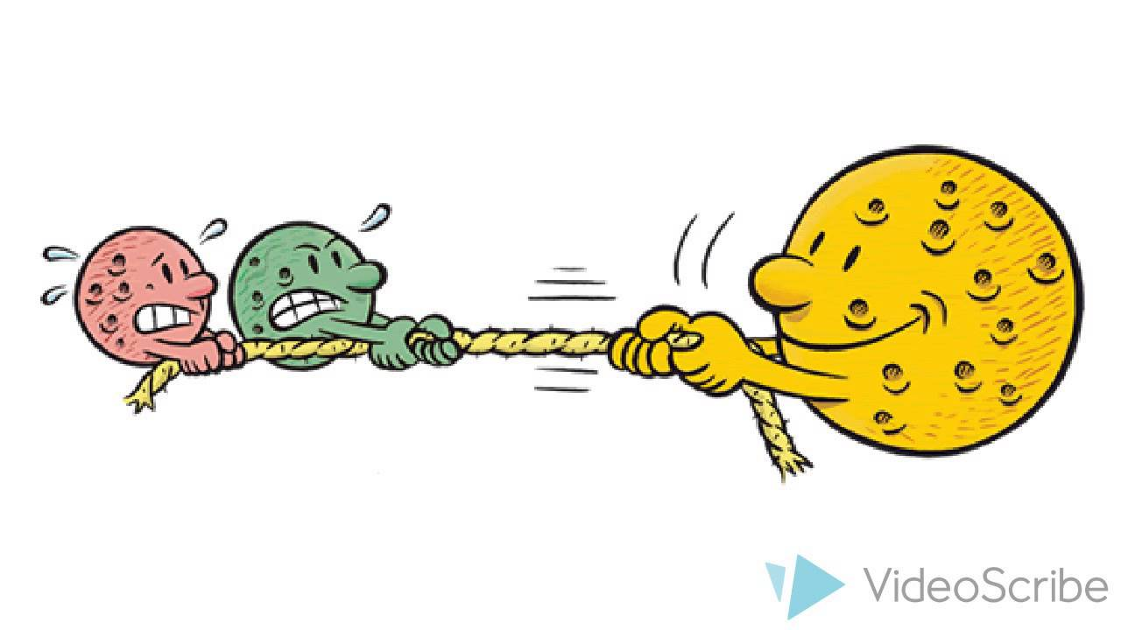
Newton’s Gravity Sucks
Gravity related to mass and distance.
Large Mass = Stronger Gravity
Weaker when farther away

Slide 4
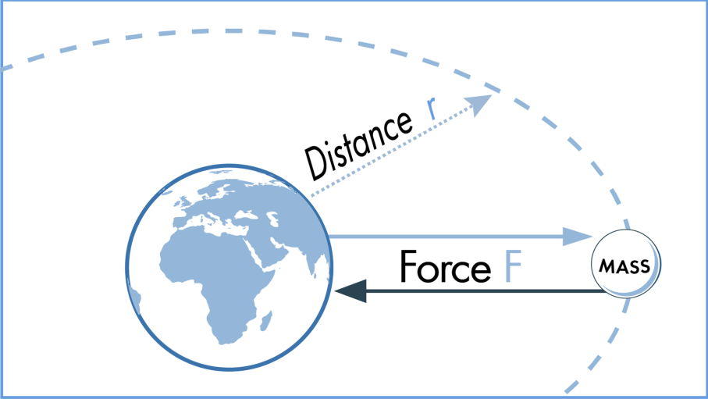
Newton’s Gravity

Slide 5
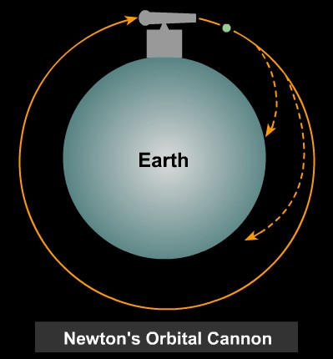
Isaac Newton
Gravity is a force – instantaneous connection.
What if we fired a cannon ball at just the right speed?
The moon would fall into Earth but keep missing it…
Orbit!

Slide 6
The gravitational attraction between two objects in the
solar system is greatest when their masses are
A) |  | small, and the objects are close together
B) |  | small, and the objects are far apart
C) |  | large, and the objects are far apart
D) |  | large, and the objects are close together

Slide 7
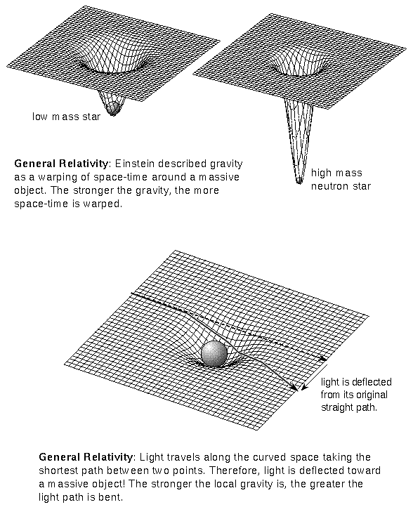
Einstein’s Gravity
Gravity is not a force…not instantaneous
Nothing faster than speed of light.
If space is curved or warped, then gravity is just how things move along curve.

Slide 8
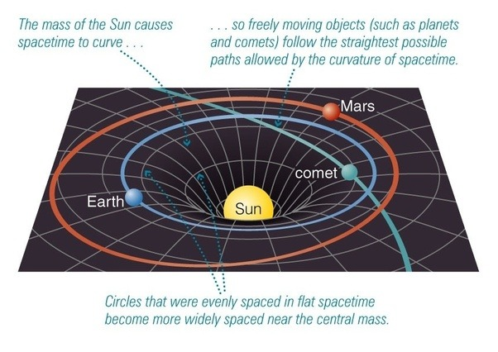

Slide 9
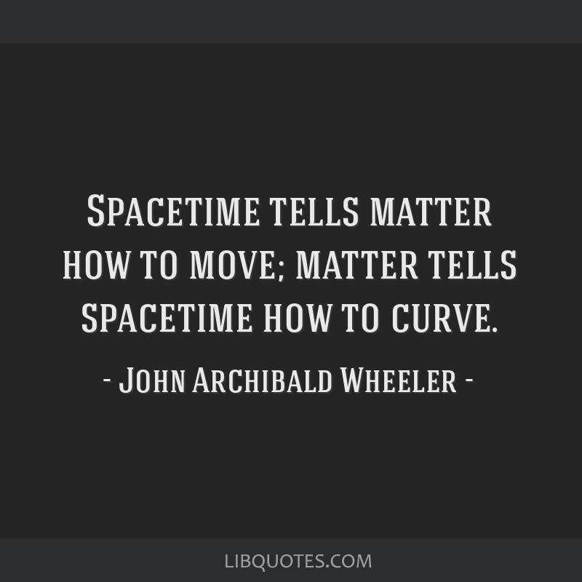

Slide 10
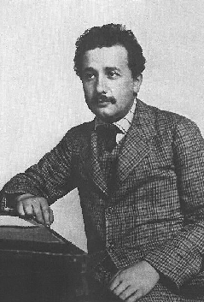
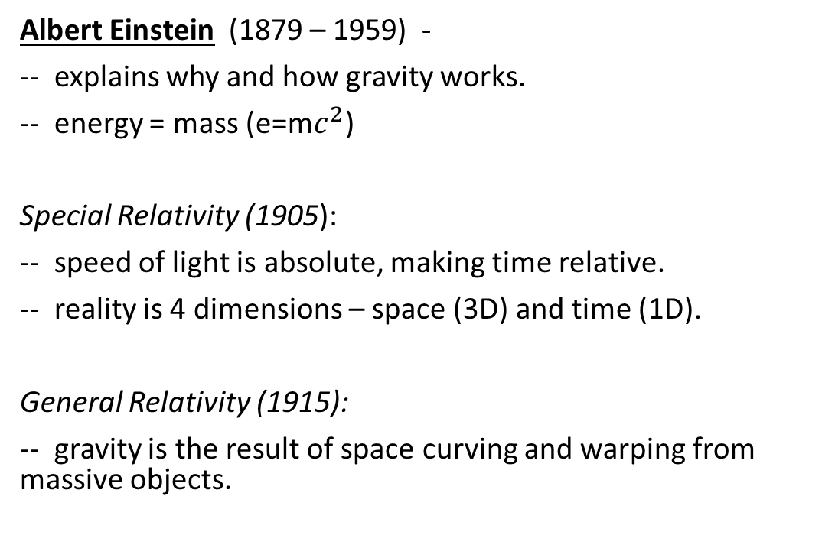
Einstein’s Gravity
Albert Einstein (1879 – 1959) -
-- explains why and how gravity works.
-- energy = mass (e=m$c^{2}$)
Special Relativity (1905):
-- speed of light is absolute, making time relative.
-- reality is 4 dimensions – space (3D) and time (1D).
General Relativity (1915):
-- gravity is the result of space curving and warping from massive objects.

