Slide 1

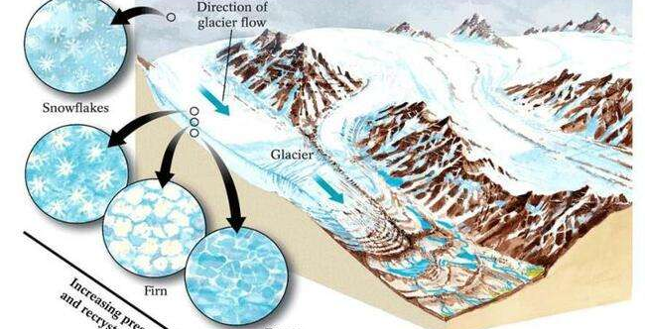
Glaciers
Thick ice that moves
Where do they come from?
Where there is more snow than melting.
-- Tops of mountains and polar regions.
-- Ice flows downhill due to gravity

Slide 2
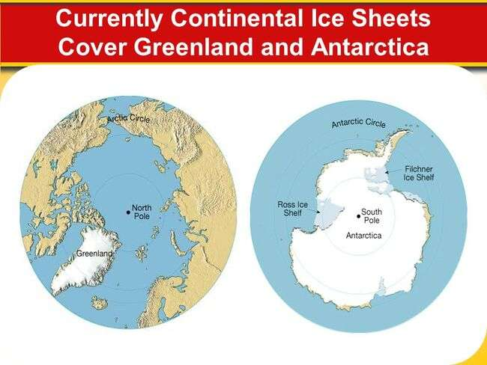
Continental Glaciers
Ice sheets that cover continents.
-- up to 4 miles thick.
-- 3% of all water on Earth is freshwater (97% saltwater)
-- 99% of all freshwater is in ice sheets
Only 2 exist:
Greenland and Antarctica

Slide 3
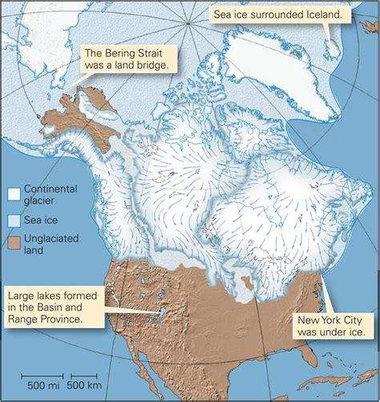
Ice Age

Slide 4
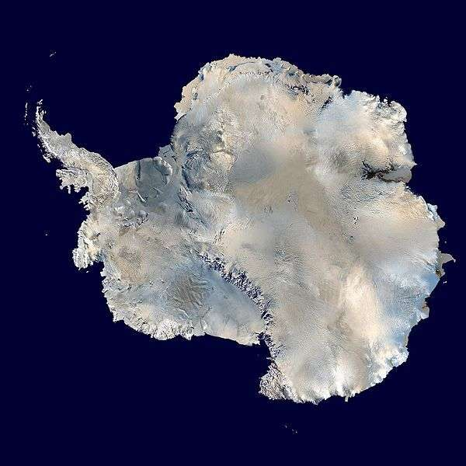

Slide 5
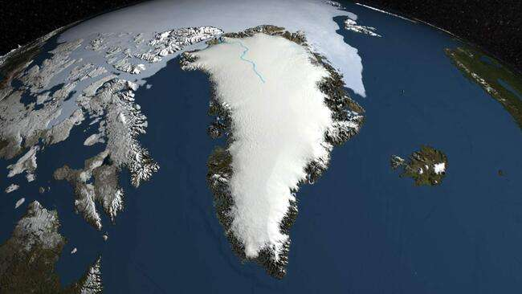

Slide 6
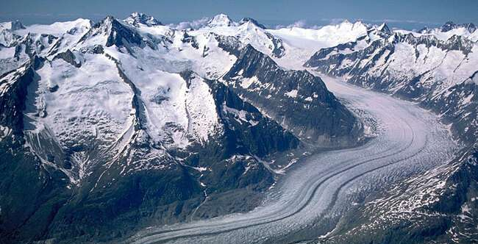
Valley Glacier
Flows downhill because of gravity

Slide 7
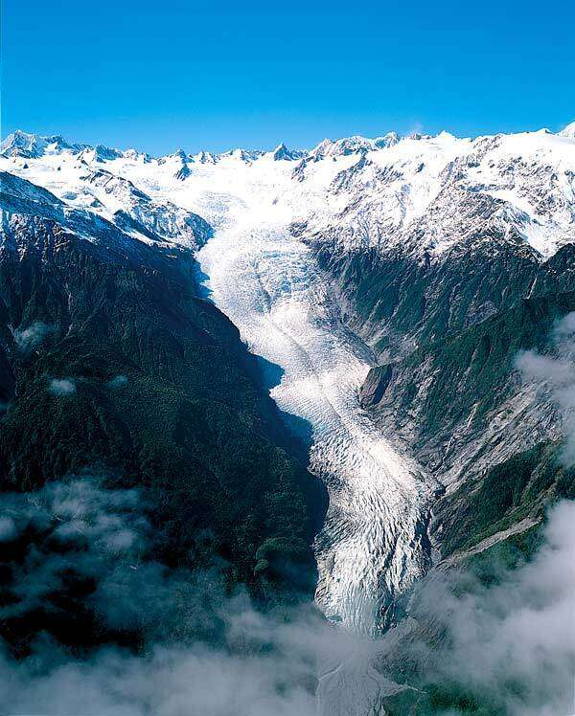

Slide 8
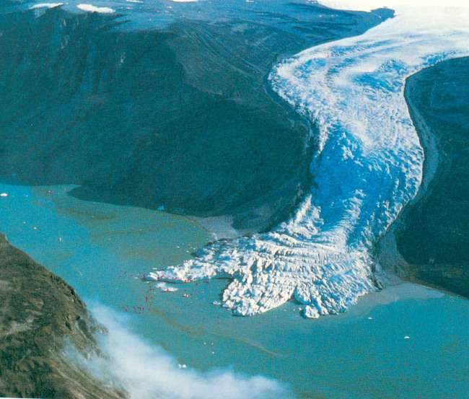

Slide 9

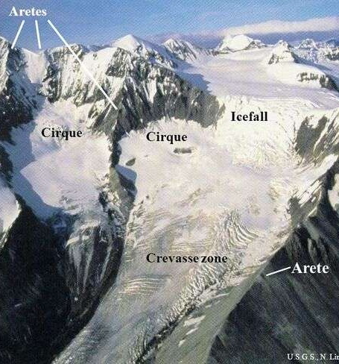
Vocabulary
Cirque – bowl-shaped basin where glacier begins.
Arete – between 2 cirques
Horns – between 3 cirques

Slide 10
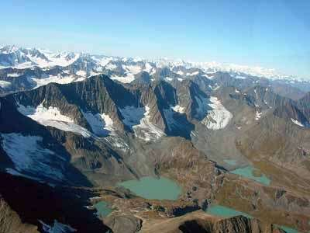

Slide 11
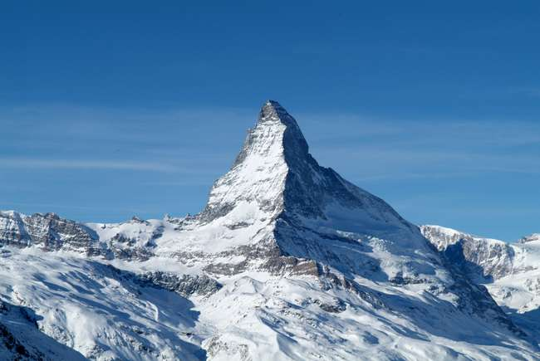

Slide 12
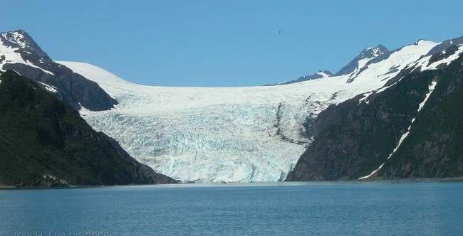
U-shaped Valley

Slide 13
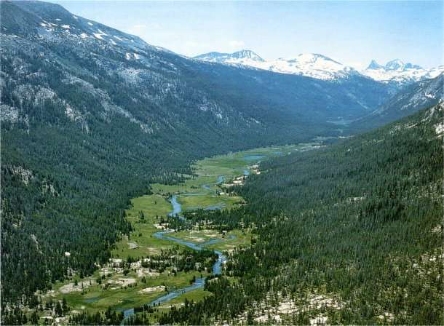

Slide 14
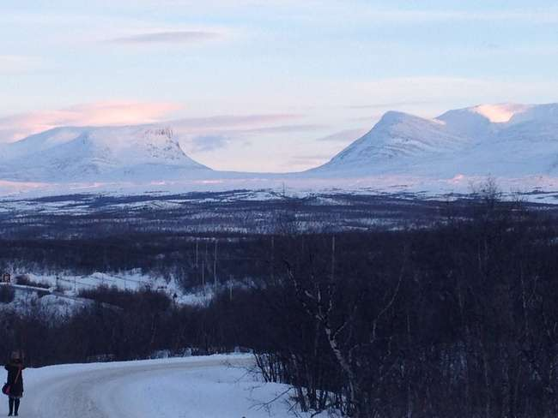

Slide 15
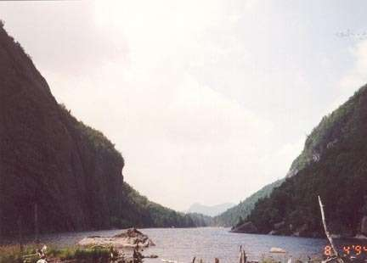

Slide 16
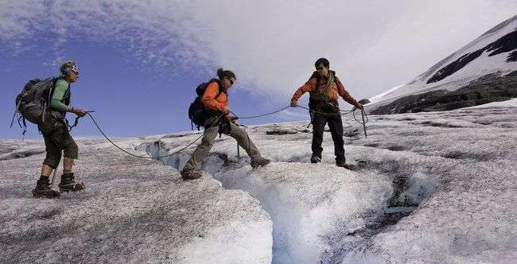
Crevasse – crack in the ice

Slide 17
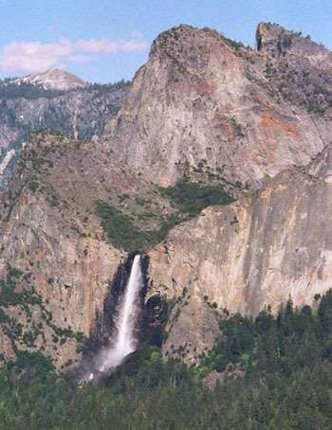
Vocabulary
Hanging Valleys

Slide 18
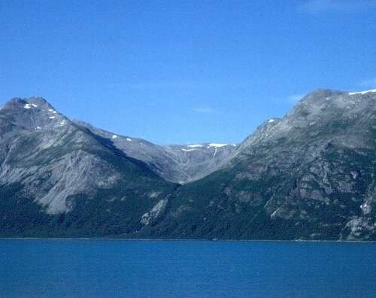

Slide 19
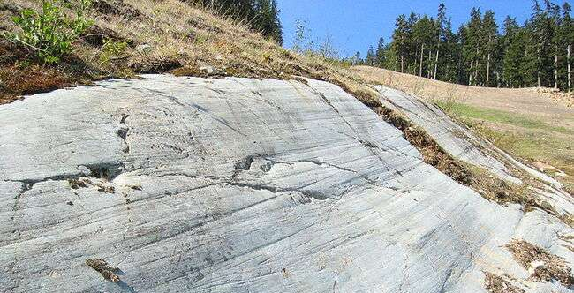
Striations = parallel scratches

Slide 20
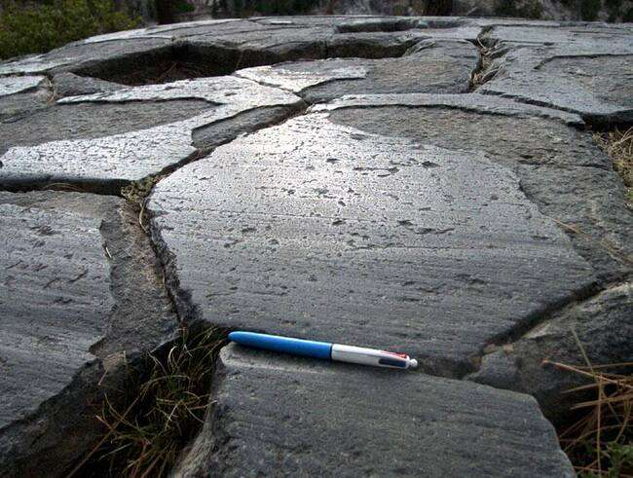
Polish

Slide 21
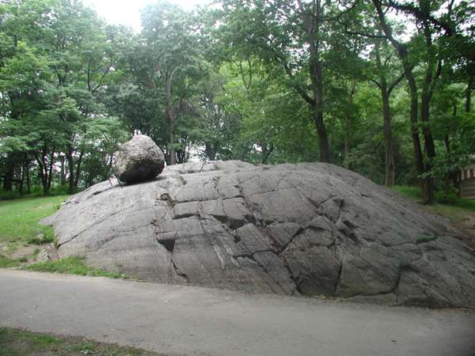
Erratic in NYC
Erratic
large isolated boulder transported by glacier

Slide 22
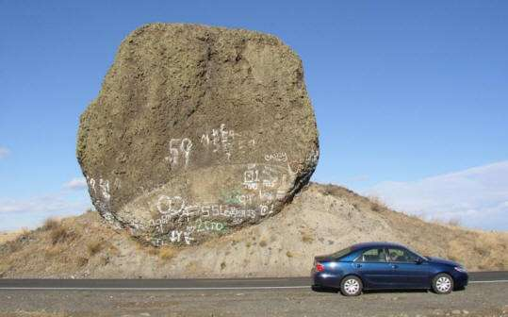
Erratic

Slide 23
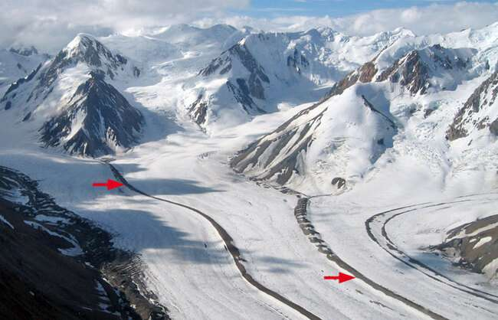
Moraine
Moraine
Unsorted pile of debris

Slide 25
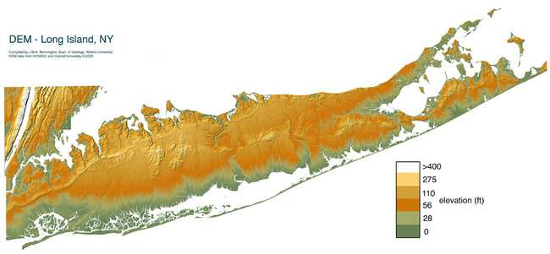

Slide 26
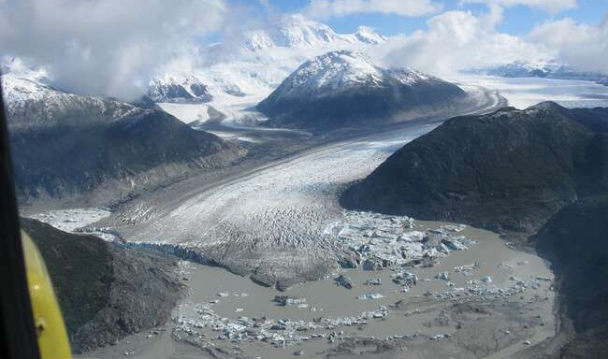
Outwash Plain sorted runoff from glacier

Slide 27
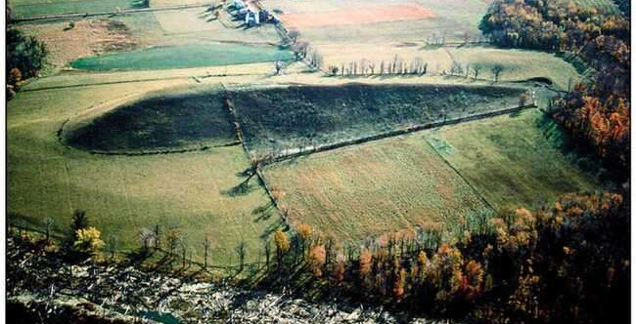
Drumlin
Long mound of debris with teardrop shape.
Unsorted

Slide 28
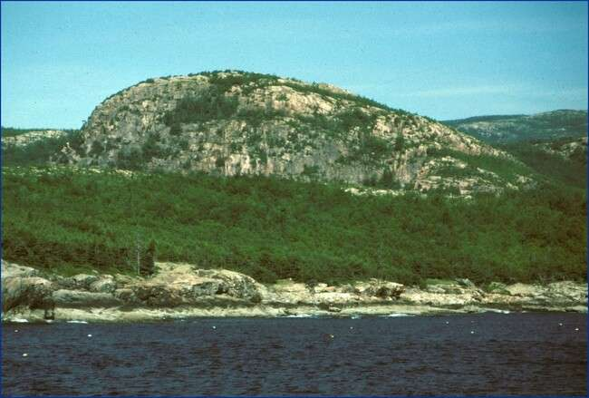
Drumlin

Slide 29
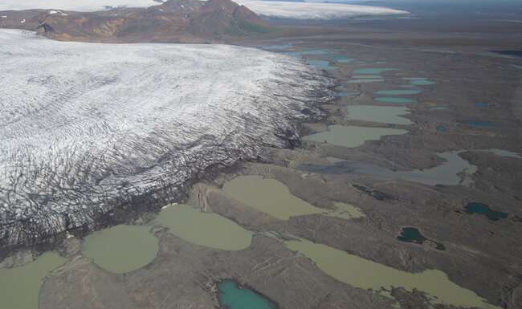
Drumlins

Slide 30
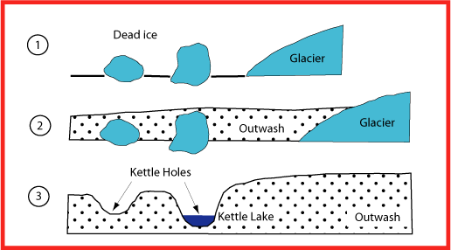
Kettle Lakes

Slide 31
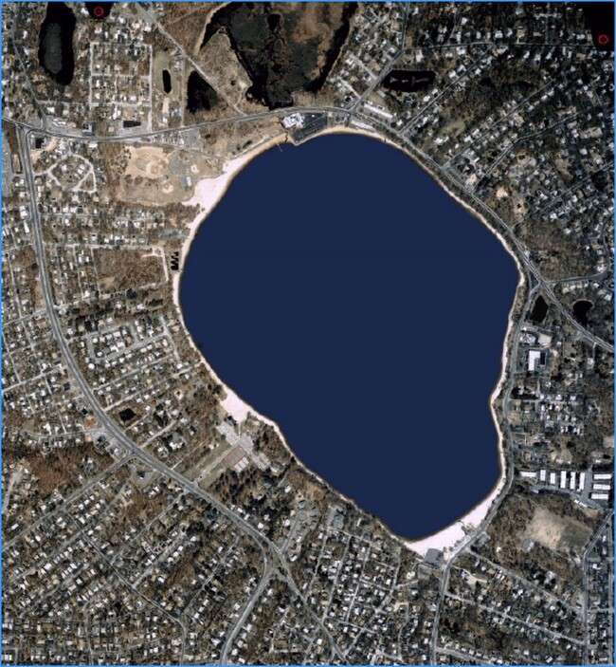
Lake Ronkonkoma
Long Island

Slide 32
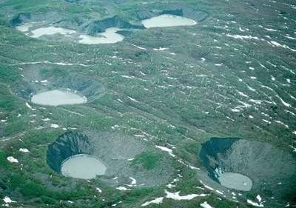
Kettle Lakes

Slide 33
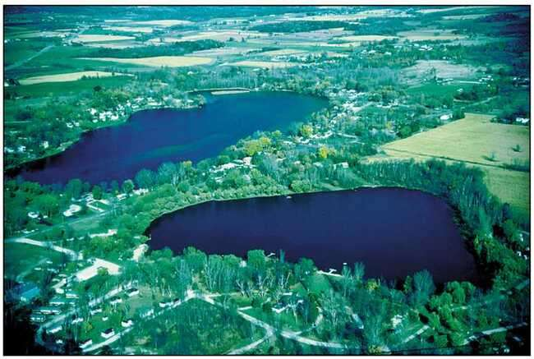

Slide 34
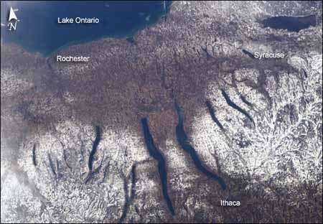
Glacial Lake
Forms when ice dams a stream.

Slide 35
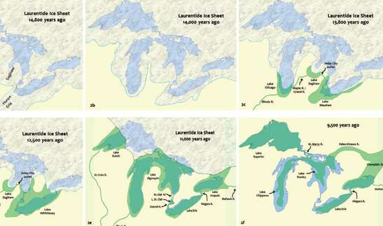
Great Lakes - Glacial

Slide 36
