Slide 1
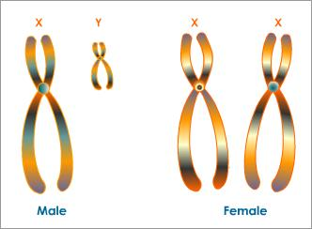
Sex
This is biologically founded.
Female has XX chromosomes
Male has XY chromosome

Slide 2
Sex
Male
Female
XY sex chromosomes
Testes
The hormone testosterone
A penis and scrotum
A lower-pitched voice
XX sex chromosomes
Ovaries
The hormones estrogen and progestogen
A uterus, vagina, and vulva
A higher-pitched voice‌

Slide 3
Intersex
Intersex - a wide range of people that don’t meet 100% of the criteria for male or female sex. An intersex person is born with or naturally develops characteristics that aren’t considered exclusively male or female. These include variations in:
Sex chromosomes
External genitalia
Reproductive system (gonads)

Slide 4
Sexuality
What Sex Isn’t: Sexuality
Sexuality is divided into three elements: who you’re attracted to, your sexual behaviors, and your identity. As with most things, descriptions of sexuality are vast and can’t be encompassed in a simple binary.
Gay
Lesbian
Queer
Bisexual
Pansexual

Slide 5






Gender
Socially constructed notion of what is feminine and what is masculine

Slide 6


Slide 7
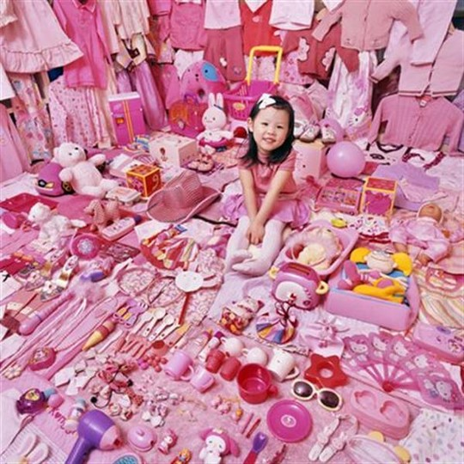

Slide 8
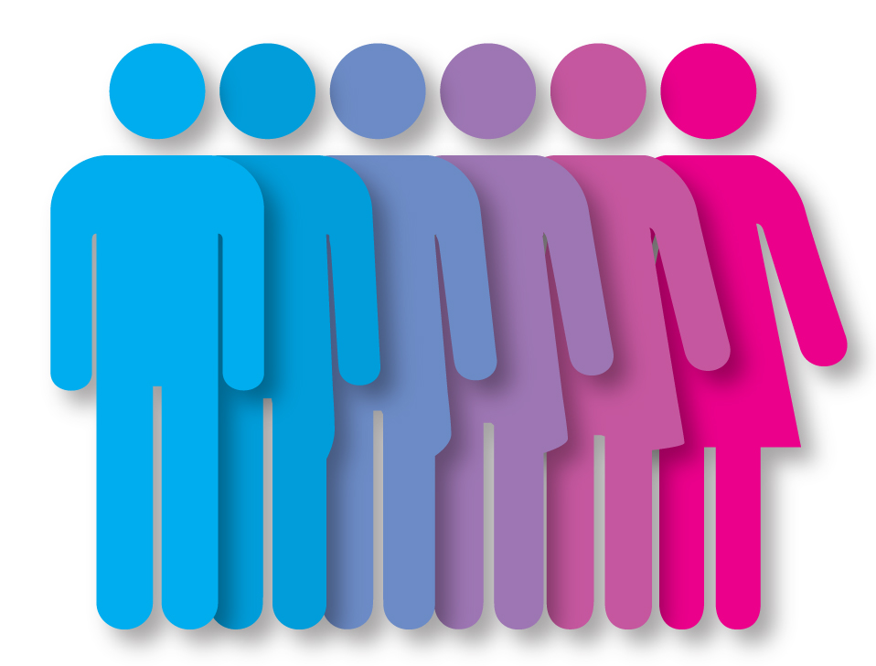
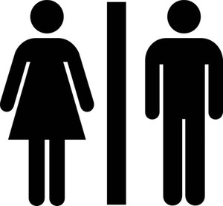
Gender Binary vs. Fluid

Slide 9
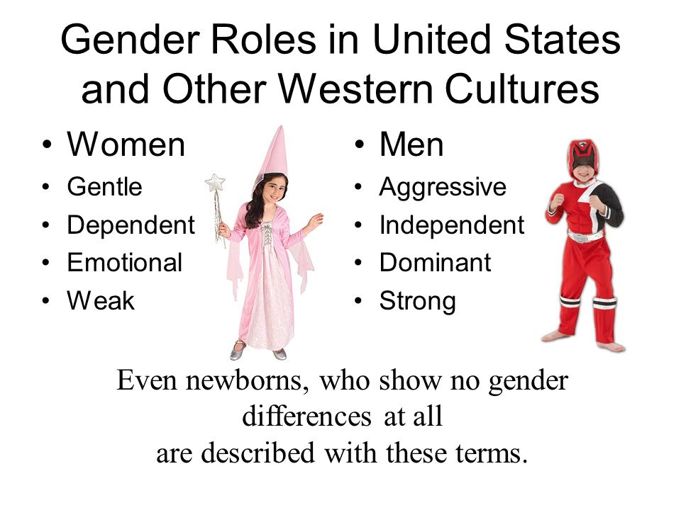
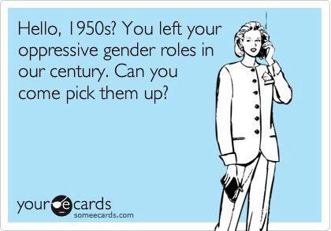
Gender Roles
Socially expected behavior for a male or a female

Slide 10
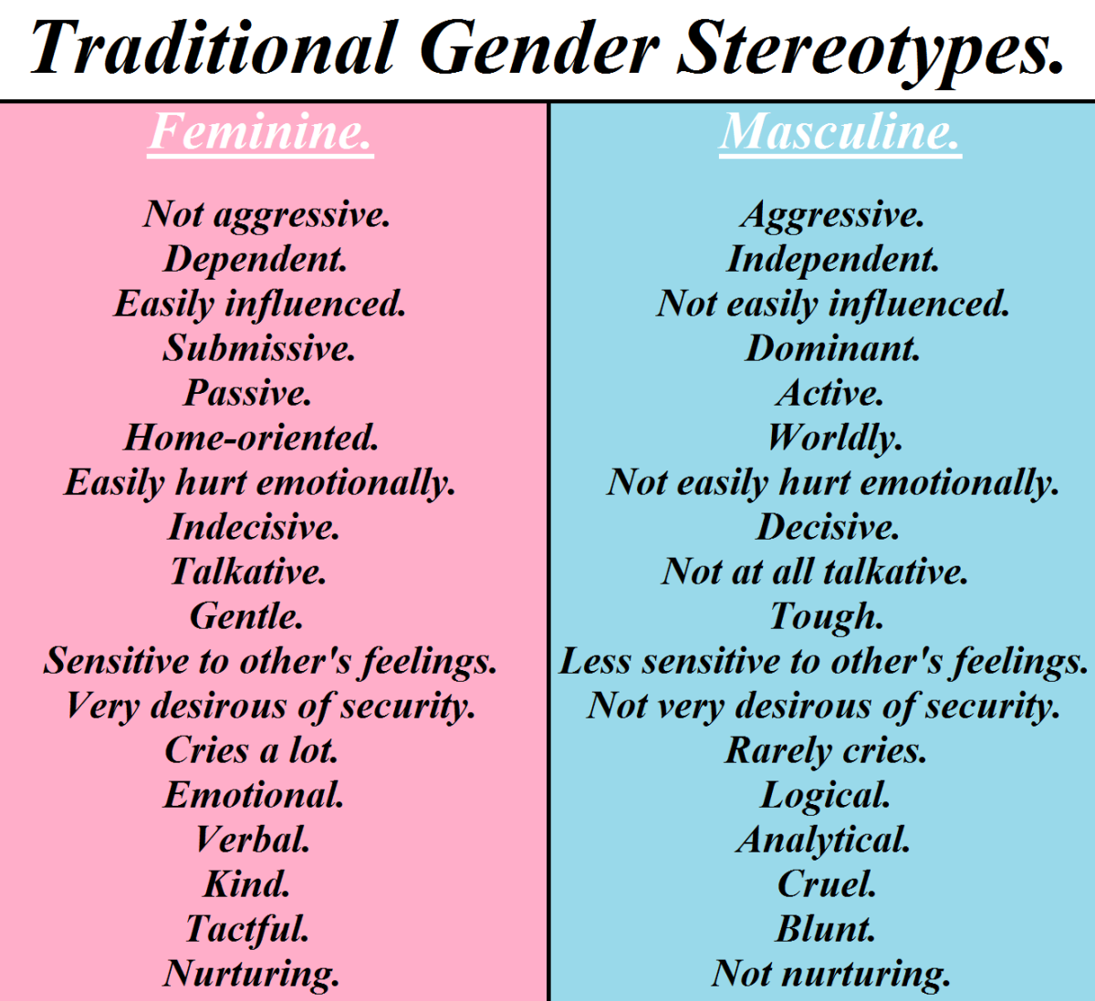

Slide 11
Sex or Gender Differences?
Compared to the average man the average woman has 70% more fat, possesses 40% less muscle and is 5 inches shorter
Women enter puberty 2 yrs sooner
Women are more likely to dream equally of men and women, to become sexually re-aroused after orgasm, smell faint odors, express emotions freely.
Women are doubly vulnerable to depression and anxiety
Women are 10 times greater risk for eating disorders
Men are four times more likely to be diagnosed with autism, color-blindness, hyperactivity, and antisocial personality disorder

Slide 12
Gender Differences in Aggression
Men tend to behave more physically aggressive. This is found in various cultures at various ages. US male to female arrest ration for murder is 9 to 1.
Women show more indirect aggression.
Both men and women equal in verbal aggression
Indirect and physical aggression both give evolutionary advantages.

Slide 13
Gender Differences in Social Power
Whether in juries or companies, leadership tends to go to males (Colarelli 2005)
As leaders, men are more directive and autocratic, while women are more democratic and elicit subordinate opinions (Engen 2005)
When people interact, men are more likely to offer opinions while women are more likely to express support. (Wood 1987)
Men are more likely to talk assertively, to interrupt, to initiate touching, to smile less, and to stare (Hall 1987)
Gender differences in power lessen by middle age as men become more empathetic and women more assertive
Men are more likely to hazard answers even when they don’t know. A phenomenon Giuliano calls the male answer syndrome

Slide 14
Gender Differences in Social Connectedness
The notion that we struggle to create our own identity (Erikson) is geared more to individualist males than relationship-oriented women (Gilligan 1982, 1990)
Women, Gilligan argues, are more concerned with “making connections.”
Boys play in large groups with an activity focus and little discussion
Girls play in smaller groups. Their play tends to be less competitive, and they are more open to feedback then males
Women use conversation to explore relationships, men use it to communicate solutions (Tannen 1990)
New Zealand - From a sample of student emails, people guessed the writer’s gender 66% of the time (Males were less likely to disclose emotion, personal info, and to offer apologies) (Thomson 2001)
US - Women spend less time gaming and more time emailing when on computers (Crabtree 2002)
France - Women make 63% of phone calls. Women talking to women = 7.2 minutes. Men to men = 4.6. (Smoreda 2000)
Women purchase 85% of greeting cards
90% of people report close relationship with mother while only 69% with their father (Hugick 1989)
While men enjoy doing activities side-by-side, women enjoy talking face-to-face (Wright 1989)

Slide 15
