Slide 1
Gamma Rays
Gamma Ray - most energetic form of EMR.
Absorbed by Earth’s atmosphere…no way to detect from Earth.
Telescope in orbit detected first gamma rays in 1961.

Slide 2
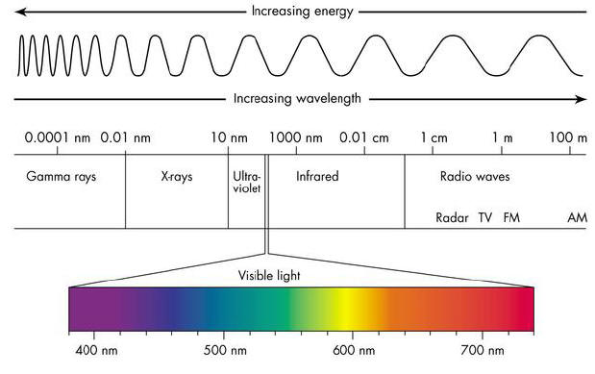
EMR Spectrum

Slide 3
Sources
Sources include:
- black holes
- active galaxies
- quasars / blazers
- supernovas and remnants
- pulsars

Slide 4
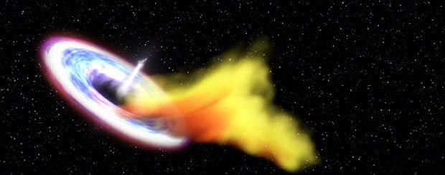
Black Hole Devouring Star

Slide 5
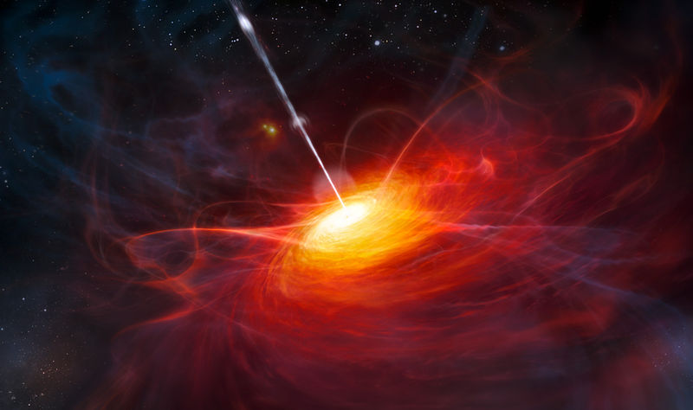

Slide 6
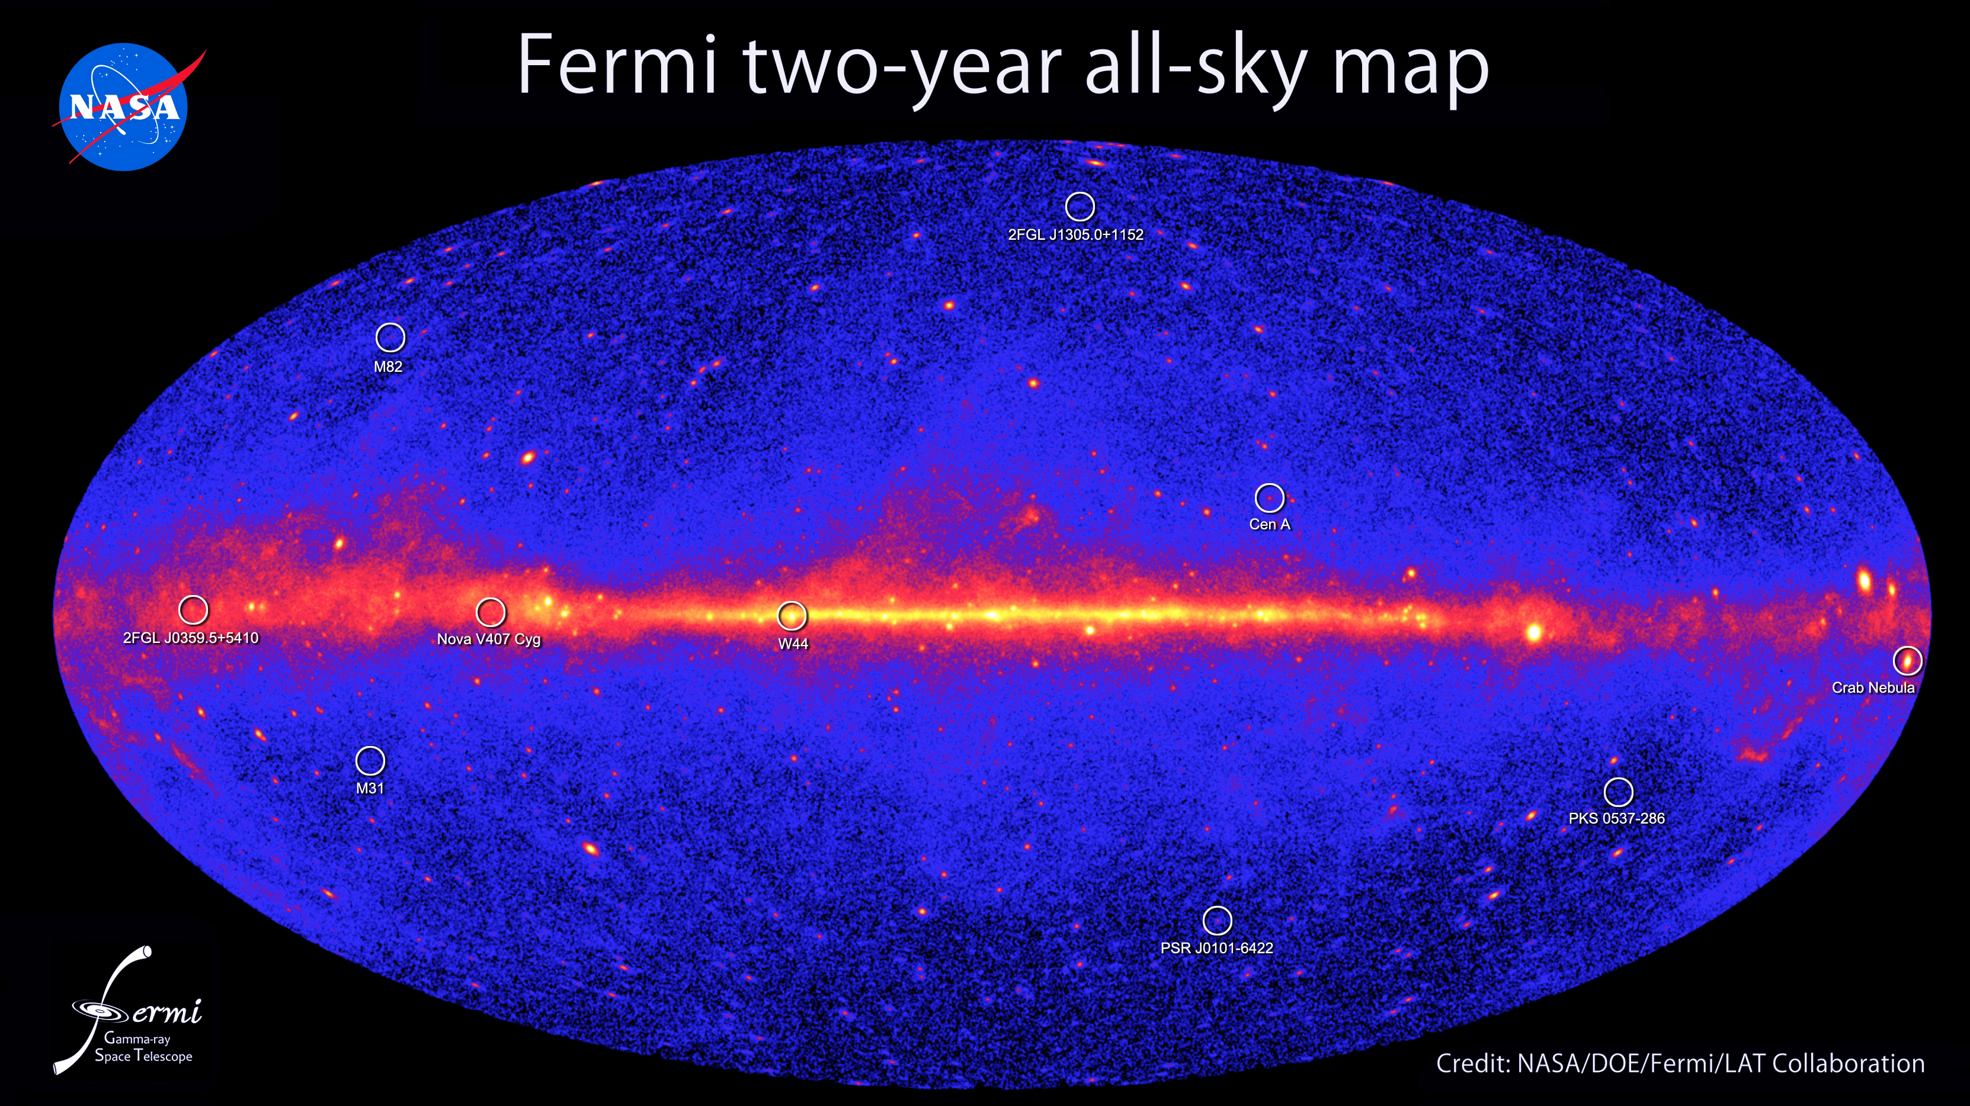

Slide 7
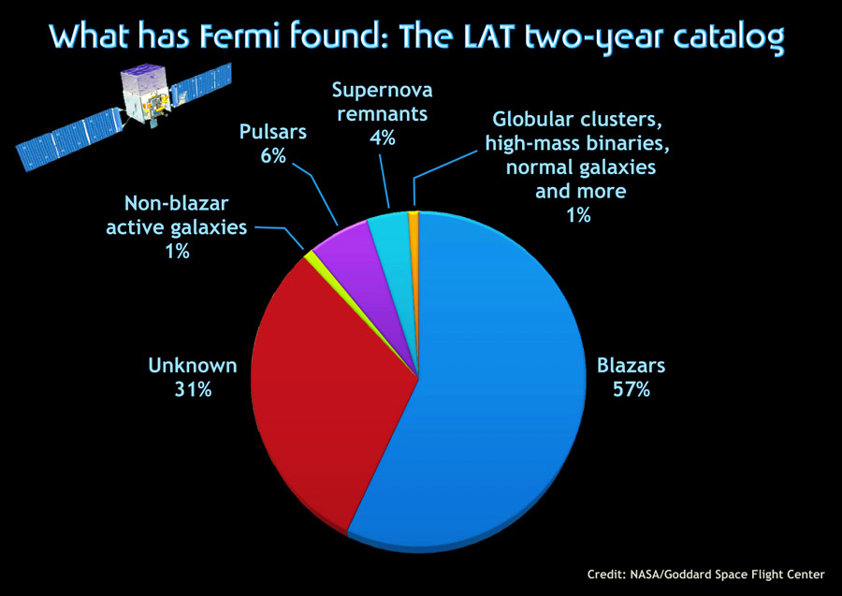

Slide 8
Gamma Ray Bursts (GRB)
Last only a few milliseconds to few minutes:
Long duration = >2 seconds
Short duration = <2 seconds
Hundreds of times brighter than supernova.
GRBs detected ~1x/day in random directions. Need to be aligned with GRB to see it.

Slide 9
What Causes Them?
Long duration GRBs likely caused by Hypernovas.
Hypernova = 100x more powerful than regular supernova.
- star >20x solar mass
- black hole forms inside star before explosion… GRB pushes out of star.

Slide 10
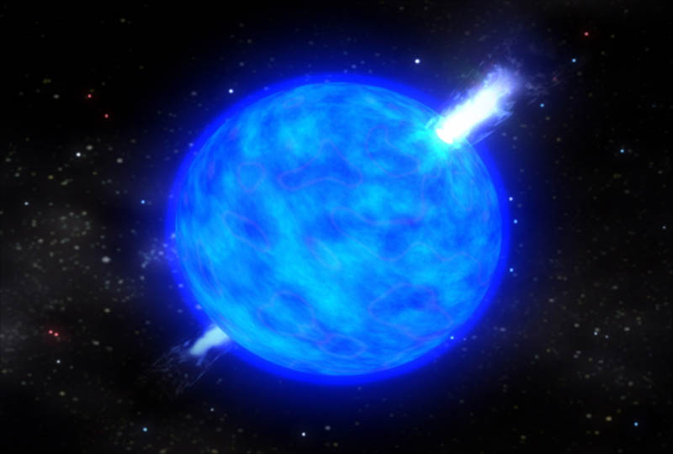

Slide 11
Causes
Short duration GRB likely caused by merging neutron stars.
Not well understood.

Slide 12
GRB Dangers (Controversial)
If aimed at Earth:
- deplete ozone
- acid rain
- global cooling
May have caused mass extinction 488 mya.

