Slide 1

SODAS
Acronym for key
FRQ Tips
Space
Order
Define
Apply
Synonyms

Slide 2
SODAS
Space!
Leave about 5 lines blank
between each separate
component of your answer.
FRQ directions say to not skip
lines, but this refers to
skipping every other line.
SODAS spacing is acceptable.
Notes:
\

Slide 3
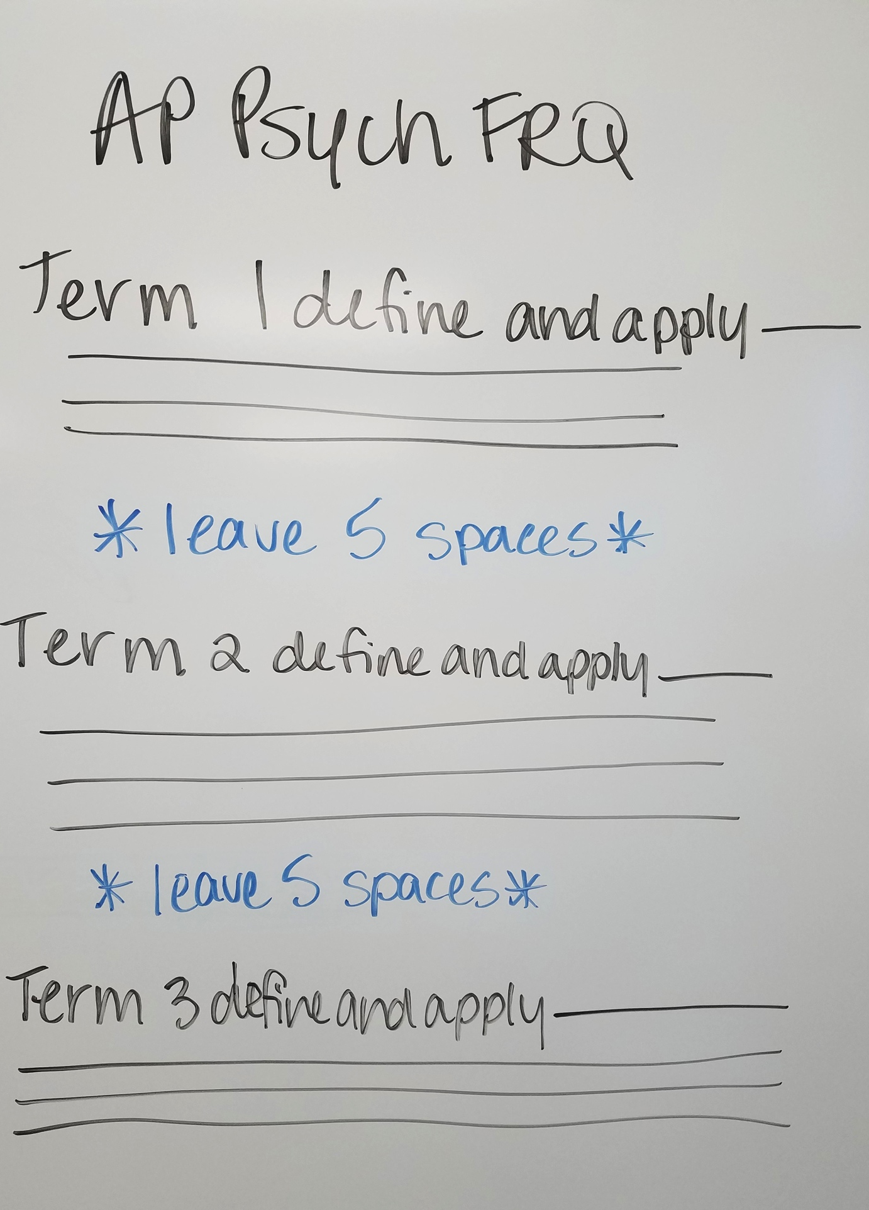
Space!

Slide 4
Order
Answer the components
(often presented in bullets) in
the same sequence that they
are listed in the question.
While there are bullet points
in the question, you SHOULD
NOT use bullet points in your
answer.

Slide 5
SODAS
Define
Briefly explain each
concept using specific
psychological terminology.
If the term is similar to another
term that is covered in the
unit/course, make sure that
you make it clearly
distinguishable from all similar
terms.
Notes:
Although on most (not all) points it is only the application that scores AP readers are allowed to score a weak application IF there is an accurate definition with it.

Slide 6
SODAS
Apply to the scenario
Relate the term to the scenario
or connect terms as directed.
Pay particular attention to
specific instructions in the prompt.
Notes:
NOTE: sometimes the apply can change throughout the question. For example the first two points may require you to relate the term to something “prior” and the last 5 points may ask for the term to relate to something that occurs “subsequently”
APPLY to the scenario – READ THE PROMPT

Slide 7
SODAS
Synonyms
Do not use the term itself
in the definition or the
application of the concept.
In other words, DO NOT use
The word to define itself- use
a synonym!
Notes:
This is often a problem. On Q 2 last year – students frequently failed to score because they used identity to describe identity v role confusion. This issue occurred on several other points as well.

Slide 8
SODAS
Synonyms
INCORRECT - Chunking involves
placing a large amount of items to be
memorized into chunks in order to increase
short-term memory capacity.
CORRECT – Chunking involves placing a
larger amount of items to be memorized into
small groups in order to increase short-term
memory capacity.

Slide 9
Directions:
Answer the following question completely.
Answers must be presented in sentences and sentences must be cogent enough for your meaning to come through. Remember to define AND apply.

Slide 10
Directions:
Spelling and grammatical errors do not reduce a student’s score, but spelling must be close enough that reader is convinced of the word in question.
Application points must be IN CONTEXT – reference the situation.

Slide 11
Directions:
Points will not be awarded if students directly contradict correct information with incorrect information.
Points will be awarded for the definition and the application as well as for correct overall procedure (SODAS)

Slide 12
Question:
Pierre, a student from France, plans to attend college in the United States next year. He is excited about his decision, but he has concerns about his ability to adjust to the cultural differences in the United States.

Slide 13
Question:
A. Define the following terms and explain how they might impact Pierre’s decision regarding what university to choose.
False Consensus
Cognitive Dissonance
Reference Group
Peripheral Route to Persuasion

Slide 14
Question:
Define the following terms and explain how they may relate to Pierre’s attitudes regarding Americans.
Ethnocentrism
Scapegoat Theory
Outgroup Homogeneity Bias

Slide 15


Practice FRQ
Welcome to the U.S. Pierre!

Slide 16
Question:
A. Define the following terms and explain how they might impact Pierre’s decision regarding what university to choose.

Slide 17
False Consensus - Definition
The tendency for individuals to overestimate how many others share their opinions or behave the same way that they do.
How much does not score

Slide 18
False Consensus - Application
Pierre overestimates how many people in his life approve of him going to the U of I and so he decides to attend that school.
Pierre overestimates how many people in his life disapprove of U of I and so he chooses not to attend a different school.
Must reference how this impacts Pierre’s decision about which university to attend.
Notes:
References to “how much” does not score

Slide 19
Cognitive Dissonance - Definition
The tension experienced when there is a mismatch between one's beliefs and actions that motivates a change to reduce the tension
Psychological tension occurring when one’s attitude and behavior are inconsistent; motivates a change in attitude or behavior to reduce the discomfort.

Slide 20
Cognitive Dissonance - Application
Pierre believes that Harvard is a good school but he reads that graduates have a hard time getting jobs in education and this makes him uncomfortable and so he decides to attend Illinois state instead.
Must reference how this impacts Pierre’s decision about which university to attend.
Notes:
For the 4 cognitive dissonance must be resolved by either justification of the attitude or a change in behavior.

Slide 21
Reference Group - Definition
The individuals with whom one shares common aspects of social identity, such as gender, interests, ethnicity, and occupation with who one makes comparisons.

Slide 22
Reference Group - Application
Pierre attends a fancy pants French high school and all of his peers are going to American Ivy League schools so he decides to attend Yale match the group he is a part of socially.
Must reference how this impacts Pierre’s decision about which university to attend.

Slide 23
Peripheral Route to Persuasion - Definition
A method of convincing others that relies on factors other than direct information about a product. The focus may be on the attractiveness of the speaker or a slogan with bright colors.

Slide 24
Peripheral Route to Persuasion - Application
Pierre watches a movie that shows scenes depicting cool student life at the University of Arizona and the flashy images and attractive students convince him to attend the University of Arizona.
Must reference how this impacts Pierre’s decision about which university to attend.

Slide 25
Question:
B. Define the following terms and explain how they may relate to Pierre’s attitudes regarding Americans.

Slide 26
Ethnocentrism - Definition
A specific type of prejudice in which an individual favors their own culture, religious, or racial group’s values, attitudes, and actions over other cultural groups.

Slide 27
Ethnocentrism - Application
Despite his desire to go to university in the U. S. Pierre believes that French students are smarter, sexier, and more cosmopolitan than American students and feels superior to his new classmates as a result.
Must explain Pierre’s attitudes toward Americans.

Slide 28
Scapegoat Theory - Definition
The theory for prejudice that states innocent out-group members are blamed by an individual or group for a negative situation.
Theory that prejudice is the result of individuals who are experiencing hardship, so they blame an innocent outgroup or individual for their misfortune.

Slide 29
Scapegoat Theory - Application
While attending U of I, Pierre becomes annoyed by all the trash on campus and he signals out fraternities as the source of the littering and develops a prejudicial attitude against fraternity members.
Must explain Pierre’s attitudes toward Americans.

Slide 30
Outgroup Homogeneity Bias- Definition
The tendency easily distinguish differences among members of one’s in-groups more easily than among members of one's out-groups.

Slide 31
Outgroup Homogeneity Bias - Application
Pierre hears some of his university classmates being loud in the library and assumes all Americans are loud and obnoxious.
Must explain Pierre’s attitudes toward Americans.

