Slide 1
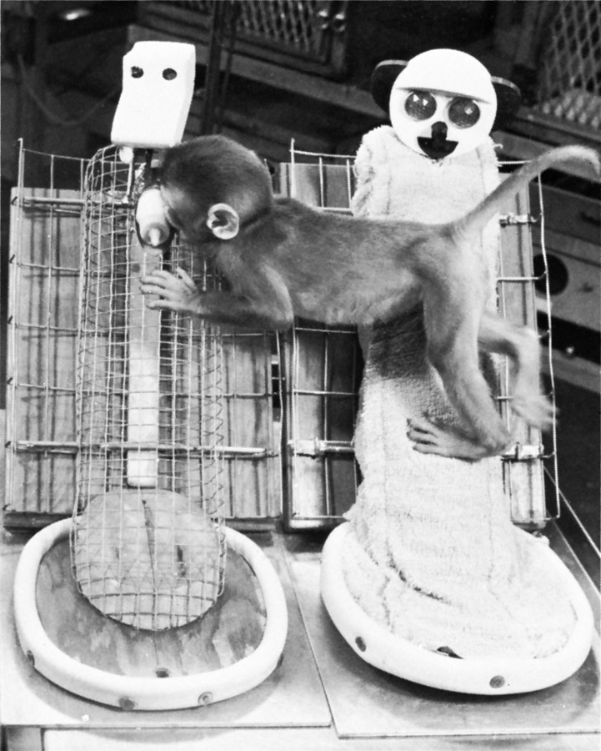
Origins of Attachment
Harlow (1971) showed that infants bond with surrogate mothers because of bodily contact and not because of nourishment.
Harlow Primate Laboratory, University of Wisconsin
Notes:
OBJECTIVE 12| Discuss the effects of nourishment, body contact, and familiarity on infant social attachment.

Slide 2
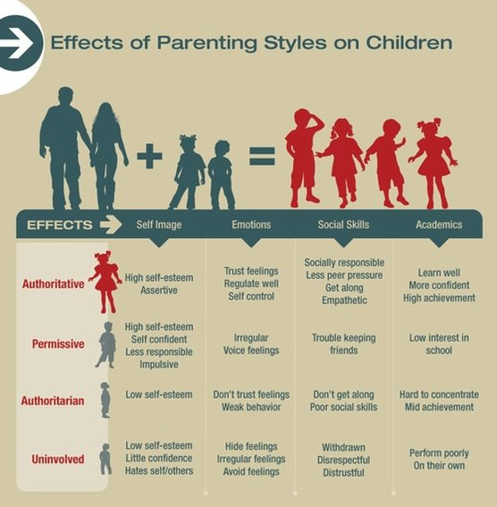

Slide 3
Child-Rearing Practices
Practice | Description
Authoritarian | Parents impose rules and expect obedience.
Permissive | Parents submit to children’s demands.
Authoritative | Parents are demanding but responsive to their children.
Notes:
OBJECTIVE 16| Describe three parenting styles, and offer three potential explanations for the link between authoritative parenting and social competence.

Slide 4

Secure Attachment
Relaxed and attentive caregiving becomes the backbone of secure attachment.
Berry Hewlett

Slide 5
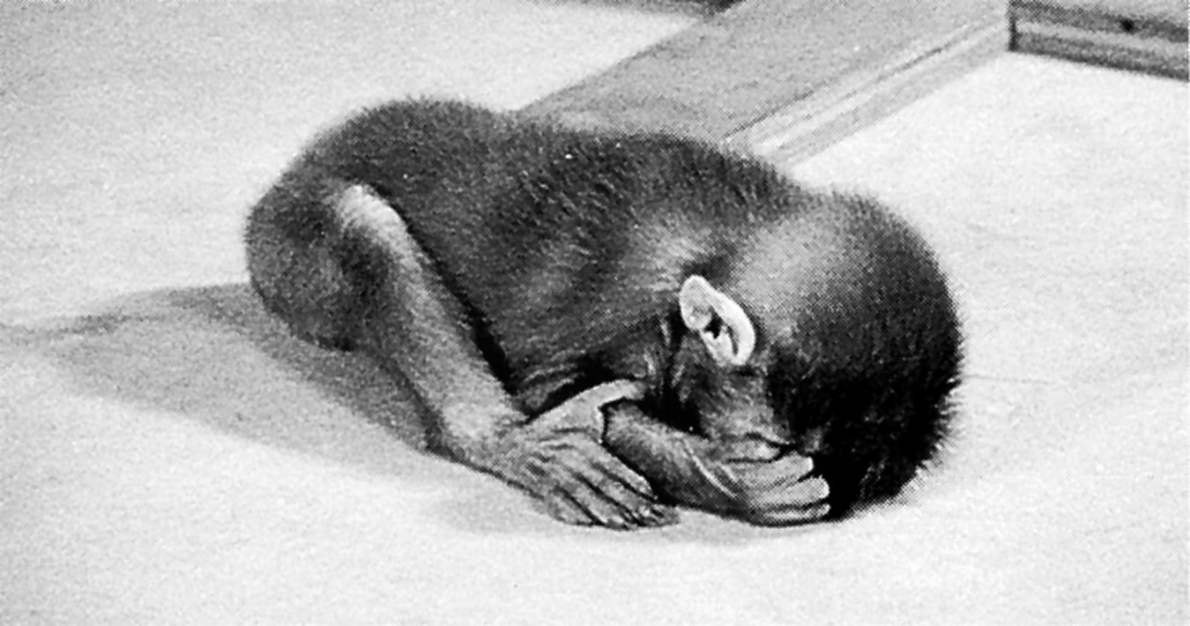
Insecure Attachment
Harlow’s studies showed that monkeys experience great anxiety if their terry-cloth mother is removed.
Harlow Primate Laboratory, University of Wisconsin

Slide 6
Deprivation of Attachment
What happens when circumstances prevent a child from forming attachments?
In such circumstances children become:
Withdrawn
Frightened
Unable to develop speech
Notes:
OBJECTIVE 14| Assess the impact of parental neglect, family disruption, and day care on attachment patterns and development.

Slide 7
Attachment Differences
Placed in a strange situation, 60% of children express secure attachment, i.e., they explore their environment happily in the presence of their mothers. When their mother leaves, they show distress.
The other 30% show insecure attachment. These children cling to their mothers or caregivers and are less likely to explore the environment.
Notes:
OBJECTIVE 13| Contrast secure and insecure attachment, and discuss the roles of parents and infants in the development of attachment and an infant’s feelings of basic trust.

