Slide 1
Extrasolar Planets
Exo-planets are planets outside the Solar System.
They orbit another star.
5,000+ confirmed…10,000 identified, but likely billions exist in the Milky Way alone.

Slide 2
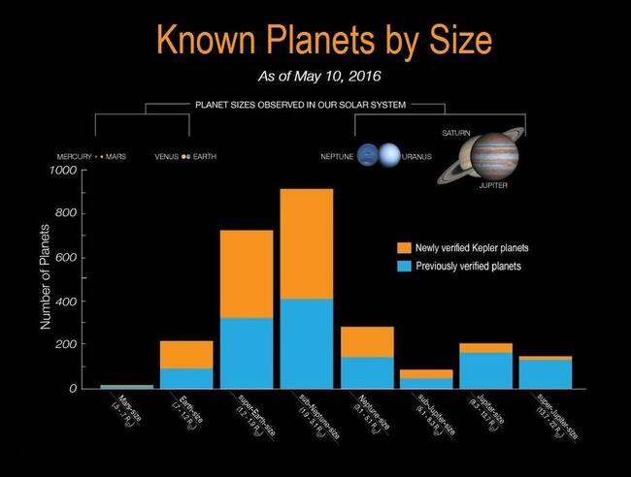

Slide 3
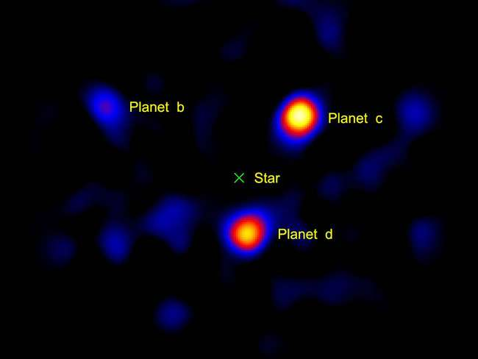
120 ly away (HR 8799)

Slide 4
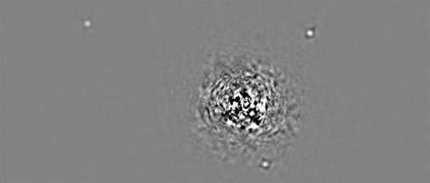
HR 8799 (Infrared-Keck)

Slide 5

Exoplanets
First one detected in 1992.
Most are giant planets like Jupiter…why?
Likely because these are easier to see.
262 orbit in “habitable zone” (liquid water).

Slide 6
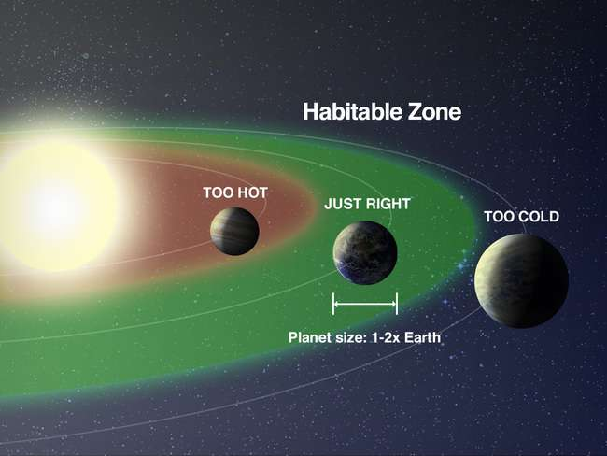

Slide 7
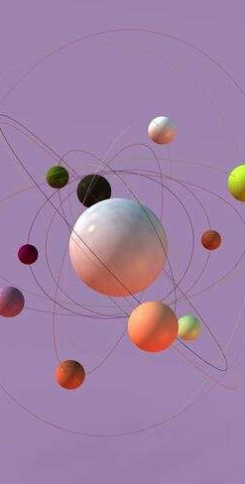
Detection Methods
Planets typically have <1 millionth of star’s brightness.
1. Doppler Method (Radial Velocity) = orbit of planet effects star’s velocity. Most productive.

Slide 8
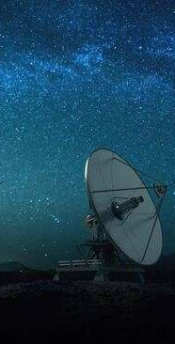
Detection Methods
2. Transit Method = watch for dimming of star brightness as planet moves in front (“transit”).
Kepler Mission Space Observatory uses this.

Slide 9

Detection Methods
3. Transit Timing Variation (TTV) = a planet’s transit can distort due to another planet.
4. Gravitational Microlensing = star’s gravity acts like a lens, magnifying light from background star. Planet distorts this light.

Slide 10
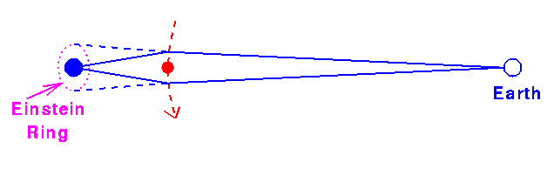

Slide 11
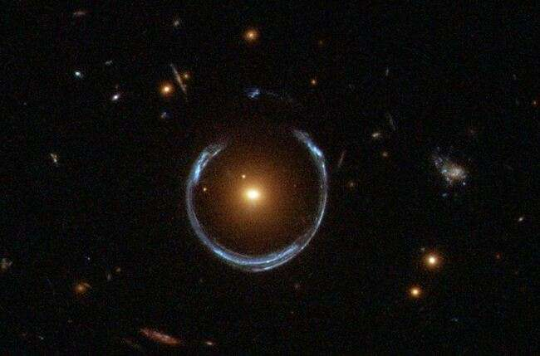

Slide 12
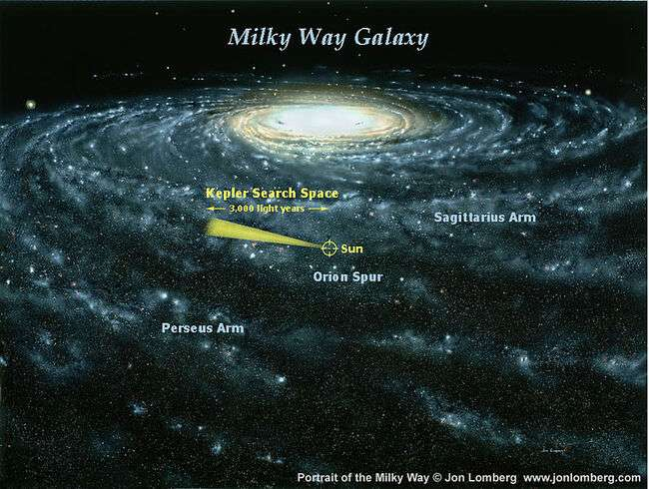

Slide 13
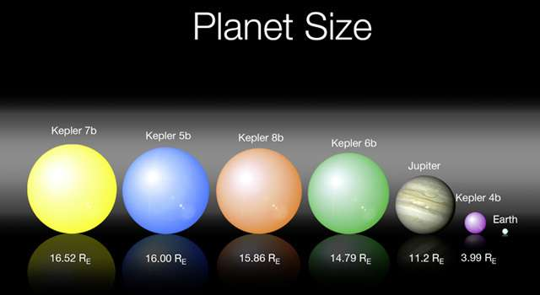
Kepler’s First Five

Slide 14
Kepler 22b
First habitable zone planet (Dec. 2011)
Rocky planet 2.4x size of Earth.
600 ly away
Star is similar to Sun, but smaller.

Slide 15
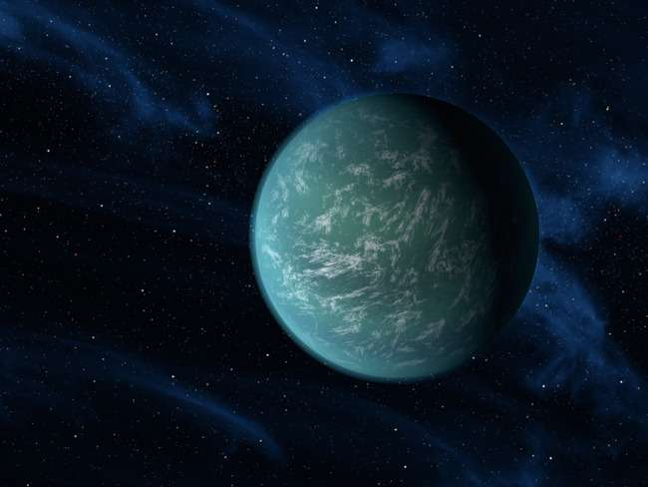

Slide 16
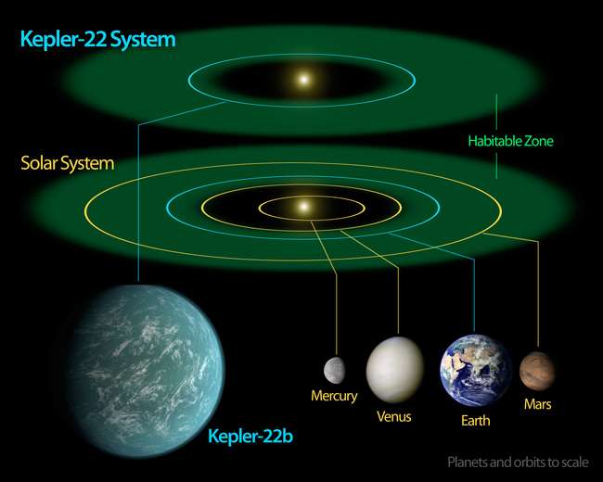

Slide 17
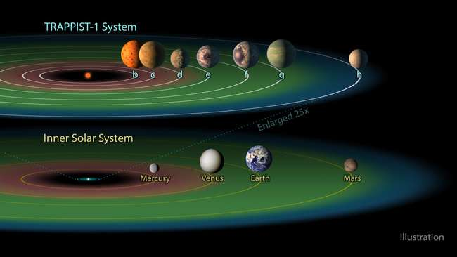
Trappist-1 System

Slide 18
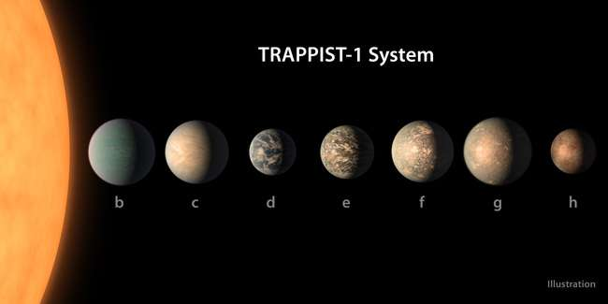

Slide 19

Trappist 1f (maybe?)

