Slide 1
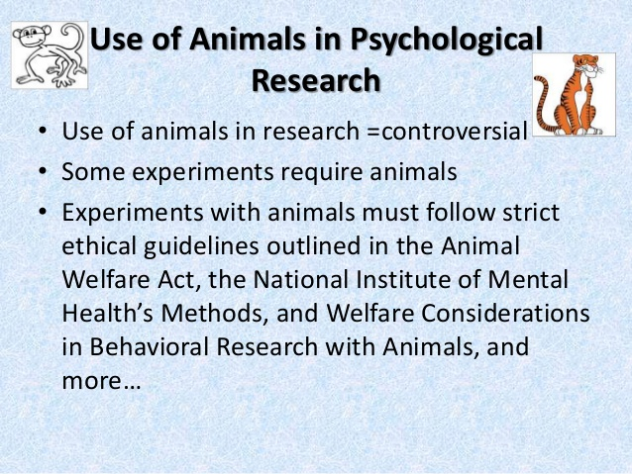

Slide 2


Slide 3
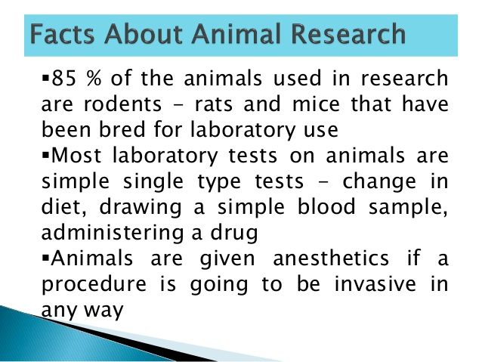

Slide 4
Ethics in Human Research
  Informed Consent
  Protect from harm and discomfort
  Maintain confidentiality
  Debriefing - if deceit used, inform after research.

