Slide 1
Erosion and Deposition
Erosion = moving sediments (particles)
Deposition = sediments stop moving.
*Gravity and Water are biggest factors*
1. Streams
2. Glaciers
Landslides
Wind
Waves

Slide 2
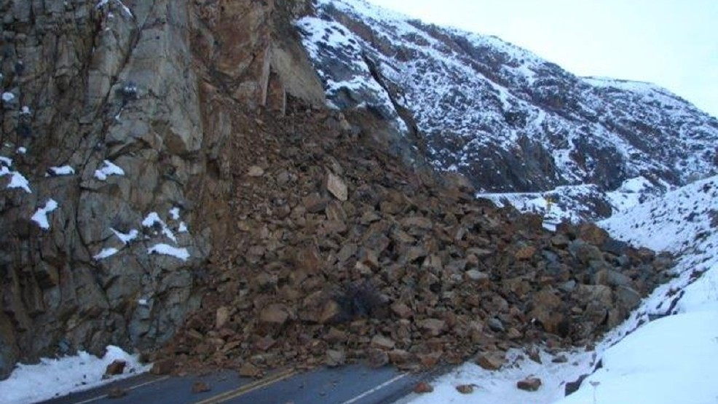
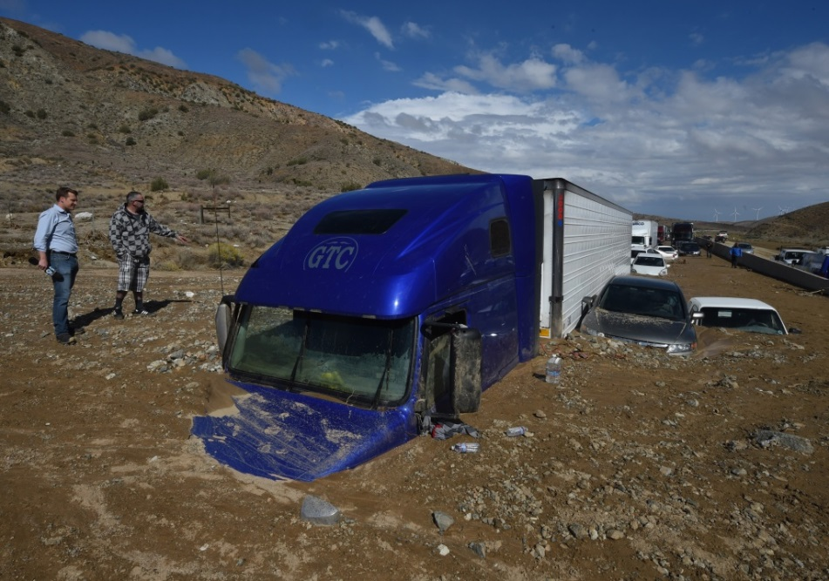
Gravity
Pulls material from high elevations to low

Slide 3
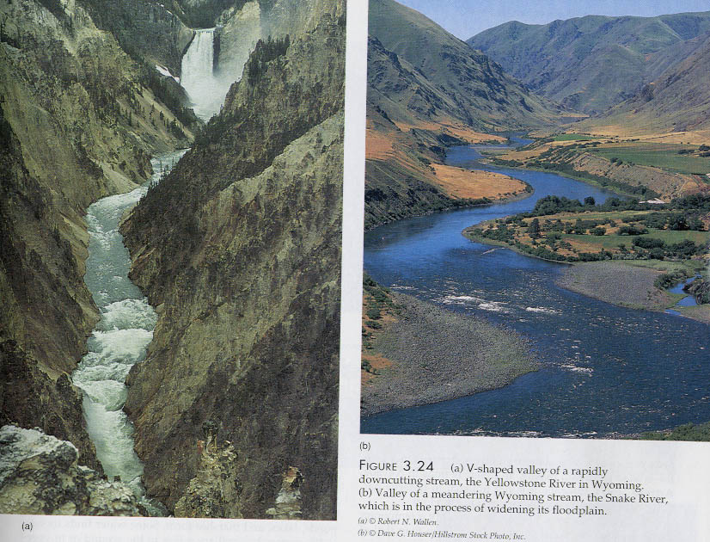
Stream Evolution
Youth (Head)
mountains, narrow, fast, steep gradients (slope)
V-shaped valley
Mature (Mouth) = gentle gradients (slope), wider, slow, stream begins to meander.
meander = to wander (curve)

Slide 4
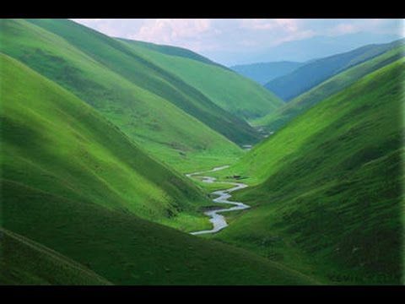
V-Shaped Valley

Slide 5
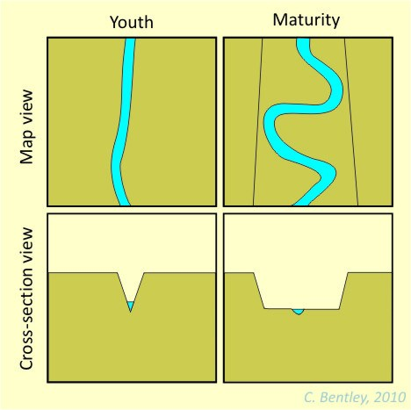
Stream Evolution

Slide 6
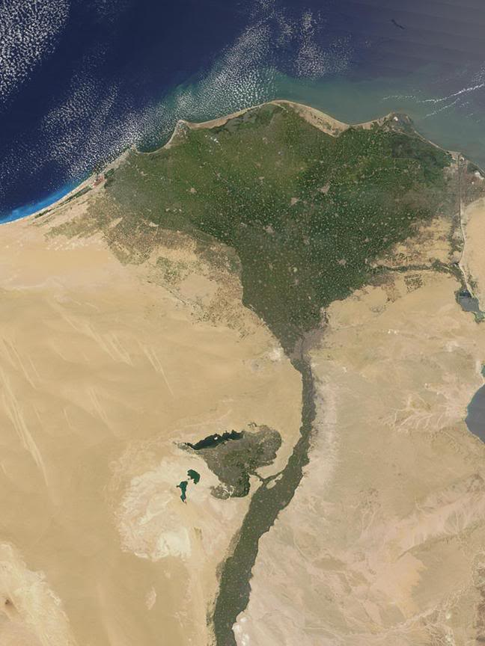
Delta
Mouth
where stream enters ocean or lake.
Delta forms here
Delta
a triangular land mass formed by deposition.

Slide 7
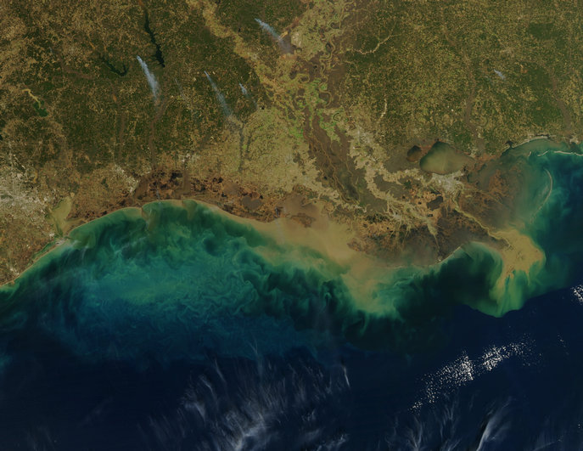

Slide 8
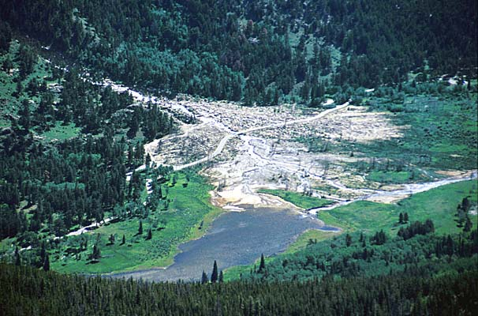
Alluvial Fan
(like a delta, but dry)

Slide 9
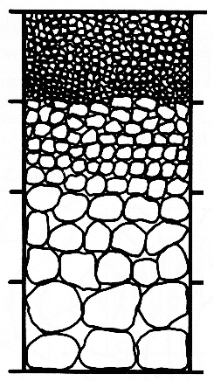
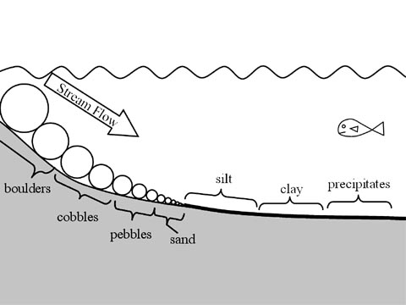
Deposition
Large particles settle more quickly than smaller particles = sorting

Slide 10
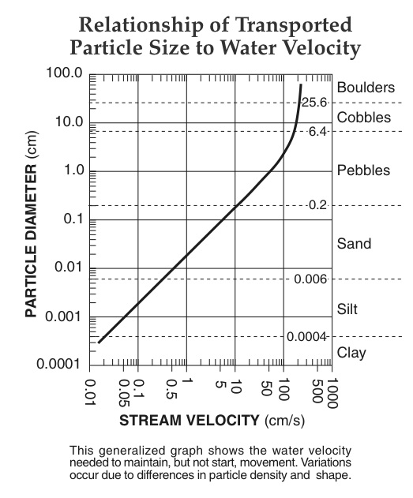
Running Water
Faster water carries larger particles (erosion)
As the speed slows, large particles are deposited first (deposition)

Slide 11
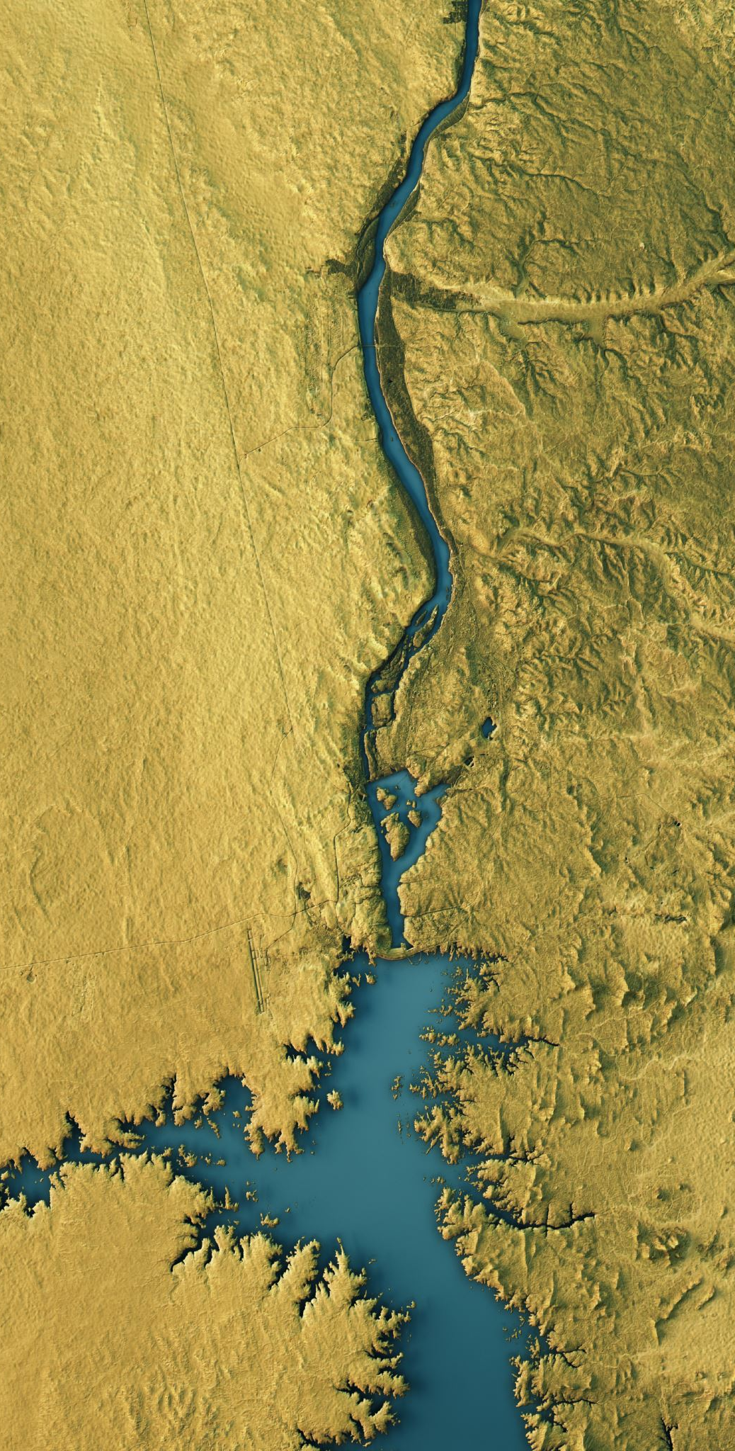
Question
A stream with a velocity of 100 centimeters per second flows into a lake. Which sediment-sized particles would the stream likely deposit first as it enters the lake?
Boulders
Pebbles
Sand
Cobbles

