Slide 1
Electromagnetic Radiation
Energy = movement of atoms and molecules.
Electromagnetic radiation (EMR) = electric and magnetic fields traveling through space.
Visible EMR is called light.
EMR travels in “waves” and “particles” that carry energy.
Photon is basic unit of EMR.

Slide 2
Frequency - Wavelength
Wavelength = distance from crest to crest.
Frequency = time it takes for wavelength to repeat.
Short wavelength are high frequency
Long wavelengths are low frequency

Slide 3
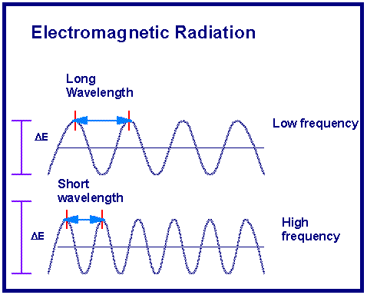

Slide 4
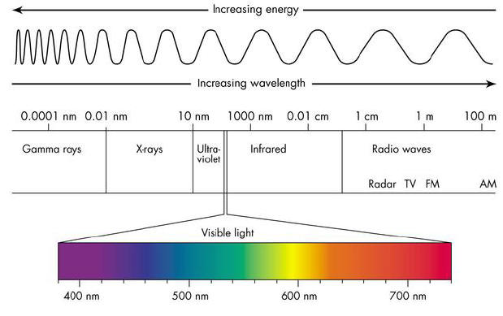
Electromagnetic Spectrum

Slide 5
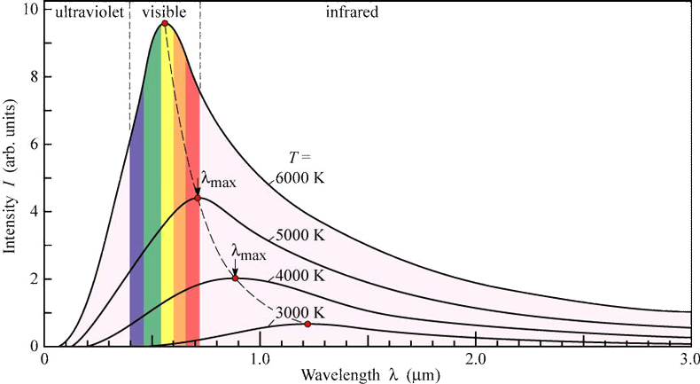
Solar Radiation

Slide 6
Temperature
Temperature = measurement of motion (or energy) of particles.
Kelvin = “absolute zero” is 0 Kelvin
Celsius
Fahrenheit
Absolute Zero = temperature where atoms move as slowly as they possibly can. (-273⁰ C or -459⁰ F)

Slide 7
Luminosity
Luminosity (brightness) - measurement of amount of EMR radiated.
Magnitude - scale used to measure luminosity
The brighter the object, the lower the magnitude number. Ex. Sun = -27, Pluto = 14

Slide 8
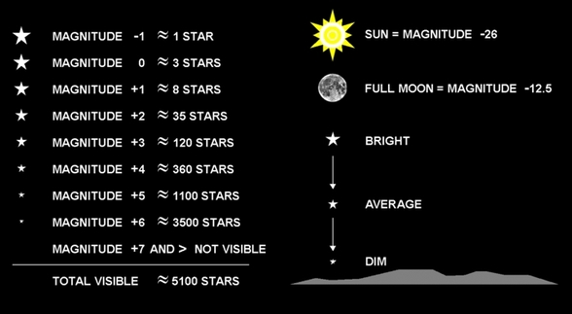

Slide 9
Magnitude Scale
Apparent Magnitude = How bright is object as seen from Earth, without Earth’s atmosphere.
Absolute Magnitude = the brightness a star would have 10 parsecs (33 ly) from Earth.
- independent of distance.

Slide 10
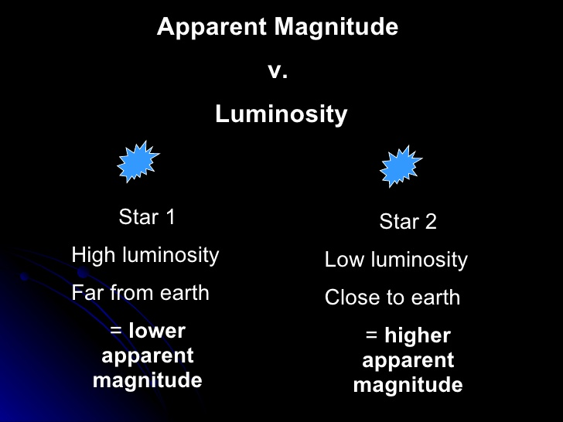

Slide 11
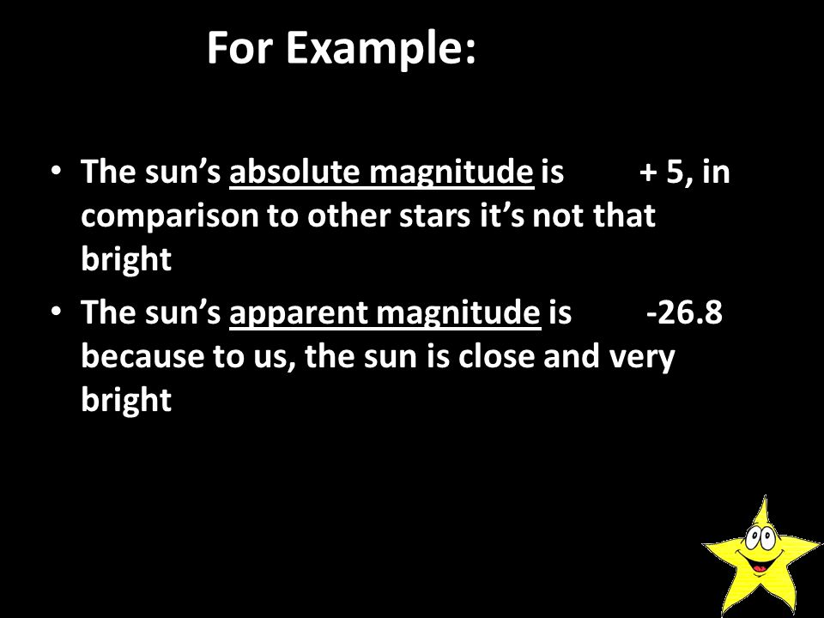

Slide 12
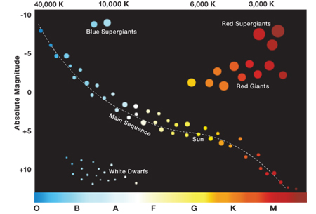

Slide 13
EM Spectrum
Continuous Spectrum = energy at all wavelengths.
Ex. rainbow.
Usually from hot, dense objects likes stars = thermal spectrum

Slide 14
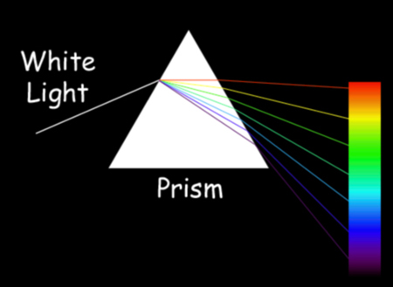

Slide 15
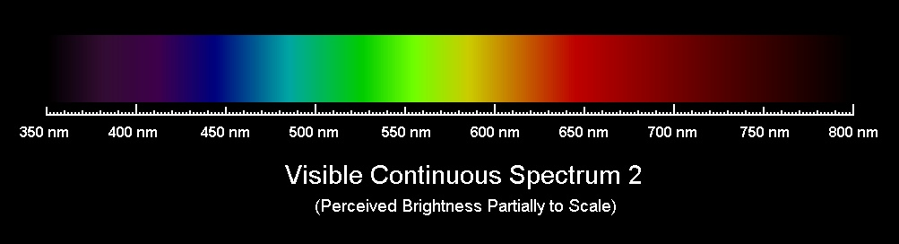
Continuous Spectrum

Slide 16
Continuous Spectrum
All mass has thermal spectrum, if over 0 Kelvin.
Only depends on temperature, not composition (can determine star temperatures).
Cool temperature = red
Hot temperature = blue

Slide 17
EM Spectrum
Discrete Spectrum = energy at certain wavelengths. Used to determine composition of object (star).
Absorption Lines (dark spaces) = radiation absorbed by cooler gas.
Emission Lines (bright lines) = radiation emitted by hot gas.

Slide 18
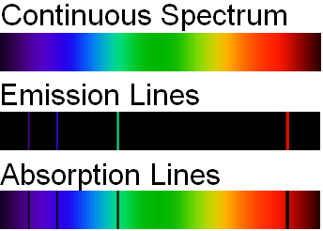
Discrete Spectrum
A spectrograph observes spectrum.

Slide 19
Interactions
1. Refracted = bent due to density differences.
2. Reflected = bounced off material
3. Absorbed = taken into material

Slide 20
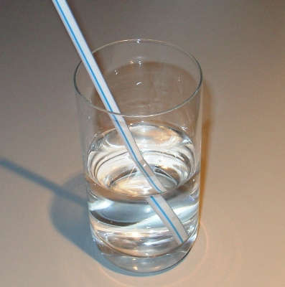
Refraction

Slide 21
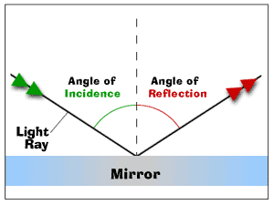
Reflection

