Slide 1
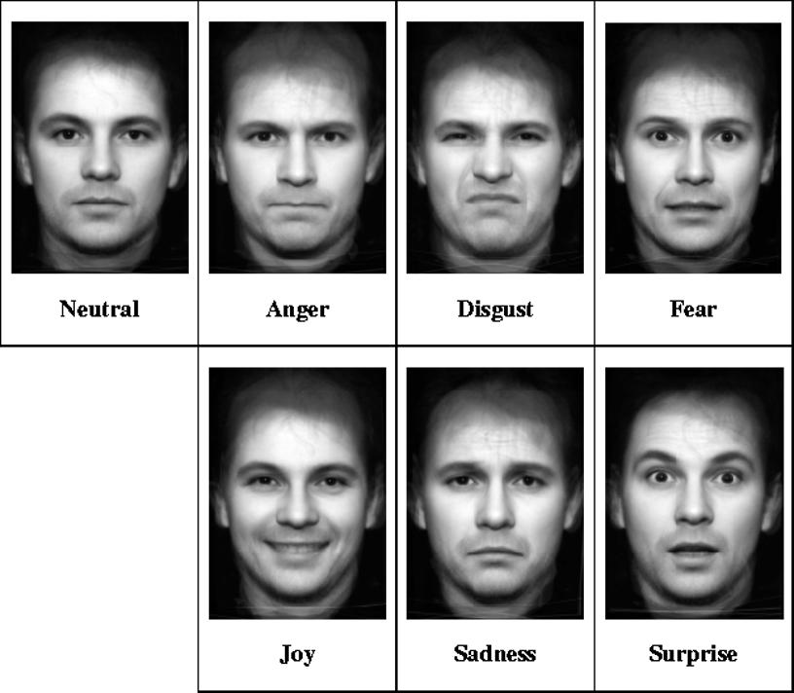
Basic Emotion
Revised model of basic emotions includes:
  Happiness
  Surprise
  Sadness
  Fear
  Disgust
  Anger

Slide 2
Theories
James-Lange Theory
Cannon-Bard Theory
Schachter-Singer Theory
High-Low Road (Ledoux)

Slide 3
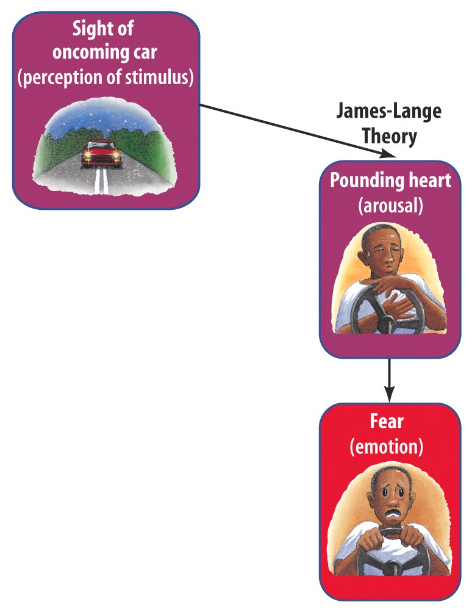
James-Lange Theory
The James-Lange Theory proposes that the emotion follows the body’s response, not before

Slide 4
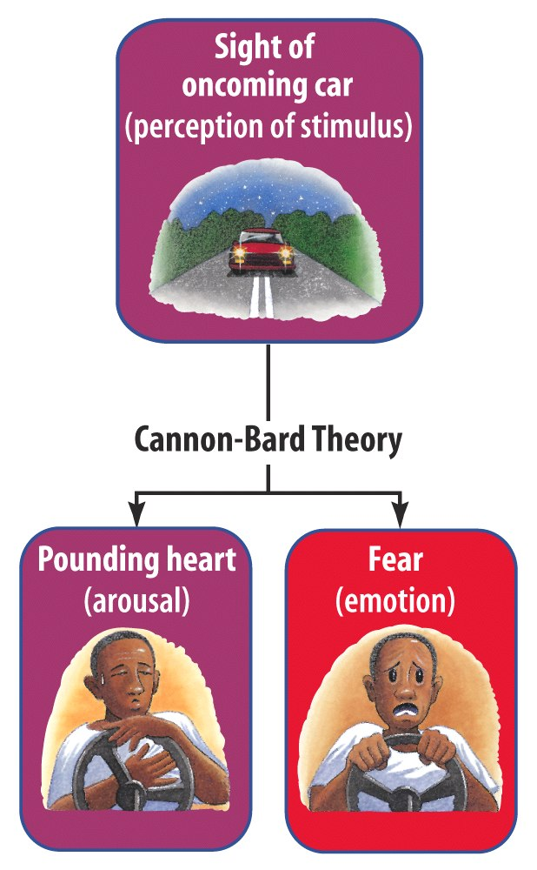
Cannon-Bard Theory
Walter Cannon and Phillip Bard proposed that an emotion and the body’s response take place simultaneously.
Notes:
1) Cannon suggested that body’s responses were not distinct enough to evoke different emotions. 2) Physiological responses seemed too slow to trigger sudden emotions.

Slide 5
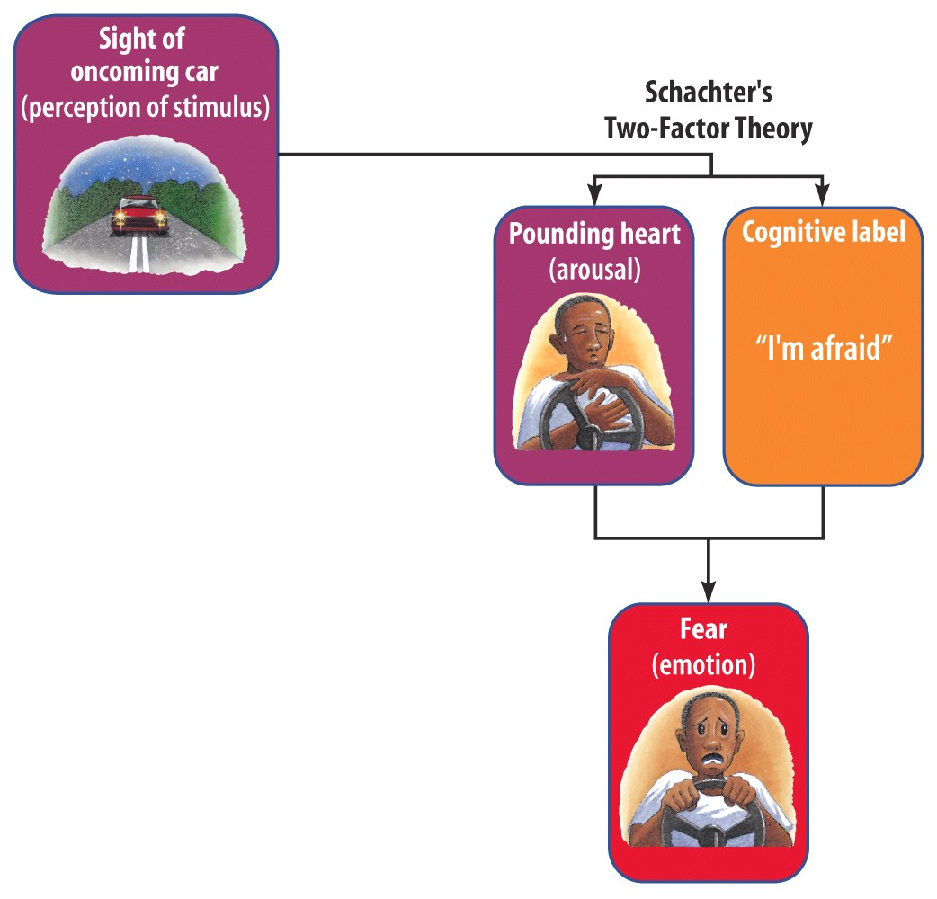
Schachter-Singer Two-Factor Theory
Stanley Schachter and Jerome Singer suggest that emotions cannot exist without appraisal.
That labeling the feeling creates the emotion.

Slide 6
The Schachter-Singer Theory
Testing the theory
Hypothesis: The same bodily reaction will cause one emotion in one situation, and another emotion in a different situation.
  Give people a dose of adrenaline;
  Put them in different situations;
  What happens?
Notes:
Of course, explained like this it might sound like it just “makes sense,” but as always, we would like a little bit of actual proof that this is what happens. To test the theory, we need a strong hypothesis that the theory would predict.
The Schachter theory assumes that the body cannot tell us exactly what we are or should be feeling. Instead, even if we have a fast bodily reaction to something, it is our mind that decides what the emotion will be. In other words, will the same bodily reaction be interpreted in different ways if you are in different situations?
Schachter & Singer did a very fun experiment to test exactly that question. Basically, they gave people a dose of adrenaline, which created a certain bodily reaction [beating heart]; but then they put them in different situations [bug/face]. The idea is that the cognitive appraisal of the situation should influence the emotion you feel. SO if you are with a giant bug, you’d feel fear; if you’re with a gorgeous man, you’d feel love. Or woman. In the pictures we’ve been using so far, we have bodily reaction; two DIFFERENT situations; and then two DIFFERENT emotions.

Slide 7



The Schachter-Singer Theory
Testing: Men get injection of adrenaline. One group told that they will feel aroused. Other group is told no effect. Then put into room with either angry or happy person. Same physiological arousal, but different emotions based on knowledge.
Told pill had no effect
(know what
pill does)
Control Group
VERY ANGRY
Medium angry
Least angry
VERY EXCITED
Medium excited
Least excited
Notes:
Ok, in a moment I’m going to ask you to make some predictions, so be ready.
Now in the real study, to make the situations, they didn’t bring in giant bugs, or even Brad Pitt, sadly. In the real experiment, instead of a giant bug, they trained a “confederate” to act as a co-participant who was really angry and annoyed at everything; and instead of movie stars, there was just a confederate who was super, super excited and happy about everything. So the two situations were a super-angry co-participant, or a super-happy co-participant.
Now, like good scientists, they of course some control groups. They had two control groups: people who didn’t take the adrenaline pill at all; and people who had taken the adrenaline pill but were told what the pill would do to them.
Ok. Take a look at those three groups in blue. Each of the groups had to deal with a very angry co-participant. Which group do you think was the angriest? First, second, or third?
Now what does this show us? It shows that even the very same feelings in the body cannot create the very same emotion; instead, it depends on how we interpret those feelings in the body, in the CONTEXT of the situation. It proves, in other words, that the mind has a great deal of control over how we feel. It also shows, however, that our body matters too. If your body is reacting in a certain way, and you have no reason to ignore it, then you will naturally interpret it as a part of your emotion; you will actually FEEL happier or angrier.
Now, next time you’re really angry at your best friend, or your parents, or your exam... If you don’t want to feel angry, it might do you some good to act like these people who knew what the pill was going to do for their body!

Slide 8
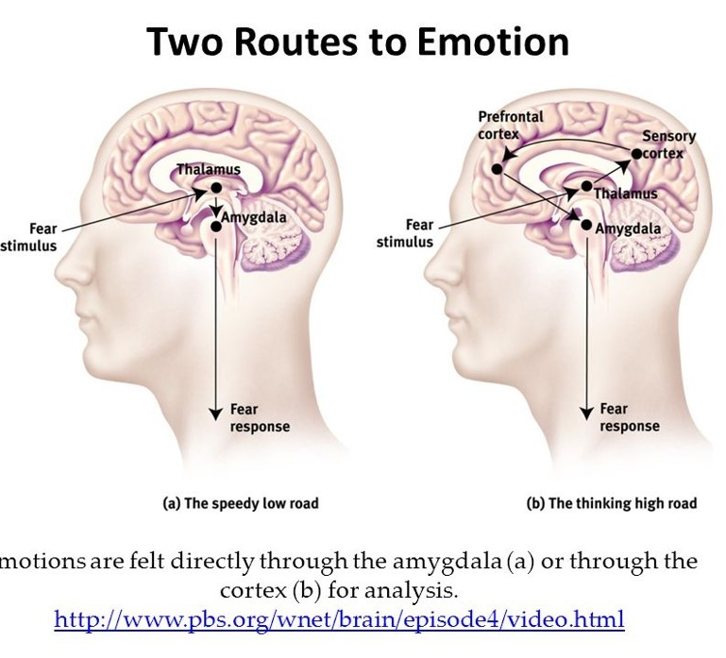
LeDoux
Jump at sound first, then realize it’s just the wind.
Fast processing path directly to the amygdala, causes initial fear,
Slower path processes sensory information first, which can then override fear response.

Slide 9
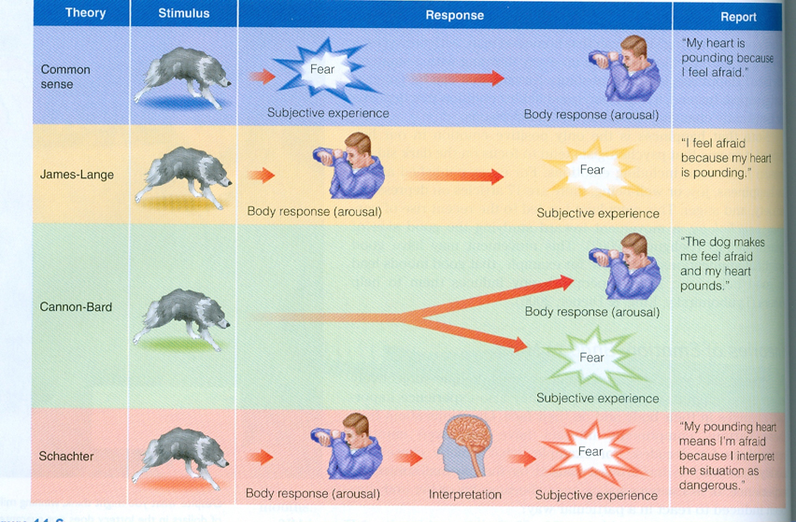

Slide 10
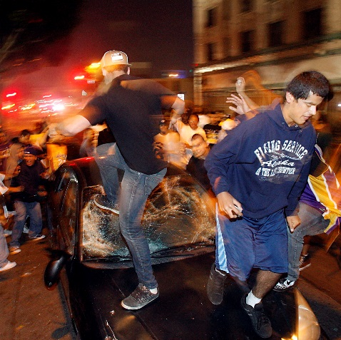
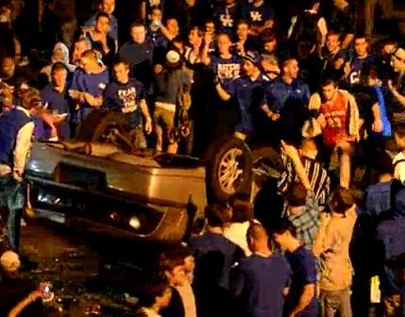
Spill-Over Effect
An arousal response to one event spills over into our response to the next event.
Arousal from a soccer match can fuel anger, which may lead to rioting. Arousal fuels emotion, cognition channels it.
Notes:
OBJECTIVE 6| Explain how spillover effect influences our experience of emotion.

