Slide 1
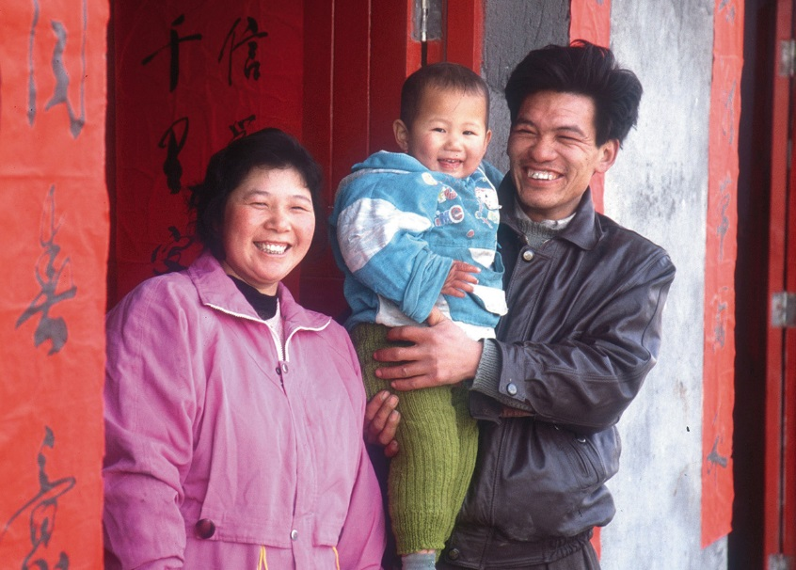
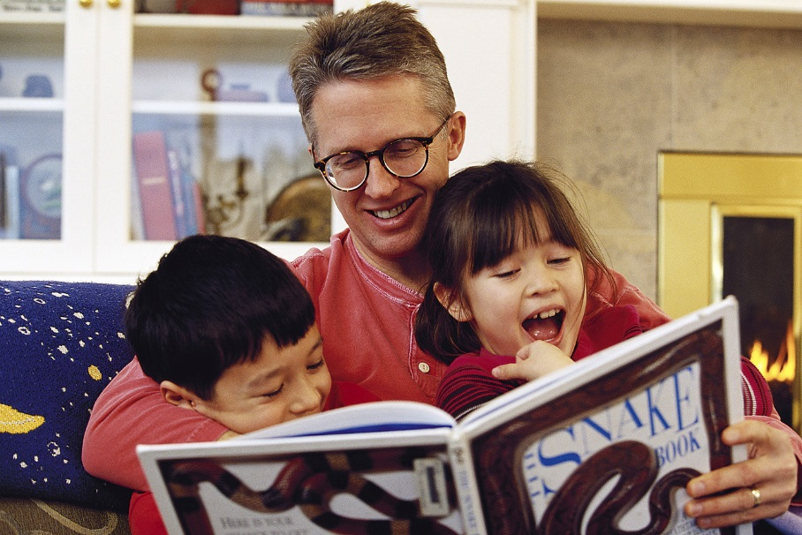
Expressed Emotion
Emotions are expressed on the face, by the body, and by the intonation of voice. Is this non-verbal language of emotion universal?

Slide 2
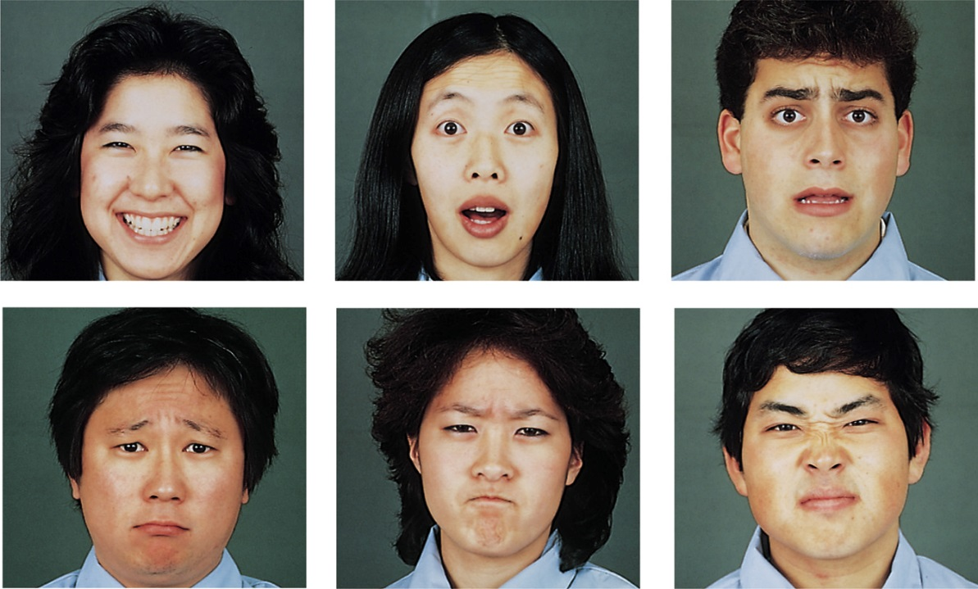
Culture and Emotional Expression
When culturally diverse people were shown basic facial expressions, they did well at recognizing them (Ekman & Matsumoto, 1989). Darwin argued this is evolutionary.
Can you tell?
Disgust
Anger
Fear
Happiness
Sadness
Surprise
Notes:
OBJECTIVE 11| Discuss the culture-specific and culturally universal aspects of emotional expression, and explain how emotional expressions can enhance survival.

Slide 3
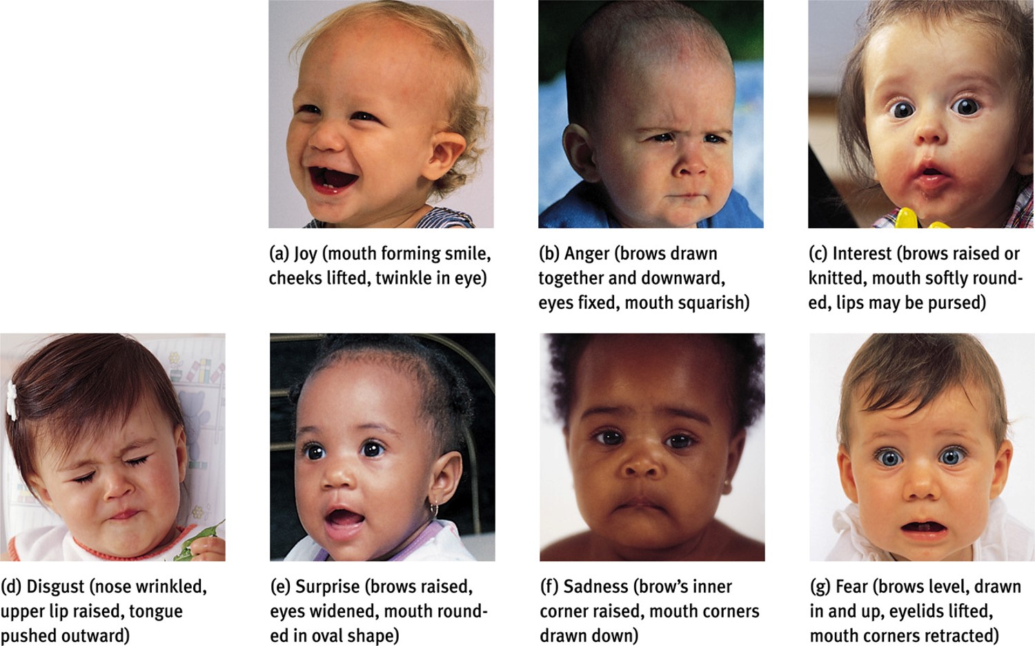
Expressed Emotions

Slide 4
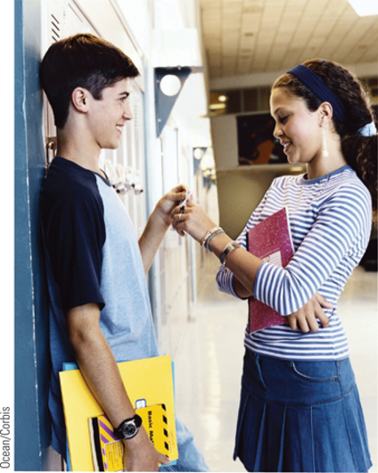
Detecting Emotion in Others
- We are good at detecting subtle changes in facial cues:
Ex. A 10 second clip of a teacher’s voice or face while talking to a child was enough for people to determine whether the teacher liked or admired the child.
- Experience effects our perception of emotion:
Ex. Physically abused children spot signals of anger quicker than others.
- Women may be slightly better at this than men.
- Context matters. Can confuse anger for fear depending on situation.
- We are very good at detecting threats:
Ex. In a crowd of faces, a single angry face “pops out” faster than a happy face.
Ex. Even in another language we can detect anger.

Slide 5
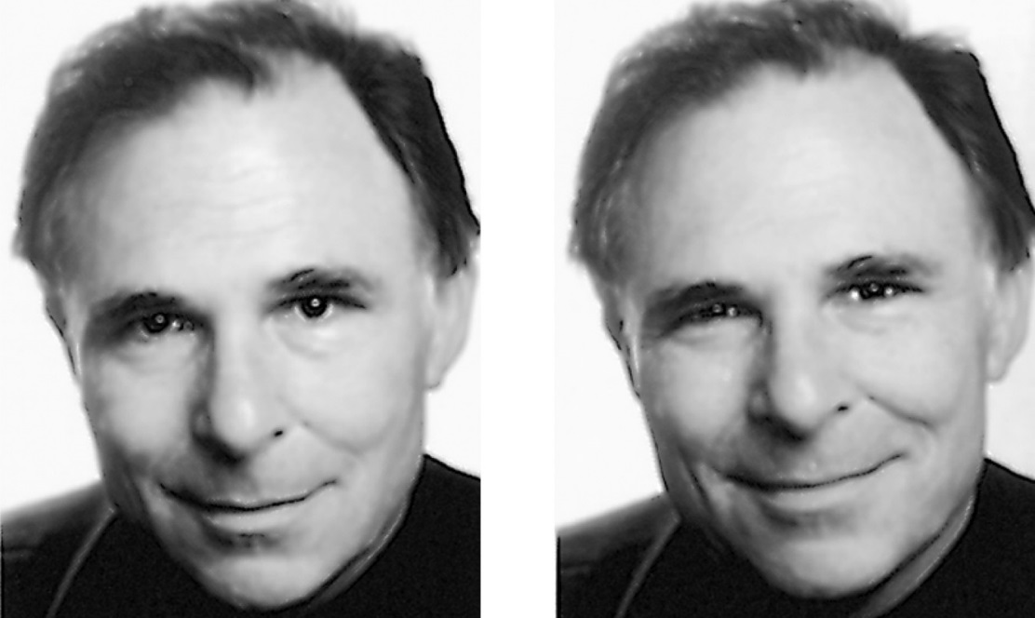
Detecting Deception
Most people find it difficult to detect deceiving emotions. Even trained professionals like police officers, psychiatrists, judges, and polygraphists detected deceiving emotions only 54% of the time.
Which of Paul Ekman’s smiles is genuine?
Notes:
OBJECTIVE 10| Discuss the research on reading and misreading facial and behavioral indicators of emotion.

Slide 6
Facial Expressions Influence Feelings
Expressions can amplify emotions
Darwin: “…an outward sign of emotion intensifies it….He who gives way to violent gestures will increase his rage.”
Try it! Pull your eyebrows together and contract the muscles. (do you feel angry?)
Fake a big grin…now scowl
(do you notice a different feeling?)
It’s been shown that people can tell when someone is smiling during a phone call. Telemarketers are told to smile during a sale…it will translate into good feelings for the seller and purchaser.

Slide 7
Work-world perceptions differ
People possess entrenched cultural ideas that associate men with leadership qualities like decisiveness, authoritativeness, and strength
Associate women with nurturing qualities like warmth, friendliness, and kindness.
Consequently, when women behave in dominant ways, they are seen as unlikeable because they violate norms of female niceness.
Alternatively, women displaying feminine traits are judged as less competent and capable.
Women, then, face a kind of trade off: competency vs. likeability. Men do not face this kind of trade off.
Notes:
http://www.stanford.edu/group/gender/cgi-bin/wordpressblog/2010/11/for-women-leaders-body-language-matters/

Slide 8
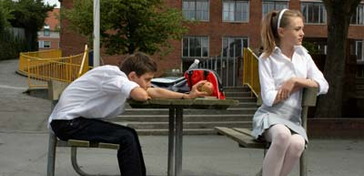

Slide 9
Flirting (mating dance?) – not necessarily
Primping
Eyes turned downward
Held tilting
Exposure of the neck
“Smile (coy)” an expression combining a half-smile and lowered eyes
Proximity
Caressing of self
Needless touch
Parading
Samson Pose

Slide 10


Slide 11



Slide 12
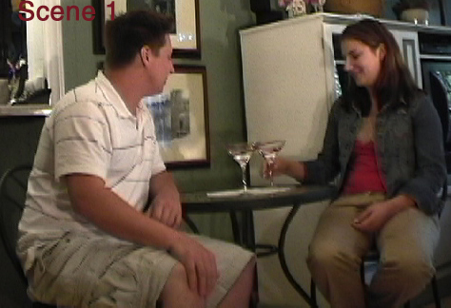

Slide 13
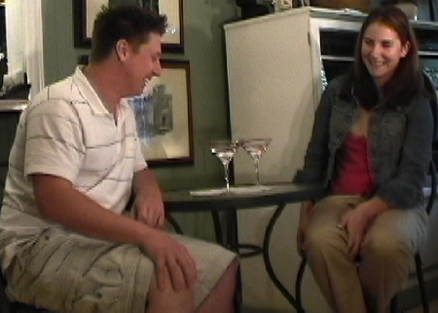

Slide 14
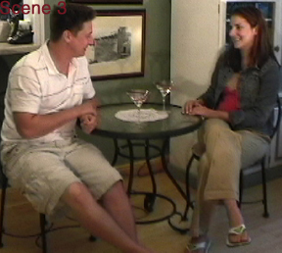

Slide 15
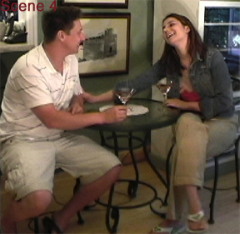

Slide 16
