Slide 1
Space, Time and Einstein
Penelope Constanta
Fermilab

Slide 2
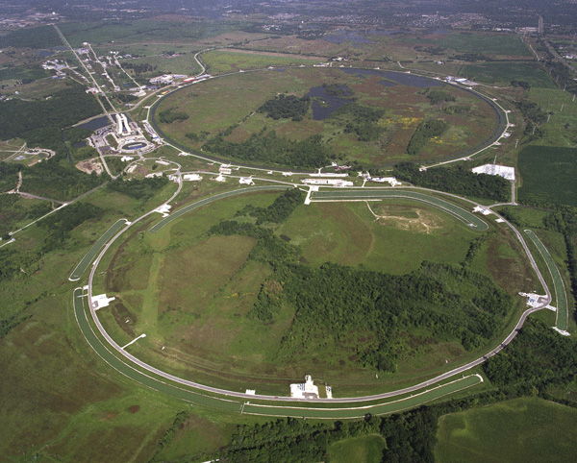
Fermilab
Chicago (~40 miles)
Still Middle School (~7.5 miles)

Slide 3
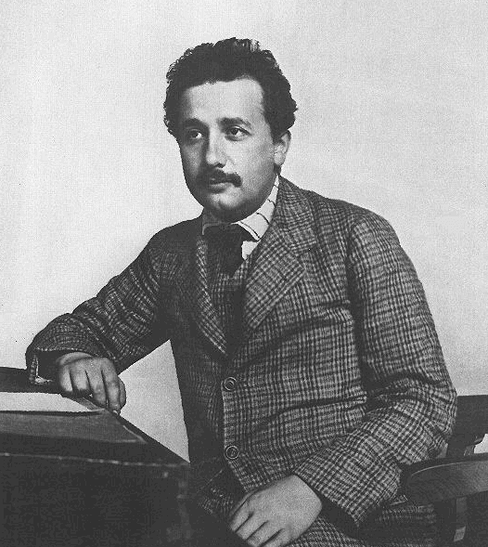
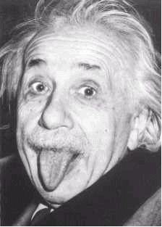
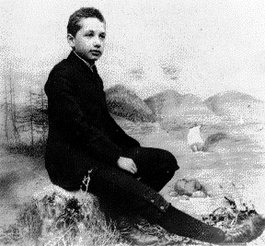
Why Einstein?
Because … he was Einstein!
Widely regarded as one of the most influential and best known scientists and intellectuals in modern history. Often regarded as the father of modern physics
1905: Clerk in Patent Office
School boy
At older age!

Slide 4
What did Einstein do?
Many, many discoveries. Easily could have won 3-4 Nobel prizes. Won only one for the discovery of the law of the photoelectric effect.
Two theories of relativity (Special Relativity and General Relativity)
  E=mc² (special relativity)
  Gravity (general relativity)

Slide 5
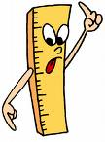

Space and Time
Space
  This piece of paper is 8 inches long
  It is 1.5 miles from the school to the store
Time
  I have to get up at 7 am
  The bus is 20 minutes late
But …
  What do we mean by distance (such as 1.5 miles)?
  What do we mean by a time (such as 7 am)?

Slide 6
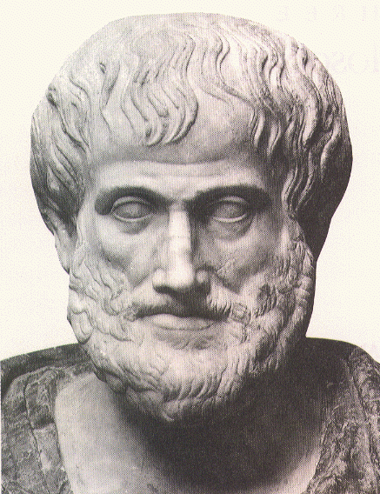
Space and Time for Aristotle
The “prime mover”
  A privileged being in the state of perpetual, absolute rest
Space
Defined by (x, y, z) coordinate system with respect to the prime mover
  Unique and clearly defined
Time
Time is measured by the prime mover’s clocks
Aristotle (384-322 BC)

Slide 7
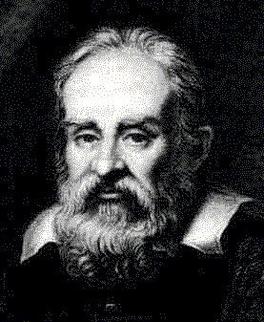
Space for Galileo
No such things as “absolute rest”
The laws of nature and physics are identical for anybody moving with a constant speed along a straight line
Galileo Galilei (1564-1642)

Slide 8
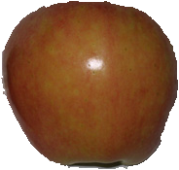
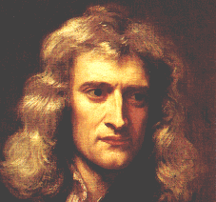
Space for Sir Isaac Newton
  There exists absolute space, but we measure space only relative to other objects in space
Isaac Newton (1643-1727)

Slide 9
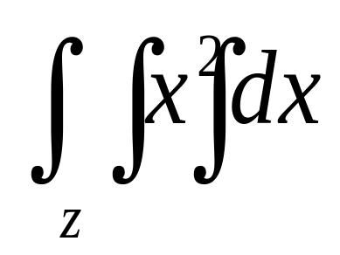
Time for Sir Isaac Newton
  There exists an absolute time, but we measure relative time only
Isaac Newton (1643-1727)

Slide 10
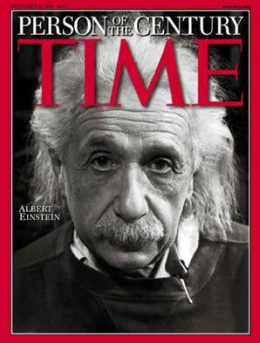
Einstein’s genius
Change the definition of time:
“It might appear possible to overcome all the difficulties attending the definition of ‘time’ by substituting ‘the position of the small hand of my watch’ for ‘time’ ”.
Example:
By “ ‘That train arrives here at 7 o’clock,’ I mean something like this: ‘The pointing of the small hand of my watch to 7 and the arrival of the train are simultaneous events’ ”
- famous 1905 Einstein paper

Slide 11
SpaceTime
A few years before Einstein, light had been shown to move at a constant speed.
Remember, Speed = d / t
Normally, speed is relative to distance and time.
However, if speed is constant, then distance and time are relative.

Slide 12
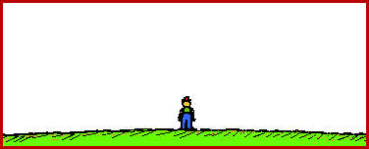
How do we see moving things?
Moving at 10% of speed of light
Moving at 99% of speed of light
Relativity of distance!
Moving sign appears to be shorter!

Slide 13
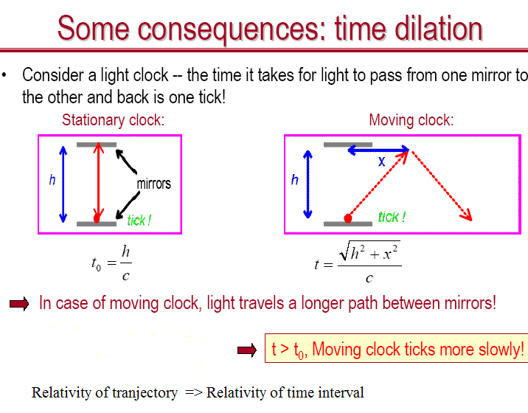
How do we measure time?
c=speed of light
Imagine a clock that measures time by how long it takes light to bounce back and forth …
Relativity of distance -> relativity of time!

Slide 14
Putting it all together
Time and distance are relative
Nothing can travel faster than light
Moving objects appear smaller and slower in space
  But the effect is really small for everyday movement

Slide 15
Elevator Thought Experiment
Imagine you’re in an elevator.
You feel the floor and if you drop your keys, they fall to the floor.
Now, cut the cord holding the elevator…what happens?

Slide 16
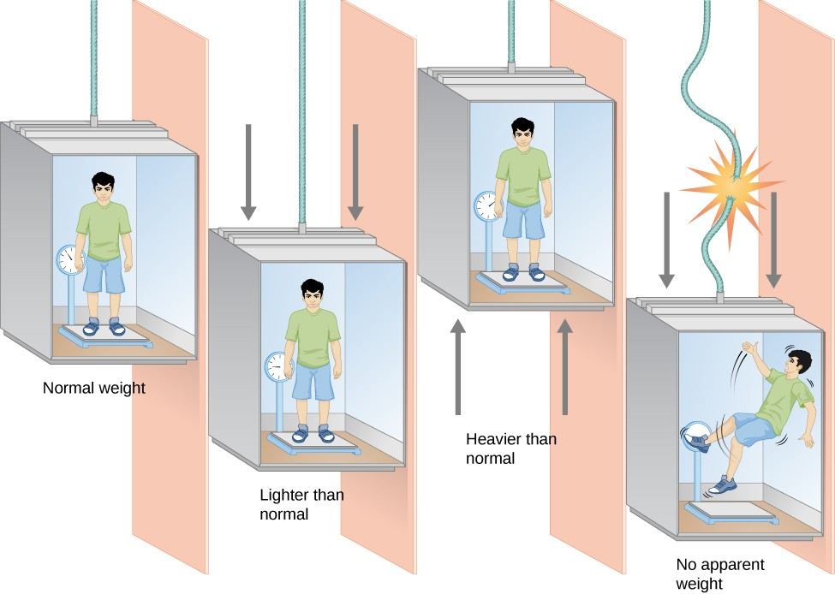
Elevator Thought Experiment

Slide 17
Elevator
For Einstein, free-falling in the elevator is the same as free-falling in space.
Gravity is the pushing we feel when we accelerate.

Slide 18
Spaceship Thought Experiment
Imagine you are in a spaceship floating in space. No acceleration…just floating.
Now, another spaceship moves past you. You think the spaceship is moving, while you are floating.
However, the other spaceship thinks it is floating, and you are moving.
Who is right?

Slide 19
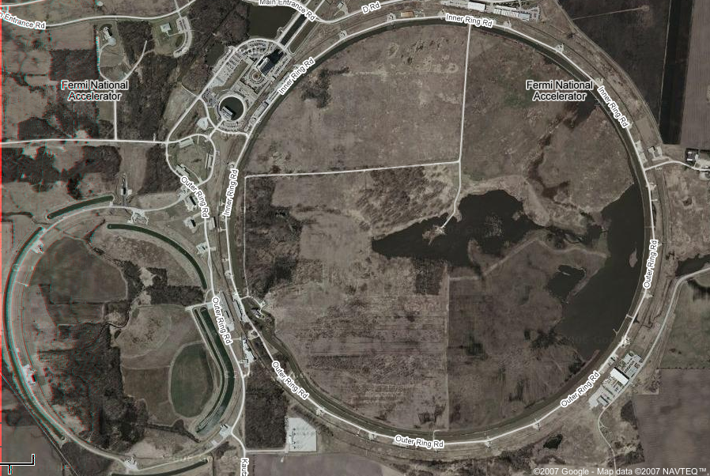
Fermilab
4 miles
Anti-protons traveling 99.99995% speed of light
The protons:
Seem 1000 times thinner
Have clocks that run 1000
times slower
Protons traveling 99.99995% speed of light

Slide 20
What about the other definition of space (all the stuff up in the sky and in the universe?)

Slide 21
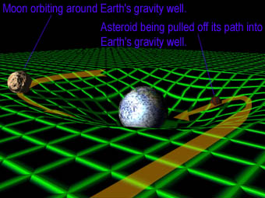
Einstein’s General Relativity
We already know that space and time are intertwined
Gravity is the distortion of space and time itself
Moon orbiting the earth
Asteroid pulled into earth

Slide 22
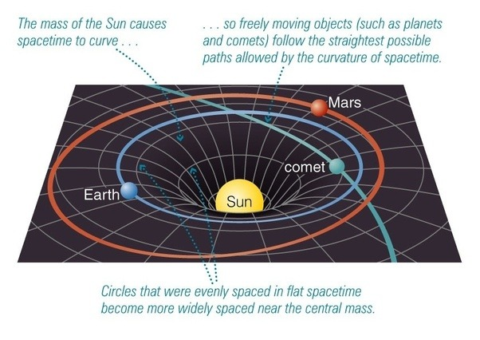

Slide 23
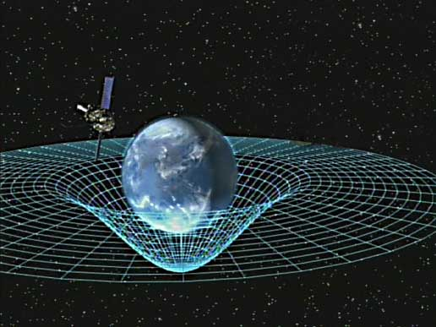

Slide 24
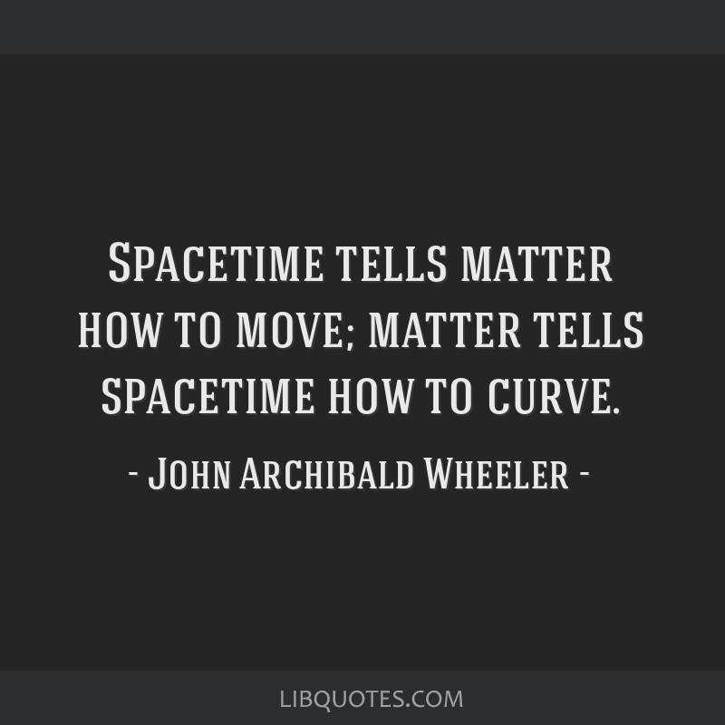

Slide 25

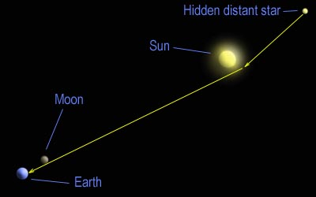
Even light is bent by gravity!
The position of a star observed during an eclipse confirmed Einstein’s theory

Slide 26
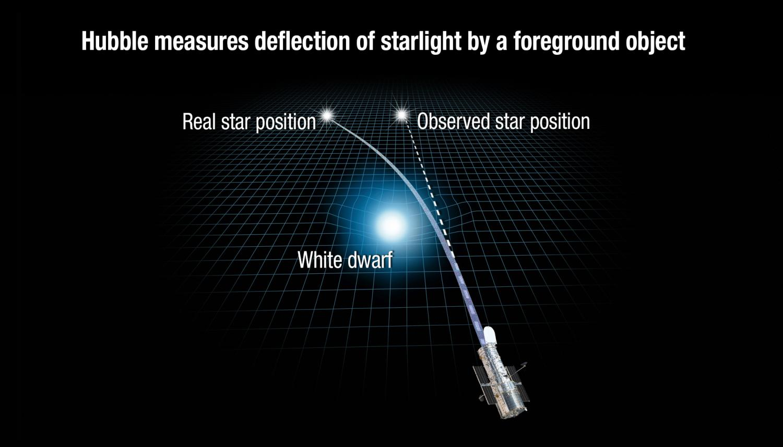

Slide 27
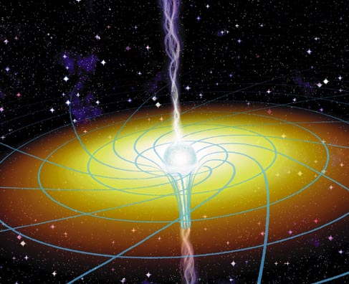
Black Holes
Dying stars can become black holes - gravity to an extreme! At some point, even light cannot escape! So named as “black holes” because you cannot see them … but you can see stuff around them

Slide 28
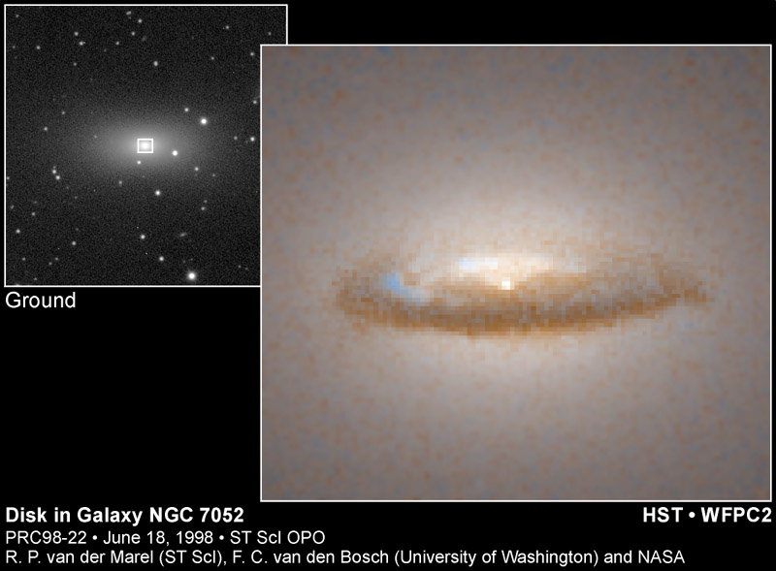
Black hole evidence
Hubble telescope observing a disk of dust orbiting around a black hole!

Slide 29
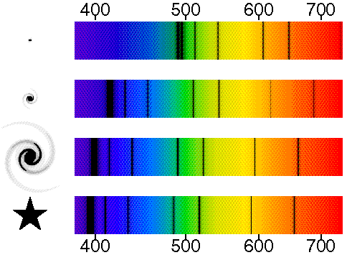
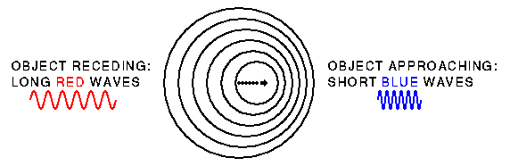
Relative motion in the Universe
Red shift
(Object moving away)
Blue shift
(Object moving away)
www.astro.ucla.edu/%7Ewright/doppler.htm

Slide 30
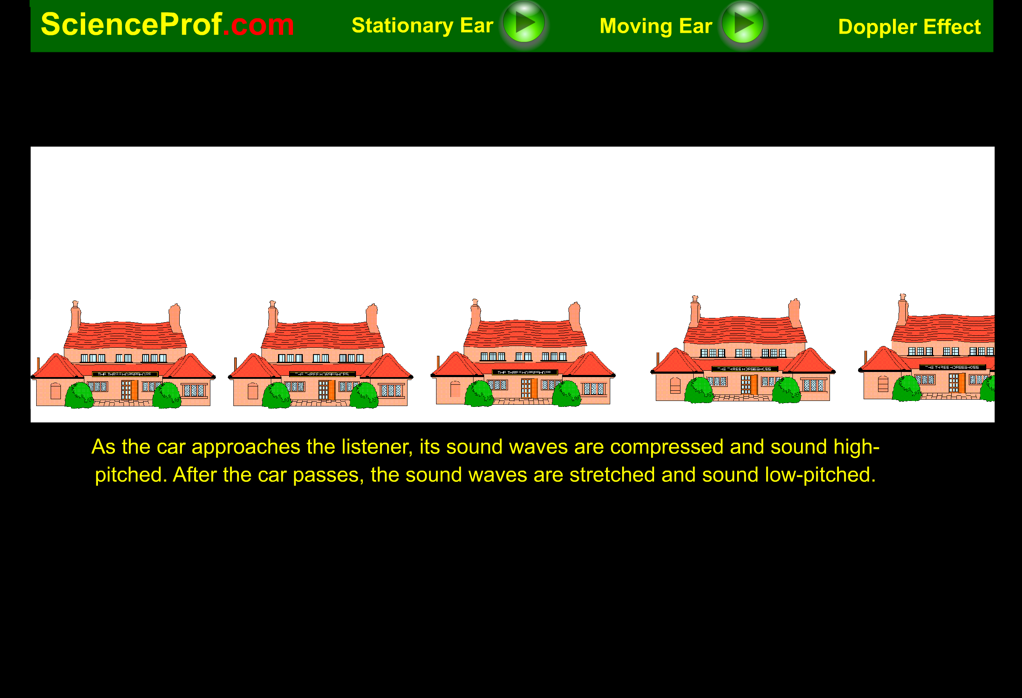
Doppler Effect

Slide 31
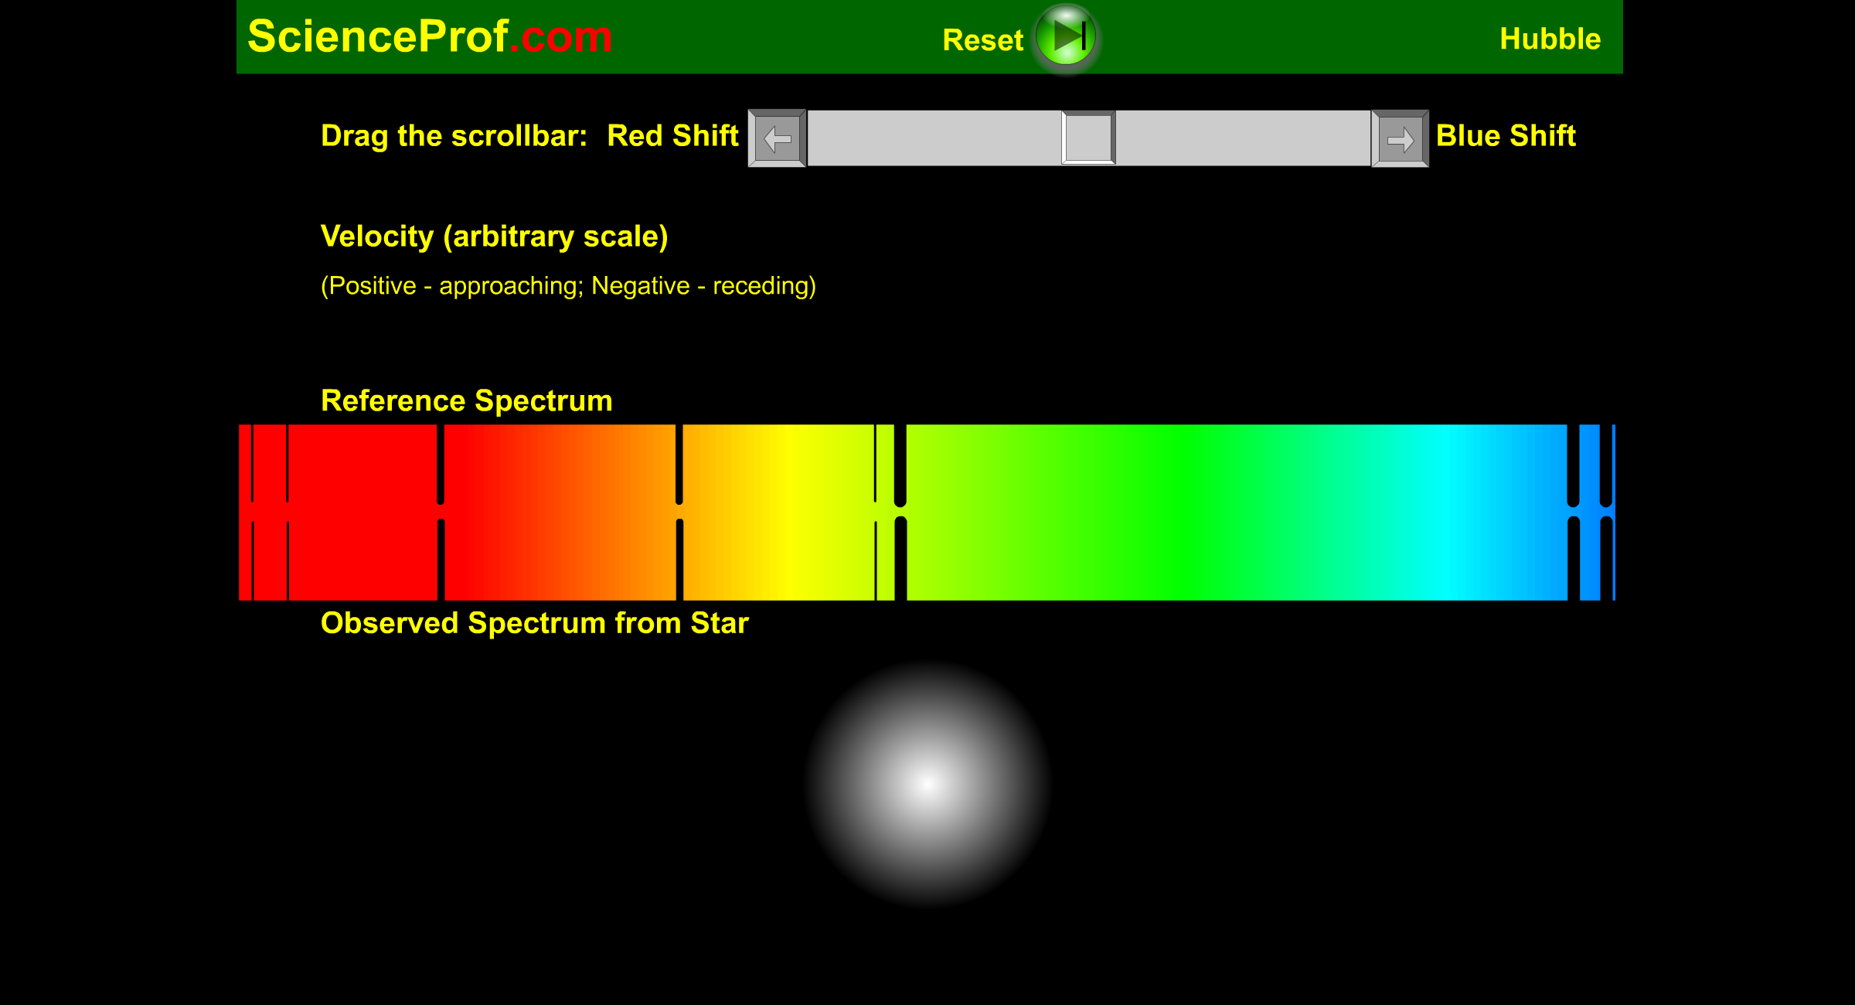
Red and Blue Shift

Slide 32
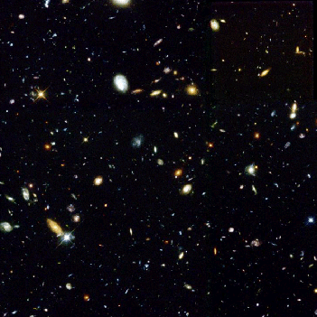
The Universe is Expanding!
A small view from the Hubble Space Telescope. Each blob is a galaxy with 100,000,000,000 stars!
The stars are all moving away from us, and away from one another
The Big Bang:
The Universe was really tiny at its birth 13.8 billion years ago

Slide 33
Summary
Space and time are relative
Moving things look shorter and time moves slower
Space-time is bent by matter
Light is bent by matter
Red-shift and Blue-shift of light is used to detect relative motion in the universe
The present universe is expanding

