Slide 1
Space, Time and Einstein
Penelope Constanta
Fermilab

Slide 2
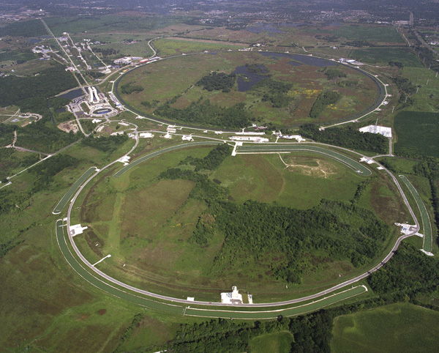
Fermilab
Chicago (~40 miles)
Still Middle School (~7.5 miles)

Slide 3
Why space and time?
Related to our work at Fermilab
Hopefully related to things you’re learning in school
  Physics and astronomy, but also chemistry
Some really interesting questions about the world
  Where do things happen? In space …
  When do things happen? In time …

Slide 4
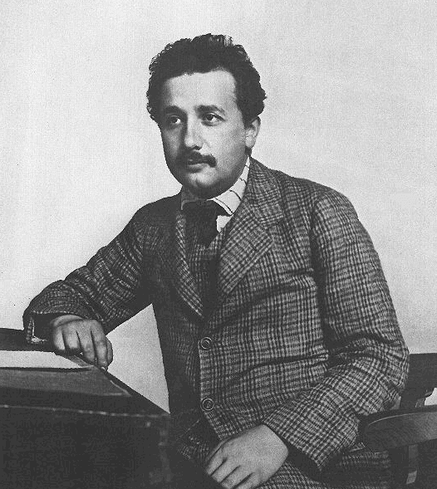
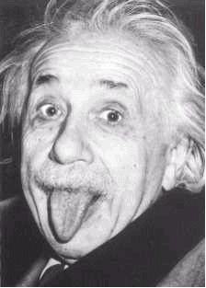
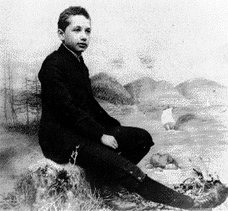
Why Einstein?
Because … he was Einstein!
Widely regarded as one of the most influential and best known scientists and intellectuals in modern history. Often regarded as the father of modern physics
1905: Clerk in Patent Office
School boy
At older age!

Slide 5
What did Einstein do?
Many, many discoveries. Easily could have won 3-4 Nobel prizes. Won only one for the discovery of the law of the photoelectric effect.
  He was a really smart man!
I will talk today about his two theories of relativity (Special Relativity and General Relativity)
  E=mc² (special relativity)
  Black holes (general relativity)

Slide 6
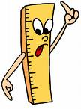

Space and Time
Space
  This piece of paper is 8 inches long
  It is 1.5 miles from the school to the store
Time
  I have to get up at 7 am
  The bus is 20 minutes late
But …
  What do we mean by distance (such as 1.5 miles)?
  What do we mean by a time (such as 7 am)?

Slide 7
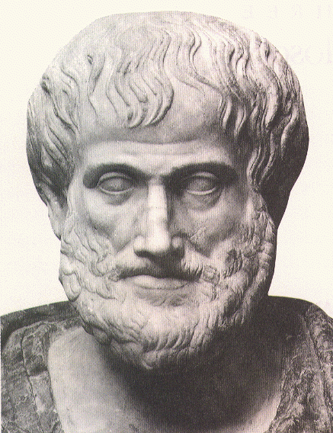
Space and Time for Aristotle
The “prime mover”
  A privileged being in THE state of perpetual, absolute rest
Space
  Defined by (x, y, z) coordinate system with respect to the prime mover
  Unique and clearly defined
Time
  Time is measured by the prime mover’s clocks
Aristotle (384-322 BC)

Slide 8
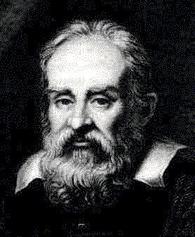
Space for Galileo
No such things as “absolute rest”
The laws of nature and physics are identical for anybody moving with a constant speed along a straight line
Galileo Galilei (1564-1642)

Slide 9
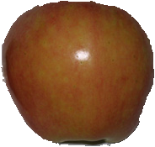
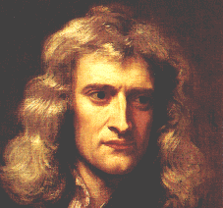
Space for Sir Isaac Newton
“Absolute Space, in its own nature, without regard to any thing external, remains always similar and immovable. Relative Space is some moveable dimension or measure of the absolute spaces; which our senses determine, by its position to bodies; and which is vulgarly taken for immovable space ... And so instead of absolute places and motions, we use relative ones”
  There exists absolute space, but we measure space only relative to other objects in space
Isaac Newton (1643-1727)

Slide 10
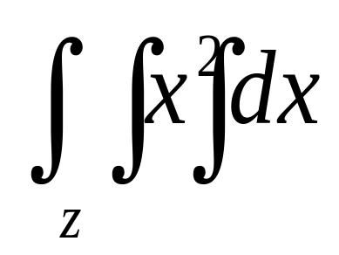
Time for Sir Isaac Newton
“Absolute, True, and Mathematical Time … flows equably without regard to any thing external … Relative, Apparent, and Common Time is some sensible and external (whether accurate or unequal) measure of Duration by the means of motion, which is commonly used instead of True time; such as an Hour, a Day, a Month, a Year.”
  There exists an absolute time, but we measure relative time only
Isaac Newton (1643-1727)

Slide 11
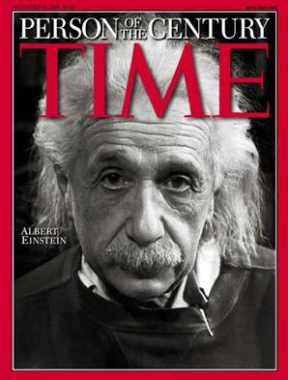
Einstein’s genius
Change the definition of time:
“It might appear possible to overcome all the difficulties attending the definition of ‘time’ by substituting ‘the position of the small hand of my watch’ for ‘time’ ”.
Example:
By “ ‘That train arrives here at 7 o’clock,’ I mean something like this: ‘The pointing of the small hand of my watch to 7 and the arrival of the train are simultaneous events’ ”
- famous 1905 Einstein paper

Slide 12

So what?
Jack sees the flashes at clocks A and B to be simultaneous events
Jack
John
What does John see?

Slide 13

But …
Jack
John
John sees the two light signals arrive at the moving midpoint at
the same moment. But he sees the flash at the A clock happened earlier, (giving the signal from the A clock more time to cover the greater distance) and the flash at the B clock happened later (as it needed less time to cover the distance to moving midpoint).
Simultaneity is relative - things occurring at the same time at one place may occur at different times in another place!

Slide 14
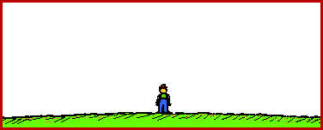
How do we see moving things?
Moving at 10% of speed of light
Moving at 99% of speed of light
Relativity of distance!
Moving sign appears to be shorter!

Slide 15
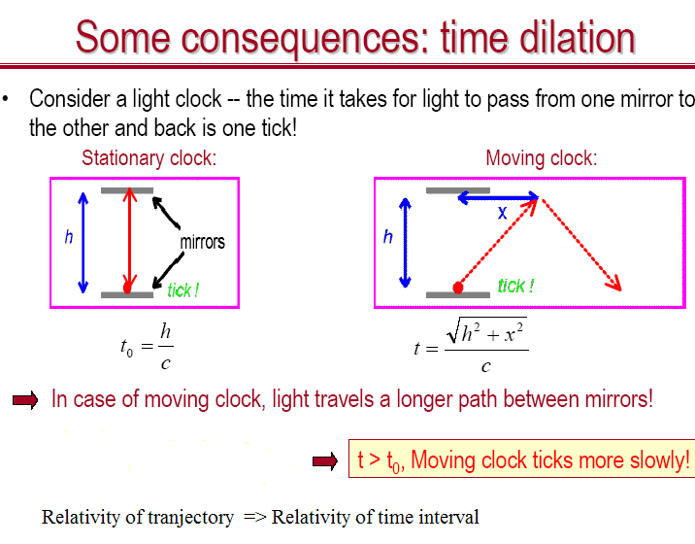
How do we measure time?
c=speed of light
Imagine a clock that measures time by how long it takes light to bounce back and forth …
Relativity of distance -> relativity of time!

Slide 16
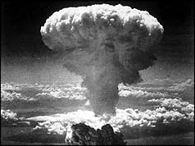
Putting it all together
The only way we can measure time and distance is by sending signals
  Time and distance are relative
The fastest signal travels at the speed of light
  Nothing can travel faster than light
Moving objects appear smaller and slower in space
  But the effect is really small for everyday movement
A result of the theory of special relativity: E=mc²

Slide 17
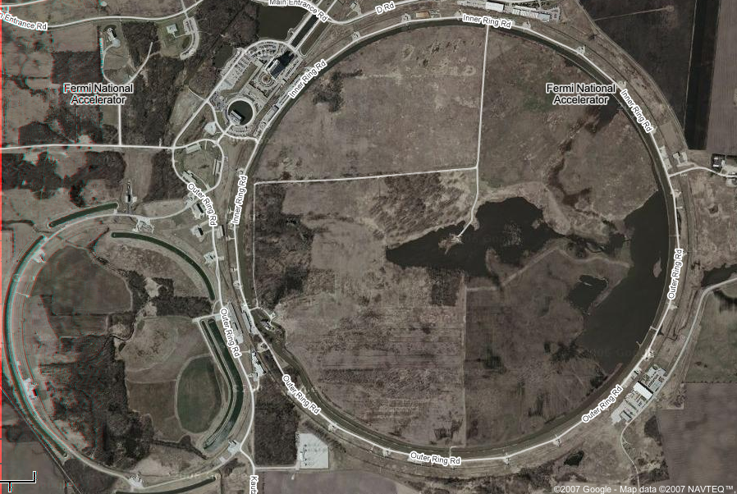
Fermilab
4 miles
Anti-protons traveling 99.99995% speed of light
The protons:
Seem 1000 times thinner
Have clocks that run 1000
times slower
Protons traveling 99.99995% speed of light

Slide 18
What about the other definition of space (all the stuff up in the sky and in the universe?)

Slide 19
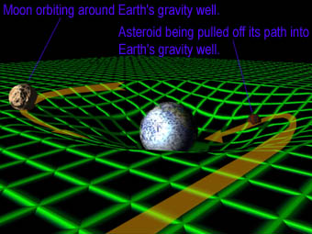
Einstein’s General Relativity
We already know that space and time are intertwined
Gravity is a distortion of space and time itself
Moon orbiting the earth
Asteroid pulled into earth

Slide 20

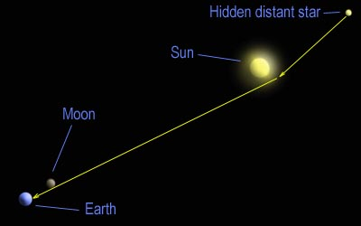
Even light is bent by gravity!
The position of a star observed during an eclipse confirmed Einstein’s theory

Slide 21
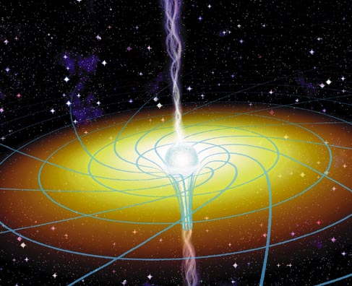
Black holes
Dying stars can become black holes - gravity to an extreme! At some point, even light cannot escape! So named as “black holes” because you cannot see them … but you can see stuff around them

Slide 22
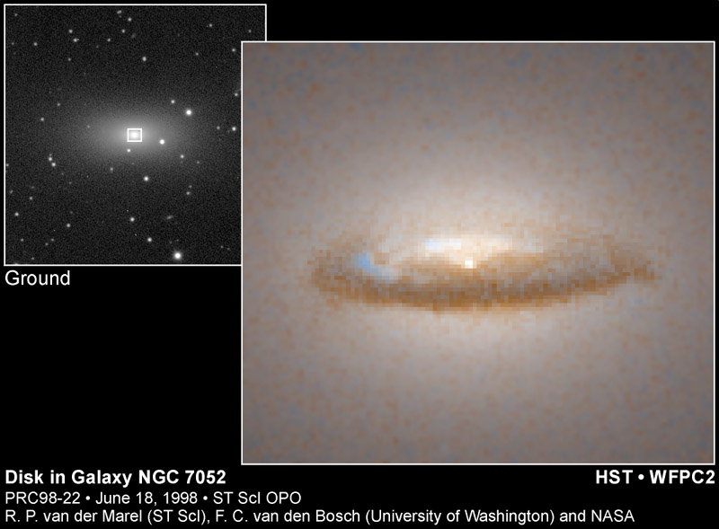
Black hole evidence
Hubble telescope observing a disk of dust orbiting around a black hole!

Slide 23
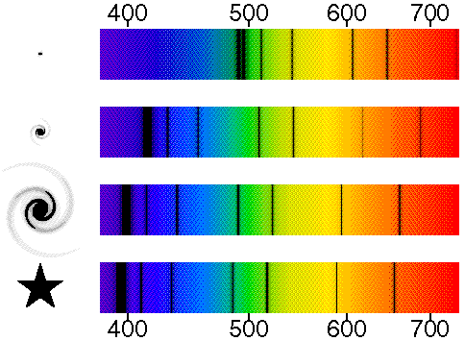
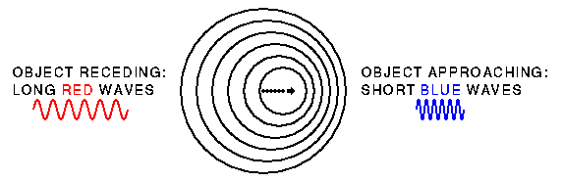
Relative motion in the Universe
Red shift
(Object moving away)
Blue shift
(Object moving away)
www.astro.ucla.edu/%7Ewright/doppler.htm

Slide 24
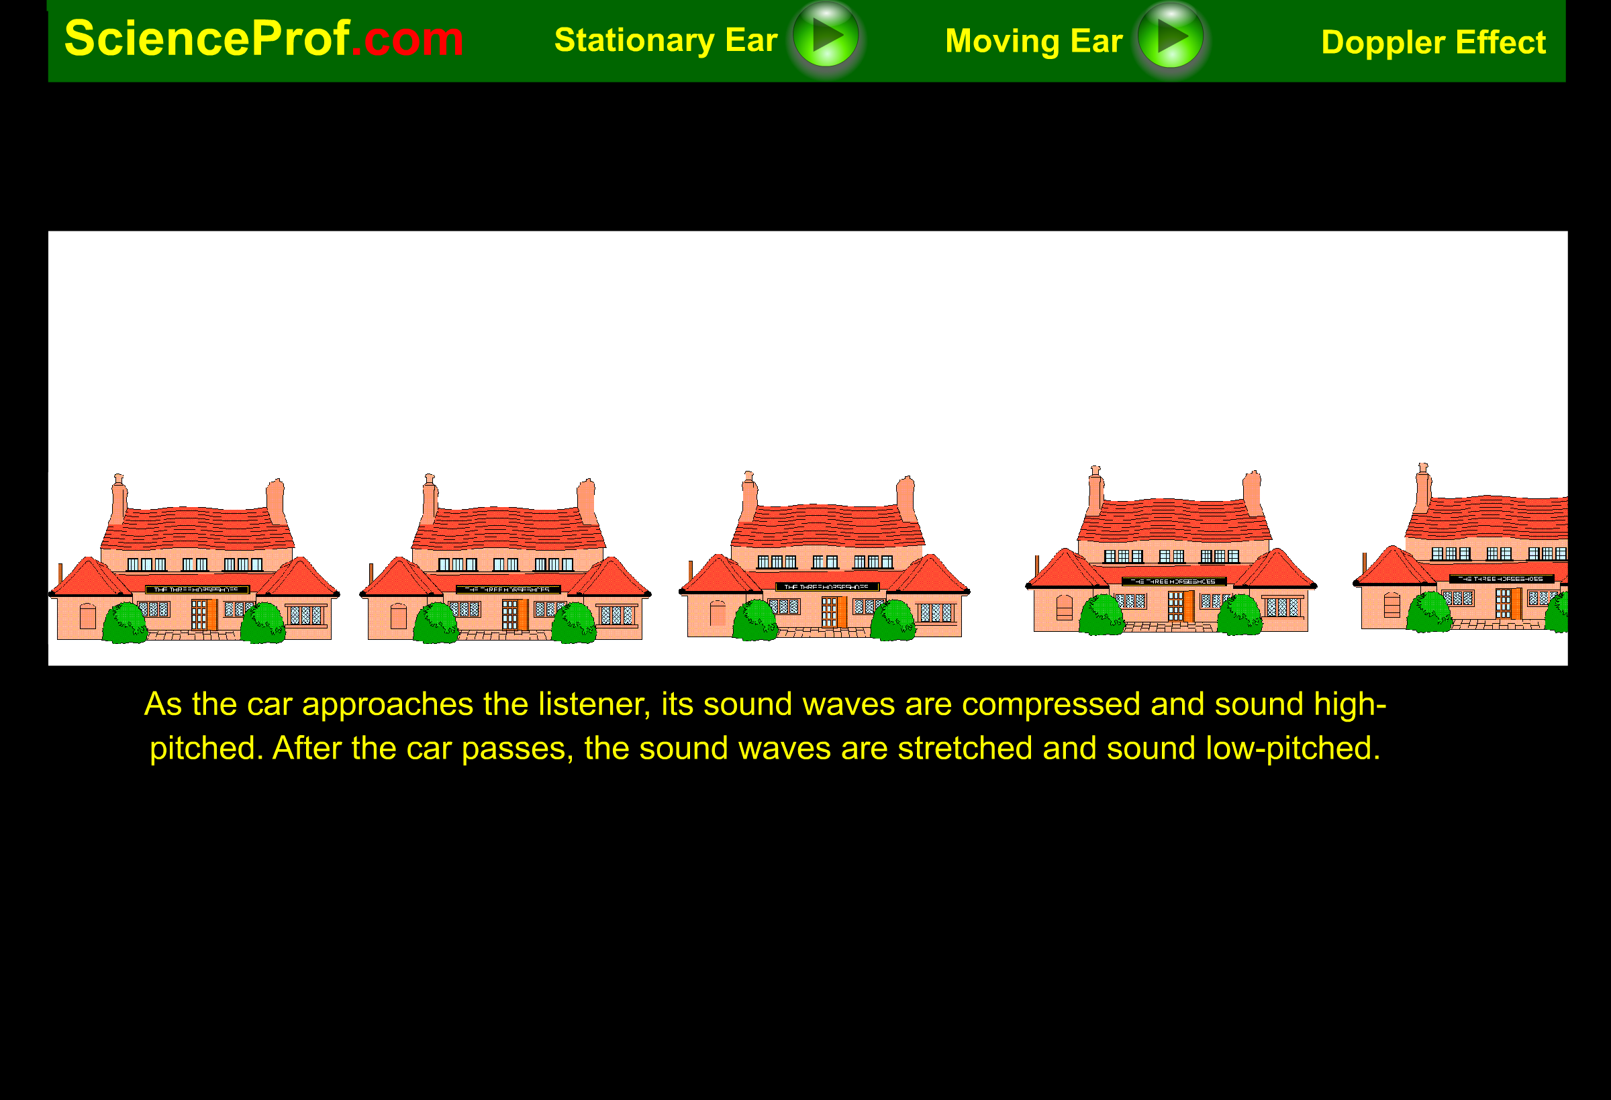
Doppler Effect

Slide 25
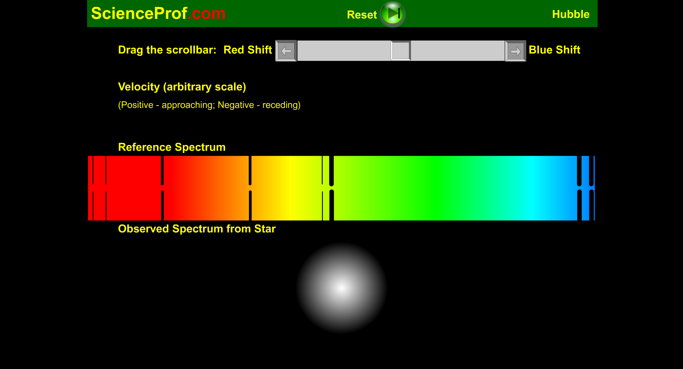
Red and Blue Shift

Slide 26
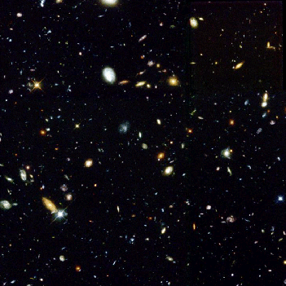
The Universe is expanding!
A small view from the Hubble Space Telescope. Each blob is a galaxy with 100,000,000,000 stars!
The stars are all moving away from us, and away from one another
The Big Bang: The Universe was really tiny at its birth 13.5 billion years ago

Slide 27
Summary
Space and time are relative
Moving things look shorter and move slower
Space-time is bent by matter
Light is bent by matter
Red shift and Blue shift of light is used to detect relative motion in the universe
The present universe is expanding
If you want to learn more about the universe, Einstein or smashing protons and anti-protons together …

Slide 28
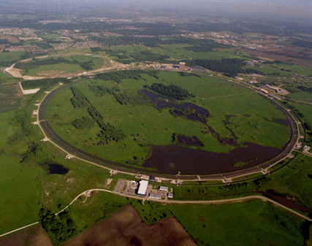
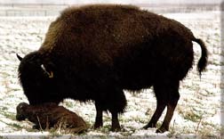
Fermilab
Come visit Fermilab!
Lots of fun science demos at the lab’s Lederman Science Center
Walk the prairies
See the lab’s bison
Come for ask-a-scientist
www.fnal.gov

