Slide 1
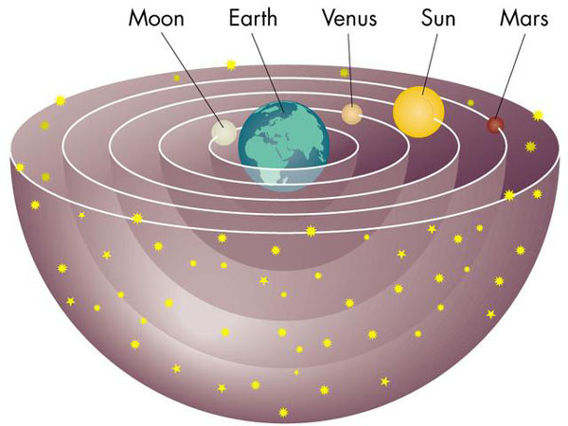
Early Philosophers
Aristotle (350 BC) - Geocentric model. Why?
Because it explained observations
Geocentric Model:
Earth at the center of universe.
Everything revolves around Earth.
Universe is unchanging and static.

Slide 2
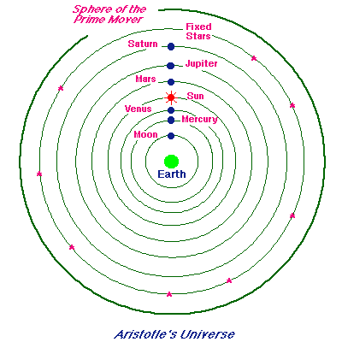
Aristotle’s Universe

Slide 3
Geocentric Model
Observations it explains:
-- The stars, sun, and planets appear to revolve around the Earth each day.
-- Earth does not seem to move… no constant wind.
-- No parallax... the stars do not appear to move in the sky.

Slide 4
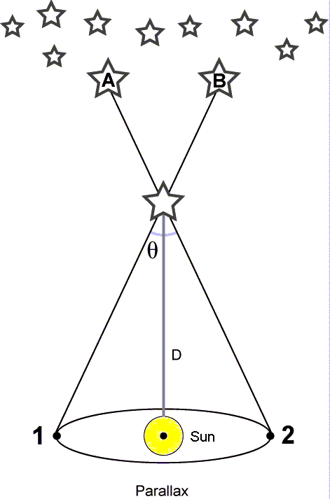
Parallax
Parallax = apparent movement of object when observer’s location moves.
How do we determine distances in space?
Simple way is triangulation. If you know two angles and one side, trigonometry does the rest.

Slide 5
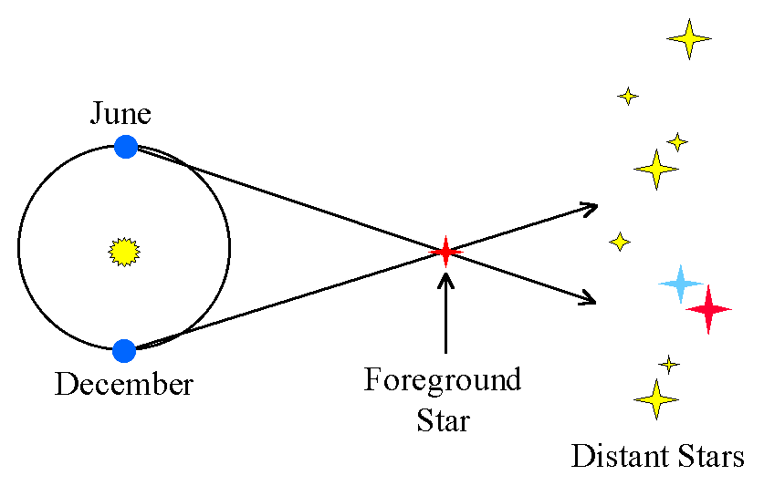
Parallax

Slide 6
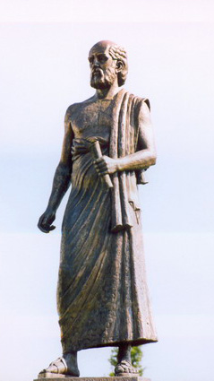
Early Philosophers
Aristarchus of Samos (310- 230 BC)
1. No parallax because stars are too far away. ✔
2. Earth and all planets orbit Sun. ✔
- idea rejected by later philosophers because they conflicted with Aristotle.

Slide 7
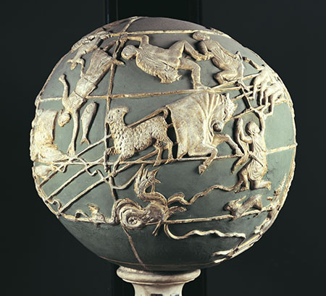
Early Philosophers
Hipparchus (150 BC)
-- first star chart
-- could be preserved on the Farnese Globe.
-- discovered precession

Slide 8
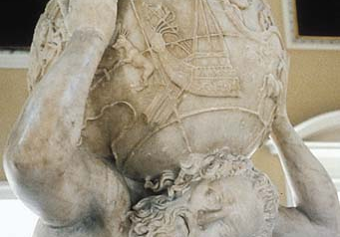
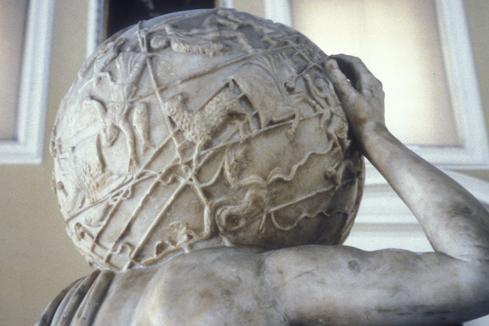
Farnese Globe

Slide 9
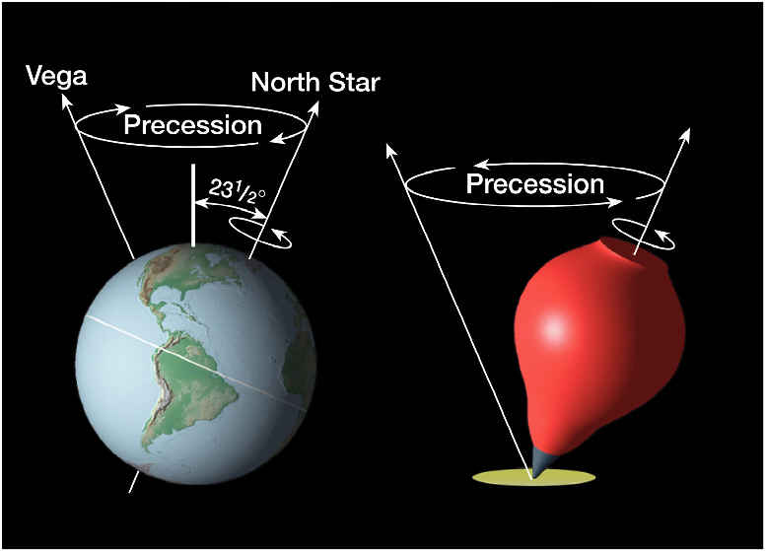
Precession
Earth “wobbles” on its axis like a spinning top.
Every 26,000 years Earth completes one wobble.
Caused by Moon’s gravity.

Slide 10
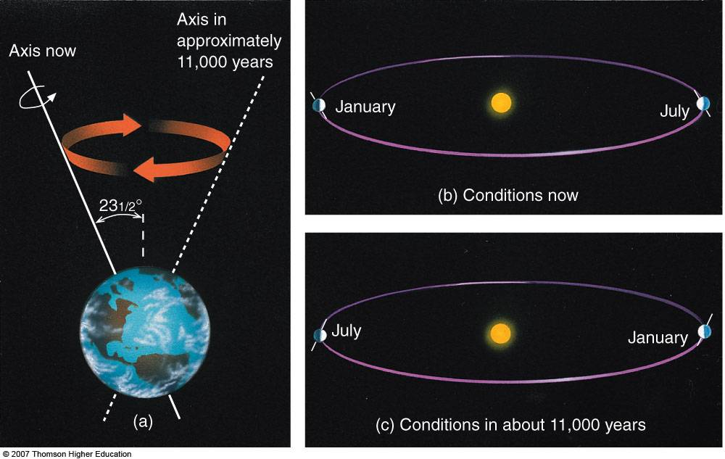

Slide 11
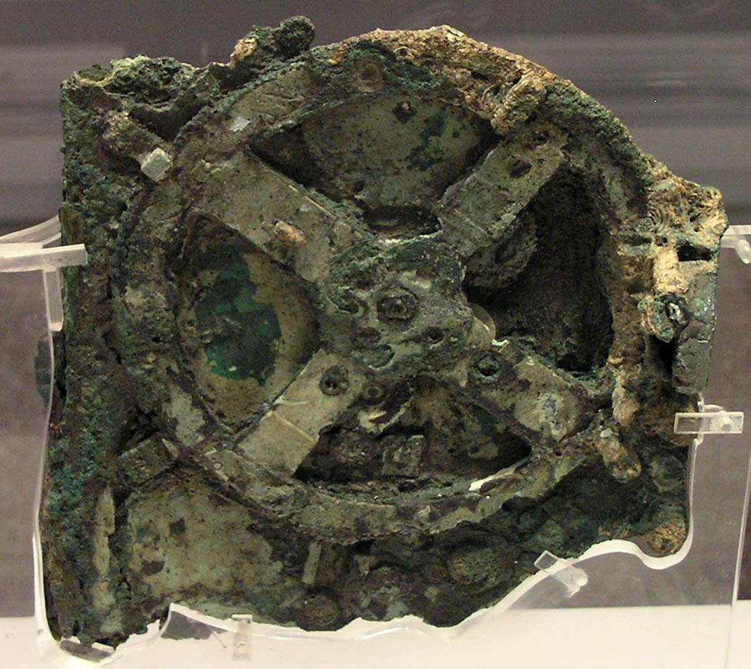
Astronomical Clock
Antikythera Mechanism (150 BC)
made in Greece
31 gears – sun, moon, 5 planets, eclipses.
As complex as a 19th century clock.

Slide 12
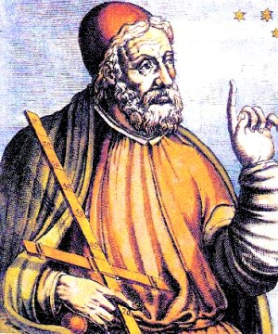
Ptolemy

Slide 13
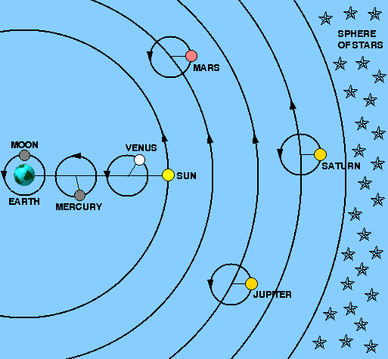
Early Astronomers
Claudius Ptolemy (140)
-- made geocentrism the standard model.
-- very complicated with 80 epicycles.
-- explained Mars retrograde motion.

Slide 14
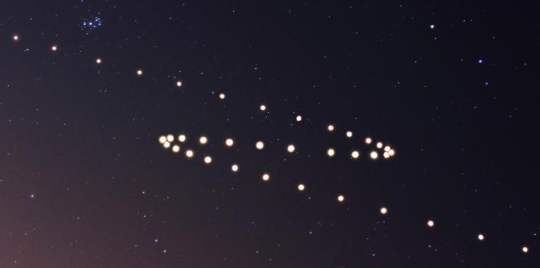
Mars’ Retrograde Motion

Slide 15
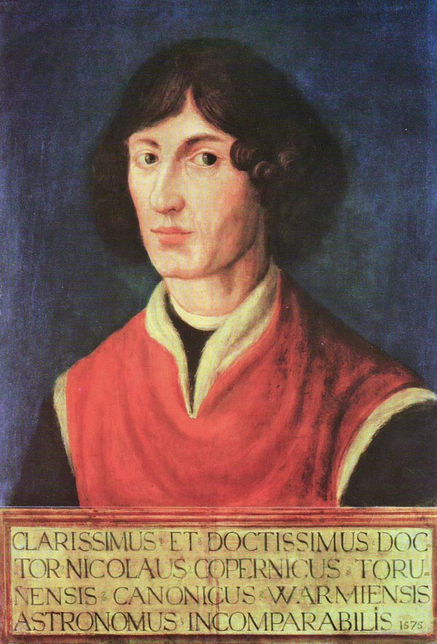
Copernicus

Slide 16
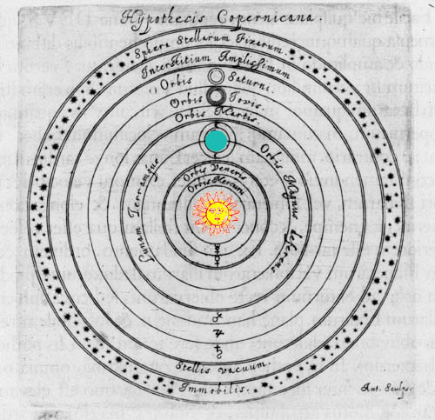
Early Astronomers
Nicolaus Copernicus (1473 – 1543)
Heliocentric Model: Sun is at the center of universe.
Simple… no epicycles
Not accepted until Galileo 100 years later

Slide 17
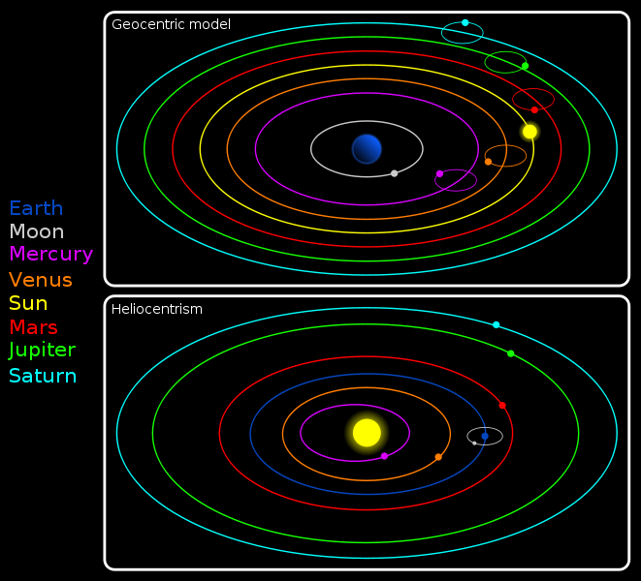

Slide 18
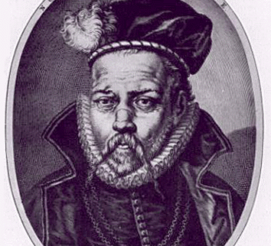
Early Astronomers
Tycho Brahe (1546 – 1601)
made very accurate star charts
based ideas on actual observations
Sun and Moon orbit Earth, but other planets orbit Sun.

Slide 19
