Slide 1
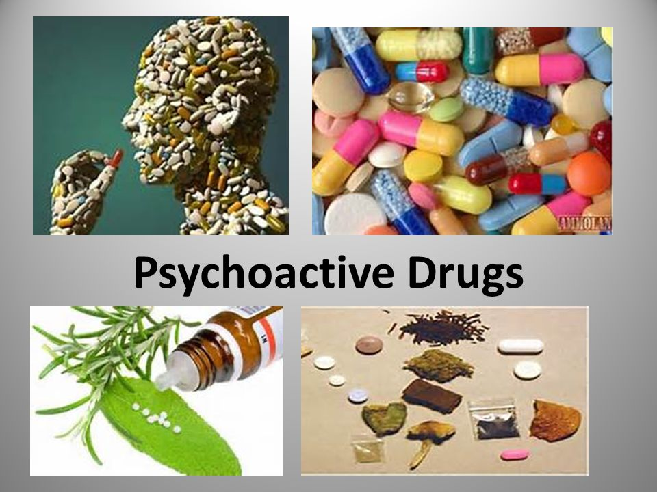
Psychoactive Drugs
A chemical substance that alters perceptions and mood (consciousness).
Prone to overuse and addiction, however psychological benefits are actively being studied today

Slide 2
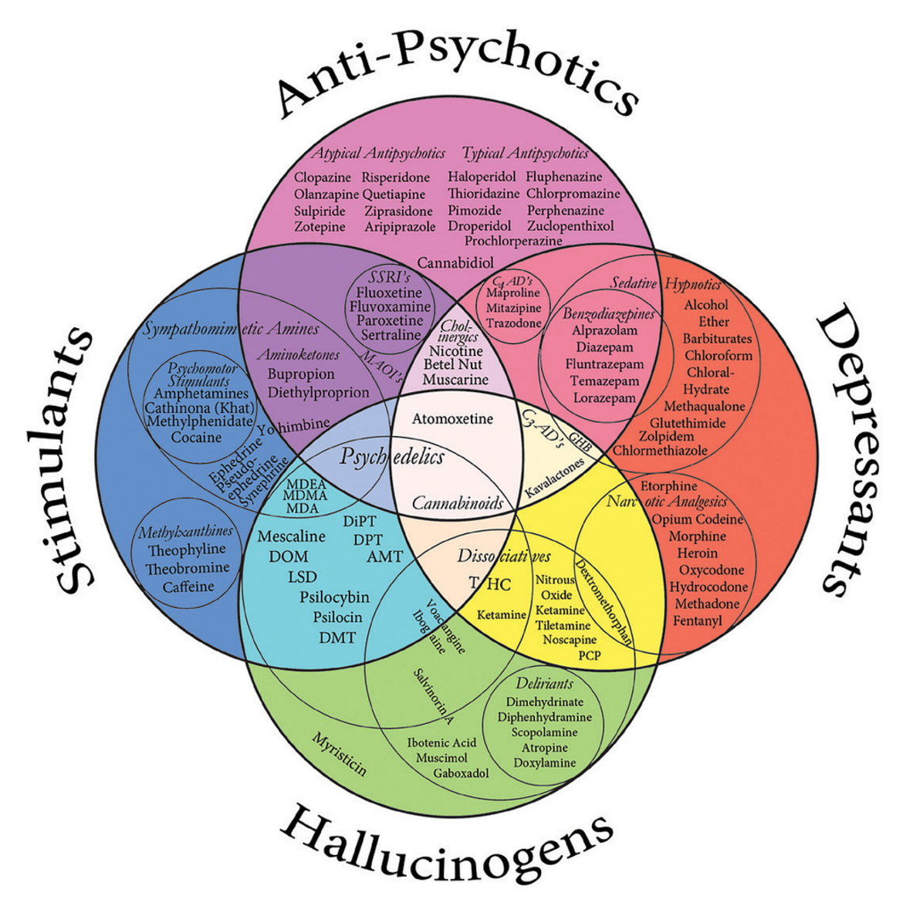
Psychoactive Drugs
Four types
  Depressants
  Stimulants
  Hallucinogens
  Anti-Psychotics

Slide 3
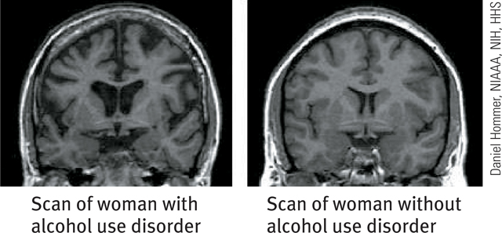
Depressants
  Alcohol
  Barbiturates (tranquilizers)
  Opiates

Slide 4
Depressants: Alcohol
Depresses the nervous system.
Sometimes perceived as a stimulant because it relaxes inhibitions
Men are three times more likely to be problem drinkers

Slide 5
Depressants:
Barbiturates
“Downers”
Often used to treat insomnia
Can interfere with sleep patterns and cause dependence
Effects are similar to alcohol

Slide 6
Depressants - Opiates
Includes opium, morphine, and heroin
Opiates resemble endorphins, the body’s natural painkillers.
Causes euphoria followed by clouded mental functioning

Slide 7

Stimulants
Substances that excite the central nervous system
  Caffeine
  Nicotine
  Amphetamines
  Cocaine - crack
  Methamphetamine
  Ecstasy (MDMA)

Slide 8
Caffeine
Naturally occurring substance found in coffee, tea, cocoa, and chocolate. Most used psychoactive substance in Western world.
Increases alertness
In high doses, can cause anxiety, headaches, heart palpitations, insomnia, and diarrhea

Slide 9
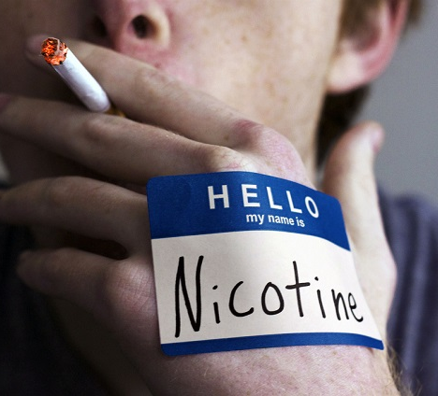
Stimulants: Nicotine
Found in tobacco.
Considered by many to be the most addictive stimulant in use today

Slide 10
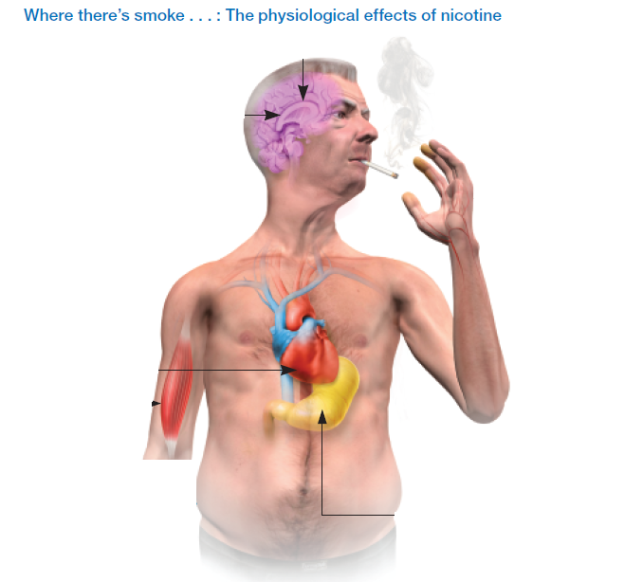

Slide 11


Slide 12
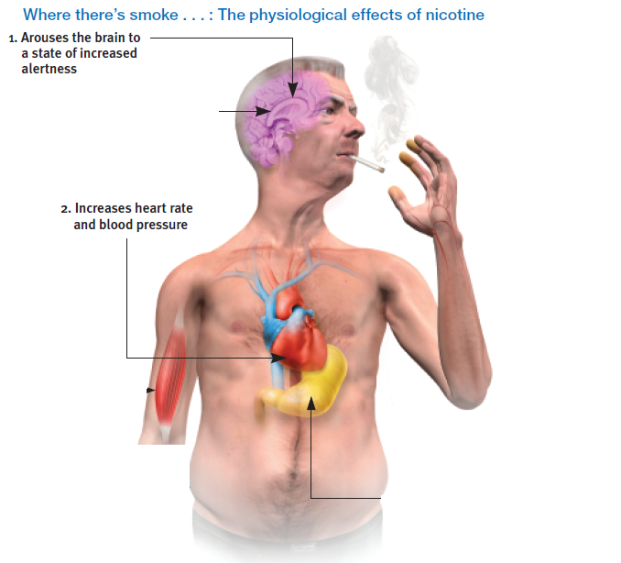

Slide 13
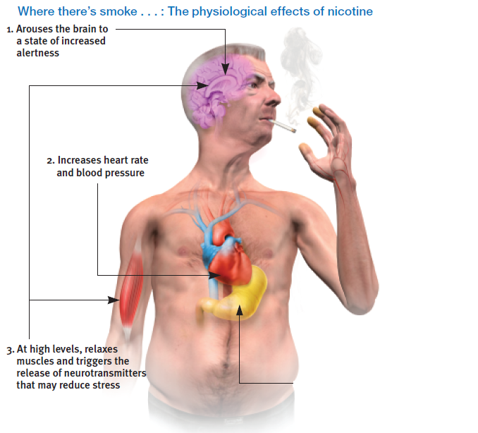

Slide 14
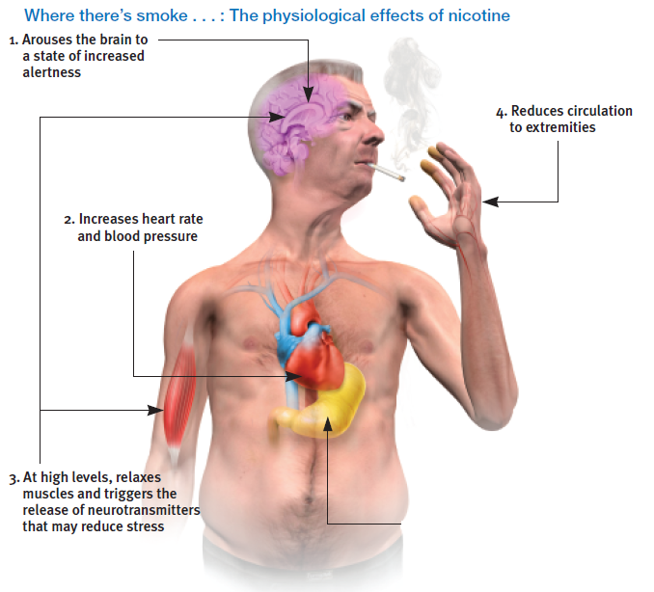

Slide 15


Slide 16
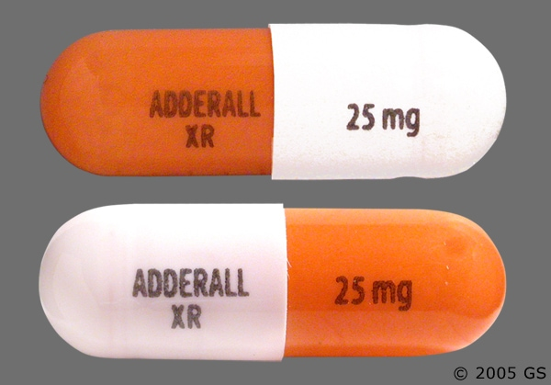
Amphetamines
Chemically like epinepherine, the hormone that activates the sympathetic nervous system
Increase alertness as well as feelings of well-being followed by a crash

Slide 17
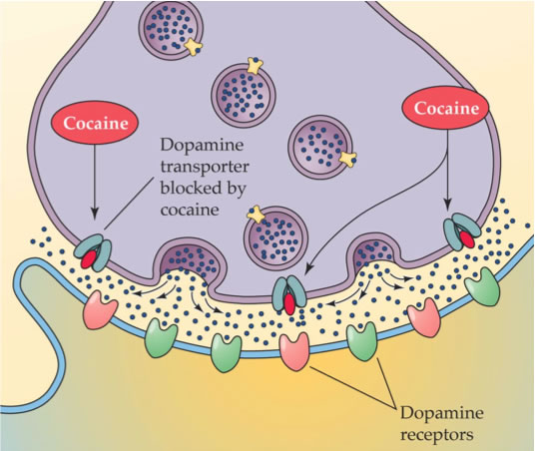
Stimulants: Cocaine
  Blocks reabsorption of dopamine
  Increased aIertness, motivation, and euphoria
  Then crash, with anxiety, depression, and strong cravings

Slide 18
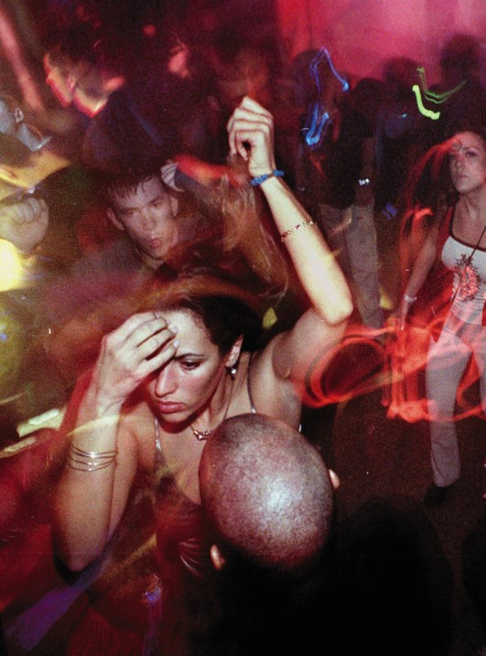
Ecstasy (MDMA)
  Dopamine and Serotonin
  “Love Drug” – feelings of empathy and euphoria
  Research shows benefits for psychiatric use (PTSD, cancer pain)

Slide 19
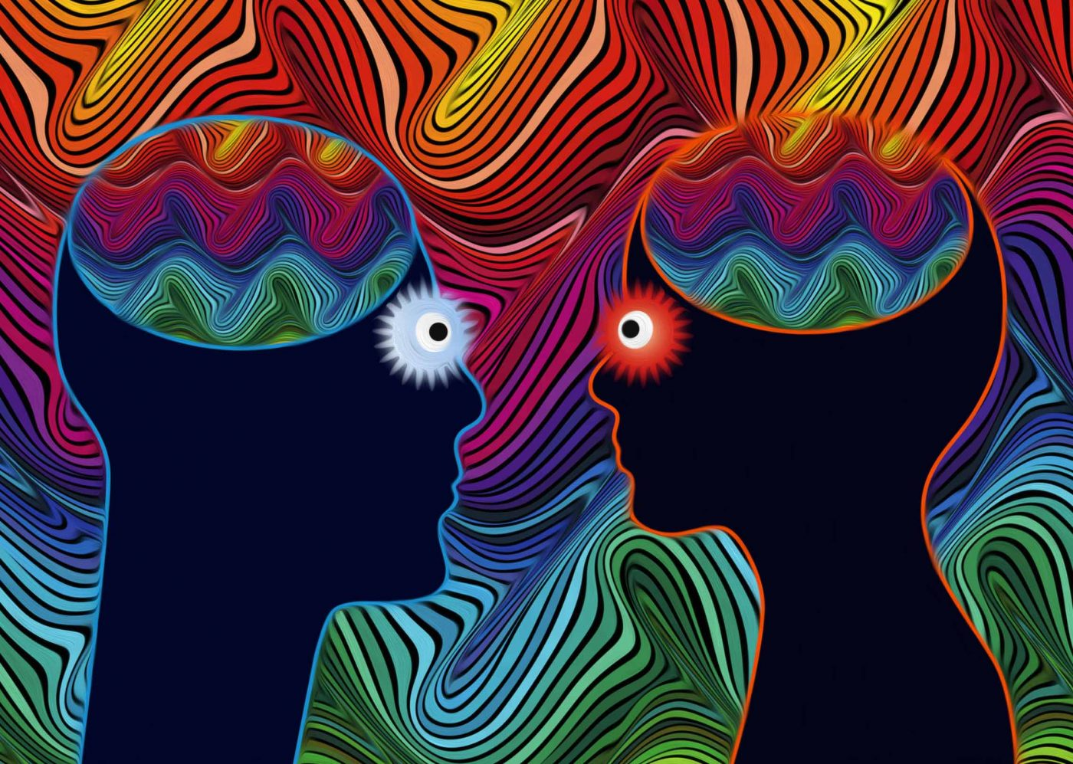
Hallucinogens
Substances that distort visual and auditory perception (psychedelics)
  LSD (lysergic acid diethylamide)
  Psilocybin (mushrooms) – several studies show benefits for anxiety and depression.
  Marijuana

Slide 20
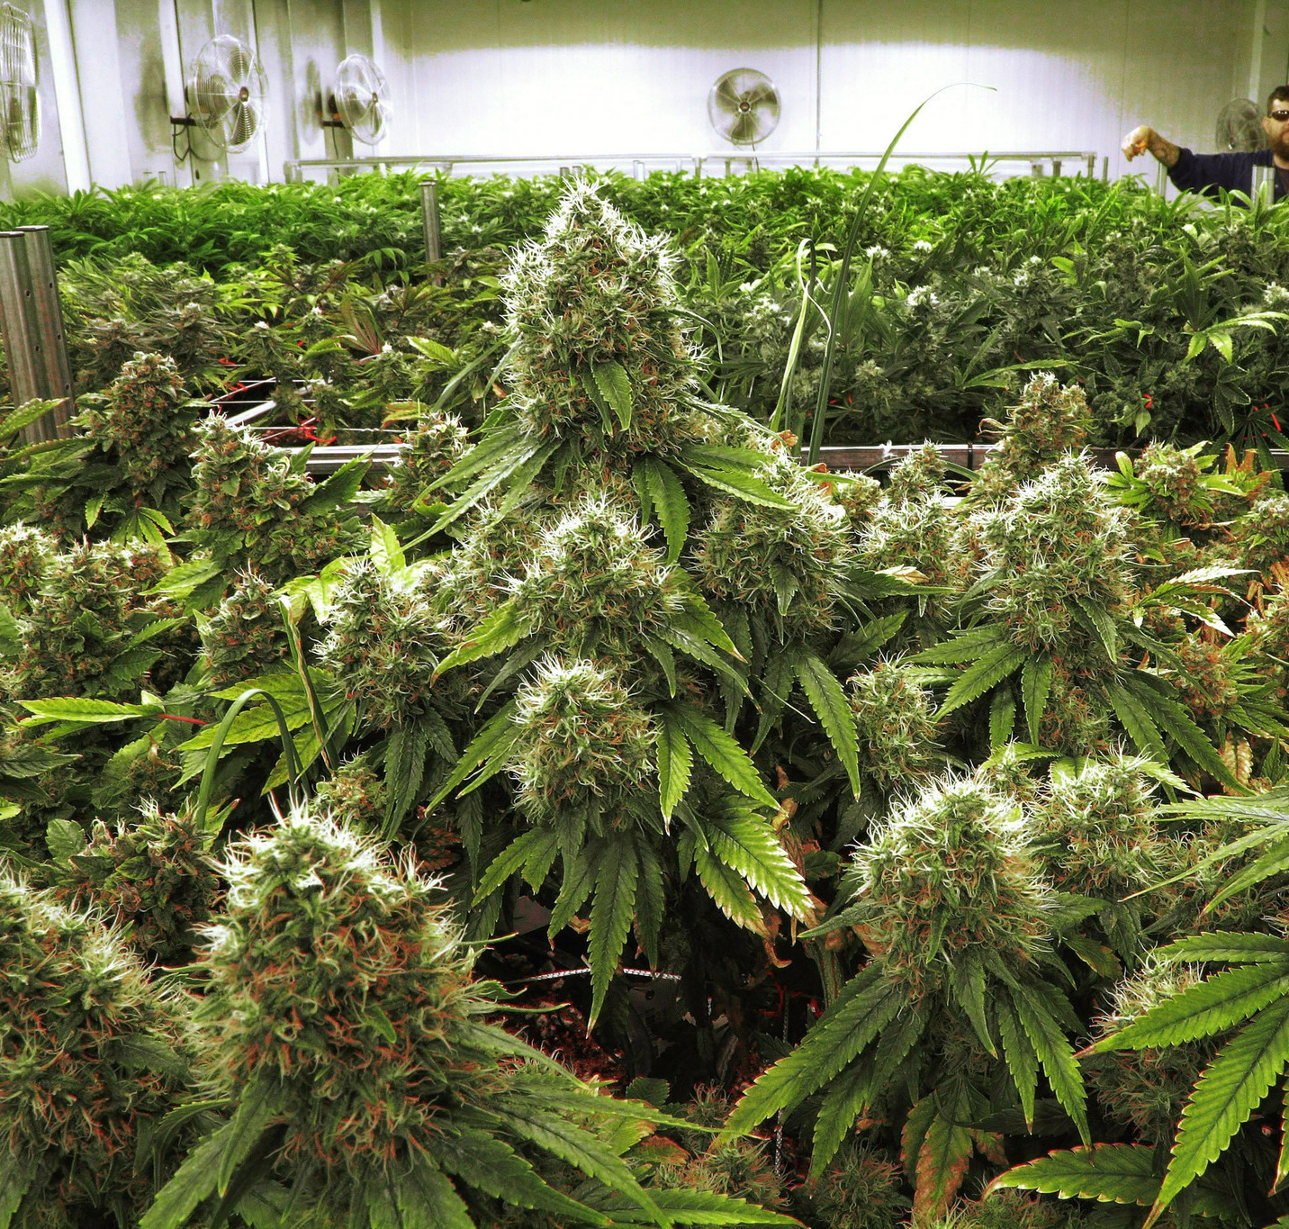
Marijuana
THC, the active ingredient in marijuana. Effects include:
  Mild hallucinations
  Euphoria
  Relaxation
Many states have legalized it
Medical uses include anxiety, depression and pain relief

