Slide 1
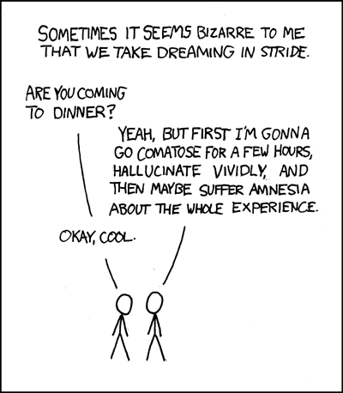
Dreaming is weird – let’s understand this better.

Slide 2
Dreams
Negative Emotional Content: 8 out of 10 dreams have negative emotional content.
Anxiety Dreams: People commonly dream about failure, being attacked, pursued, rejected, or struck with misfortune.
Sexual Dreams: Contrary to our thinking, sexual dreams are sparse. Sexual dreams in men are 1 in 10; and in women 1 in 30.
Dreams of Gender: Women dream of men and women equally; men dream more about men than women.
Notes:
OBJECTIVE 9| Describe the most common content of dreams.

Slide 3
Dream Theories
Activation Synthesis
Physiological Function
Information Processing
Cognitive Theory
Psychodynamic Theory
Dreams mean very little
Dreams mean a lot

Slide 4
Activation-Synthesis
Dreams result from random activation of brain cells. Bursts of vivid dreaming.
The brain then synthesizes this activity with existing knowledge and memories
Dreams are the brain trying to make sense of this activity.
How we interpret the random images and sensations is the dream’s meaning.

Slide 5
Physiological
Function
Dreams are physiological rather than psychological.
During REM sleep the brain is activated and "warming its circuits" helping in preserving neural pathways... anticipating the sights, sounds and emotions of the waking state. -- Hobson
Dreams represent a parallel consciousness state that is running continuously, but which is normally suppressed while the person is awake.
May explain schizophrenia (activation of dream state while awake), and lucid dreaming (awake inside a dream).

Slide 6
Information Processing
Cartwright
Dreams help us sort the days events and consolidate our memories
They may also help us work out unsolved problems.
When we are under stress or depressed, we sleep longer, and the amount of time spent in REM increases. This fact strongly suggests that we are working on the things that are worrying us while we dream.

Slide 7
Information
Processing
Dreams reflect problems of waking life (concerns over relationships, work, sex, or health)
Dreams more likely to relate to person’s current concerns.
  - Students dream about failing exams
  - Teachers dream of forgetting lecture notes
Notes:
7

Slide 8
Cognitive Theory
G. Stanley Hall
Dreams reflect problems of waking life (concerns over relationships, work, sex, or health). Similar to Information-Processing Theory.
Images are sometimes symbols for things in everyday life.
This theory agrees with Freud that dreams contain symbols, but there is no “latent” (unconscious) meaning. The meaning is at the surface level—”manifest” content.

Slide 9
Psychodynamic Theory
Freud
Wish-fulfillment
Dreams provide a psychic safety valve to discharge unacceptable feelings from the Id.
  Libido (sex drive) and Thanatos (death)
The superego creates symbolic content to mask the unacceptable thoughts…“manifest”
The true meaning of that “manifest” content is called the “latent” content.

Slide 10
