Slide 1
Cosmic Distances
How do we determine the distance to celestial objects?
No single method works at all distances… close, intermediate and far.
Astronomers use a “cosmic distance ladder”.

Slide 2
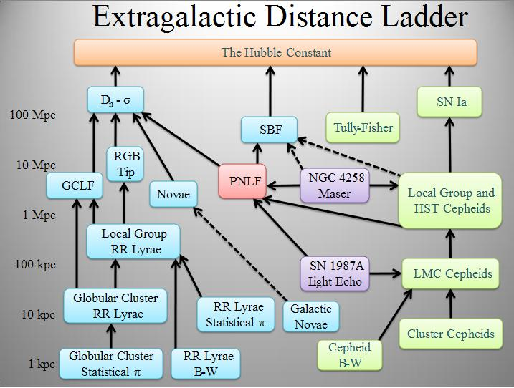

Slide 3
Parallax
How do we determine distances in space?
Simple way is triangulation. If you know two angles and one side, trigonometry does the rest.
Parallax = apparent movement of object when observer’s location moves.

Slide 4
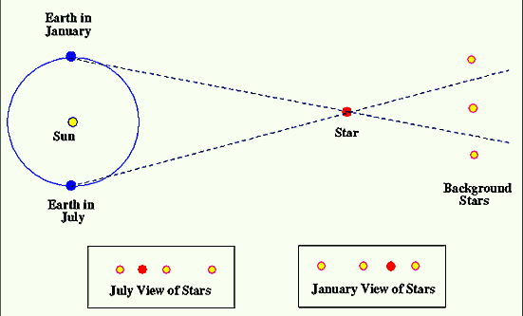
Parallax

Slide 5
Standard Candles
Standard Candle = a celestial object with a known luminosity.
Three problems:
1. calibration - what is the absolute magnitude
2. identifying candle - have to be sure you’re using the same object.
3. how standard are they?
Ex: Type 1 supernovas, cepheid variables, spectral lines (calcium) directly related to magnitude.

