Slide 1
Scientific Method
Theory – an “explanation” that has been tested over and over again… as close to a fact as we can currently get.
This is different from the way we normally use the word theory.
Must be able to repeat and get same results.

Slide 2
Types of Descriptive Research
Naturalistic Observation
Case Studies
Survey

Slide 3
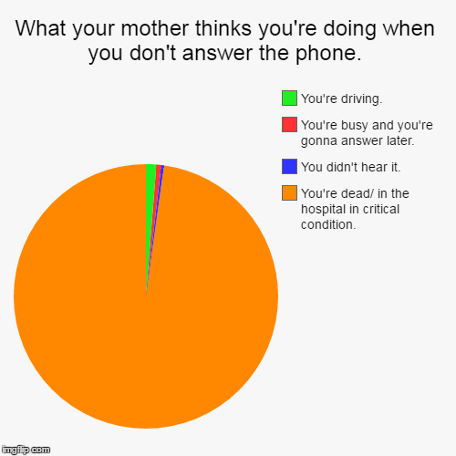
Descriptive Research
(DESCRIBES)

Slide 4
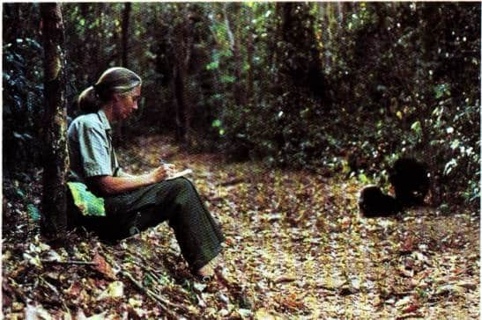
Naturalistic Observation
Researcher describes the behavior of the human or animal in their natural settings

Slide 5
Naturalistic Observation
Strengths:
  The behavior is more natural than if it occurred in the lab
Weaknesses:
  Can not replicate (repeat)
  Can not generalize (apply them to new situations)
  Observer bias - when researchers know the goals of the study and allow this knowledge to influence their observations.

Slide 6
Case Studies
Study of a single individual or a few individuals.
Purpose? Take advantage of situation that you can not replicate.
How? Observation, psychological tests, interviews, medical records etc.

Slide 7
Case Studies
Strengths:
  - nonreplicable situations
  - You get a lot of in-depth understanding
Weaknesses:
  - Can not replicate
  - Can not generalize
  - Observer bias

Slide 8
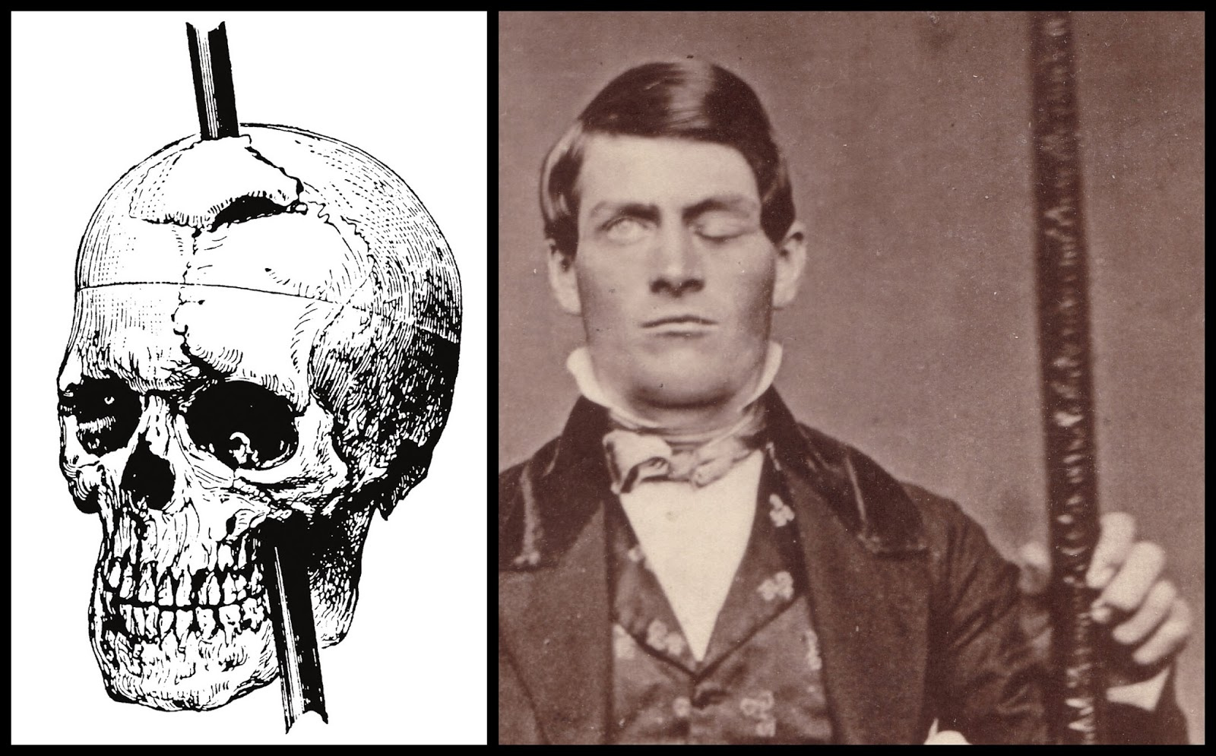
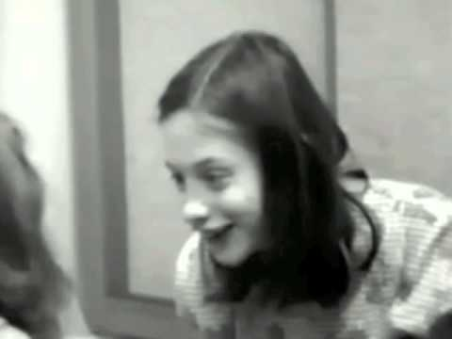
Two Famous Case Studies
Genie
Phineas Gage

Slide 9
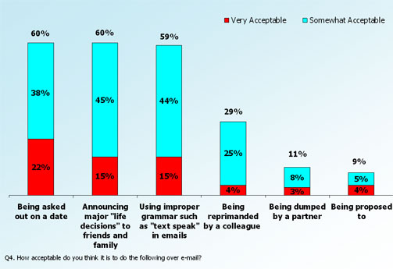
Surveys
- Questionnaires or interviews to a selected group of people.
- To describe a large group of people you ask them carefully worded questions.

Slide 10
Surveys
Strengths:
Cheap and relatively quick
If you randomly sample, then you can generalize your findings to the population from which you sampled.

Slide 11
Survey
Weaknesses:
1. Framing Effect – wording and order of questions can change the results of a survey.
Individuals are more influenced by the possibility of a loss than the prospect of an equivalent gain
93% of PhD students registered early when there was a penalty fee for late registration, while only 67% registered early when there was a discount for earlier registration.
2. Social Desirability Effect - if directly asked about a sensitive subject, we may alter our answer to what we think is socially acceptable.

Slide 12
Random Sampling
“The root of the problem is that in real life, all scientists ever observe are samples. And, in real life, all they want to know about is populations.” Nancy Darling, Ph.D.

Slide 13
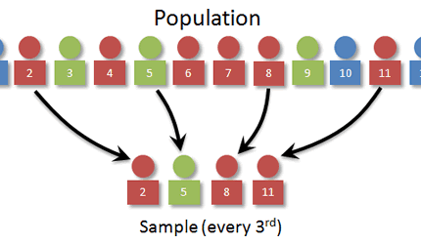
Random Sampling
Each potential population member has an equal chance of being surveyed.
Can’t just pull names from a hat…names at bottom less chance.
Alphabetical list and pick every 10th name.

Slide 14
Non-Response Bias
Women and Love study by Shere Hite 1974
98% dissatisfied by their marriage
75% extramarital affairs
But only 4% responded to the survey.
When randomly sampled:
93% of women are satisfied in their marriages
Only 7% had affairs

Slide 15
Comparison
Research Method | Advantages | Limitations
Naturalistic Observation | More accurate than reports after the fact Behavior is more natural | Observer can alter behavior Observer Bias Not generalizable
Case Studies | Depth Takes advantage of circumstances that cannot be replicated | Not generalizable Time consuming and expensive Observational Bias
Surveys | Immense amount of data Quick and inexpensive Generalizable Replicable | Poor sampling can skew results Wording Effect Social Desirability Bias
Notes:
15

