Slide 1
Isolines
Isolines = lines that connect points of equal values. (iso = equal)
The “values” can be anything… temp, pressure, elevation, etc.

Slide 2
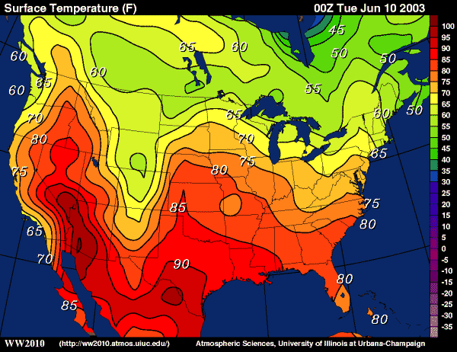

Slide 3
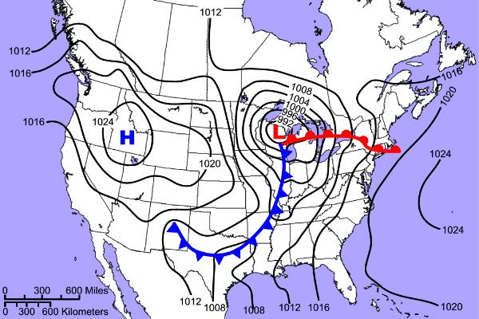

Slide 4
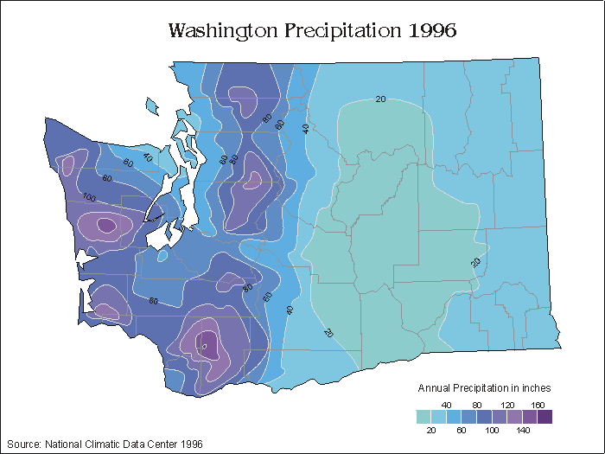

Slide 5
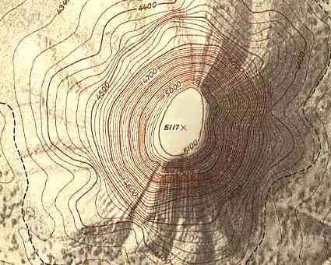
Topo Map

Slide 6
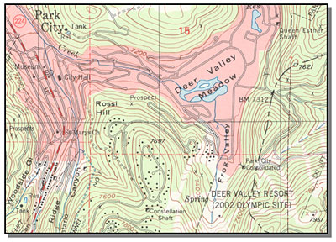

Slide 7
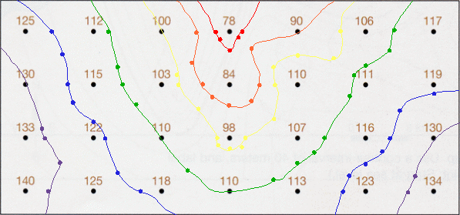
Isolines

Slide 8
Isoline Rules
Isolines connect points of equal value.
2. Isolines are gentle, curving lines - no sharp corners.
5
5
10
10
10
15
10
15

Slide 9
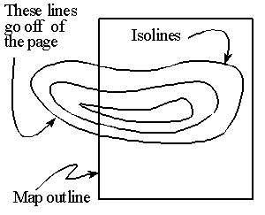
Isoline Rules
3. Isolines are always closed curves, even though the map might only show part of it.

Slide 10
Isoline Rules
Isolines NEVER cross - this would mean that one point has two different values.
50 °
60 °
40 °
30 °
20°
X
Z
Y

Slide 11
Topographic Maps
AIM: How do we use isolines to make topographic maps?
Topo maps use isolines (contour lines) to show elevation.
They also show natural and man-made features.
Ex. lakes, rivers, roads, buildings, etc.

Slide 12
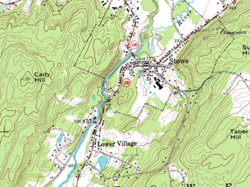
Topo Map

Slide 13
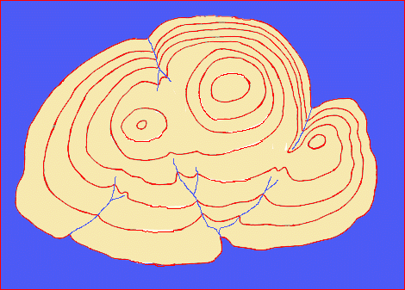
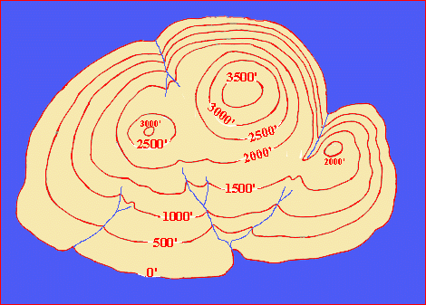
Contour Map
Notes:
This is an aerial view of the island that *name* drew the contour lines on.

Slide 14
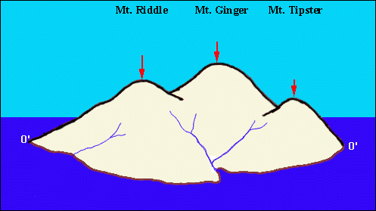
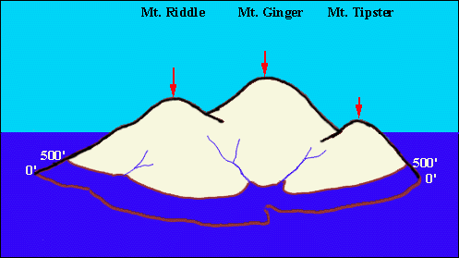
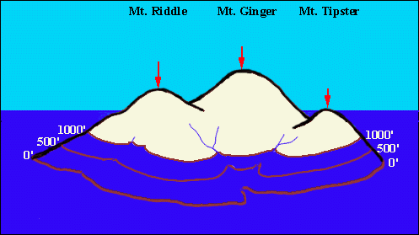
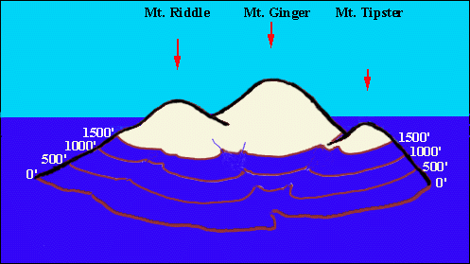
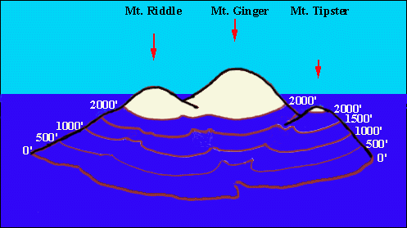
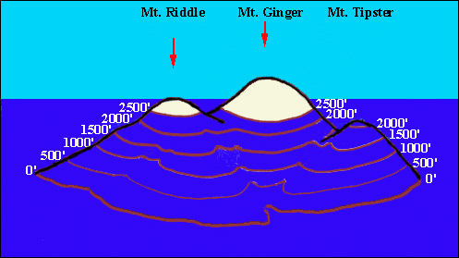
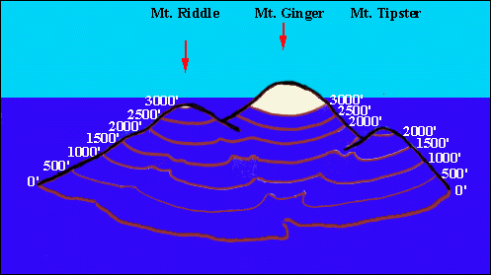
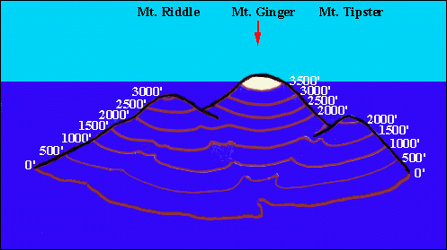
Rising Water
Notes:
Imagine someone flew to this island and ran around the shoreline marking sea level with brown paint, labeling it 0’. Each morning she awoke to discover the water level had risen another 500’ and each morning she ran around the island marking the levels with her brown paint and labeling them accordingly

Slide 15
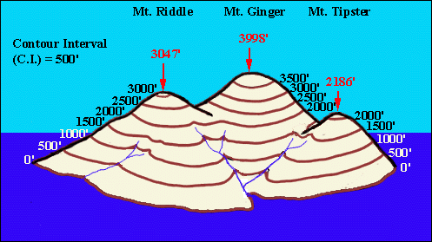
Contour Lines
Notes:
Remarkably, on the eighth day she rose and discovered that just as mysteriously as the water had risen, it had fallen back down to it’s original level. Now all the lines marking the different levels could be seen. Isolines are lines that connect points of equal value on a map. When working with contour (topographic) maps these isolines are referred to as contour lines. What value do these contour lines represent? Eleveation or height. Contour lines join points of equal elevation. As you see on the picture in the left hand corner there is a notation saying contour interval (C.I.) = 500’. What do you think this means? (Answer: the contour interval is the difference in value between two contour lines) Why do you think we need to establish contour intervals for our contour lines?

Slide 16
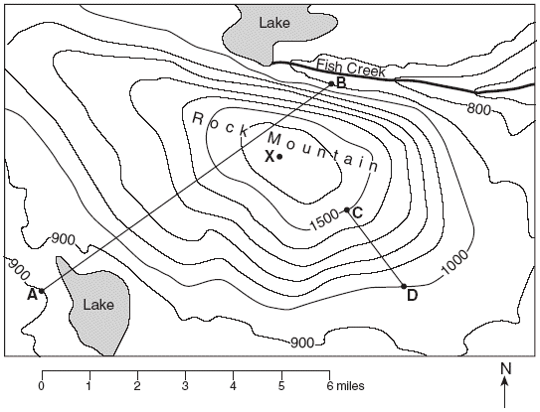
Intervals
Contour Interval
difference between two contour lines.
** Points between lines can be any value within interval range.
Ex. point between 20 and 30 contour lines can be 21 – 29

Slide 17
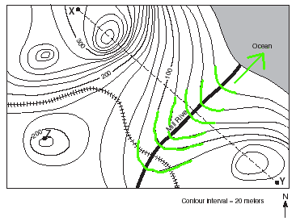
Rivers
Contour lines that cross rivers point upstream.

Slide 18
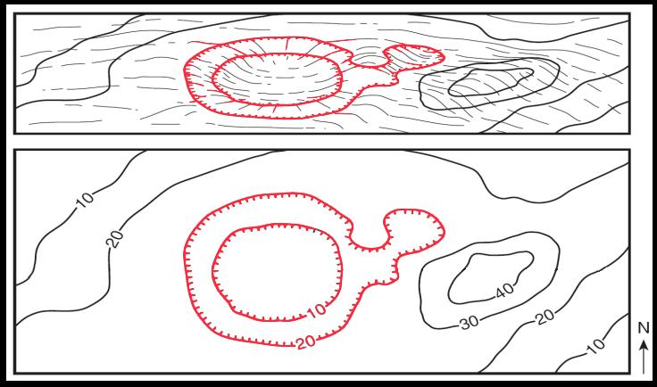
Hachure Lines
Hachure Lines
show depressions (holes)
The first depression line has same value as last regular contour line.

Slide 19
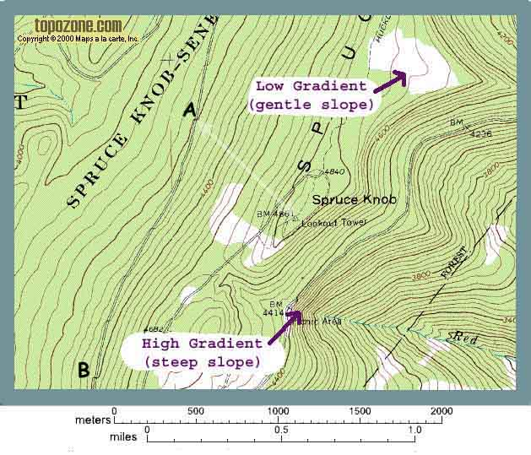
Gradients
Gradients
How high do you go in a certain distance.
lines close together steep slope
lines far apart
gentle slope.

Slide 20
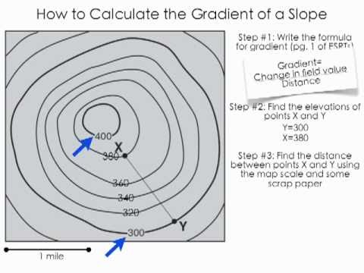

Slide 21
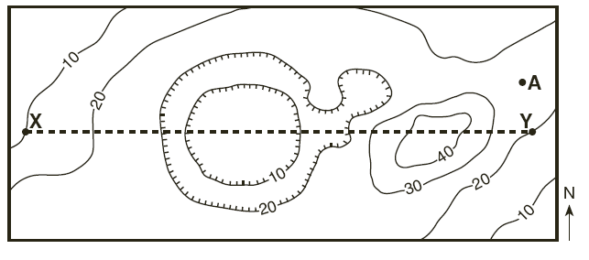
Profiles
10
20
20
10
10
20
30
40
40
30
20
Step 1: Get a scrap piece of paper
Step 2: Line it up under the line X-Y
Step 3: Draw “tick marks” for each instance that a contour crosses the line X-Y
Step 4: Label each “tick” with its appropriate value

Slide 22
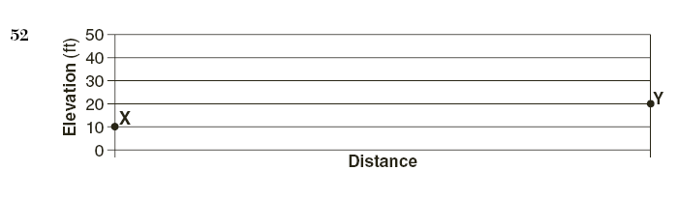
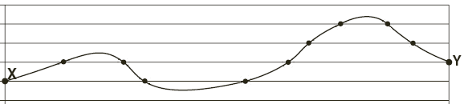
10
20
20
10
10
20
30
40
40
30
20
Step 5: Align your scrap paper with the profile as shown above.
Step 6: Place a dot on the graph for each of your “ticks” at the indicated elevation.
Step 7: Connect the dots with a smooth curving line.

