Slide 1

States of Consciousness
    Sleep
    Awake
    Altered states

Slide 2
Consciousness
State of being awake and aware of what is happening around you, and of having a sense of self.
What is this feeling of self we all have…our subjective inner voice.
It is always with us while awake. How and why does our brain do this?
Question: How do I know your red is my red?

Slide 3
Waking Consciousness
How the material brain produces subjective (1st person) experiences like the color green, or the sound of ocean waves is the "hard problem" of consciousness. (David Chalmers)
Explaining how the body’s physical systems work to sense the world is the supposed “easy problem”.
Consciousness seems to “emerge” from the working processes of our brain and body.
Is each neuron conscious? Is the brain conscious? No, all the parts of the body working together create something we call consciousness.

Slide 4
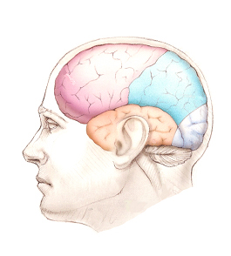
Culmination of Subconscious Brain Events
Consciousness emerges from the interaction of individual subconscious brain events, much like a chord that is created from different musical notes.
Research has shown that you consciously decide to move your wrist 0.2 seconds before actually moving your wrist.
But your brain waves jump 0.35 seconds before you were conscious of moving it.
“…Consciousness sometimes arrives late to the decision-making party.” David Meyers

Slide 5
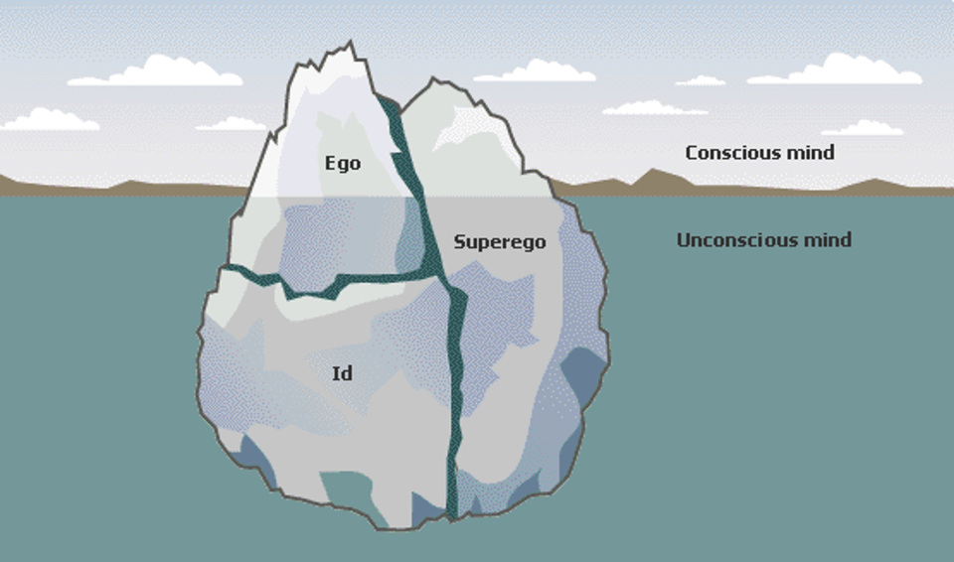
Tripartite Theory - Freud

Slide 6
Daydreaming and Fantasy
Spontaneous shifts of attention away from the here and now into a make-believe world
Urge to daydream peaks about every 90 minutes and is highest between 12:00 and 2:00pm
Almost half of your waking hours?
Daydreams may provide stress relief and encourage creativity

Slide 7

Hypnosis

Slide 8
Hypnosis
  Is hypnosis an altered state?
  or, a social phenomenon (placebo effect)?

Slide 9
Hypnosis
Can Anyone Experience Hypnosis? No.
  Susceptibility
Can Hypnosis Enhance Recall of Forgotten Events? Not shown
Can Hypnosis Force People to Act Against Their Will? No
Can Hypnosis Be Therapeutic? Hypnotherapists? Mixed… considered controversial.
Can Hypnosis Alleviate Pain? Yes (a form of distraction?)

Slide 10
