Slide 1
Conformity and Compliance

Slide 2
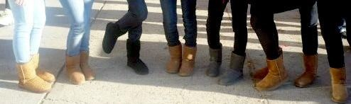
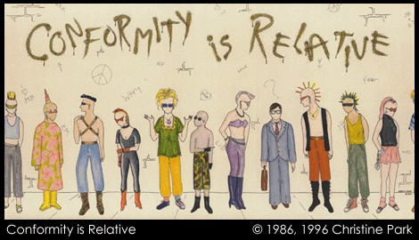


Slide 3



Slide 4
Conformity
Conformity – adjusting one’s behavior or thinking to a group standard.
Chameleon Effect: Unconsciously mimicking those around us. Ex. You may cross your arms if the person you’re talking to is doing the same.

Slide 5
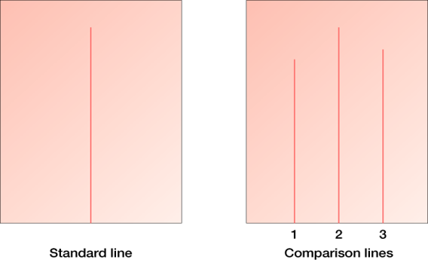
Solomon Asch Study
Six people at table shown a standard line and 3 comparison lines… which line is like the standard. First 2 trials no problem… answers are correct. Third trial 5 people at table say wrong answer (in cahoots with experimenter).

Slide 6
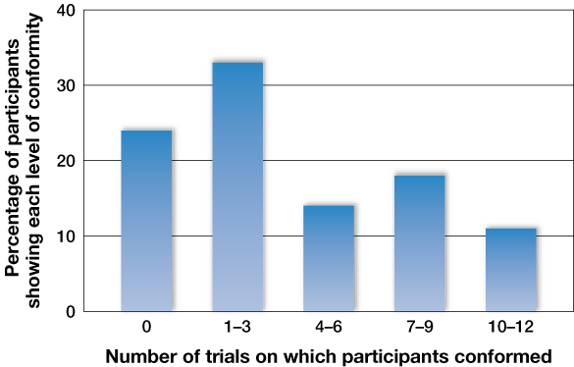
Conformity
76% conformed on at least one of the trials

Slide 7
Conformity
Private vs. Public
Private:
when a person privately accepts the position taken by others.
Public conformity:
superficial change in overt behavior, without a corresponding change of opinion, produced by real or imagined group pressure.
Asch studies demonstrate PUBLIC conformity

Slide 8
Normative Social Influence
Normative Influence
Conformity occurs when a person fears the negative consequences of appearing deviant.
If they write answers privately, conformity drops markedly.

Slide 9

Unanimous Group
When the group’s position is unanimous, conformity is greater.
If one person dissents (an ally), conformity drops.
Additionally, if you conform to group norms most of the time, you earn idiosyncracy credits that give you the right to deviate occasionally without serious consequences.

Slide 10
Compliance
Foot-in-the-door effect:
small request accepted, then large request asked.
Ex. Sign a petition. Then ask to attend a march.
Door-in-the-face effect:
large request (denied) to get small.
Ex. Ask to attend a march. Answer is no. Then ask to sign a petition.

Slide 11
Stanley Milgram Study
Teacher, Learner and Experimenter.
Teacher is asked to give shocks to Learner if answer is wrong.
Teacher gives shock to Learner, regardless of pain inflicted, about 60% of the time.

Slide 12
Summary of Milgram Studies
% Obeying
Teacher does not deliver shock but helped out. 93%
Victim pounds on wall then becomes silent 65%
Victim heard protesting 50%
Victim in same room 40%
Teacher has to put victim's hand on shock plate 30%
Victim says at outset that he will do study
only if he is let out when he wants to be 40%
Study done in Bridgeport, CT 48%
Experimenter in remote location 19%
Teacher told to select the level of shock
(experimenter legitimizes all levels) 3%

Slide 13
Additional Findings
Experimenter is not a scientist 20%
Two other confederates refuse 10%
Two experimenters disagree 0%
Script Prods
“Continue please.”
“The experiment requires that you continue”
“It is absolutely essential that you continue.”
“You have no other choice teacher.”

Slide 14


Slide 15
Gender
Are men or women more obedient in Milgram’s paradigm?
About the same.

Slide 16
Other replications
Hofling et al. (1966)
Unknown doctor called nurses and asked them to administer 20 milligrams of the drug "Astroten" to a patient on the ward. Violated hospital policy.
21/22 (95%) of the nurses administered the drug.

Slide 17
How well can people predict their own obedience?
The researchers told a group of nurses and nursing students about the study and asked them how they would react.
Nearly all said they would not administer the medication as ordered.

Slide 18
Hofling Conclusions
- Nurses pointed out that many doctors were in the habit of giving orders by telephone and became annoyed if not obeyed.
- Unequal power relations between doctors and nurses meant it would be difficult if nurses did not do what they were told.
- Hofling’s study showed how the social pressure brought about by the imbalance of power could lead to a nurse putting a patient at risk, rather than disobeying orders.

Slide 19
Another Replication
Sheridan & King (1972)
Replicated Milgram exactly, except that (a) participants were male & female college students, (b) victim was a "cute, fluffy, puppy," and (c) the shocks were real (not harmful).
Participants instructed to deliver a shock each time the puppy failed to learn a discrimination task, which was actually unsolvable
Results: 50% of male subjects and 100% of female subjects shocked the puppy

Slide 20
Sheriden & King
-Many subjects showed high levels of distress during the experiment and some openly wept.
-The duration for which the shock button was pressed decreased as the shocks got higher, meaning that for higher shock levels, subjects showed more hesitance towards delivering the shocks

Slide 21
Would Milgram find less obedience if he conducted his experiments today?
Thomas Blass
  Examined Milgram studies and replications during a 25-year period from 1961 to 1985. Correlated year of publication and the amount of obedience. No significant correlation.

Slide 22
Historical insights
How might Milgram’s research offer insights into historical events such as
the Holocaust and the My Lai massacre?

Slide 23
Stanford Prison Experiment
Some chosen to be guards, other’s prisoners.
After 6 days Zimbardo had to stop experiment.
Guards treated prisoners poorly… degrading and cruel routines.
Prisoners broke down, rebelled, or were passively resigned.

Slide 24
Controversial
Zimbardo acted as “supervisor” in the “jail”.
Provided instructions on how to act?
Punishments may have been suggested to guards.
Zimbardo defends the study.

