Slide 1
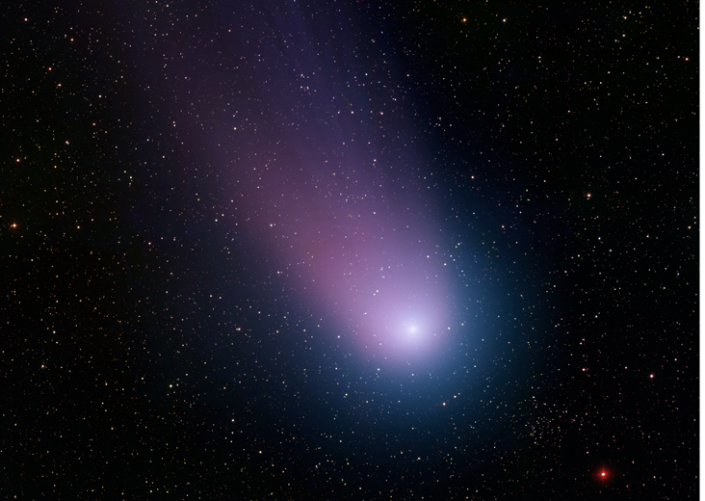
Comet NEAT

Slide 2
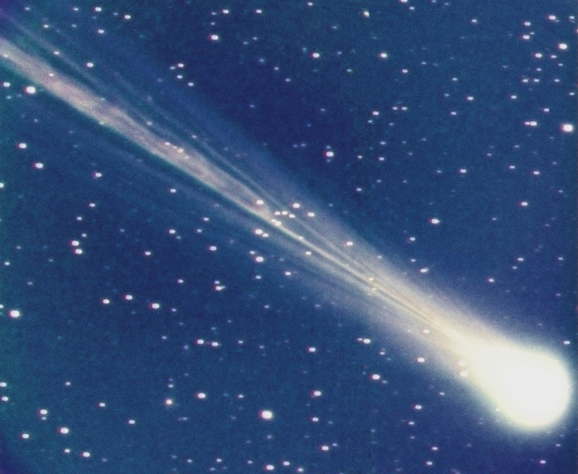

Slide 3
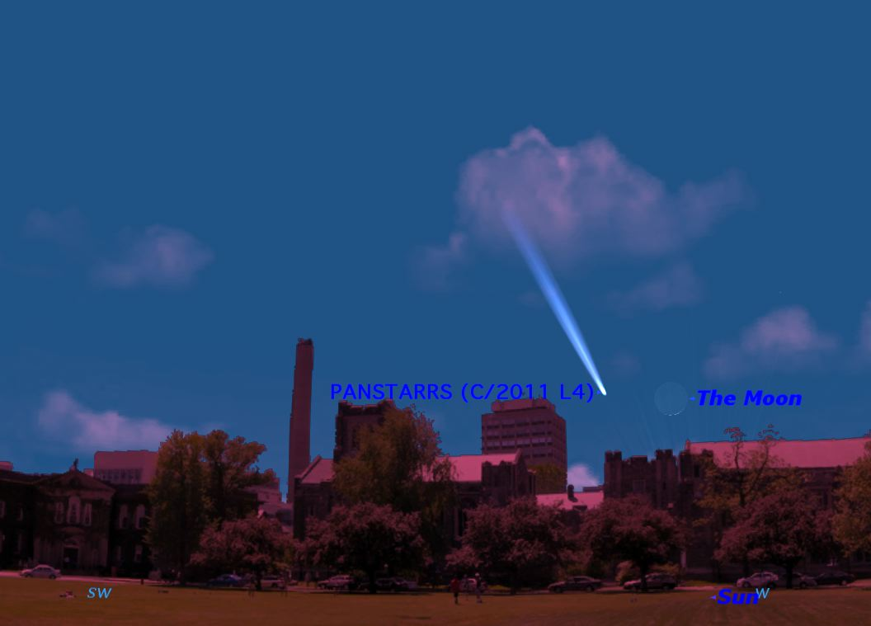

Slide 4
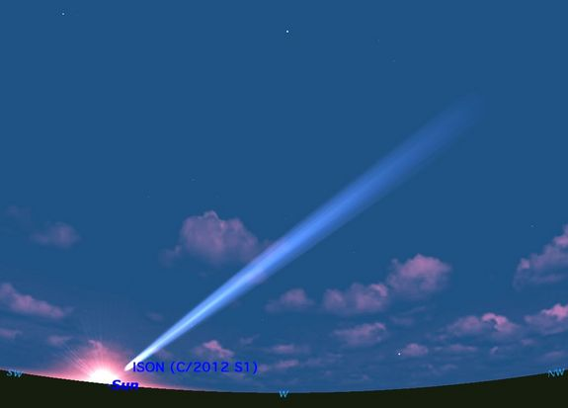

Slide 5
Comets
Small icy objects that orbit the Sun… 1-10 km
Nucleus of ice coated with dark organic material (dirty snowball)
Short period comets (<200 yr orbit) are in Kuiper Belt
Long-period comets (>200 yrs) are in Oort Cloud

Slide 6
Comets
Comet warms as it nears the sun.
Develops an atmosphere, or “coma”.
Coma gets blown by solar wind, forming tail.

Slide 7
Comets
Halley’s Comet - every 76 years (1986 last).
Pictured in Bayeux Tapestry (1066)
Adoration of Magi painting (Bondone - 1303)
Chinese astronomers kept extensive records.

Slide 8
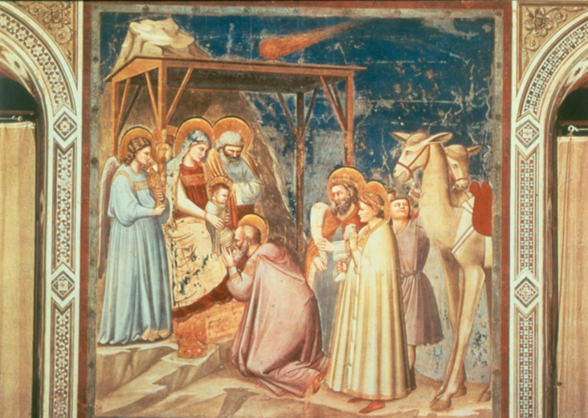

Slide 9
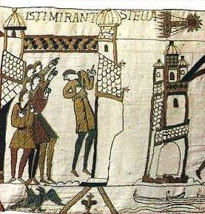

Slide 10
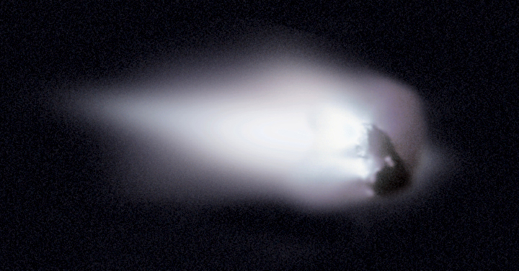
Halley’s Comet

Slide 11
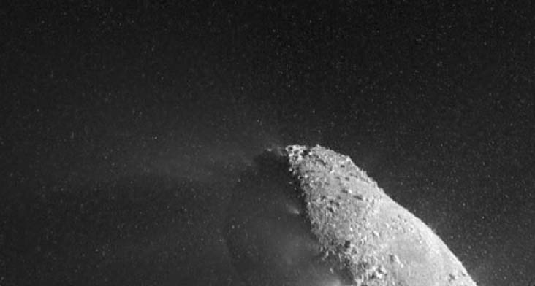
Comet Hartley 2

Slide 12
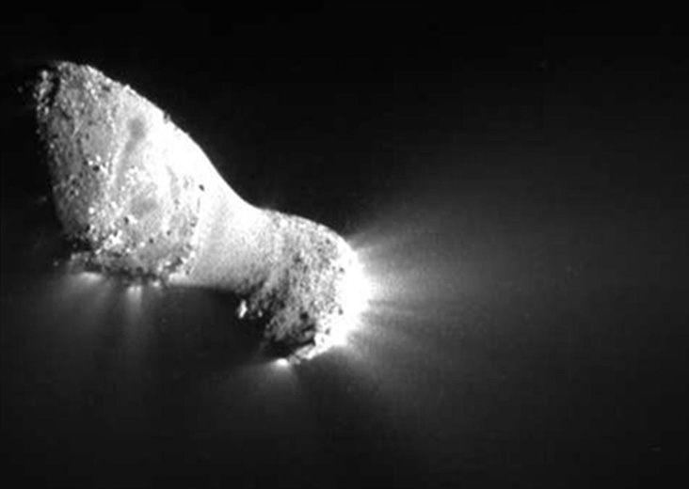

Slide 13
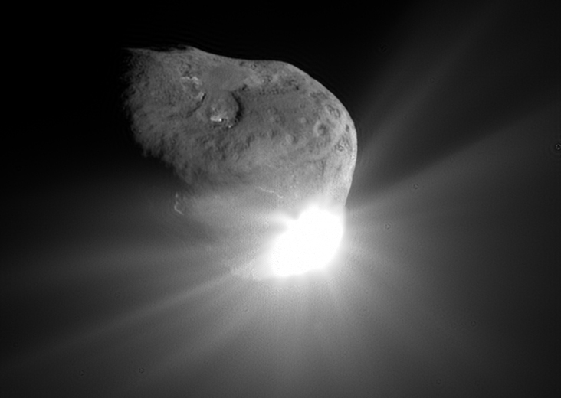
Tempel 1 (Deep Impact)

Slide 14
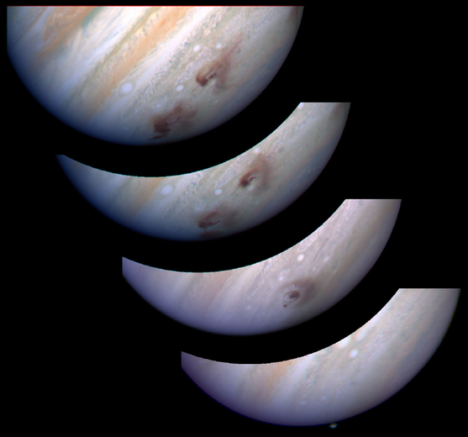
Shoemaker-Levy 9

Slide 15
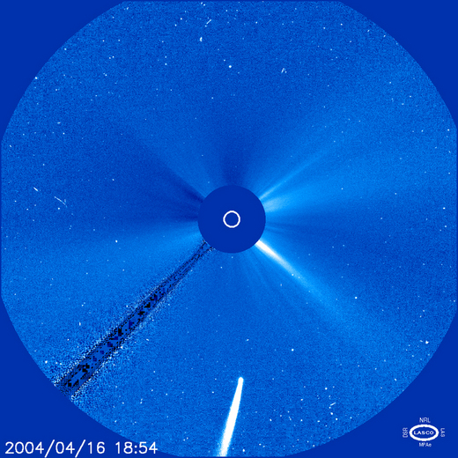
Bradfield’s Plunge

Slide 16
Oort Cloud
Between 5,000 to 100,000 AU (~1 ly) from the sun.
Oort Cloud comets can take 30 million yrs to orbit.
Long-period comets inhabit region.
Not only comets there.

Slide 17
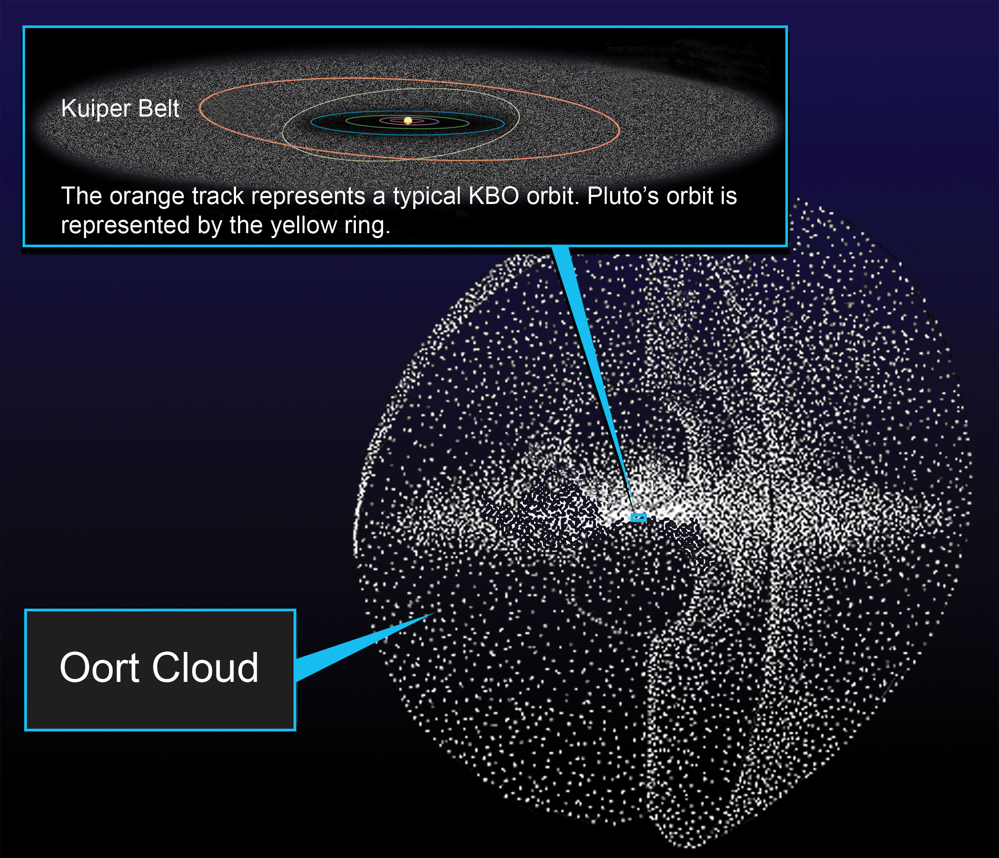

Slide 18
Sedna
From 76 AU to 960 AU (36x Neptune).
11,000 yr orbit.
Is it Kuiper Belt or first Inner Oort Cloud?
Will likely be confirmed as dwarf planet.

Slide 19
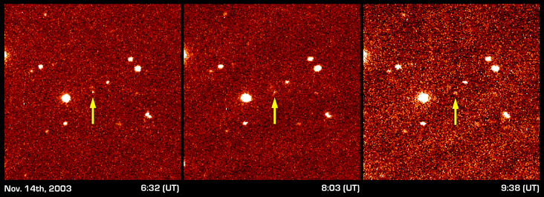

Slide 20
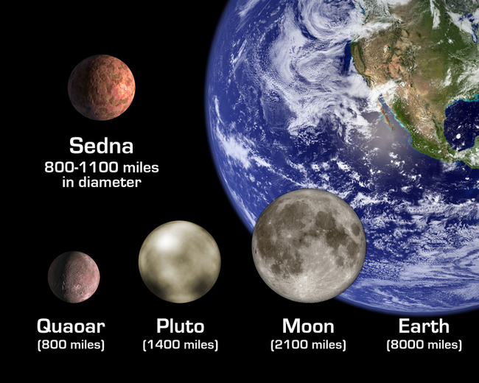

Slide 21
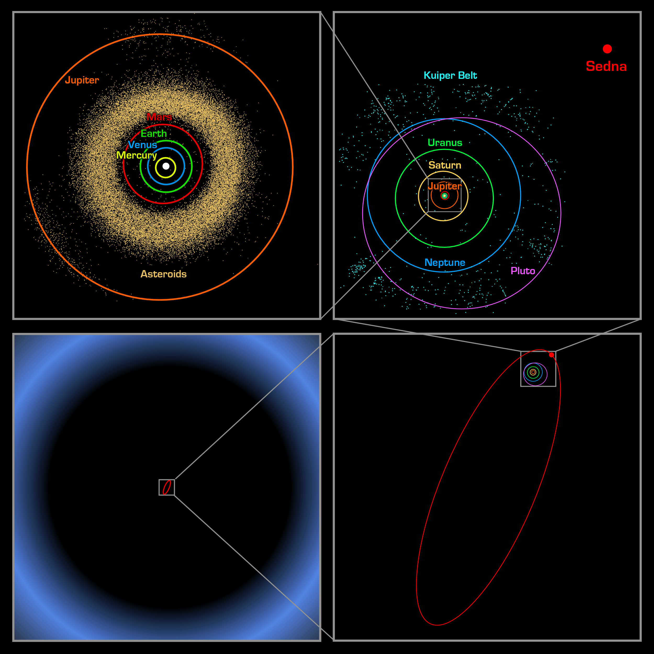

Slide 22
