Slide 1
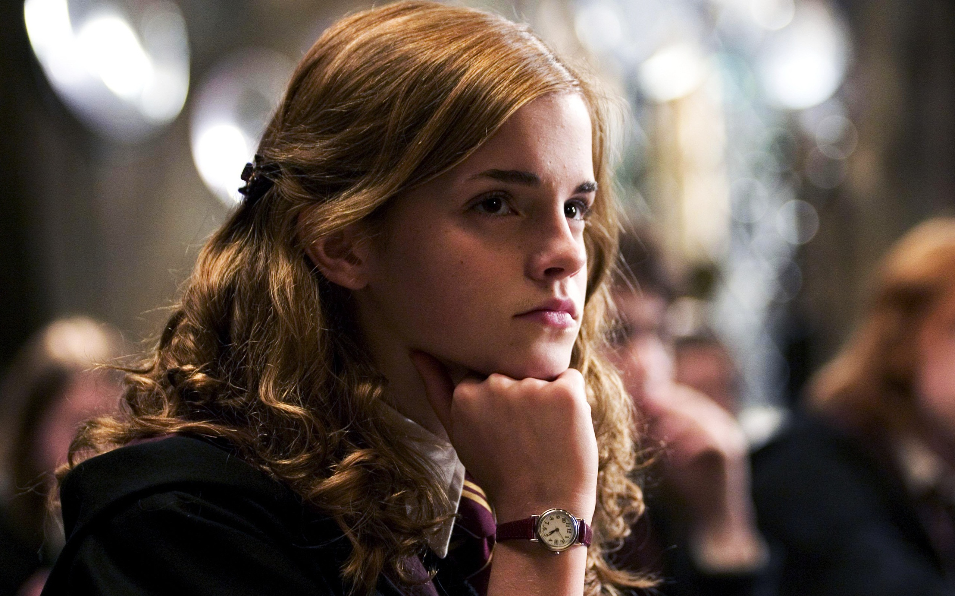
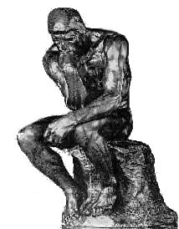
Cognition Definition
Cognition (thinking)
process of knowing, understanding, remembering, problem solving and communicating.
Purposeful!
Notes:
OBJECTIVE 1| Define cognition.

Slide 2
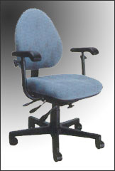

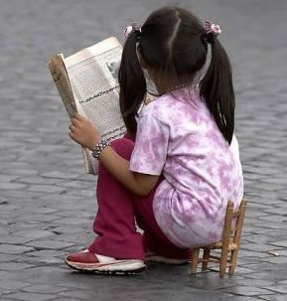
Schema or Concepts
Mental grouping of similar objects, events, ideas, or people.
Example: chair schema
Notes:
OBJECTIVE 2| Describe the roles of categories, hierarchies, definitions, and prototypes in concept formation.

Slide 3

Chair Schema
Furniture
Seat
Four Legs
Back
Arms
Sits one person
Cushioned
Made of wood

Slide 4
Prototypes
The best example or representation of a certain concept.
Concept
List characteristics that make a place a college or university.
Prototype
Now list a specific college that BEST represents those characteristics.

Slide 5


Can I read your mind?
State a color.
Name or draw a triangle.
List the first type of motor vehicle that comes to mind.
Write a sentence
Give me a hero.
Describe a heroic act

Slide 6
I gave schemata and tried to predict prototypes.
red or blue
a picture of an equilateral triangle
a car
a short declarative statement, e.g., “The boy is home.”
Superman, Batman, or possibly a fireman
a single act by a male, e.g. a rescue by a fireman

Slide 7
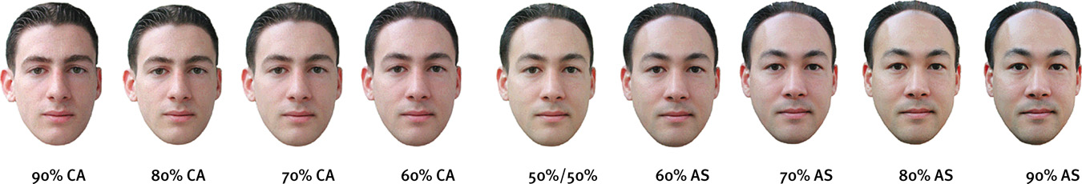
Categories
Once we place an item in a category,
our memory shifts toward the category prototype.
A computer-generated face that was 70 percent
Caucasian led people to classify it as Caucasian.

Slide 8
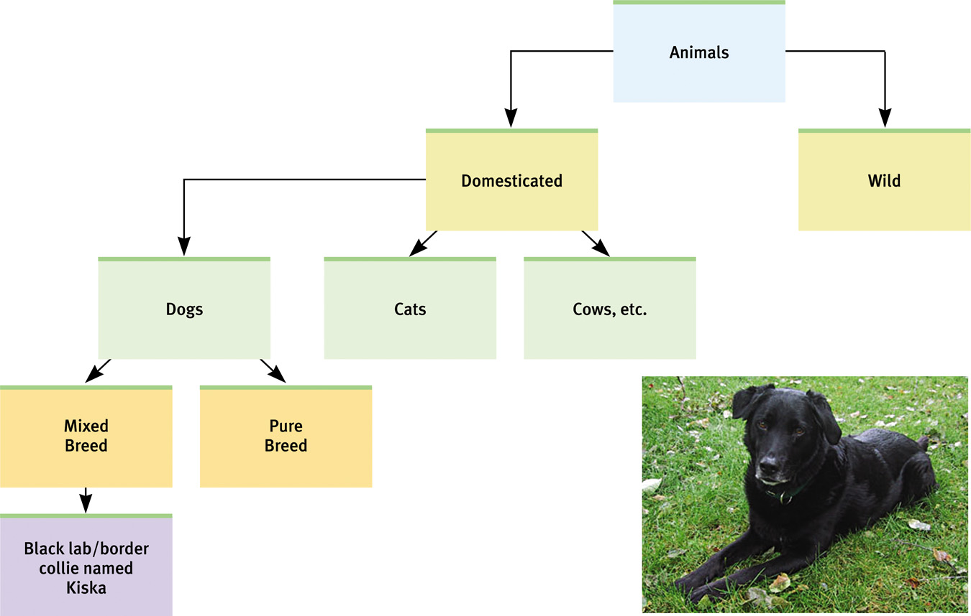
Category Hierarchies
We organize concepts into category hierarchies.

Slide 9
Concepts Can Get Fuzzy
Is a whale a mammal?
Are penguins and kiwis' birds?
Are 17-year-old people children or adults
People more easily detect male prejudice against females than female against males or female against female

