Slide 1
Clusters
Small collection of stars… thousands to millions
2 Types:
1. Open
2. Globular

Slide 2
Open Cluster
Small collection of stars (few thousand) in spiral galaxies.
New star nursery… stars formed from large nebula.
Located in galaxy plane (disk).
Not seen in elliptical galaxies… since there are no new stars forming.

Slide 3
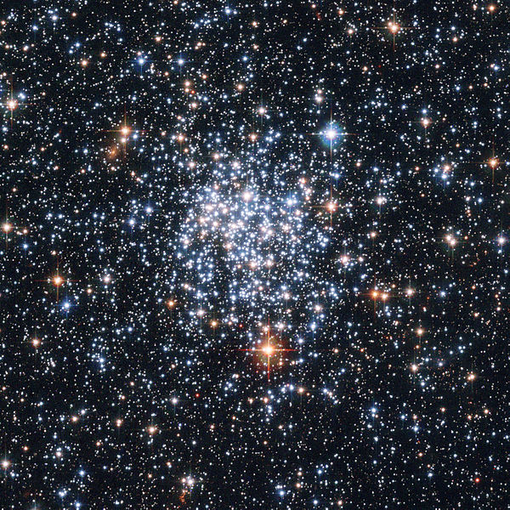

Slide 4
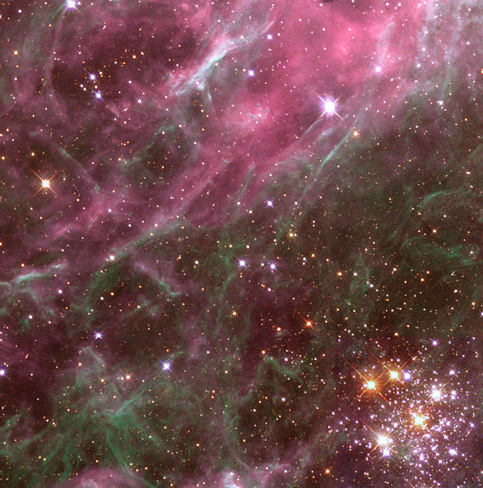
Tarantula Nebula

Slide 5
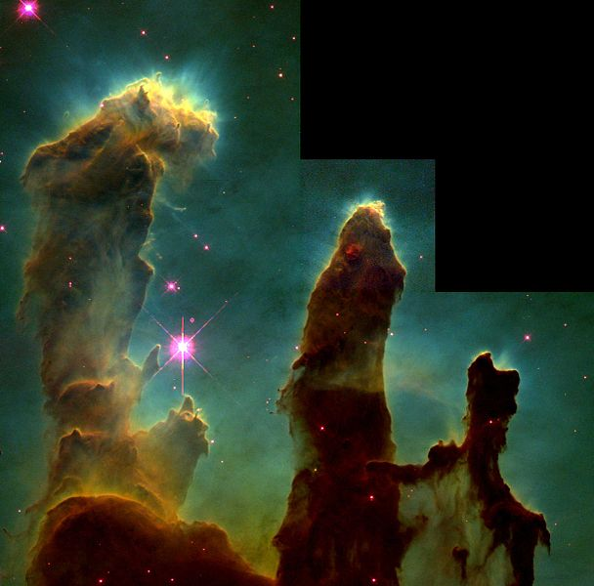
Pillars of Creation – Eagle Nebula

Slide 6
Open Clusters
New stars and dying stars (supernovas) clear away the nebula gas within ten million years.
Measurements - Since all stars are same distance from Earth, easy to tell mass of stars from brightness.

Slide 7
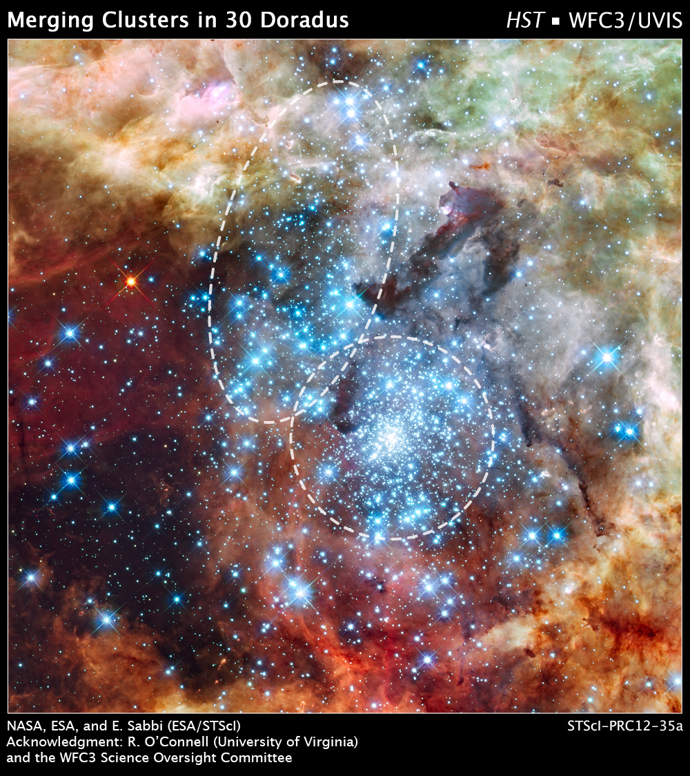

Slide 8
Globular Clusters
Larger collection (~million) of old stars found in the “halo” of galaxies.
The oldest stars found in galaxies.
There may be black holes at the center.

Slide 9
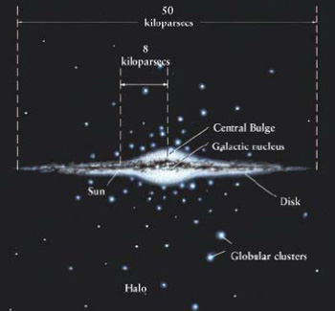

Slide 10
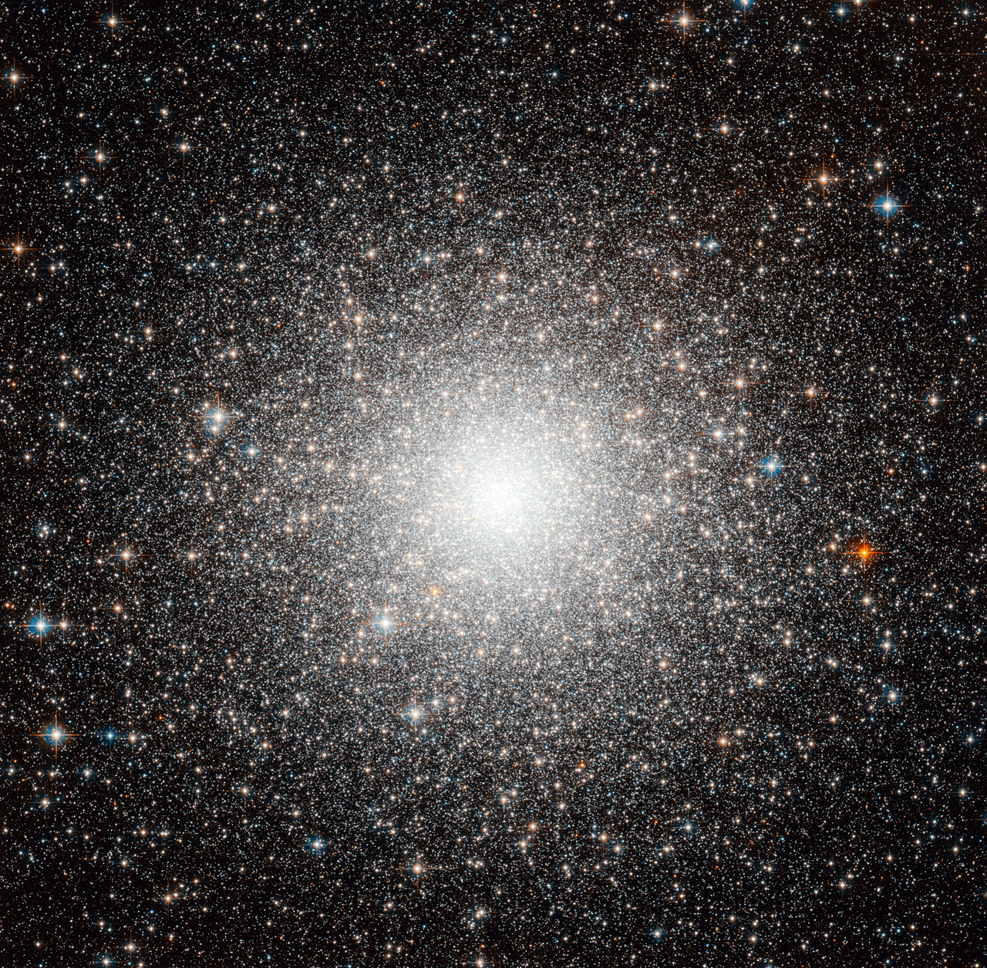

Slide 11
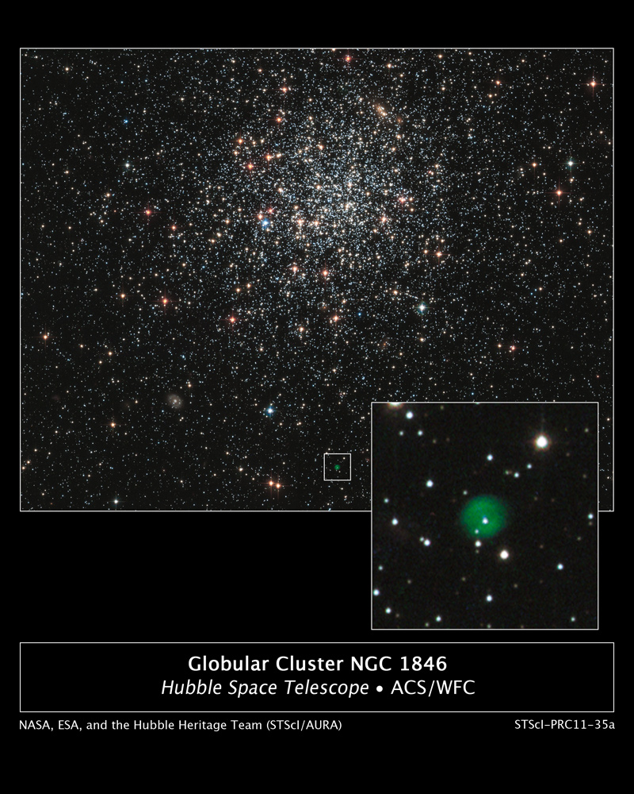

Slide 12
Comparisons
Open Cluster:
Found in galaxy disk
Few thousand stars
Newer stars
~1,100 found in Milky Way
Globular Clusters:
- Found in halo of galaxy
- Millions of stars
Oldest stars in galaxy
- ~150 found in Milky Way

Slide 13
Large Magellanic Cloud
A nearby irregular galaxy…a satellite of the Milky Way.
Likely was a barred spiral at first.
Visible in the night sky as a “smudge”.

Slide 14
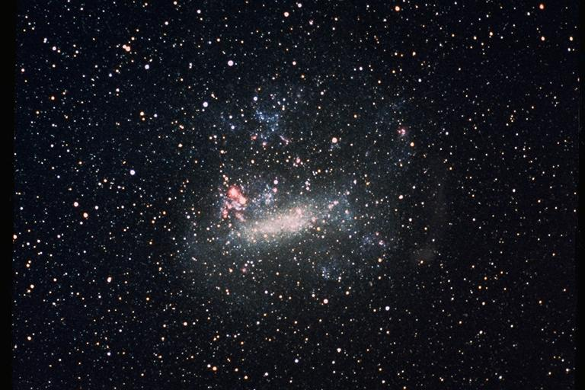

Slide 15
