Slide 1
Climate
Climate = characteristic weather of a region. Ex. 100 year pattern.
Major Elements:
-- Temperature
-- Precipitation (Moisture)

Slide 2
Climate Factors
Latitude - primary temperature control
Distribution of land and water
Pressure and wind belts
Ocean currents
Elevation - mountains

Slide 3
Climate Types
Arid = Dry
Little moisture -- desert
Less vegetation – no soil protection
Can be cold or hot

Slide 4
Climate Types
Humid = wet
-- More moisture
-- More vegetation – protects soil.
-- Hot, cold, or temperate (mix)

Slide 5
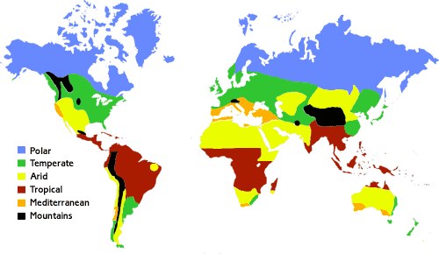

Slide 6
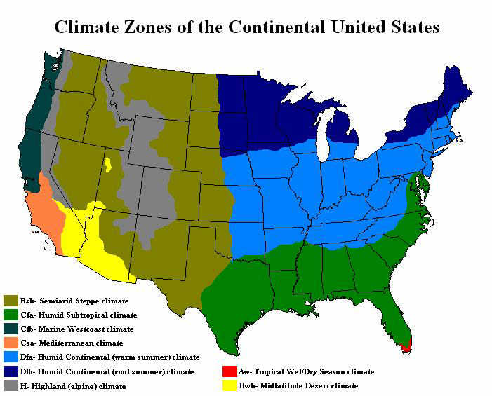

Slide 7
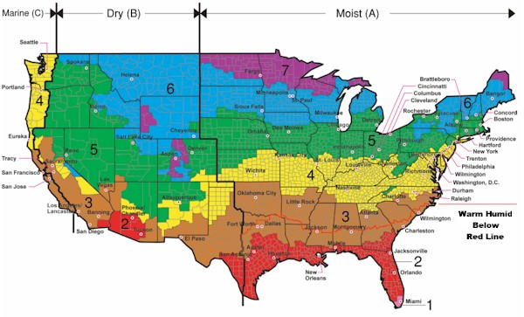

Slide 8
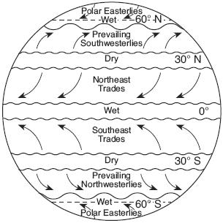

Slide 9
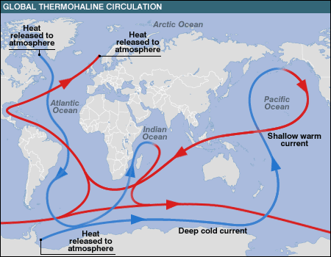

Slide 10
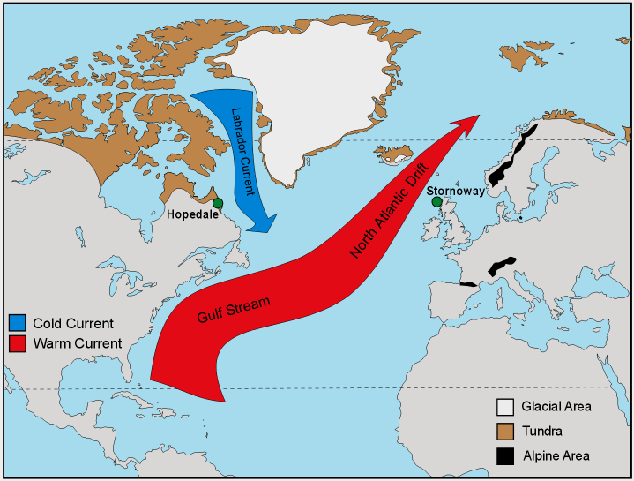

Slide 11
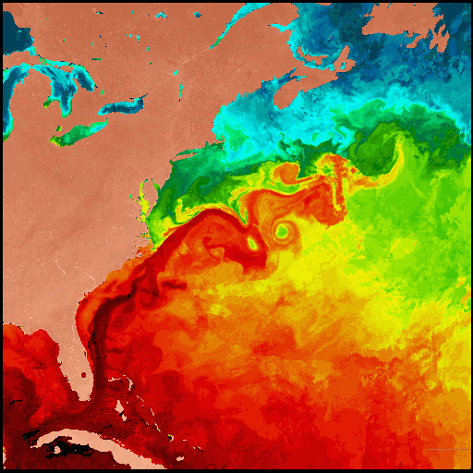

Slide 12
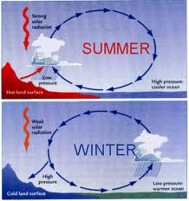
Monsoons

